Slide 1
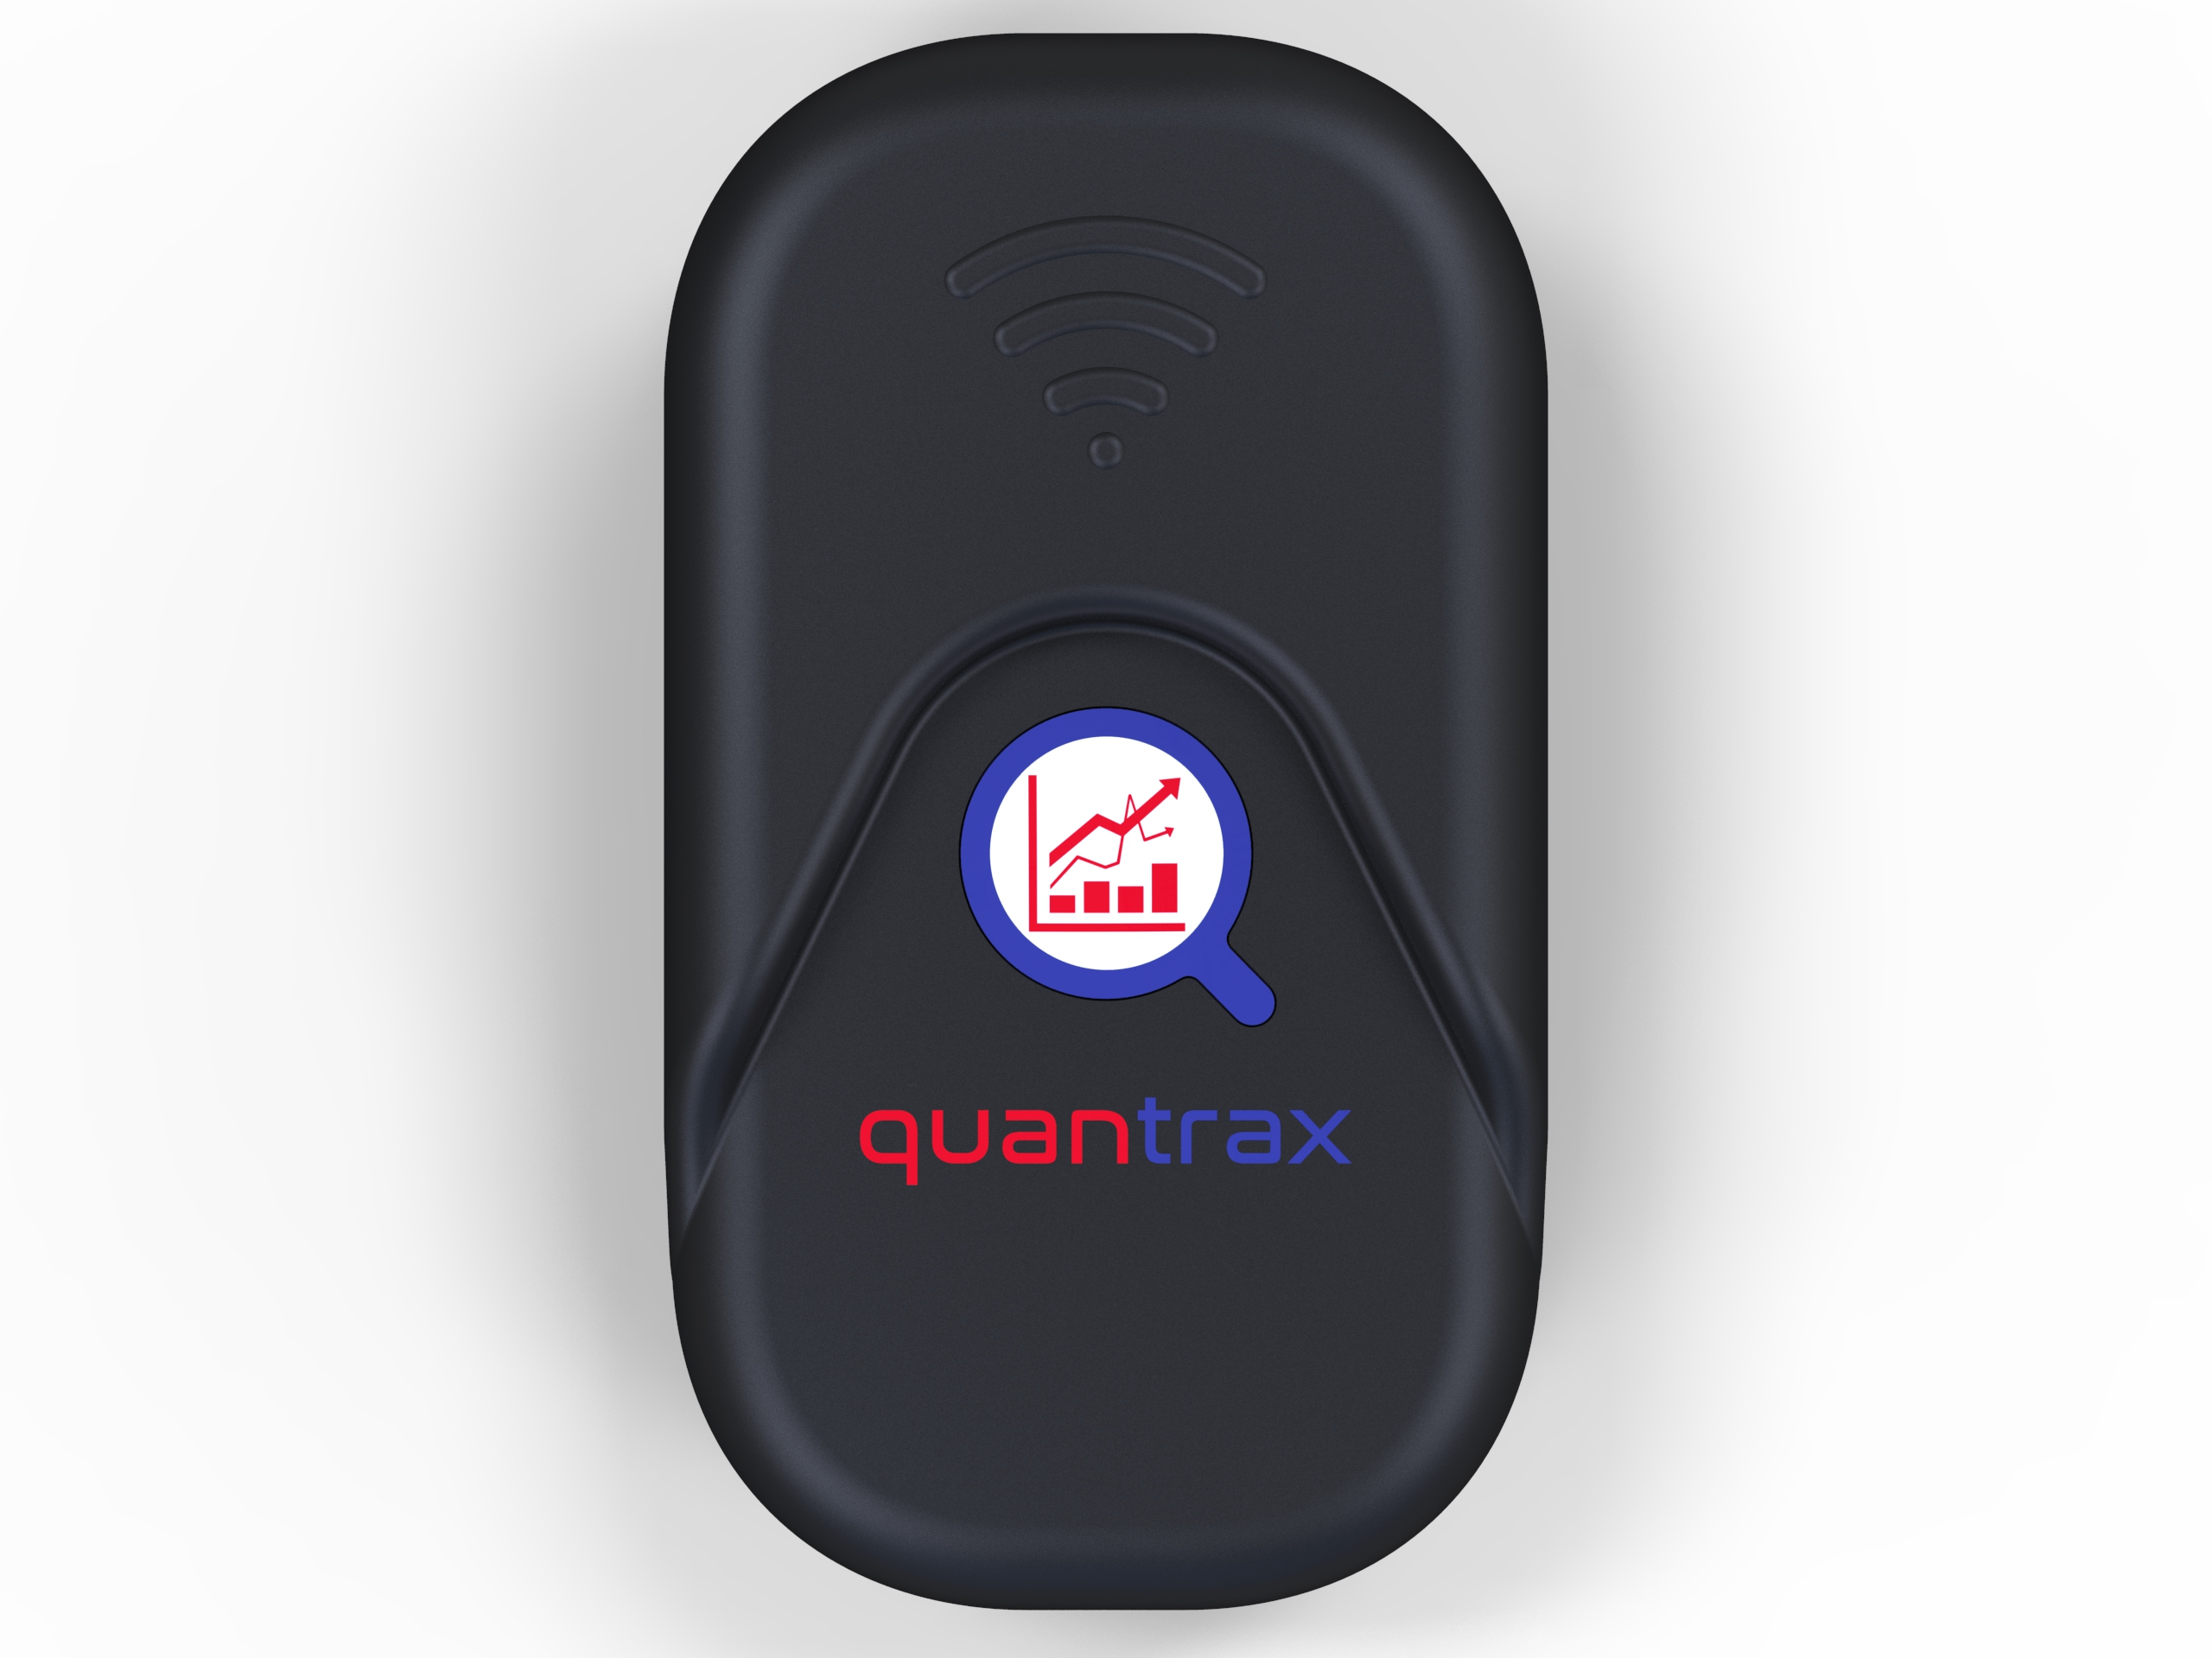
 | From this to This
The Professional doctorate Study three
wearable technology for use in sport education in FE settings in the UK
The journey in the applied settings (Building the solution)

Slide 2
The journey
the challenge b) the solution/approach c) the deliverable
The challenge
Business- To create a system that was affordable and accessible to more people than before, was similar to other products in the market place yet had unique features that filled the void that existed.
Academia- to create a tool that was affordable and had better accessibility as being individualised, adaptable and simplifying to wider audience across the curriculum in Further education settings.
solution/approach
Employing previous network of experts in the field of wearable technology design, manufacture of electronics and garments and plastic enclosures. Software engineers, developers and operators, Sport scientists and lecturers and students. Using a innovative bottom up and action research approach drawing on theoretical knowledge from university graduate conducted a doctoral research into the use of wearable technology in further education and football. Combined with expertise from industry in the form of Small medium enterprise (SMEs) namely QUANT-CX Ltd to provide the business component.
the deliverable
By partnering with industry business and academia, by placing student the deliverable will be achievement of the main aims of a professional doctorate to create a solution to a real world problem. Business will have a viable commercial product for the market place

Slide 3
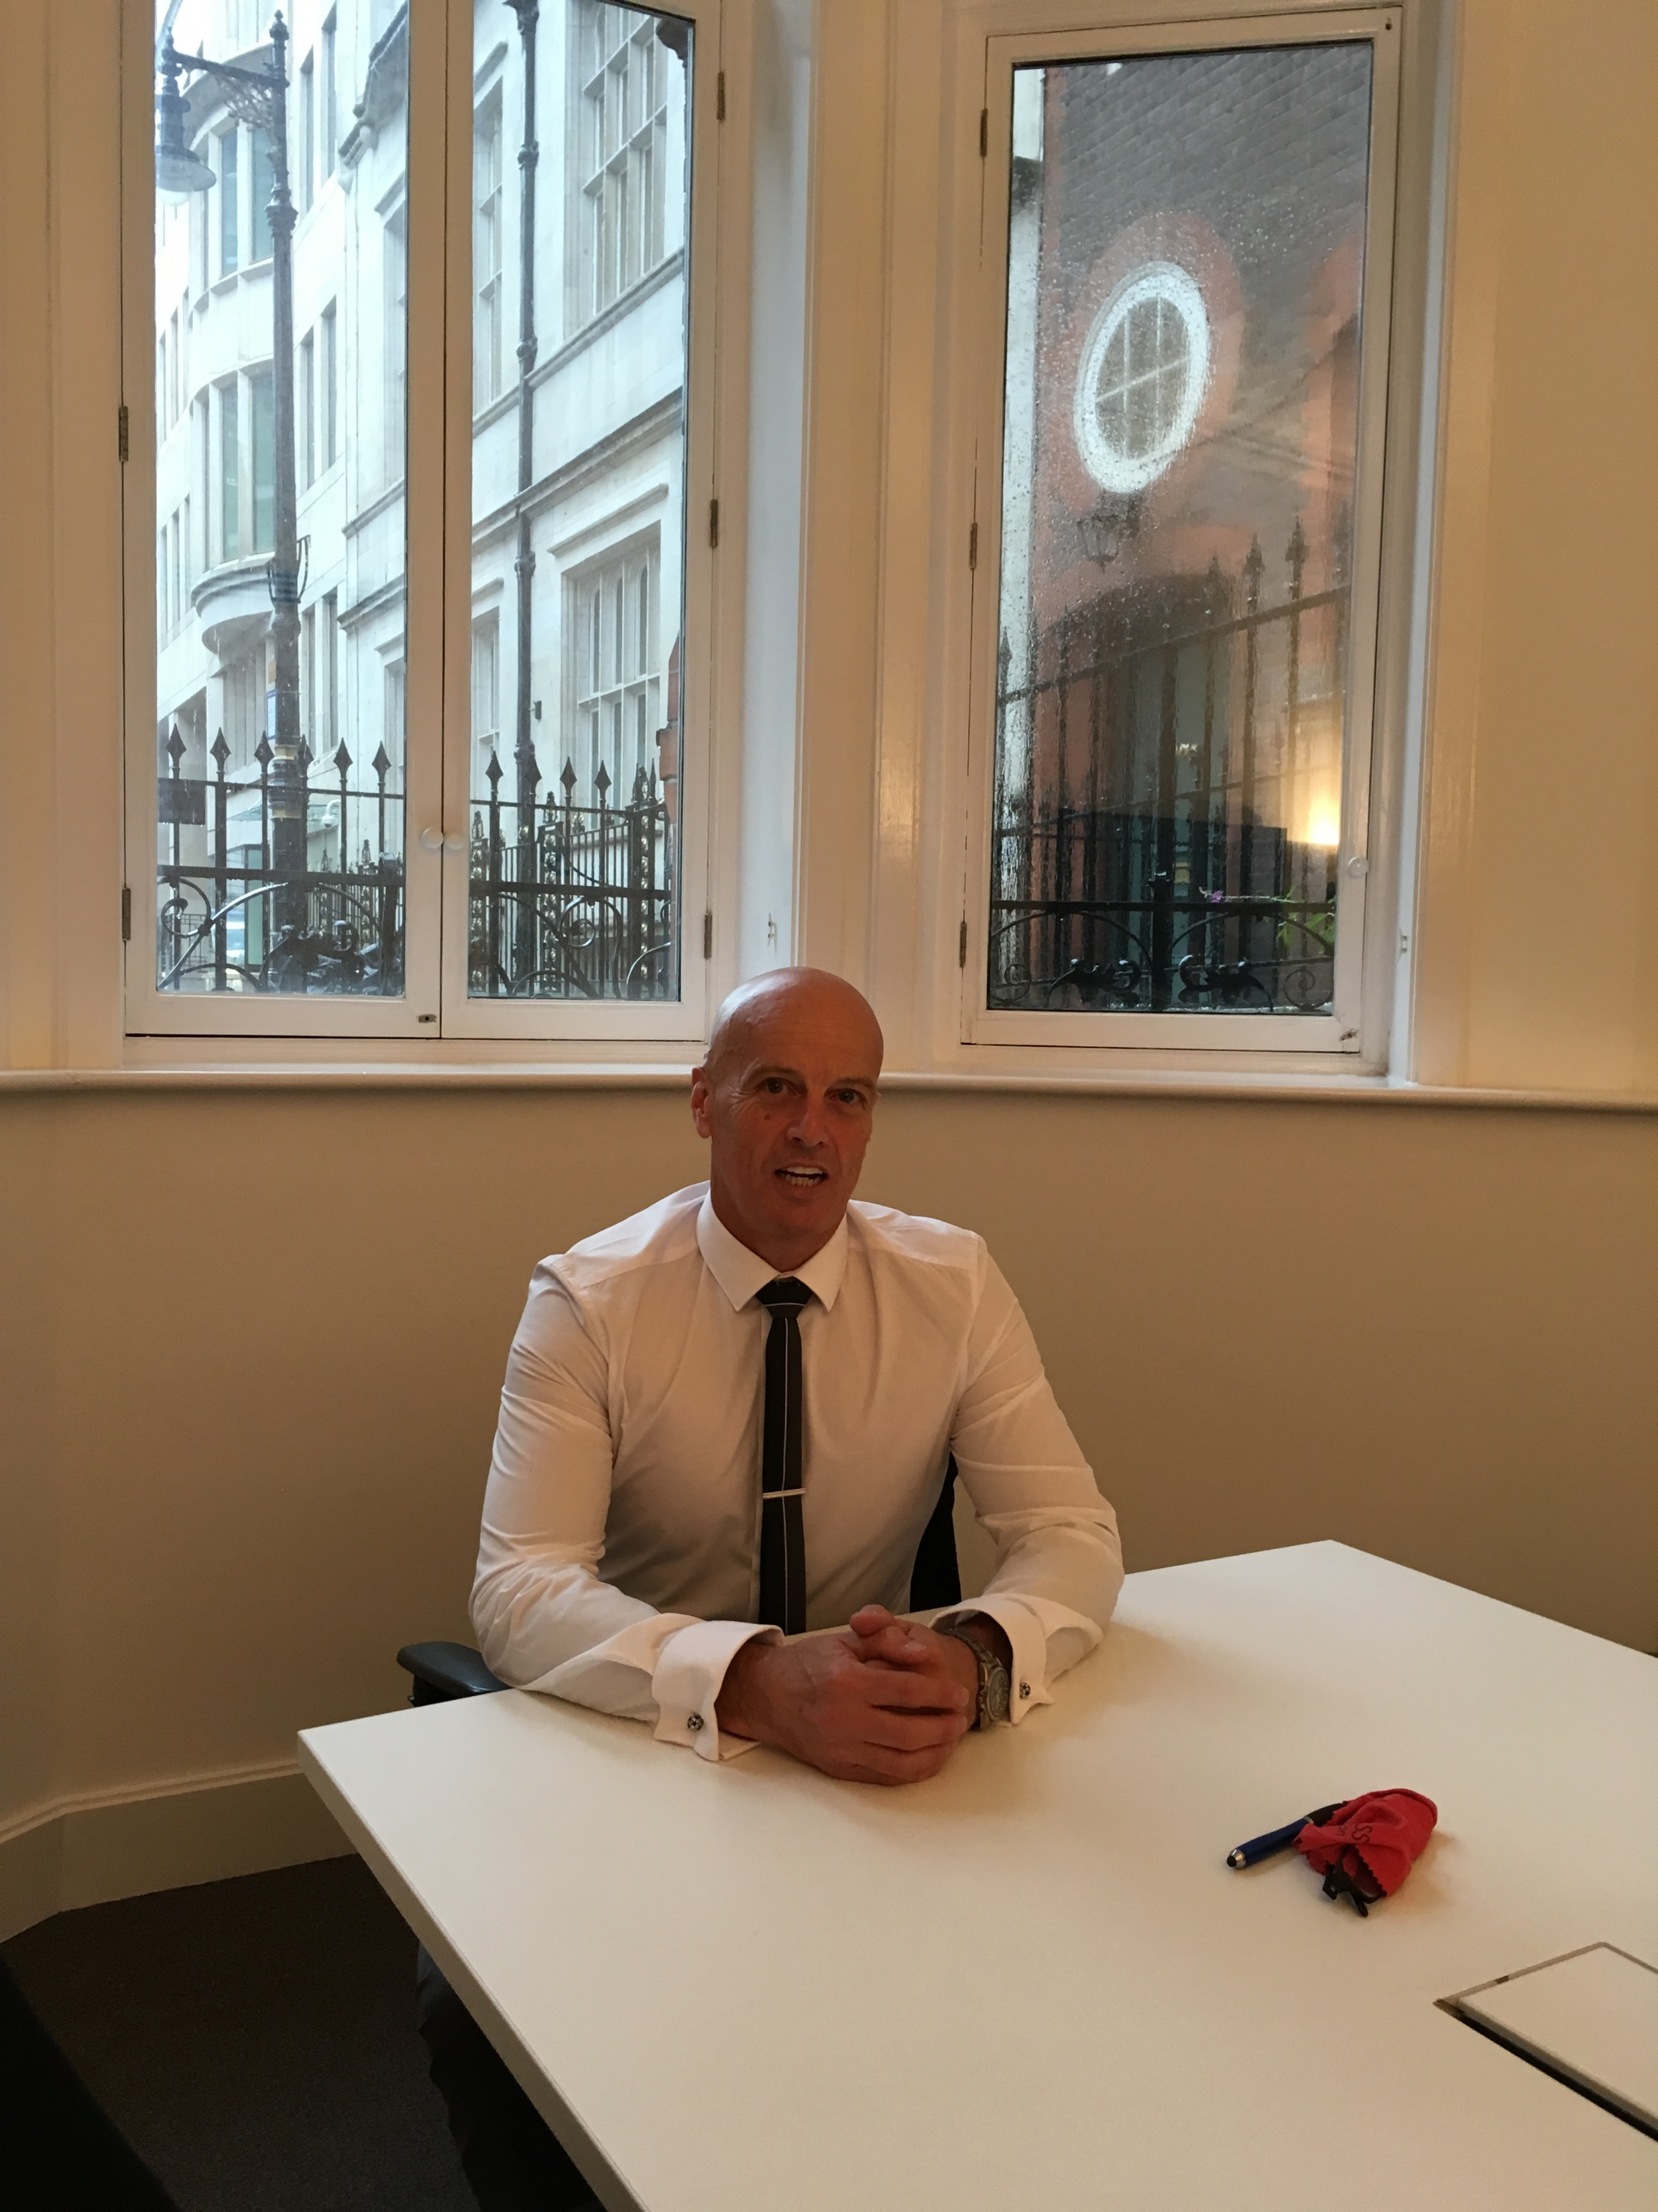
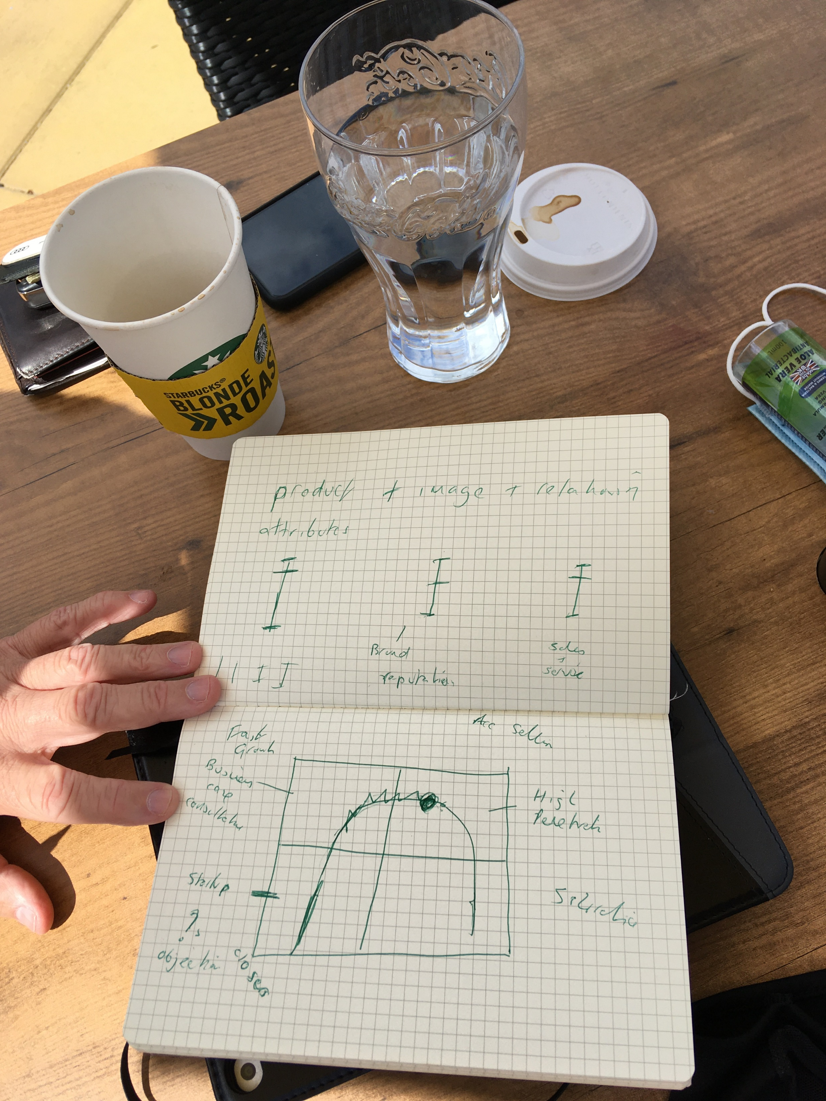
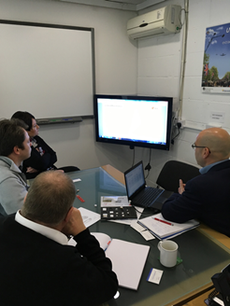
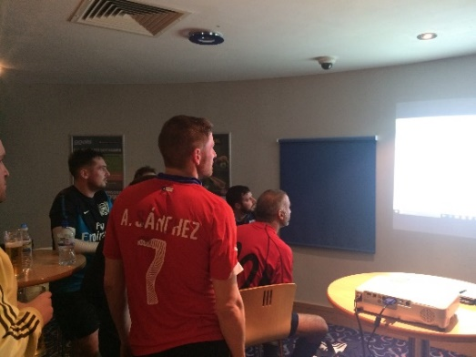
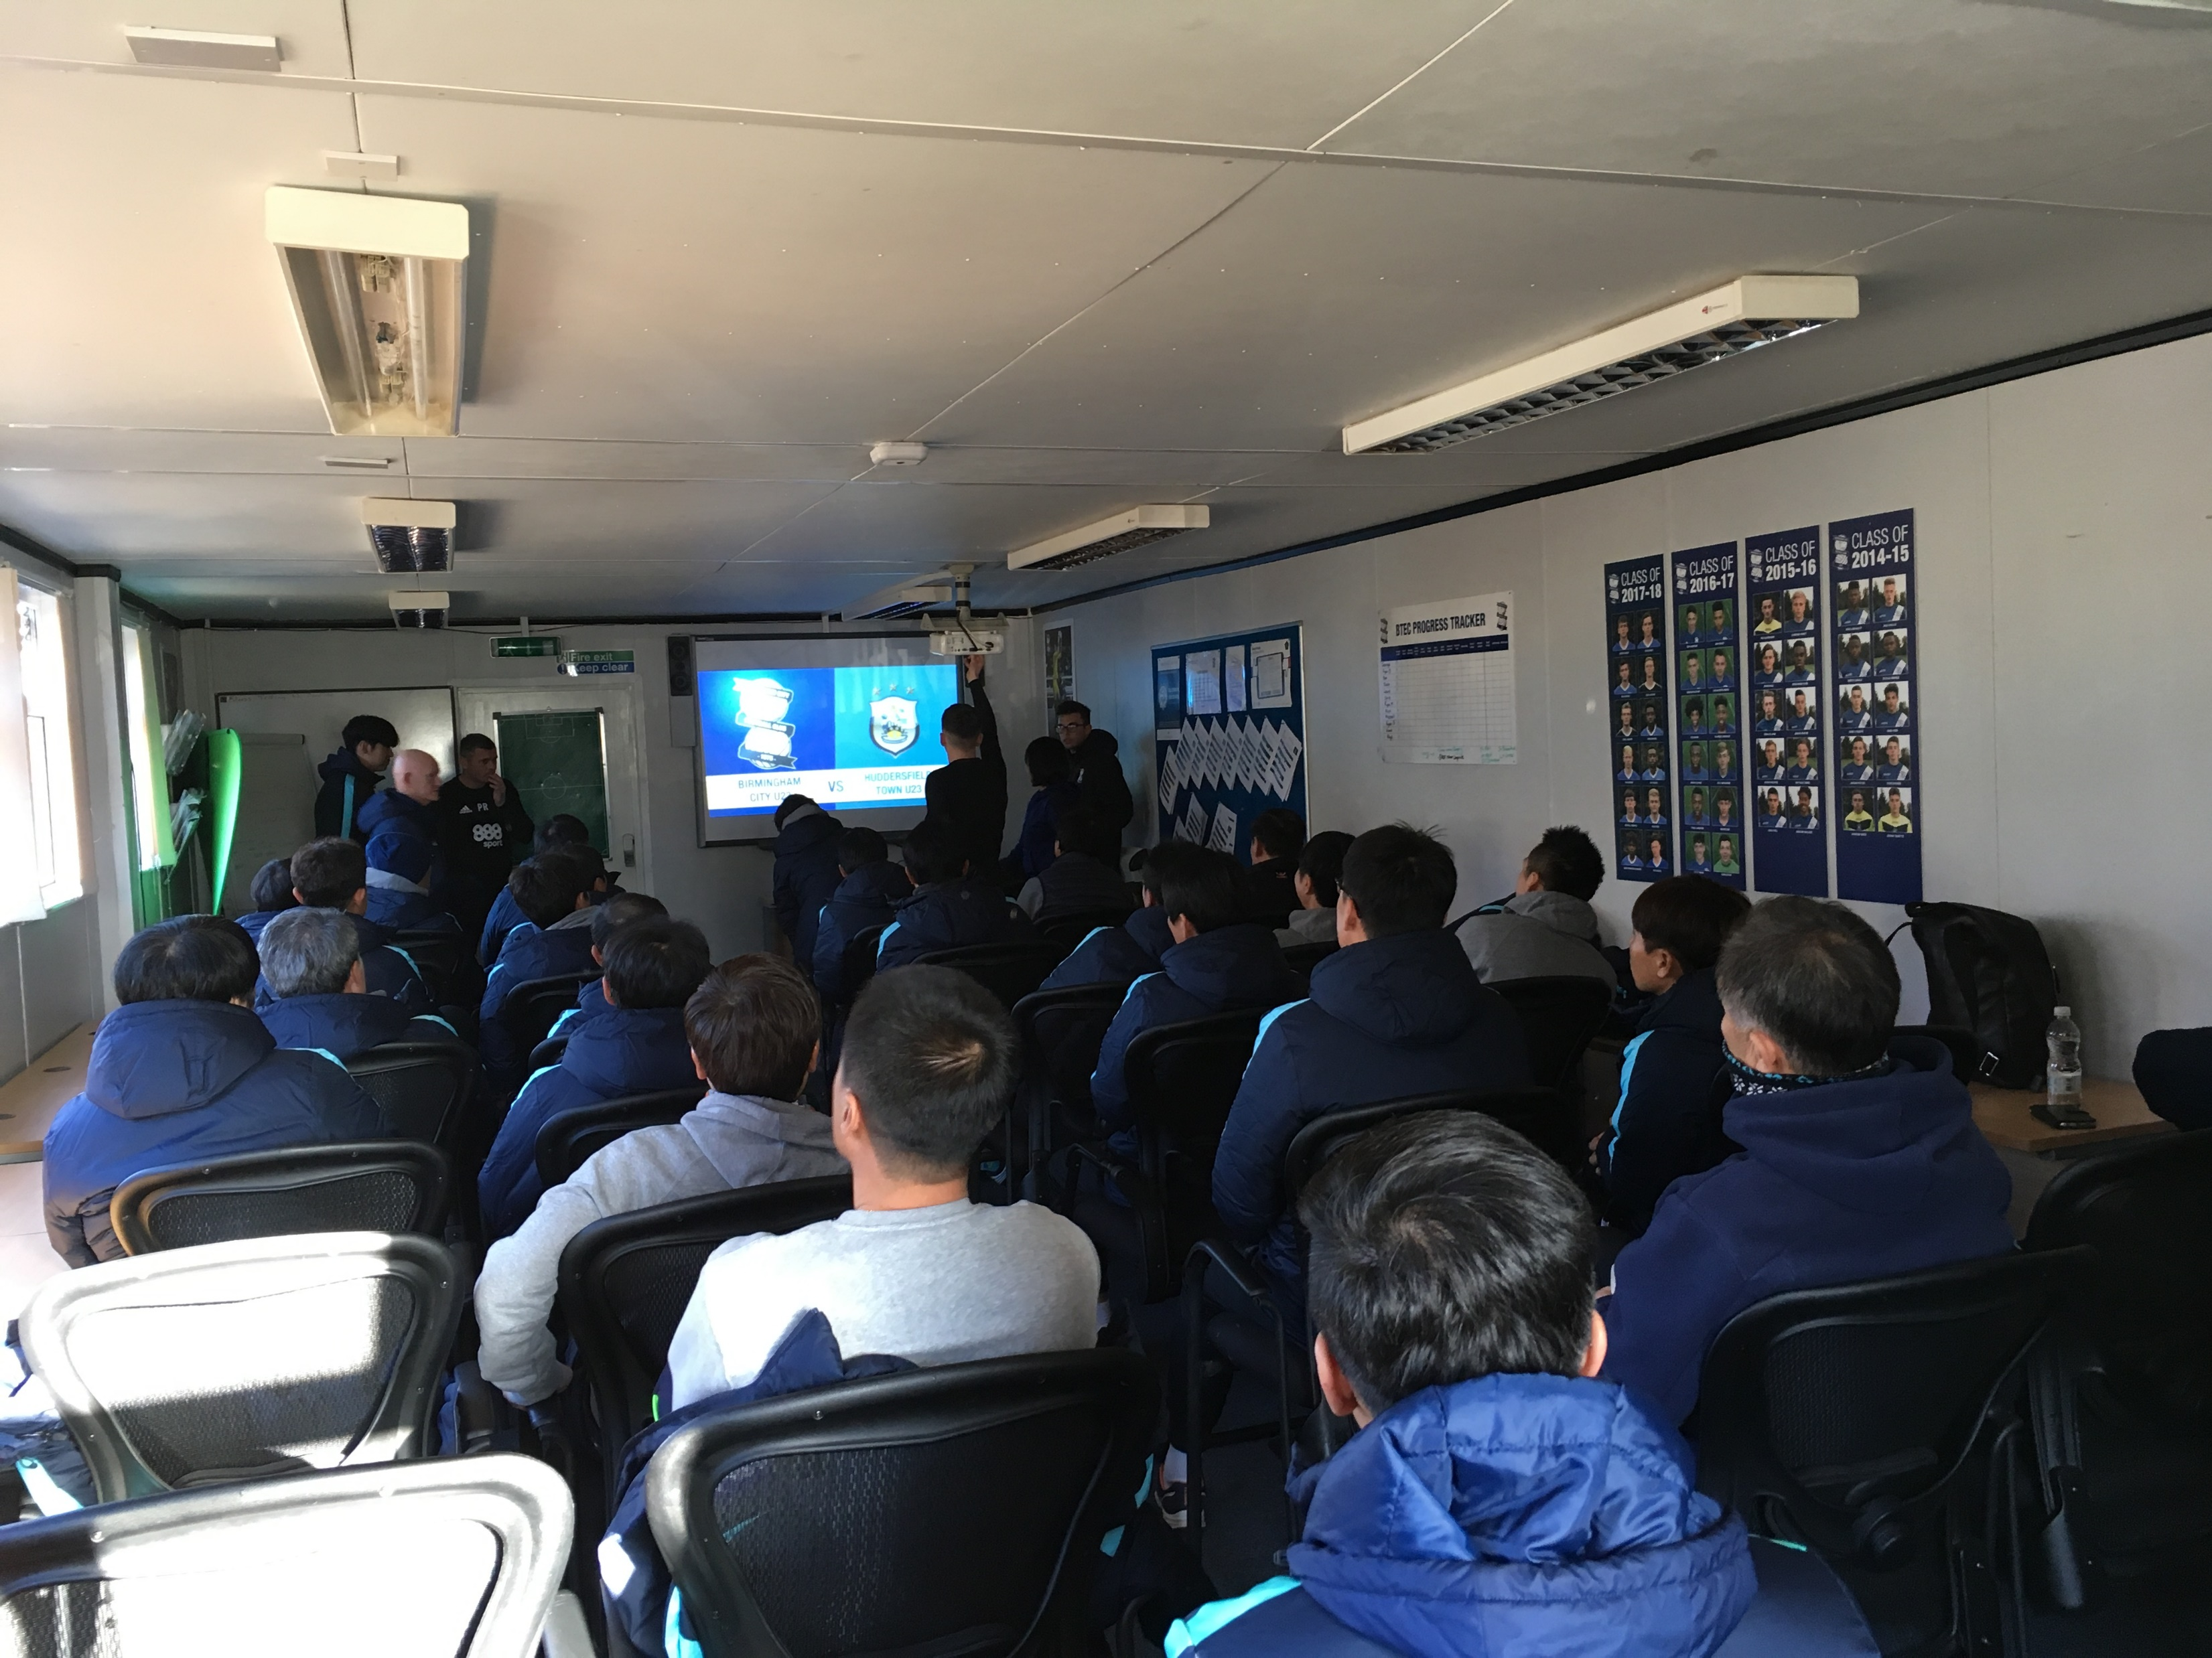
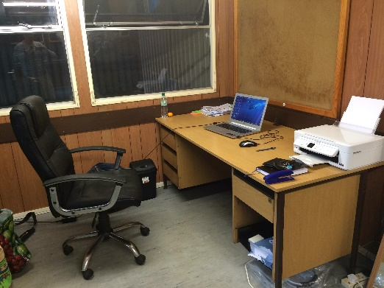
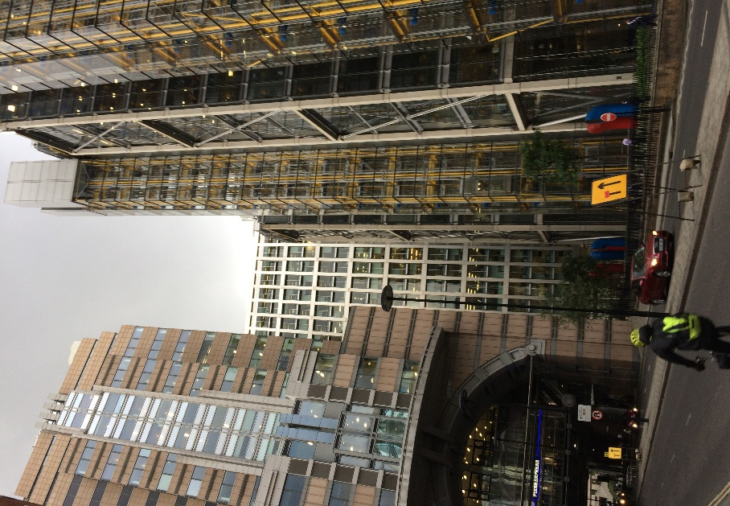
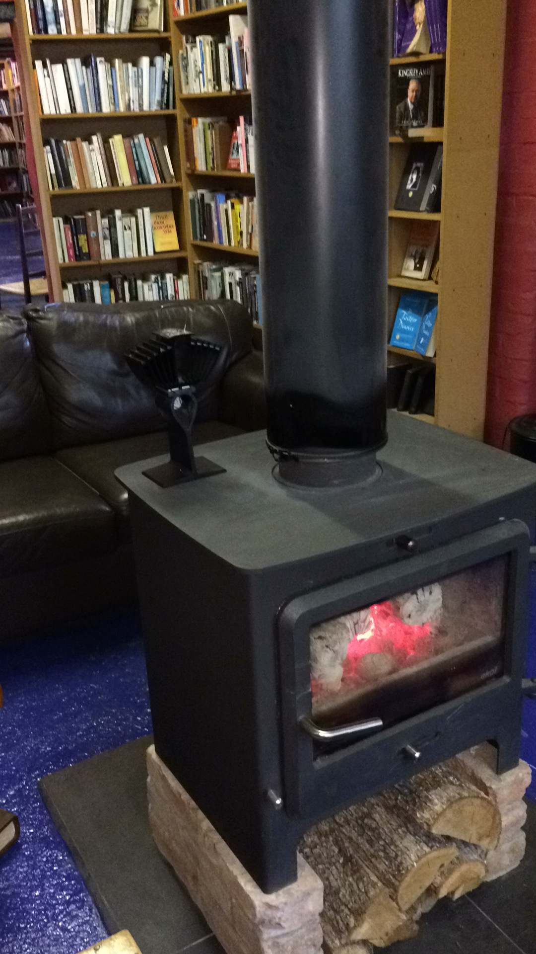
Meetings and office environments as everything in the applied world and a project that is multifaceted that there can be in many types of venues and many different formats

Slide 4
Timeline
Sept 2018 strategy plan and timeline
Nov 2018 Student recruitment and industry partnerships
Nov 2018– software including liaison with team in India to formulate and create POC and splash pages screens
Jan 2019 – hardware review and manufacturing strategy. This involved creation of a platform that could work with multiple timezones( UK, Australia, India). And evaluate designs of Gen 1 Market research, research plan, timeline, Lit review,
Nov 2019 – Prototype V1 to improve functionality and scalability including firmware. Mobile Application development using software team.
Feb 2020 – Prototype V2 testing and interactions with software, Study 1 & 2, software development cloud and mobile applications
June 2020- V3 reduced size to commercial type testing and develop. Software trials mobile applications including android, IOS phones and tablets.
Aug 2020 – V4 final prototype for field trials end users
Sept 2020 – sign off of project ready for production
Nov 2020 – Production and commercial offering to commence. Field study with further education settings
Dec 2020 – Marketing and sales and further developments

Slide 5
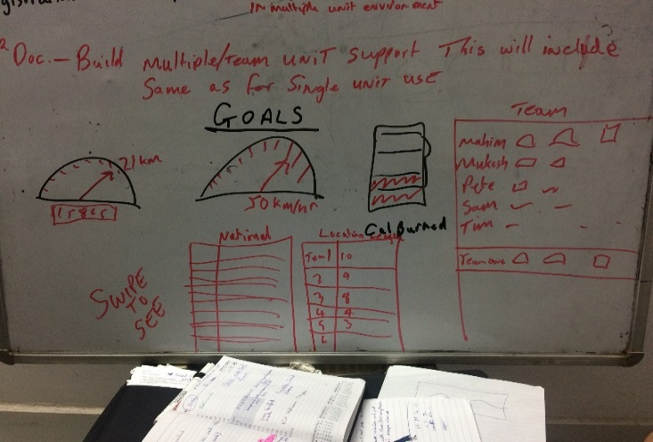
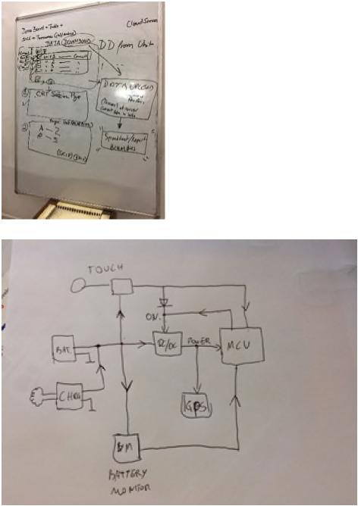
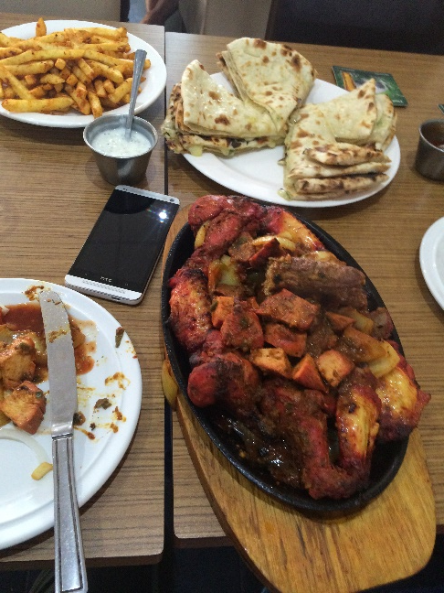
brainstorming session with engineers and supplying lunch for all as we work
one of the chief engineers first drawings. So on paper it works
Now for the hard work

Slide 6
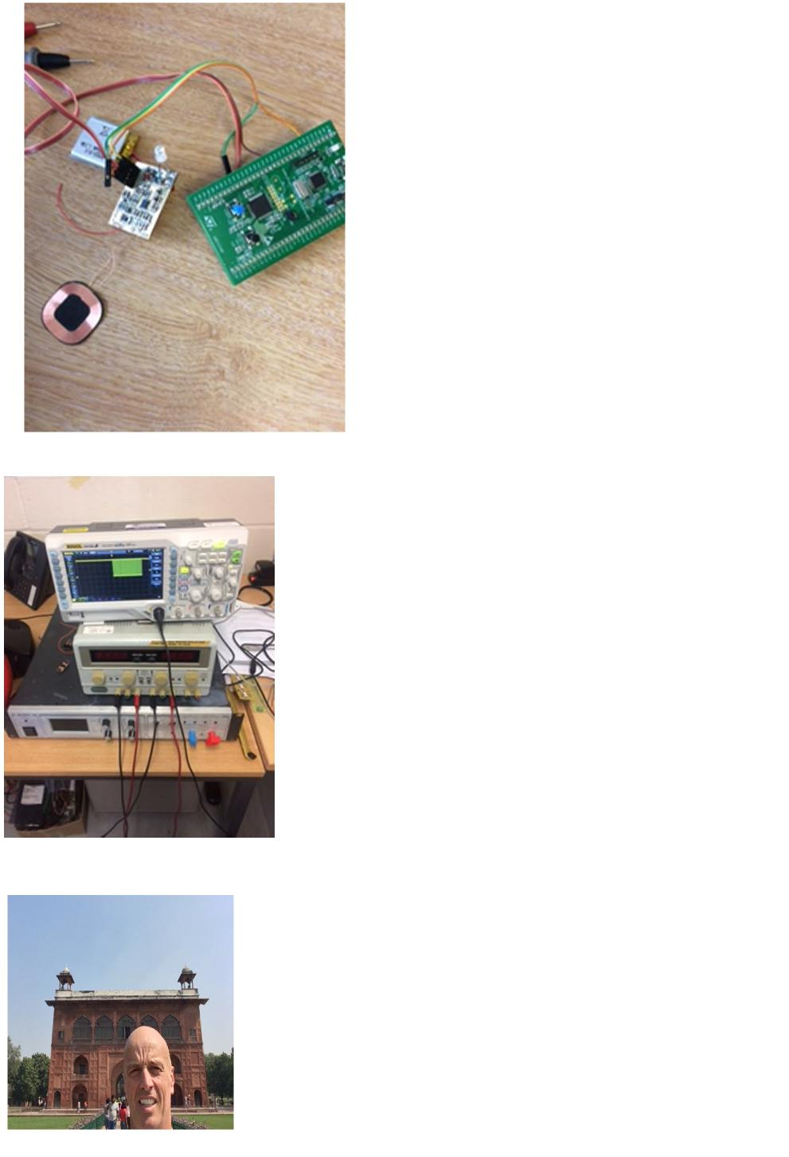
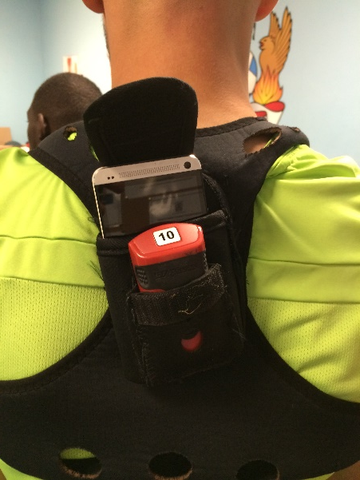
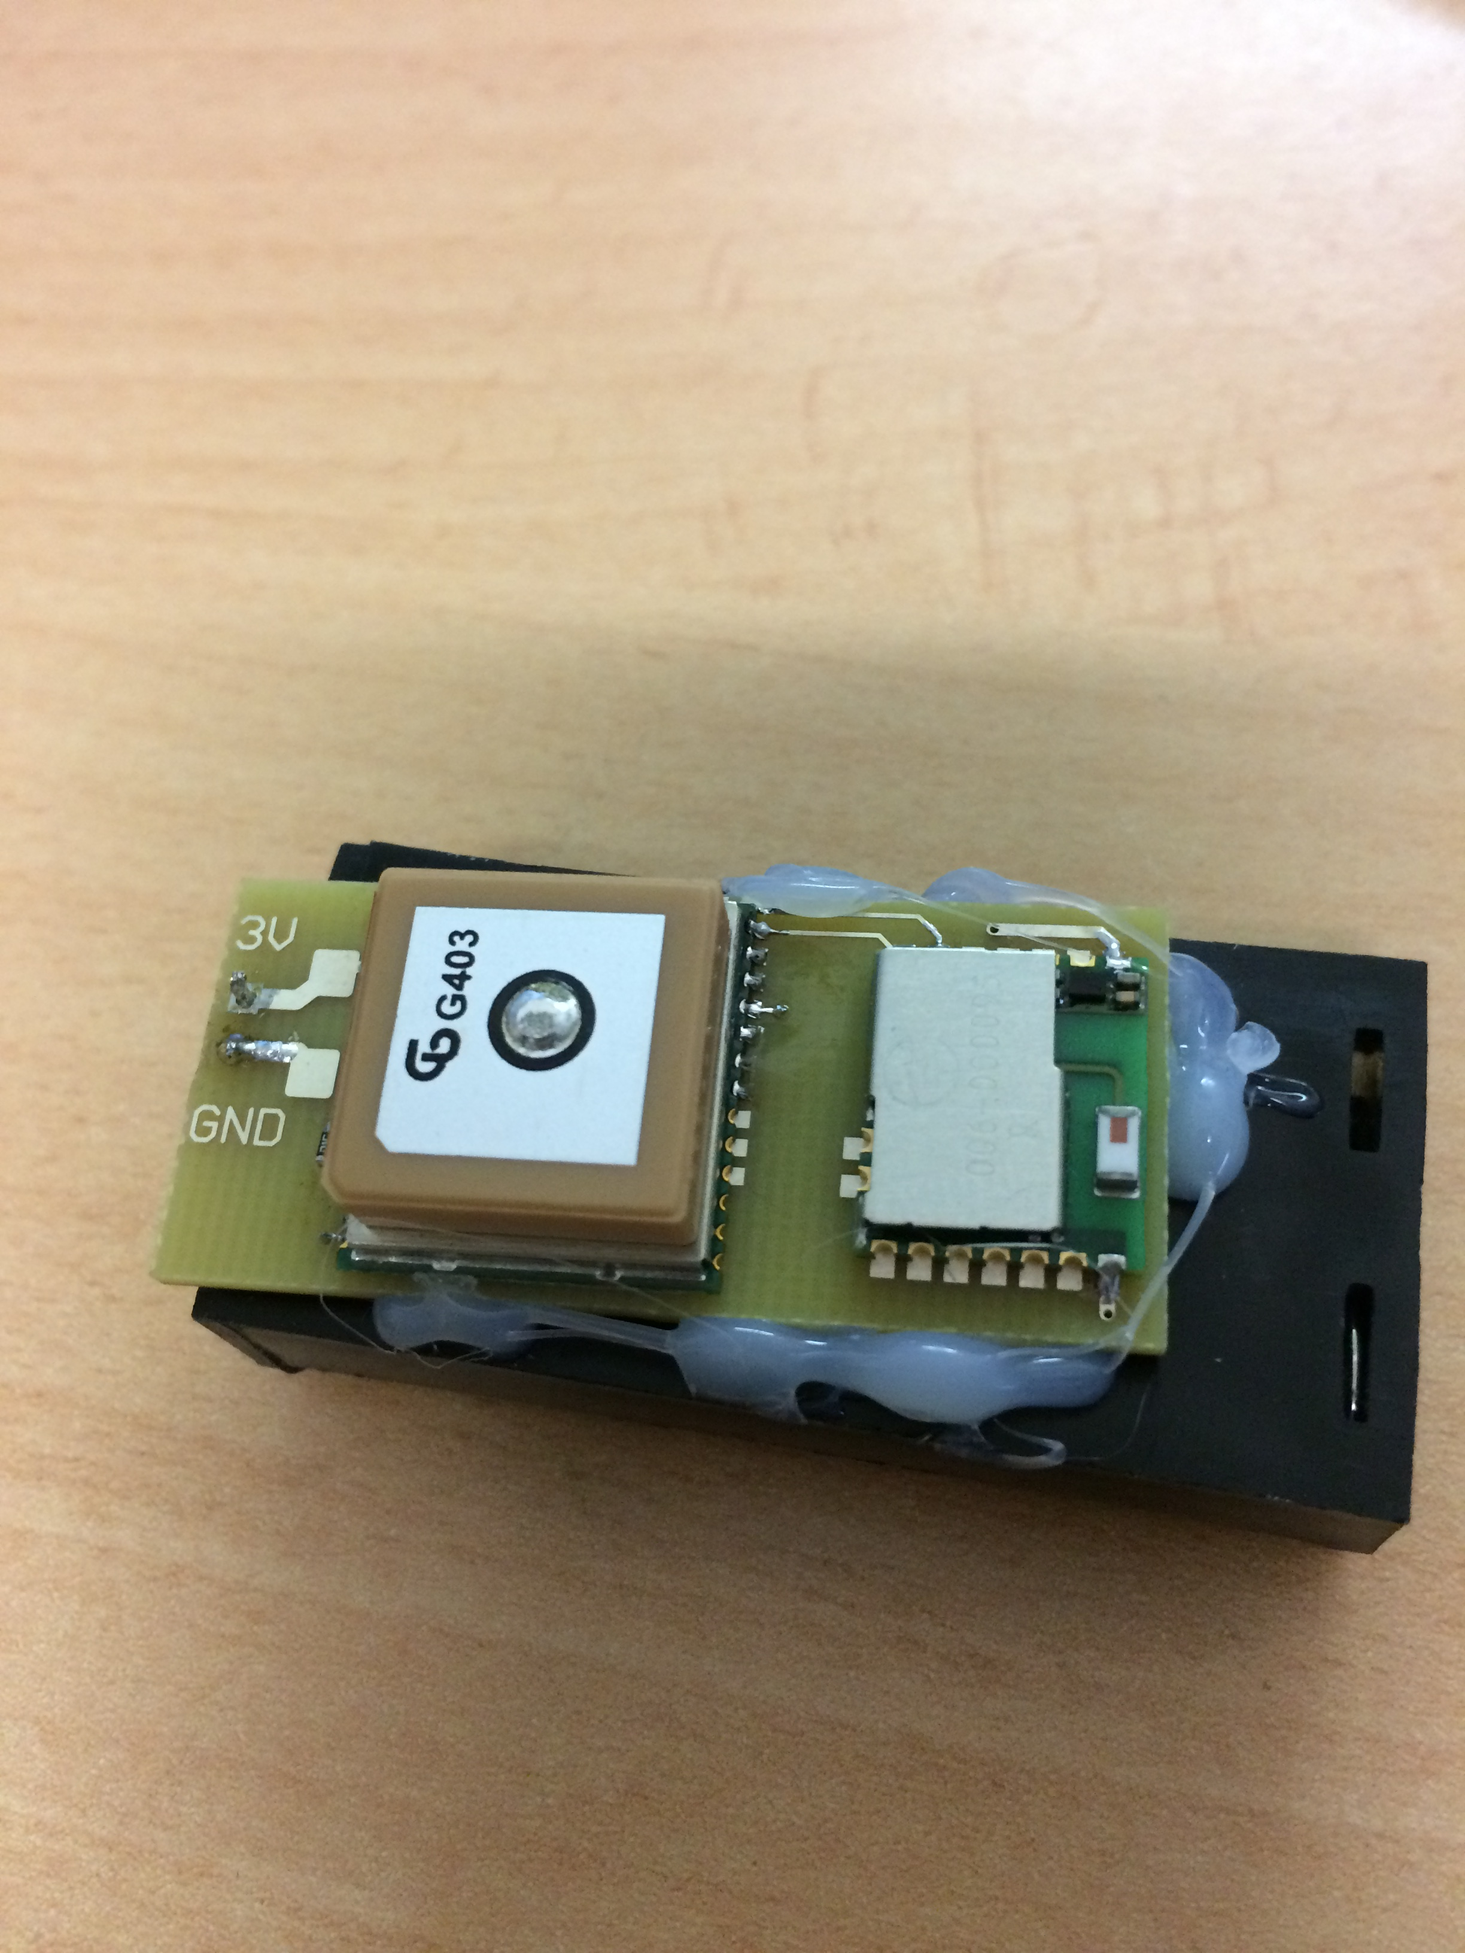
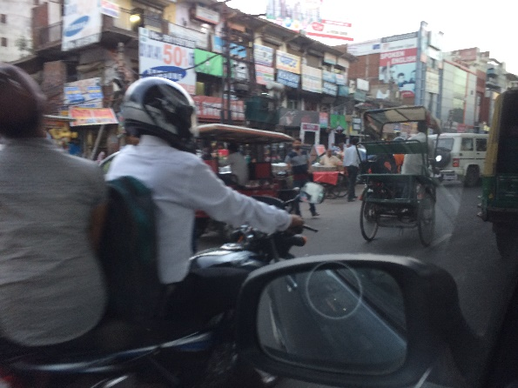
concept testing the first large bare board assessing if the drawings can become a reality
wired up to some expensive and technical looking equipment
Testing the concept
time to relax and perform some informal reflection and networking by understanding the wider culture and society that the team evolving, is living in (India)
downtime, the engineers based in India, evidencing this was a truly global project with multiple timezones and teams in 3 different continents Although transport to and from the software office was maybe different

Slide 7
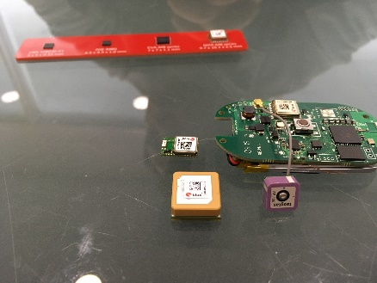
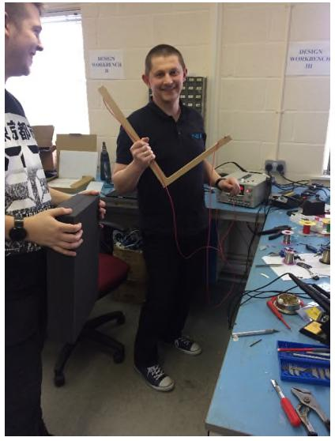
V1 to help proof of concept a larger board is first produced that allows for ease of access
Electronics engineers may not always use electronic gadgets as seen here with some wood!
Component sizes evaluation

Slide 8
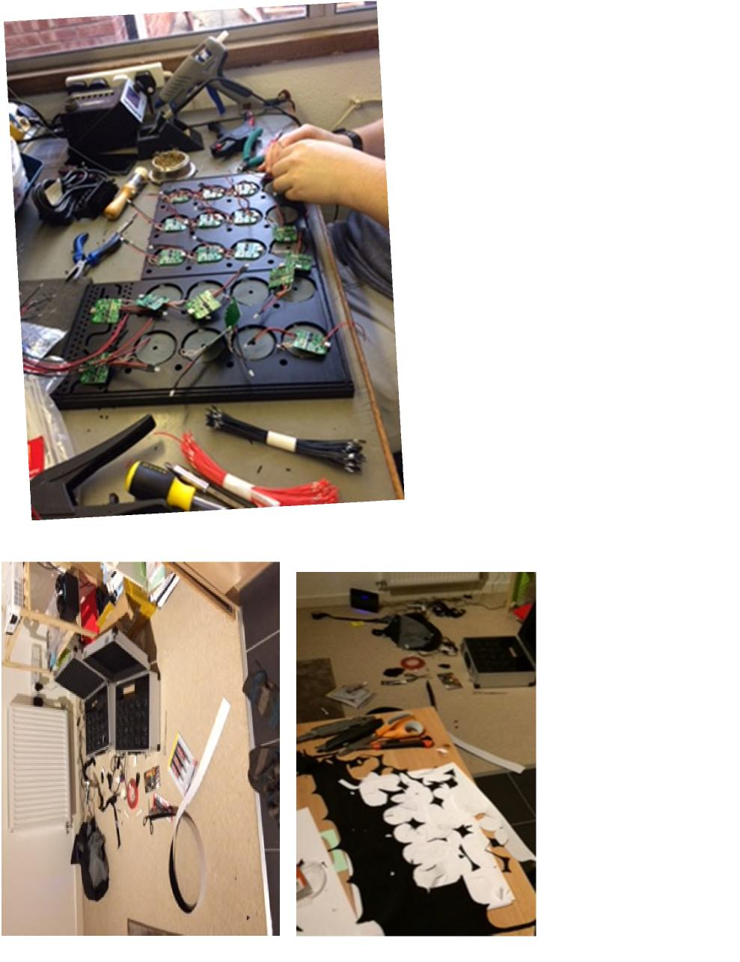
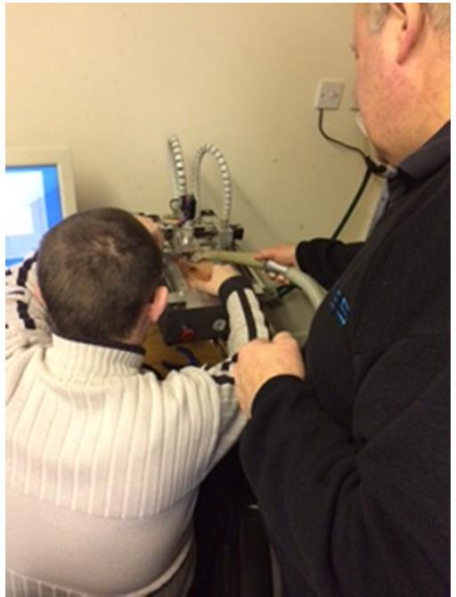
Inside the development area of an electronics facility is not what expected but is the reality of workings
The reality is that sometimes work may have to come home with you as is the case in 2020 with COVID -19

Slide 9
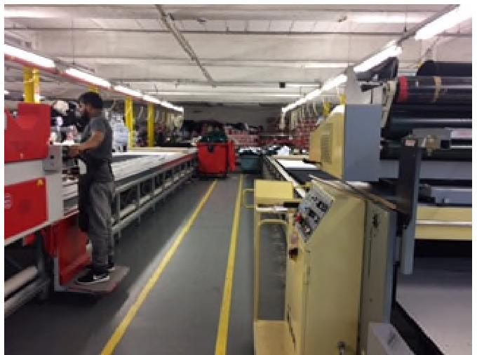
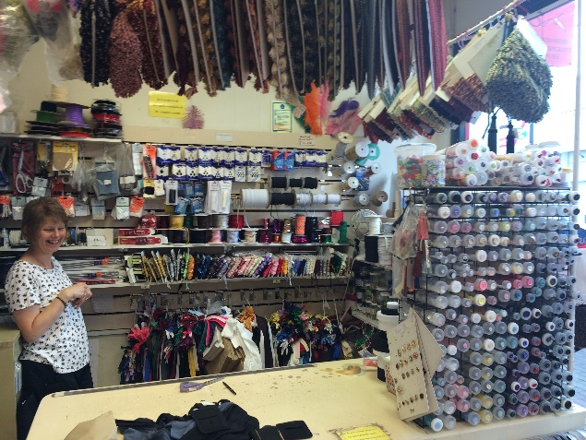
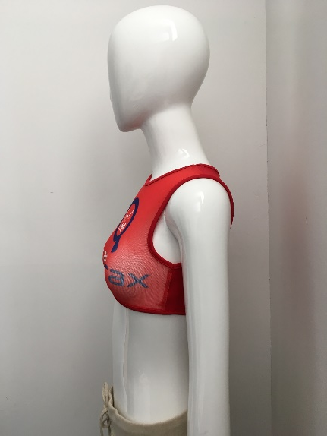
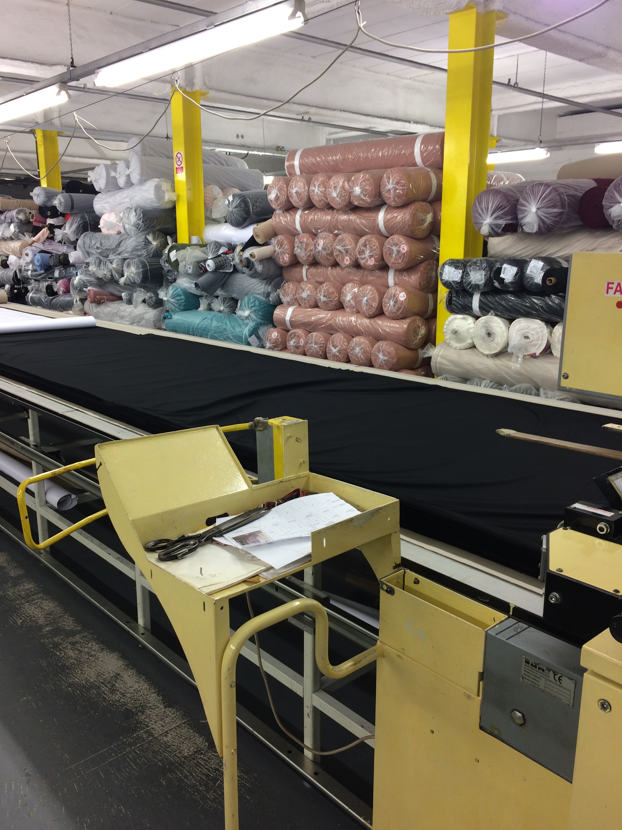
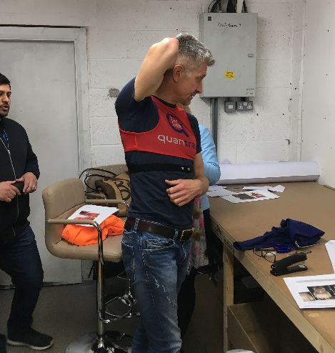
Each component is built in different factories Here is the garment factory in Leicester, and far right thread suppliers Nuneaton
Here with industry mentor in sports garment (previously head of sportwear for UMBRO)

Slide 10
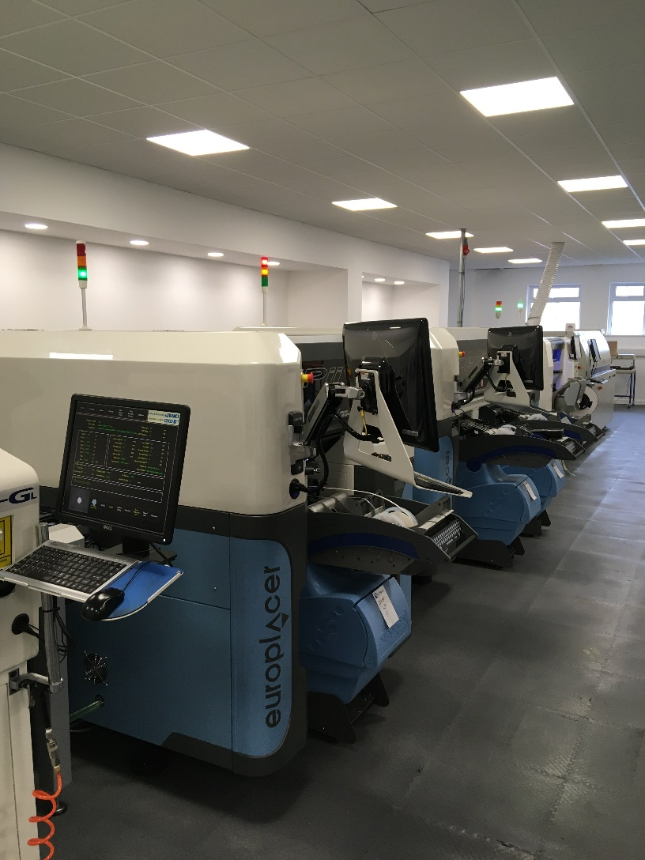
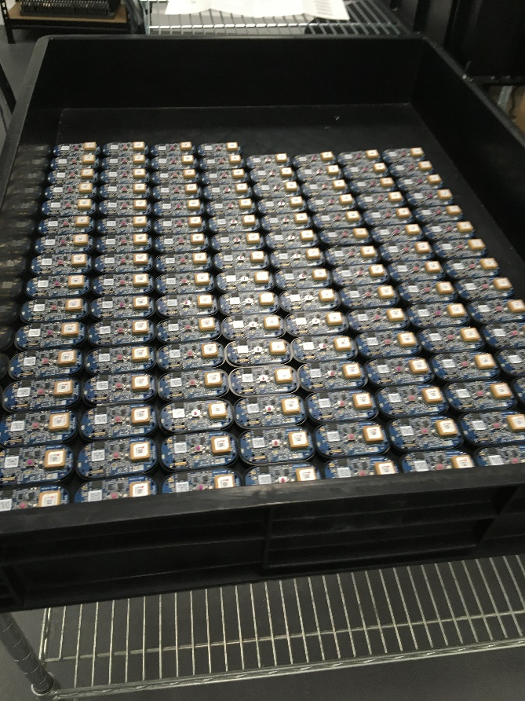
Electronics company Production machinery for pick and place of multiple components fully automated
Electronics ready then for final assembly
Aston Birmingham

Slide 11
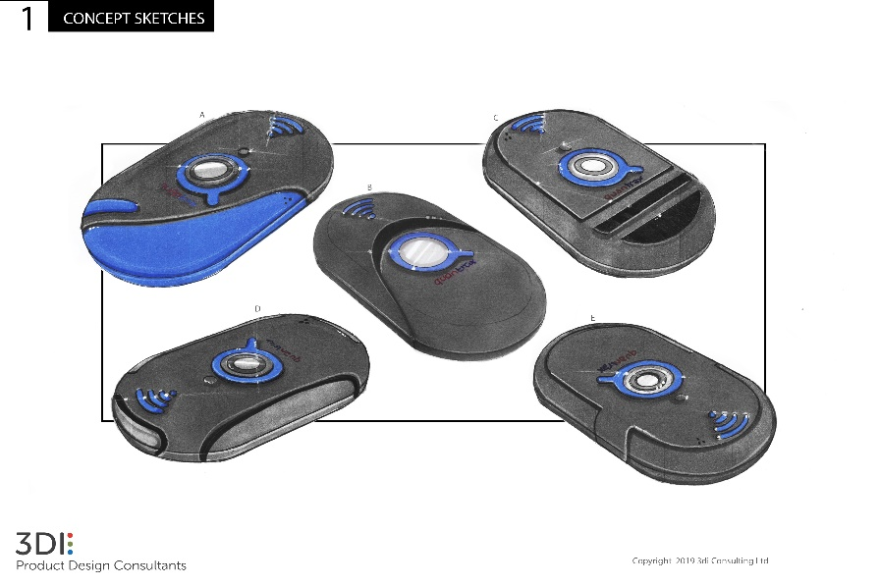
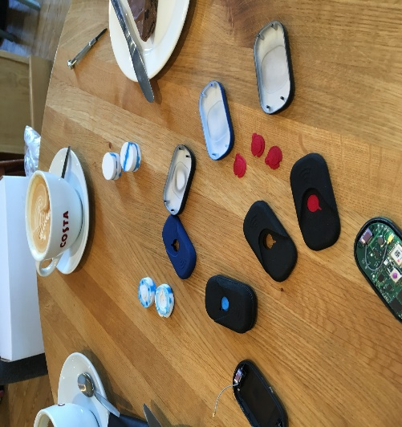
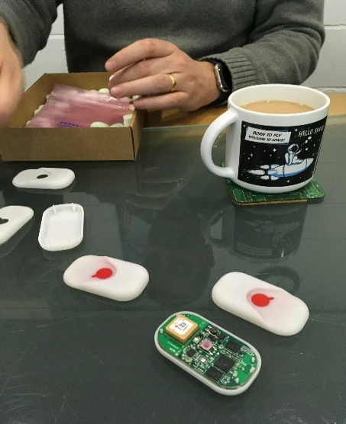
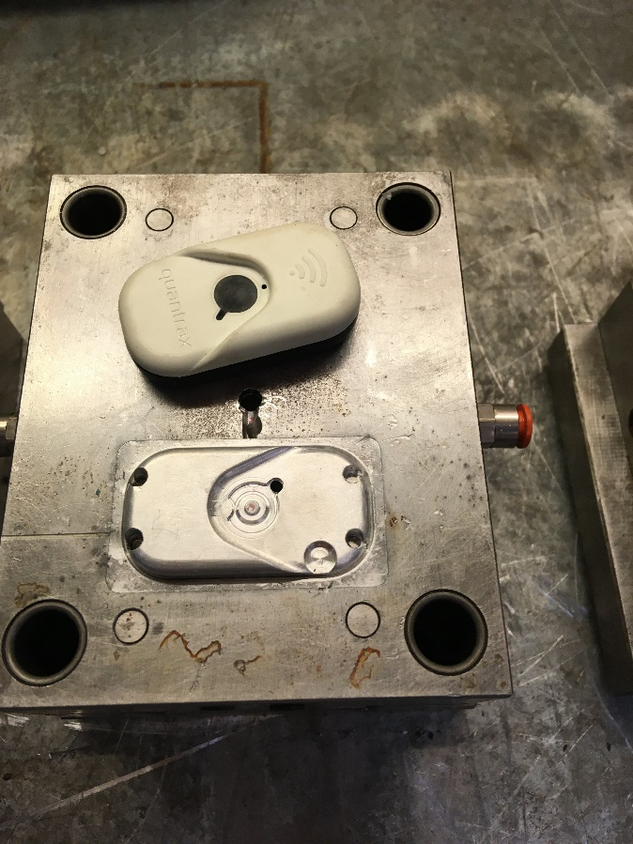
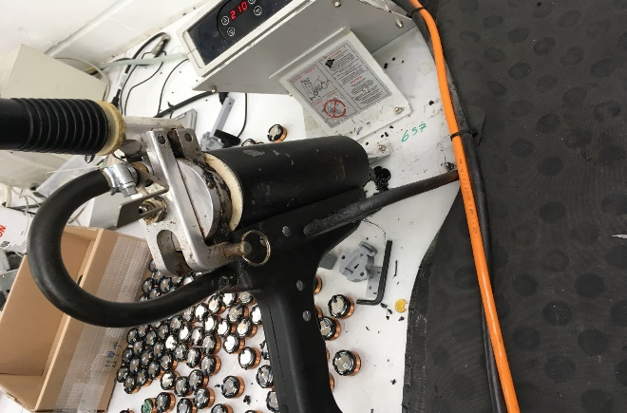
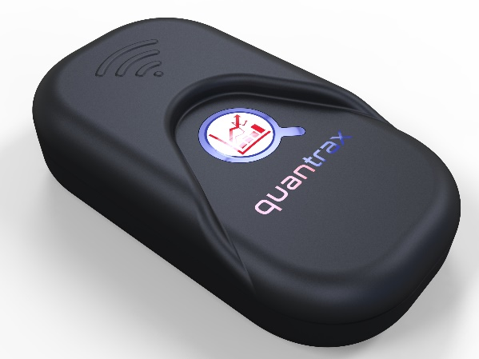
Plastic enclosure design from concept sketch to final tooling and production quality cases

Slide 12
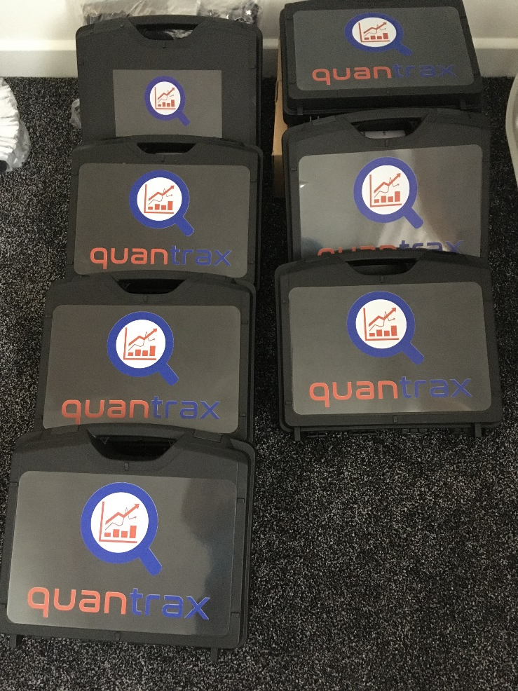
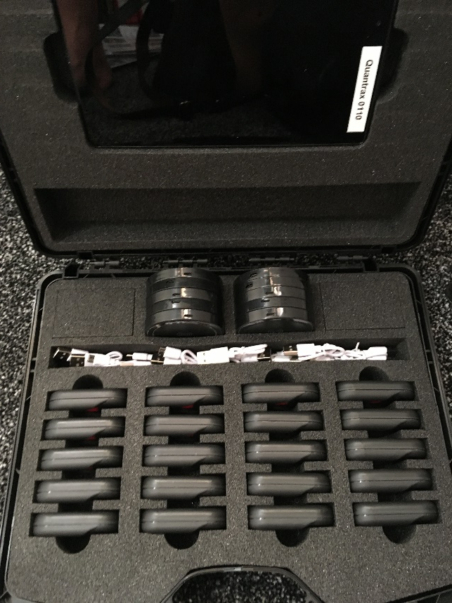
The final component being the carry and charging case also produced in Leicester Carrying upto 20 GPS units and Tablet with software installed

