Slide 1
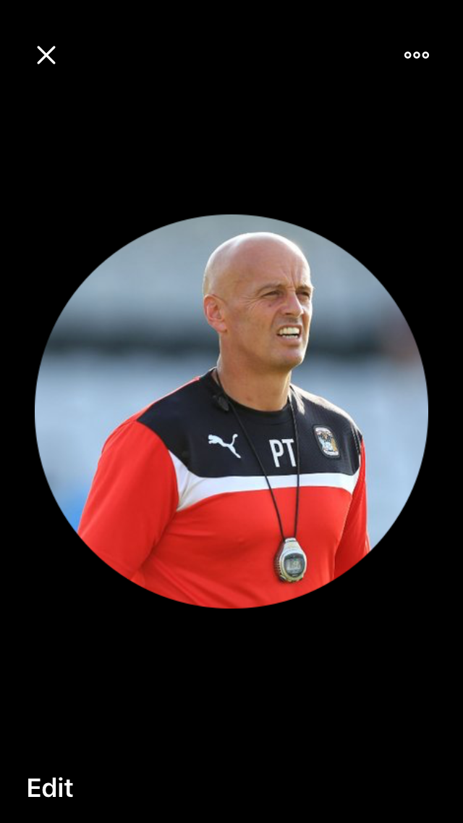
A career in Sport Science Living the dream?

Slide 2
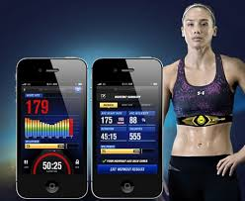
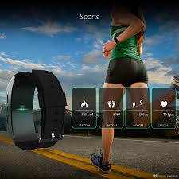
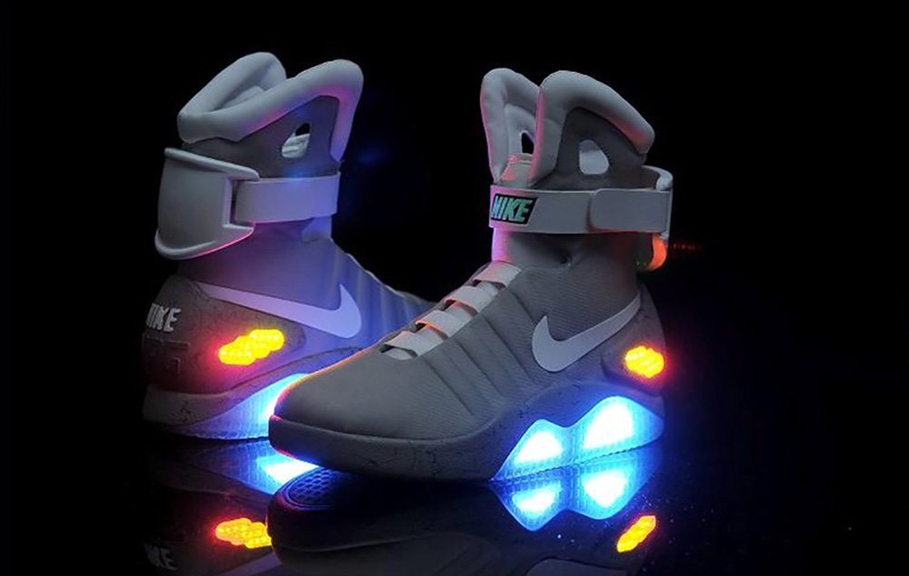
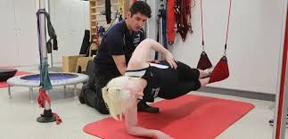
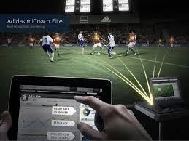
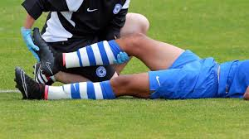
Sports industry Support in the UK
Sport & Exercise Science graduates currently employed added £3.9 billion to the economy 0.3%GDP
Estimated social and public purse benefits £7.8 billion
Around 71% are employed in directly related occupations 6 months after graduation, 96% stay in UK
Est for every £1 student invests in SES yields £5.50 in future earnings
Notes:
Equivalent to supporting over147,300 jobs
Football 1st team sport science support to community and occupational health
From birth to grave across the landscape
No barriers, culture, age, sex, disability, job……. Military, hospitals, sports, parks, wellness, teachers
this is added income to the uk every year including 1.3 billion tax
Approx £90 million in savings from NHS savings,
£160 million saving from unemployment and related benefits, less crime, fewer police

Slide 3
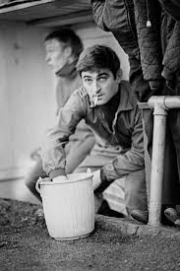
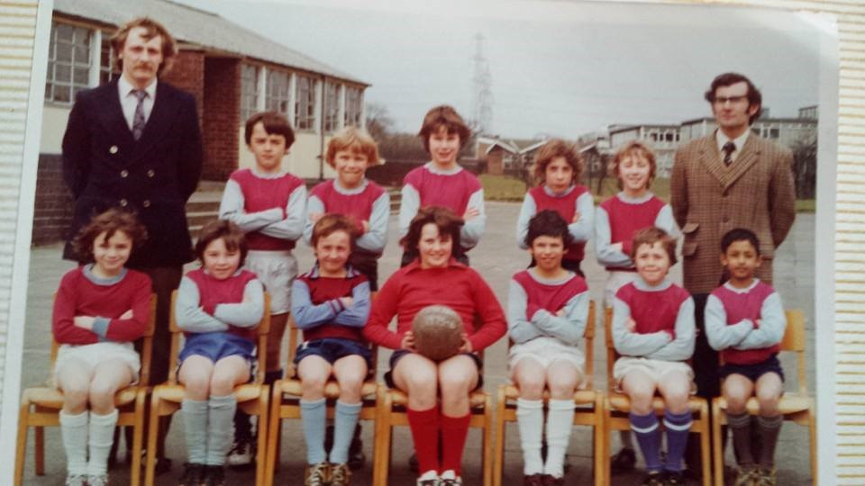
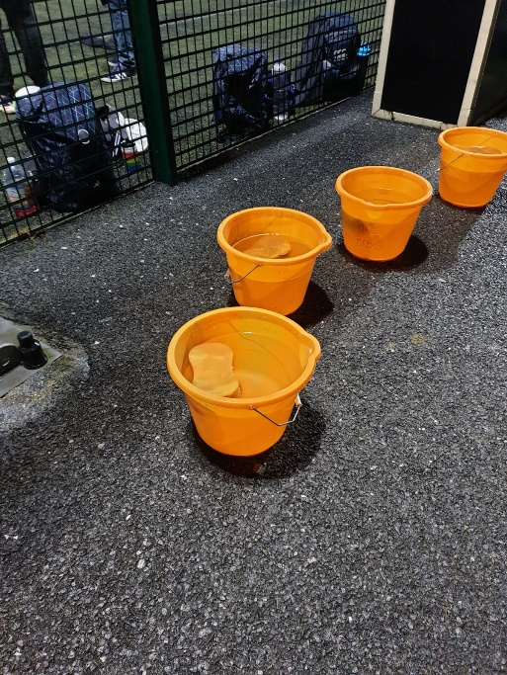

Slide 4
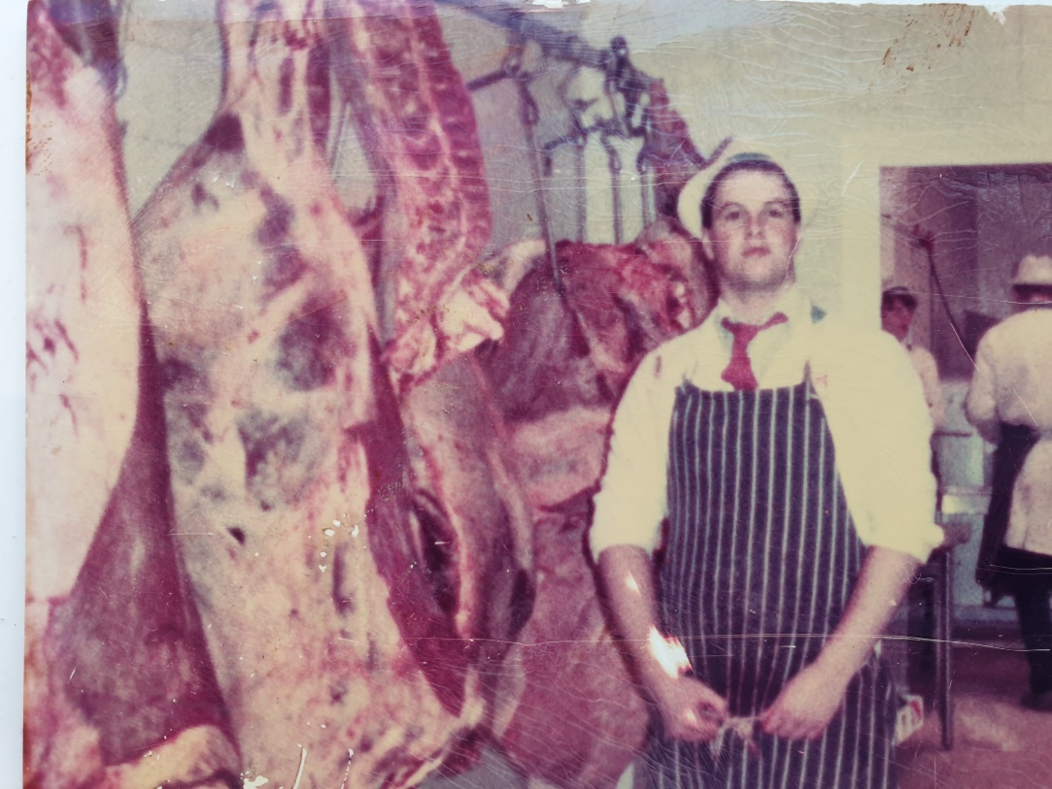
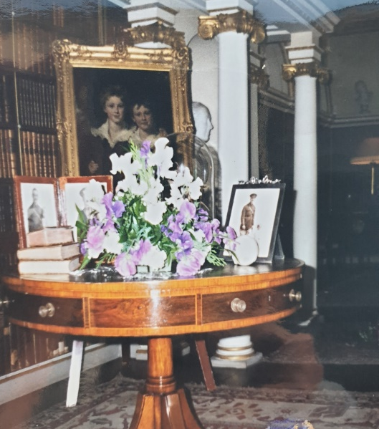
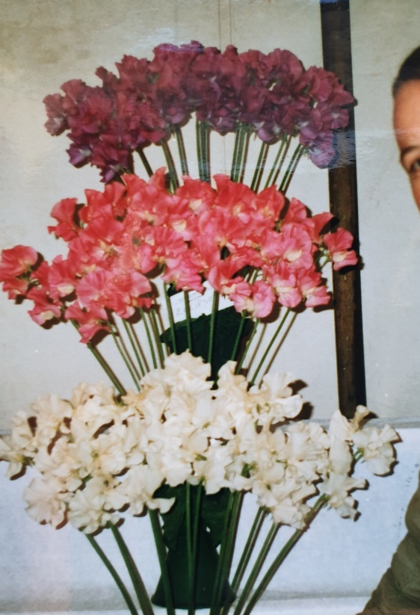
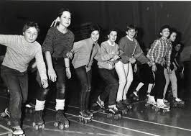

Slide 5
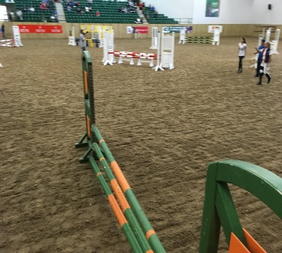
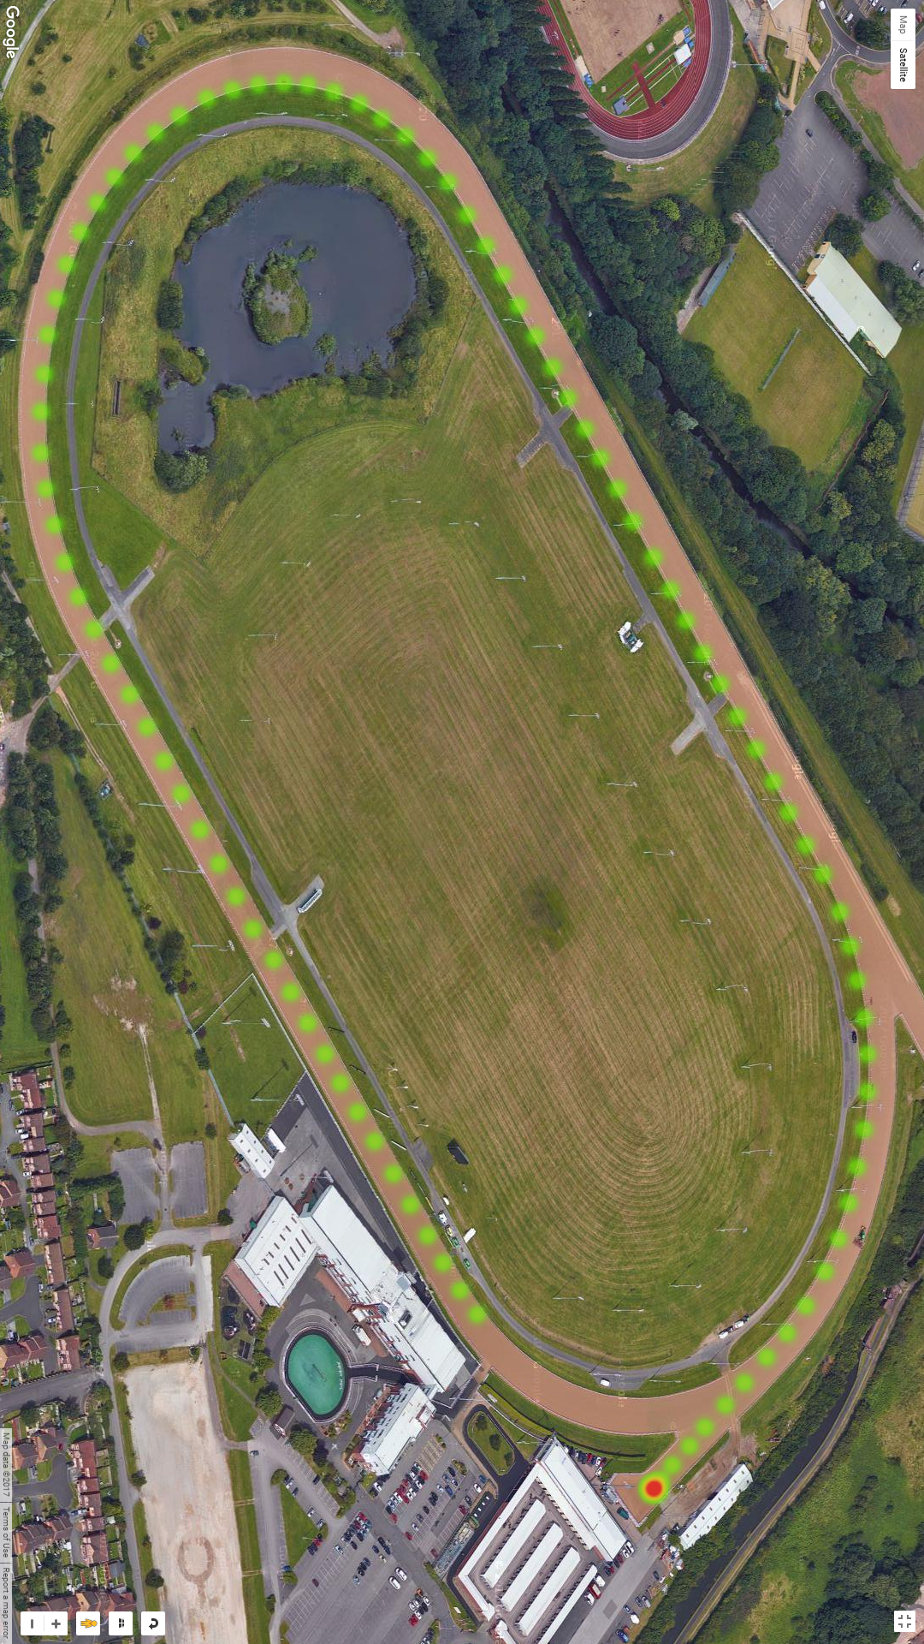
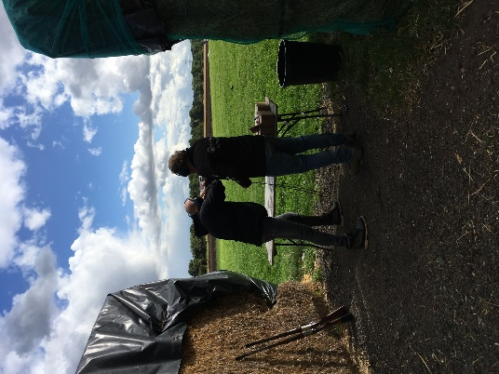
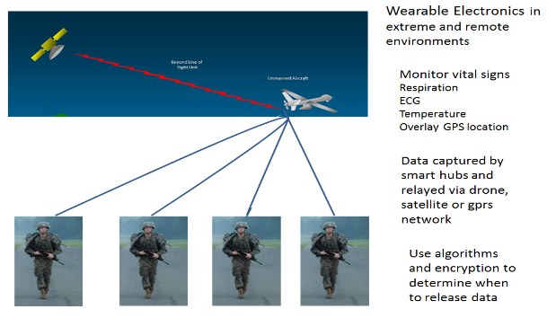
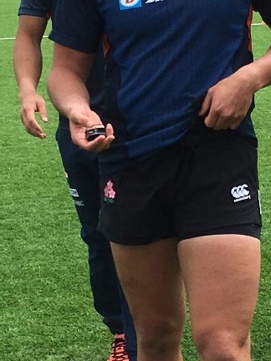
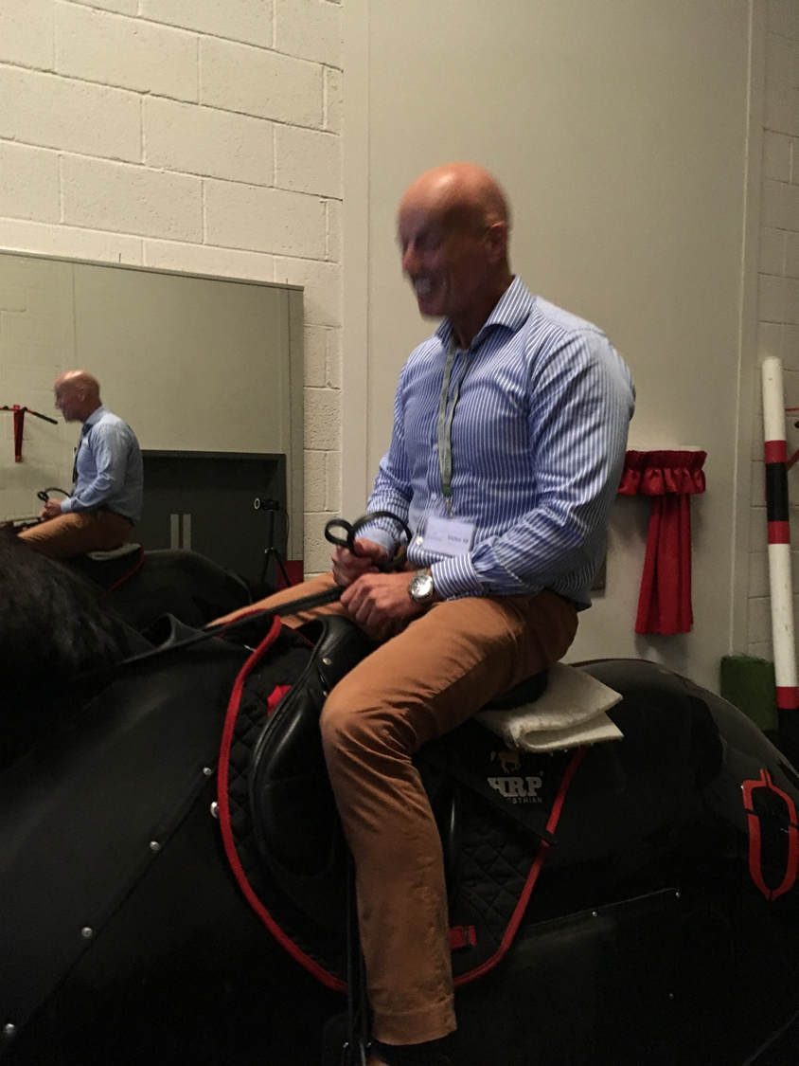
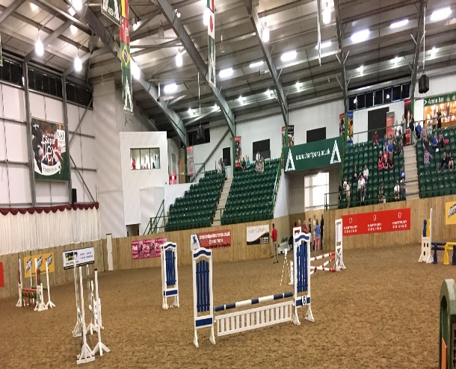
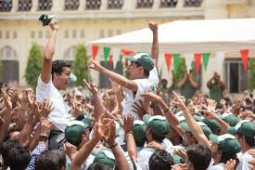

Slide 6
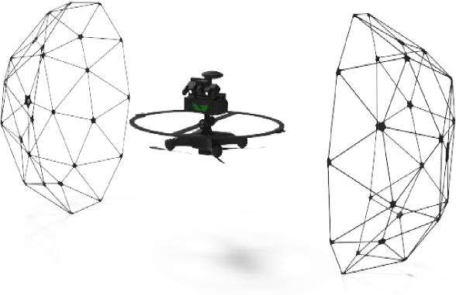
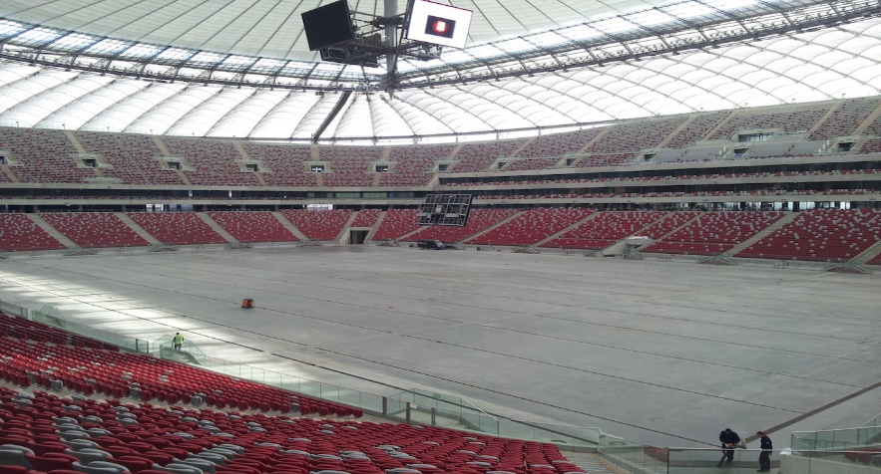
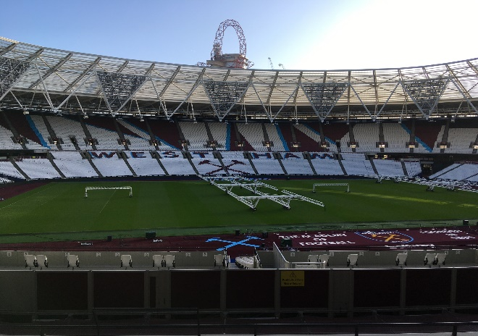
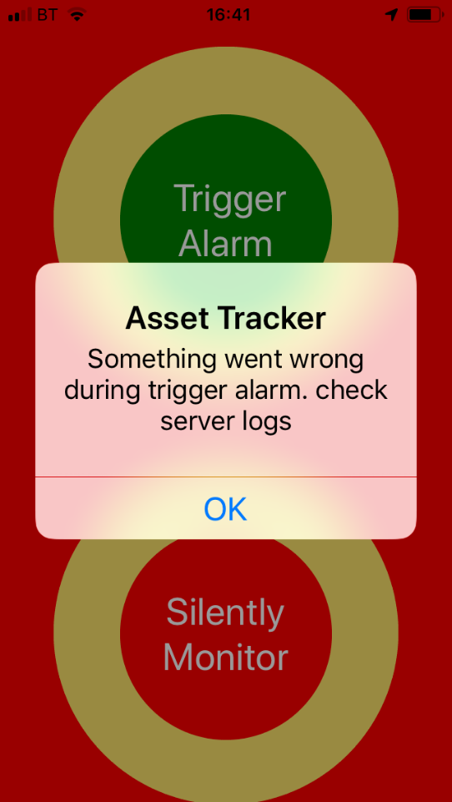
Notes:
Not just direct sports coaching there are lts of spin offs related to

Slide 7
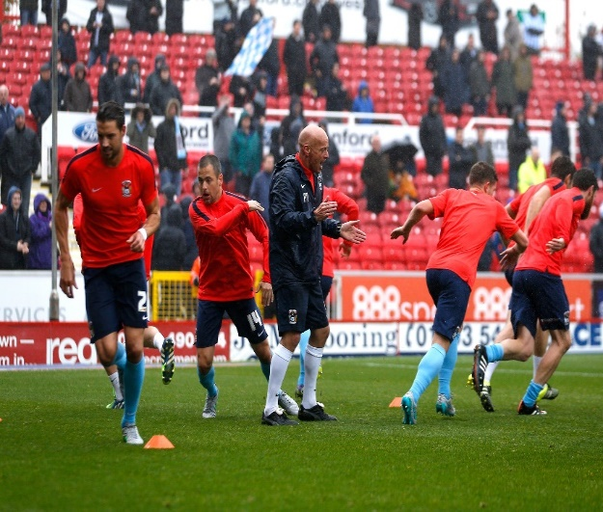
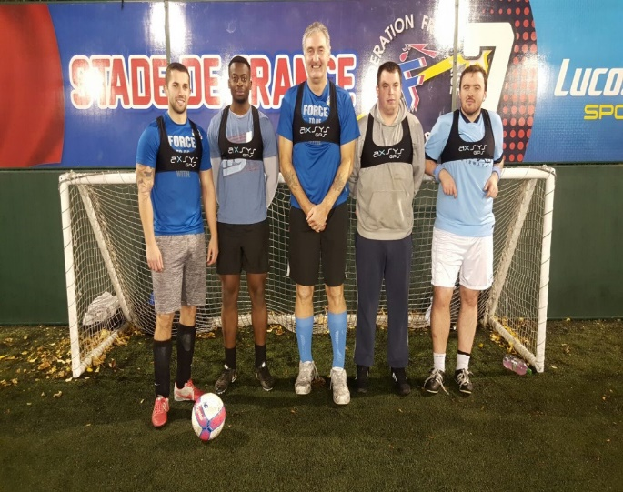
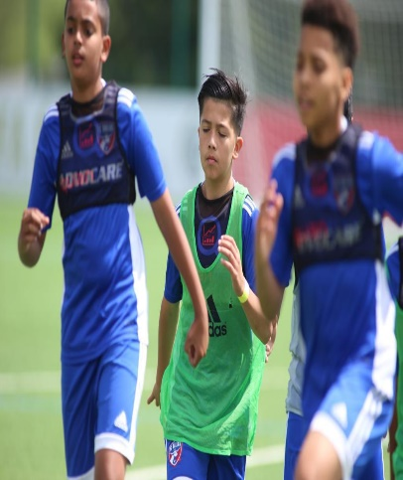
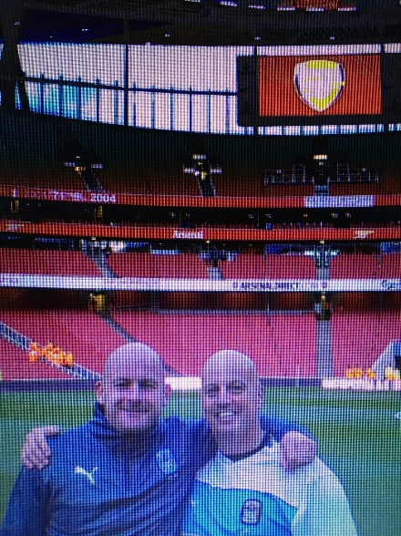
Working with pro teams to leisure leagues
Dug Out to
London Mayfair office
8 yr olds
to 80 yr olds
Astley Castle Gate
Brandenburg Gate
India Gate
creating some
lifetime friendships
Notes:
Sayings
One door closes another opens or the grass is greener
Ive opened and closed some gates and seen a few gates from>>>>>>>>>>>>>>>>>>>>>

Slide 8
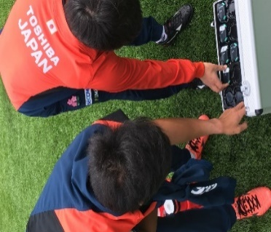
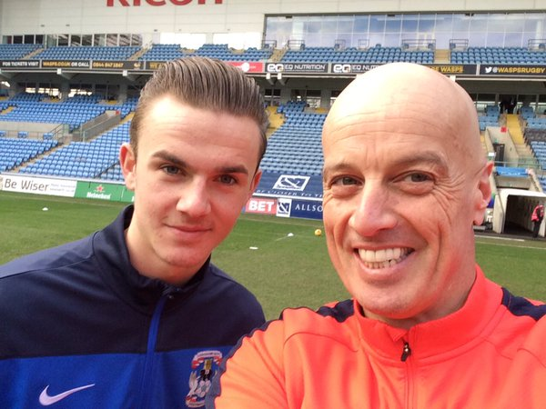
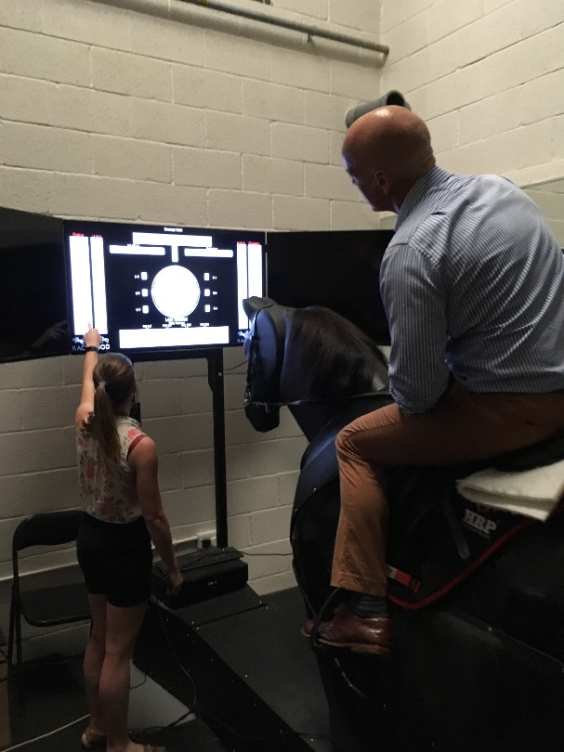
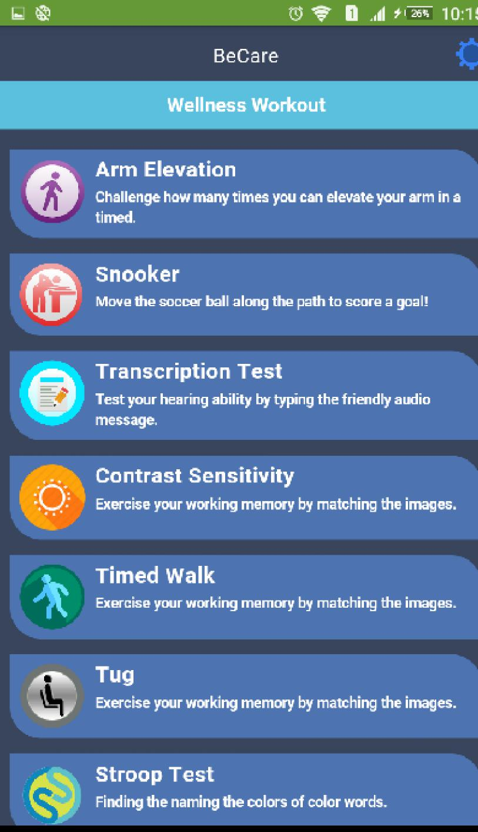
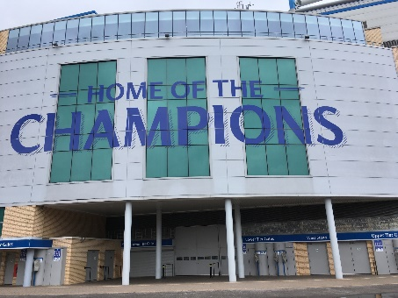

Slide 9
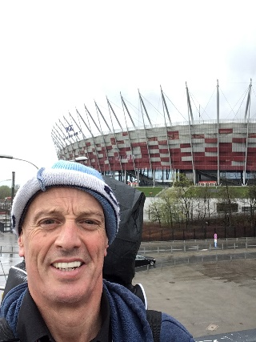
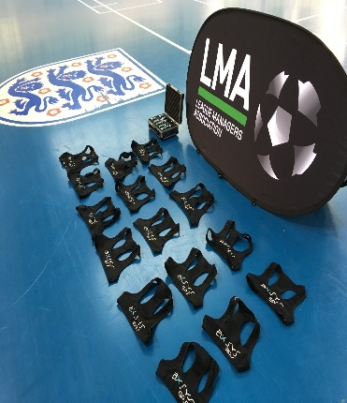
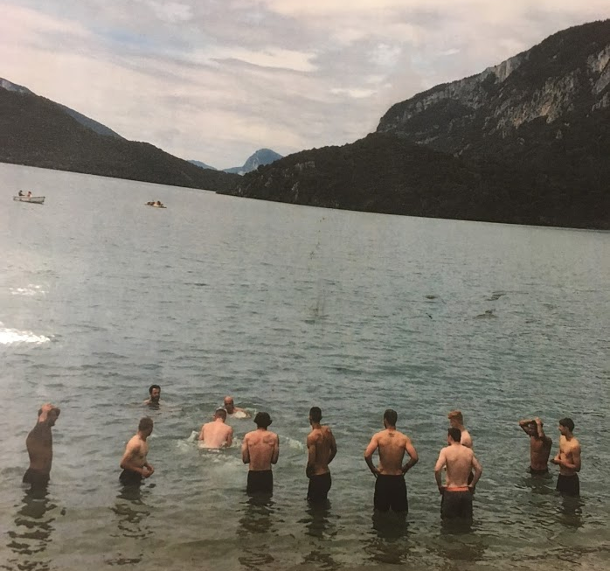
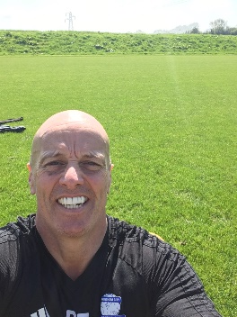
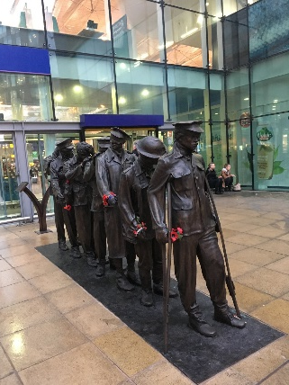
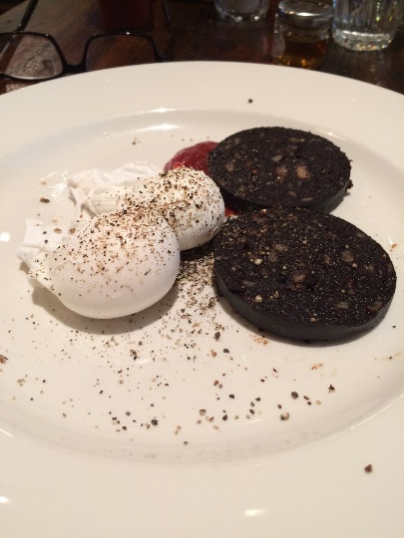
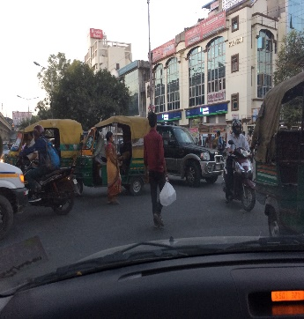
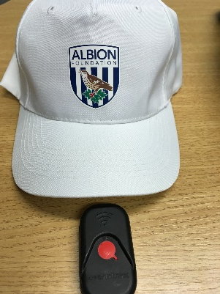
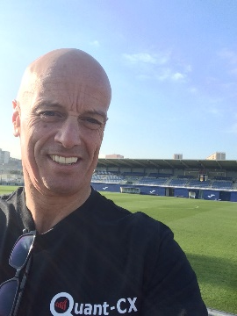
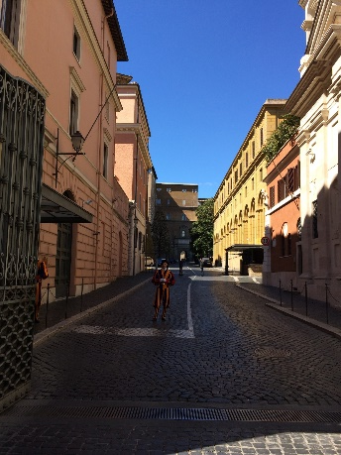
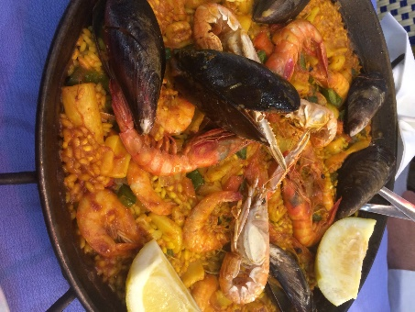
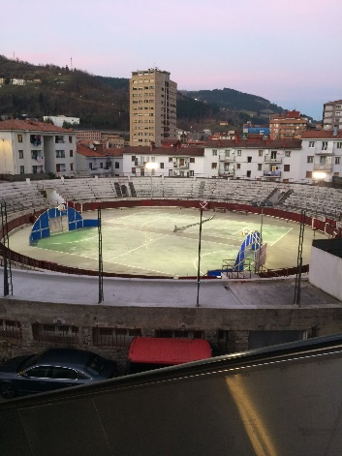
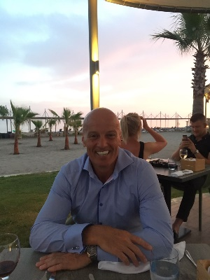
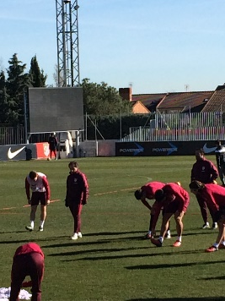
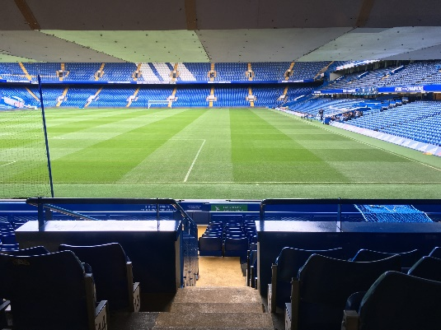

Slide 11
Notes:
Transferring all those skills to help achieve academic success

Slide 12
Current Lit review for Phd 457 references and growing
Ongoing reviews
Referencing
Dellaserra et al (2014). Use of integrated technology in team sports
Vickery et al (2014) Accuracy and reliability of GPS devices for measurement of sports-specific movement patterns
Tierney et al (2016) match play demands 11v11 formation and position
Peart et al (2017) use of mobile applications to collect data in sport, health and exercise sciences
Hennessy & Jeffreys (2018) The Current Use of GPS, Its Potential, and Limitations in Soccer
Hulteen et al (2017) Global participation in sport and leisure-time physical activities
Malone et al (2015) Seasonal Training-Load Quantification in Elite English Premier League Soccer Players
Buchheit & Simpson (201) Playertracking technology: Half Full or Half empty Glass?
Little (2009) Optimizing the use of soccer drills for physiological development
Romeo (2017) Children at football academies are more likely to 'get hit by a meteorite' than succeed as professionals
Aughey (2011). Applications of GPS Technologies to Field Sports
Blatter, & Dvorak, (2014). Playing football on a regular basis contributes to the improvement of public health
Krustrup & Krustrup (2018). Football is medicine - it is time for patients to play!
Krustrup, et al (2010). The health and fitness benefits of regular participation in small-sided football
The Football League (2015) 11 Million Footballers In England Cannot Be Wrong
The football League (2017) Five-A-Side and Futsal
Plan 2018

Slide 13
From this to this

Slide 14
Transferable skills
Fashion designer, Machinery tooling Electronics manufacturing, marketing, advertising, Promotions, RESEARCH

Slide 16
My Philosophy
Adaptable
- To modify or adjust to new circumstances. To changes that can and cannot be envisaged and/or predicted
Agile
Able to respond appropriately and scale the speed of response
Strategy
- Create a plan to optimise development integrated with the club/playing philosophy
Notes:
It is not necessarily having a set philosophy,
If I was to put a label on it (Agile adaptable strategy)
Plan
There must be a plan as with then we are able to constantly review and progress
Historically It has been shown that when people and organisations have a rigid set philosophy, then these subsequently fail.
This is mainly been evidenced that, once they achieve some success, then this success is rewarded and this in turn is followed by complacency.
A status quo then ensues (not the band)
more a set of principles that underpin an ever evolving philosophy that adapts to the changes and environment encountered.

Slide 17
The 3 r’s
Robust;
Strong and healthy,
sturdy, tough, powerful, solid,
Resilient;
able to withstand or recover quickly from difficult conditions flexible, pliable, pliant, supple, elastic, springy ( all athletes need to train and play)
Reliable;
Consistently good in quality and Performance,
Repeatability, Dependable, Authentic
Performance
“Accomplishment of a task that is measured against pre-set data giving a result”

Slide 18
Key Principles or Core values
Specificity;
Is it what they need to be doing
Overload;
Are they overall doing more/improving
Progression;
Are they advancing
Individual;
Is it individualised not a generic one size fits all but enhances the collective
Knowledge;
Understand the subject area/specialism

Slide 19
Be Prepared
Weather
Nutrition
A different way

Slide 20
Peter Tierney
Liverpool John Moores University P.J.Tierney@2019.ljmu.ac.uk
Pete.tierney100@gmail.com
pete@quantrax.co.uk tel: 07948800069

