Slide 1
Why me? Elite Performers
Fulfilling potential?
Assists in pushing a player to his or her full potential by helping analyze training and match performances and identifying position and formation specific demands
Work rate?
Applying all the latest sport science on performance
But what is performance? Physical v technical & tactical
By monitoring and recording body loading over time then any volume and intensity issues are detected and highlight injury risk

Slide 2
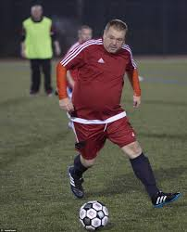
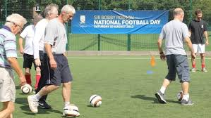
Why me? Football Fan
Health & well being
Captures & calculates fitness metrics eg distance, speed zones, calories burned
Time series of data all stored in the cloud
Measure improvements over time – day one “exercised for 60 minutes, distance 3KM, ran for 30%, sprinted for 5%, 755 calories burned” – week 5 “exercised for 60 minutes, distance 3KM, ran for 45%, sprinted for 15%, 900 calories burned”
Walking football
Compare your performance against self, team mates
Compare your performance against rival team
Heat map

Slide 3
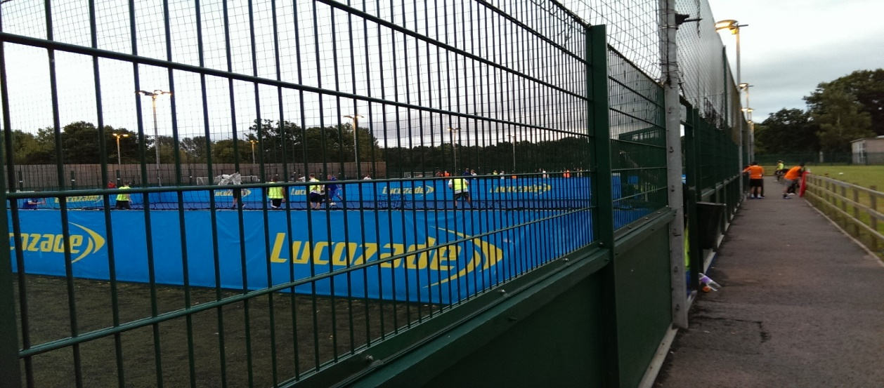
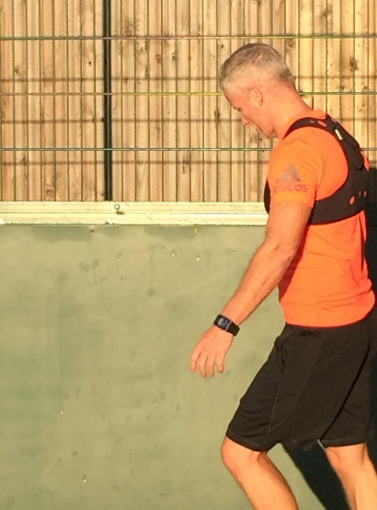
Why me? Five a side consumer
Just how good could I be
Match performances and identifies position, formation and tactics
How do I compare with my team mates?
Compare your performance against team mates, rival teams, professional player performances and sporting idols
Capture your fitness metrics
Distance; Speeds; Calories burned;

Slide 4
The Offering
All users can have their fitness or performance data captured, analysed and assessed.
The user will get his experience and appetite from the mobile phone app – where data capture frequency is 1HZ. Free entry level or micro-payments single user model;
The TEAM APP captures all the data and provides the metrics to give comparison for team activities - walking football,five a side, or group activity, say;

Slide 5
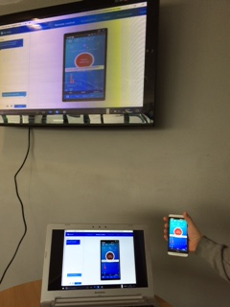
The Offering
Comparing performance – Total distance, various speed zones,
top speed, Impacts, Accels/decels,
calories burned, Gait & movement analysis,
Community Offering
Club branding
Data captured and held for all users
Corollary benefits and indirect value creation
All data is collected and held as a time series record of activity.
Multiple applications eg lottery funding, Gvt, Insurance company.

Slide 6
Background
Wearable technology is playing a growing role in sport all over the world
Data collection and transmission needs to be accompanied by analysis and interpretation
Professional players have worn GPS based devices, which collect data relating to distances, acceleration, direction, position and, crucially, the impact of collisions. These sensors collect 10’s of data points per second.
The collected data has been used in player management to rest, rotate and recover players appropriately

Slide 7
Wearable Tech in Sports
All major Football Leagues in Europe and every top club has adopted wearable technology.
Players often find that they pick up injuries due to over or under training. Wearable technology has been adopted to monitor training loads on a day-by-day basis to ensure players are not just injury-free but in peak condition for competition.
Training and match loads are specific to a player’s position and role on the pitch.
There is a vast array of technology employed to monitor professional players such as heart rate monitors to assess the responses to the demands imposed.

Slide 8
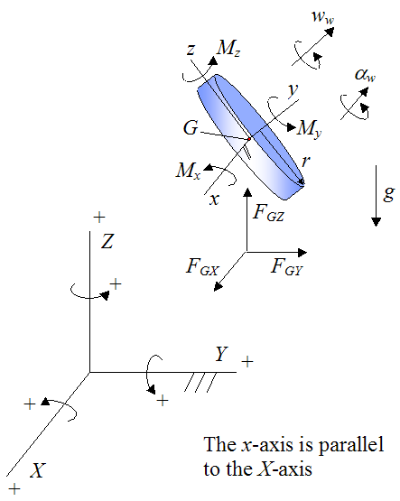
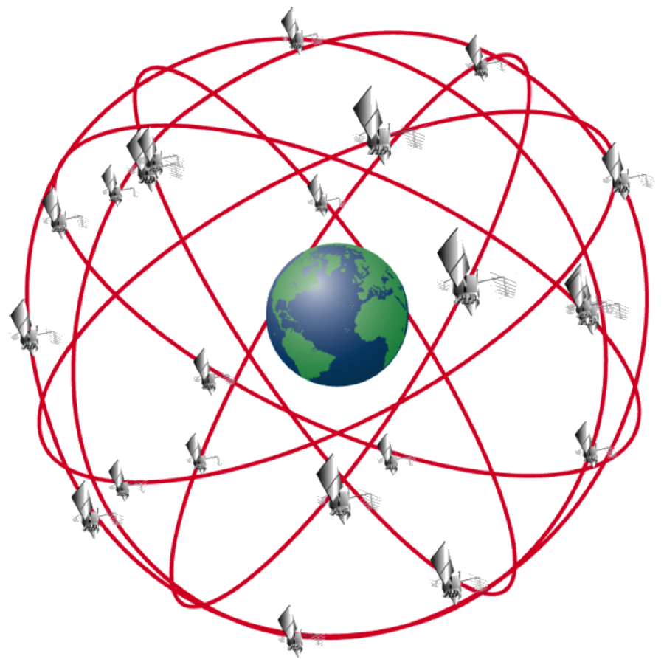
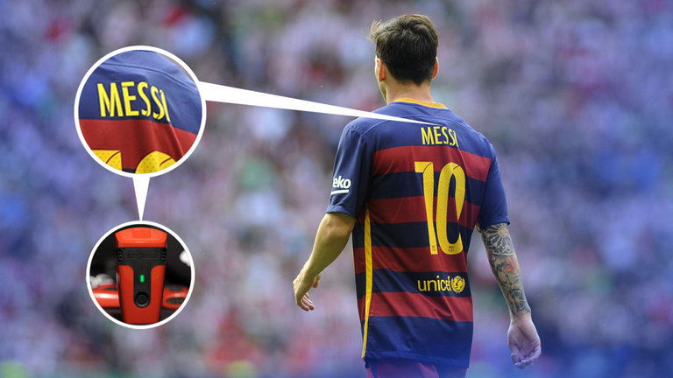
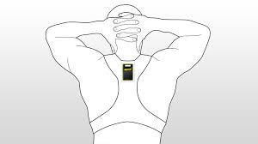
The Technology
Gyroscope
Rotational acceleration;
Roll v pitch v Yaw
GPS
Satellite based navigational technology;
Tri-axial Accelerometer
Acceleration by x, y, z axes;
Multiples of ‘g’;

Slide 9
Pilot Objectives
Test the science and technology in a five a side commercial environment
Assess and compare the accuracy of data and metrics captured across distance travelled, speed zones and calories burnt – under a range of user conditions (e.g. weather)
Assess the heat map for accuracy of representation
Assess the user experience under the normal operating/customer engagement model
Three systems pilot tested;
Sub-Elite user unit
Elite/Professional user unit
Entry level system (mobile application)

Slide 10
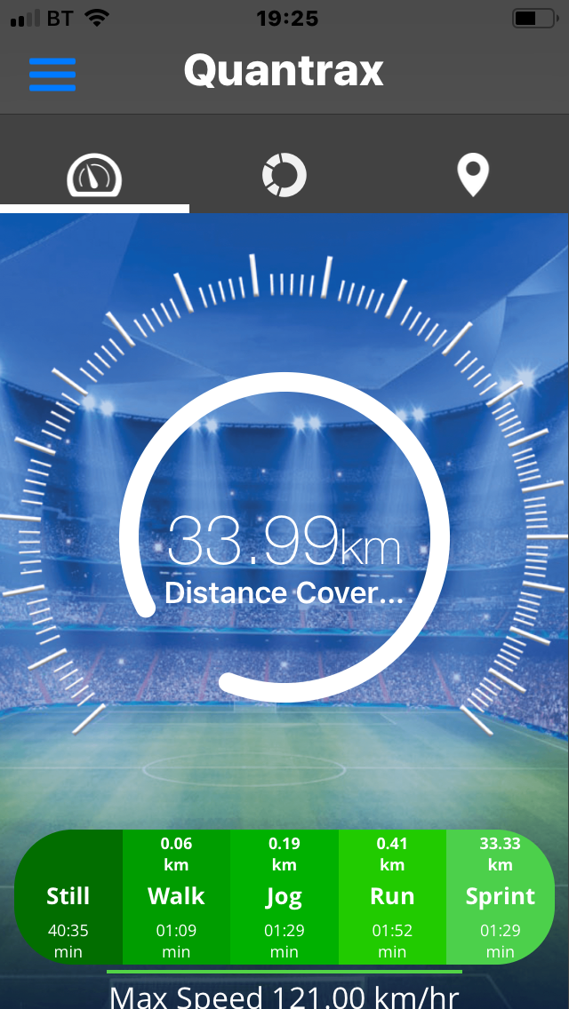
Pilot Approach
Understand, assess and map the customer experience work flows and operating procedures (from point of customer entry on site)
Develop user metrics
Testing (Leisure League, block bookings, casual users,) 150 total
Capture and record user engagement and behaviour
Capture staff and user feed back (questionnaire)
Compile results & feed back

Slide 11
Pilot Results
All three systems deployed at 5aside Leisure complex under varying weather conditions (dry, wet)
A user mix of consumer from amateur to sub- elite sportsmen, comprising of 187 pilot users
Fifteen sessions undertaken - For 8 of these sessions a mix of devices were employed, including deploying all three systems on a small number of users for the purposes of testing for noise/interference and calibration
All three systems performed; no technical limitations encountered, metrics captured and tested for variance
Technical assessment
Some drift attribution in the variance of results (satellite acquisition, satellite movement and elite v consumer user)
There is no material difference in the accuracy of results collected across the three systems. Small differences recorded across distance (2%) and max speeds (8%) - in line with tests that we have completed under strict scientific protocols and further supported with research (Marathon, 2013; Huang et al, 2015)
Accuracy reflects cost-benefit on hardware. At the consumer customer level then the difference in the metrics reported v rate of data collection (1-10 - 18 Hz) is not material (this applies to both distance and speed)

Slide 12
pilot study Results

Slide 13
Pilot Results
User experience
Mobile app > sub elite unit> elite unit
Function of operating and customer engagement model: Customers arrive on site ‘5mins before kick-off’.
Screen real estate in mobile App system provides instant results viewing and feedback
Customer engagement
The three metrics of distance run, speed zones (max speed) shown to be most popular. Building the track record of total distance run, max speeds, total calories burned
Heat map gives this the ‘Wow’ factor
Screen real estate

Slide 14
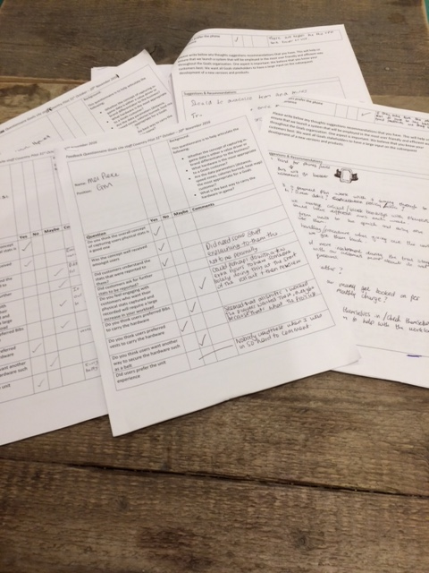
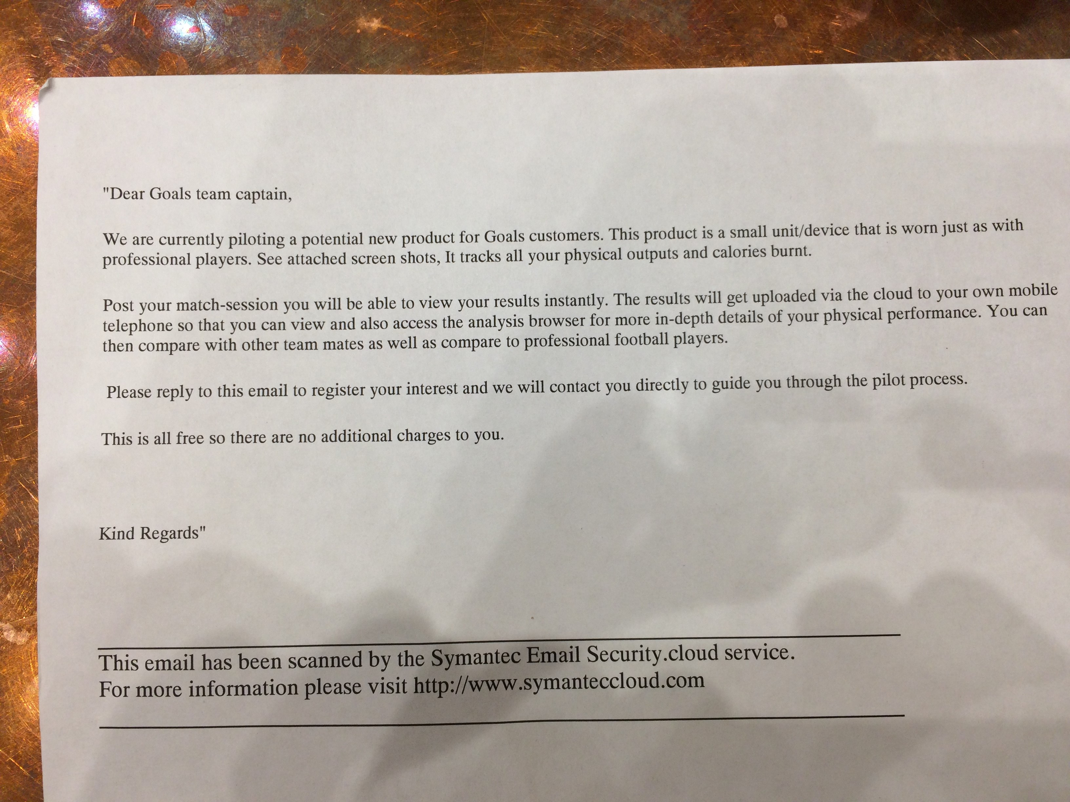
Pilot Results
Customer/user feedback
“Want what the Pros’ use” (statistics, vest)
Speed of access to results post session
Choice – to have the option of mobile app or unit
Staff feedback
Positive uptake of technology by customers
Vests > bibs
NOP and staff insight & understanding

Slide 15
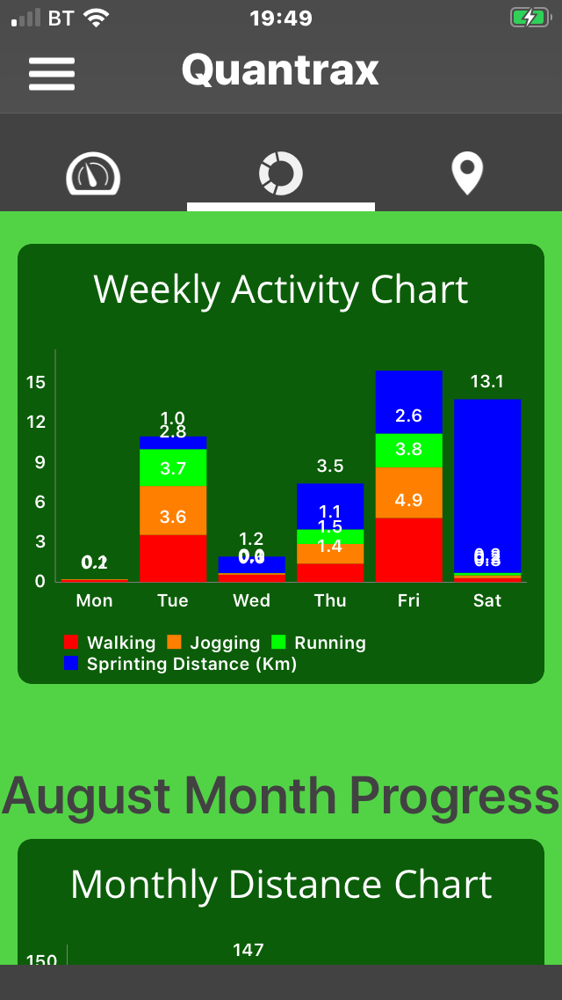
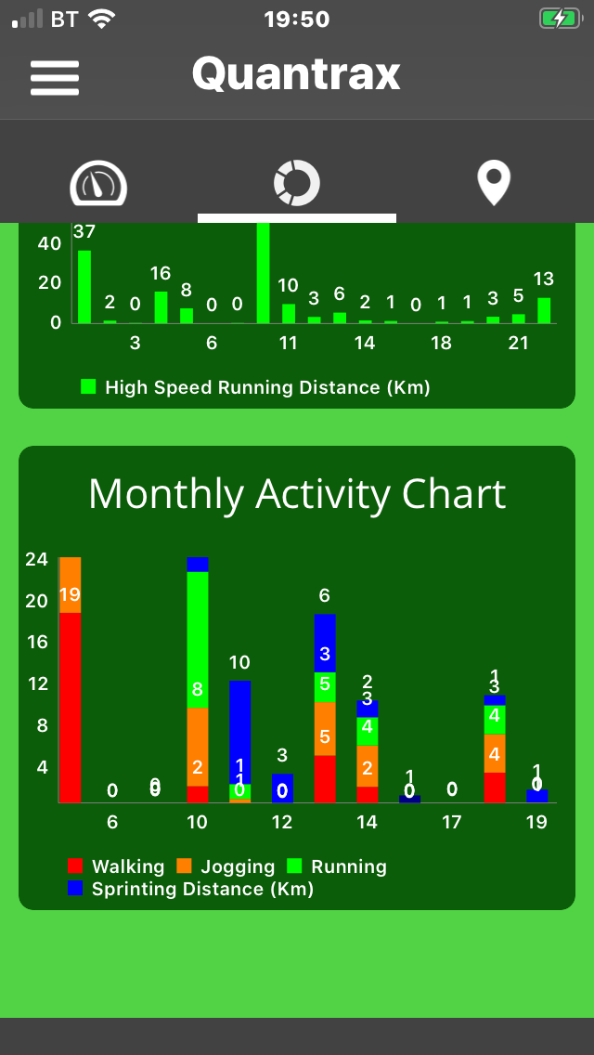
The Metrics Explained
Energy expenditure calculation example
Energy expenditure for the goals program is derived from the below table. The algorithm deployed is Energy = BL x Mets X body mass (kg) X time (m) = Kcal Based on an 80 kg person 60 mins exercise
Activity | Mets | Time | Total
Standing | 2 | 5 | 14
Walking | 5 | 15 | 105
Jogging | 9 | 20 | 252
Running | 13 | 15 | 273
Sprinting | 17 | 5 | 119
Total |  |  | 763 kcal

Slide 16
The Metrics Explained
Standardised speed zones have been determined following an extensive desk top evaluation of all research studies which investigated the physical characteristics of amateur and recreational athletic and non-athletic populations. This then was further filtered to highlight those who participated in small sided games football. In total 36 scientific peer reviewed journals were employed in determining the speed zones set, including one referenced in Goals literature (Kustrup, 2009) which has been further updated to a more extensive study (2015).
Walking (1.3 -6 km/hr)
Jogging (6.1-10 km/hr)
Running (10.1-15.5km/hr)
Sprinting (15.6 km/hr+)
It can also be observed that we have excluded data collected <1.3km/hr as this is standardised GPS Drift (accounted for in all GPS data collection of this kind).

Slide 17
Hardware How does it compare
 | Functional Requirement
Hardware | Tri-Axis Accelerometer
 | Tri-Axis Gyroscope
 | GPS | 15Hz | 10Hz | 1Hz
 | Accelerometer | 14G | 10G | 2G
 | Weight | 55g | 50g | 70-110g
Elite unit trial unit mobile app
G
G
G
G
G
G

Slide 18
What the application will track following information through Dashboard:
Daily New Users
Daily Active Users
Daily Activity Session
DAU/MAU Ratio:
Retention:
Crash-Free Sessions:
Custom Insights:
Key Performance Indicators

Slide 19
Daily New Users: The number of new app installations across all devices on a given day.
Key Performance Indicators

Slide 20
Daily Active Users: The number of users actively using application across all devices on a given day.
Daily Activity Session: A measure of how long the typical daily active user is active in the app on a specific day.

Slide 21
Retention of New Users: The percentage of unique users that were daily active users on a specific day, 1, 7, or 30, post-installation. For example, D7 is the percentage of unique users that used the app on the 7th day after the install.
Key Performance Indicators

Slide 22
Custom Insights: The application can be embedded to track custom insights that the management is looking for focussing upon any particular activity / screen within the application or installs by geo-location or metrics related to application monetisation.
Key Performance Indicators

