Slide 1
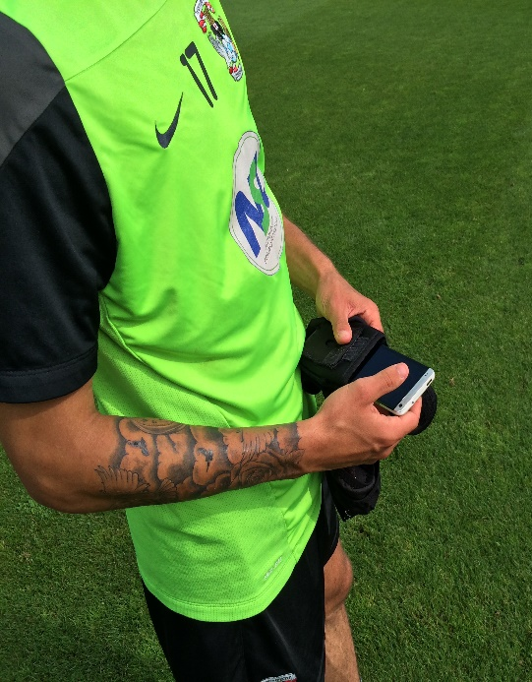
Single User The screen flows mobile app
This document shows the flow –of the screens for the APP as a proof of concept using the sensors on the phone prior to Electronics….

Slide 2
Screen Index for Single user free APP
Screen 1: APP: SINGLE USER - ??? branded page
Screen 2: APP: SINGLE USER Sign-up or Log-in
Screen 3: APP: SINGLE USER Sign-up or Log-in
Screen 4: APP: SINGLE USER Welcome page
Screen 5: APP: SINGLE USER Capture Session Data
Screen 6: APP SINGLE USER Capture Session Data
Screen 7: APP SINGLE USER Upload Session Data
Screen 8: APP SINGLE USER Session Summary dashboard
Screen 9: APP SINGLE USER Session Summary scroll down for day, week, month,
Screen 10: APP SINGLE USER annual summary whole year charts
Screen 11: APP: SINGLE USER Heat map (android and IOS)
Screen 12: APP: SINGLE USER Rankings (feature to be discussed as may be educational or performance)

Slide 3
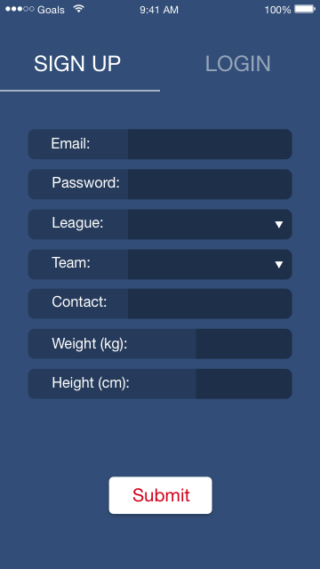
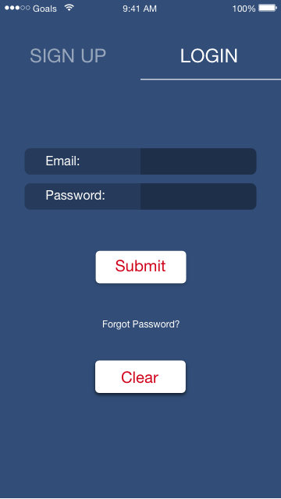
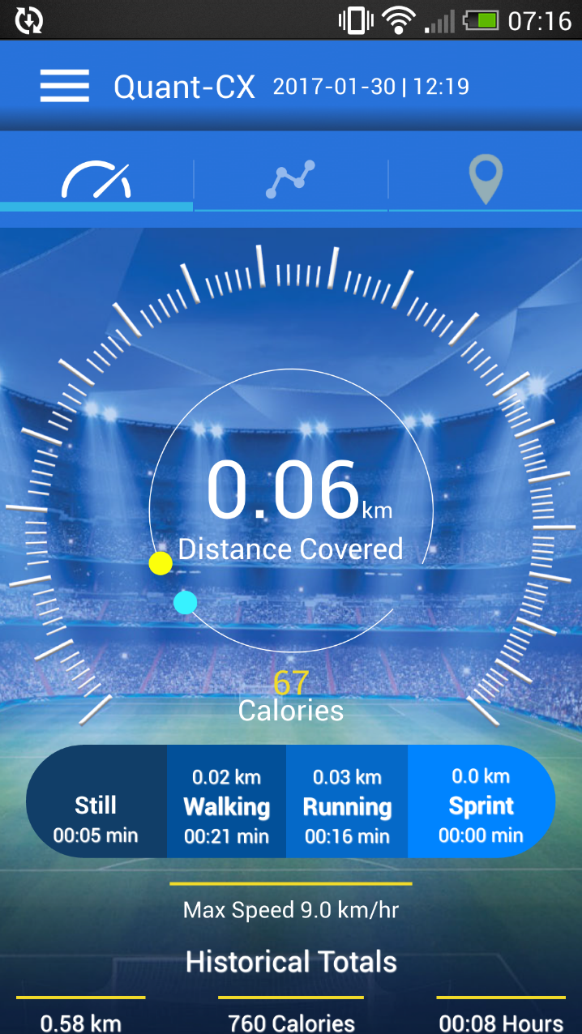
1
2
Need to insert jog as metric between walking and running these to now read
Walk,jog,run,sprint
3
4
Branding screen this is how the app label will look on smartphone (Quant)
Sign up details can be adjusted maybe just email password league or club, team, age
Based on age then the metrics zones apply

Slide 4
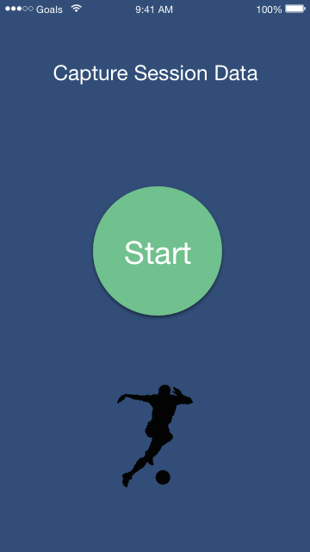
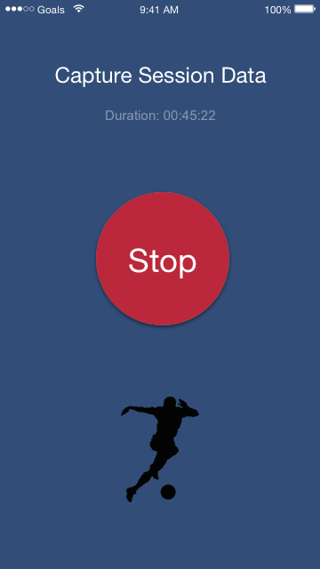
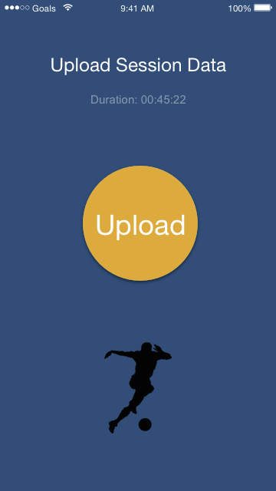
Background picture and palette colour to be discussed
5
6
7
as powered by

Slide 5
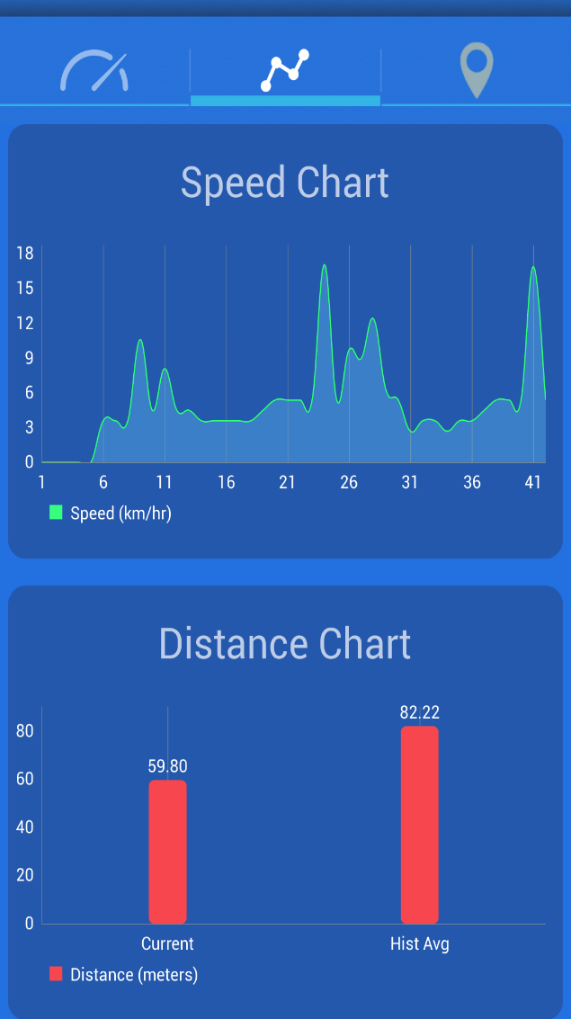
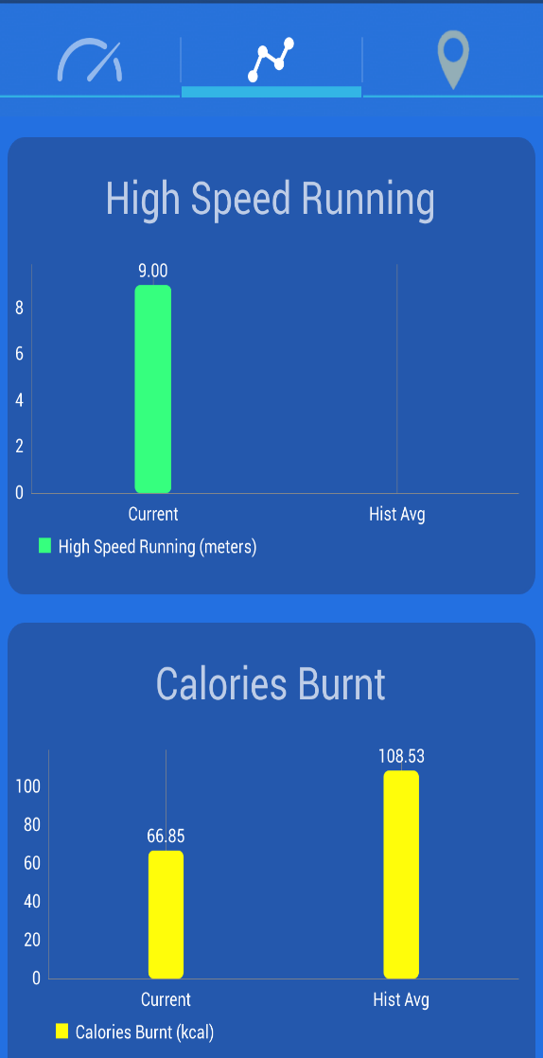
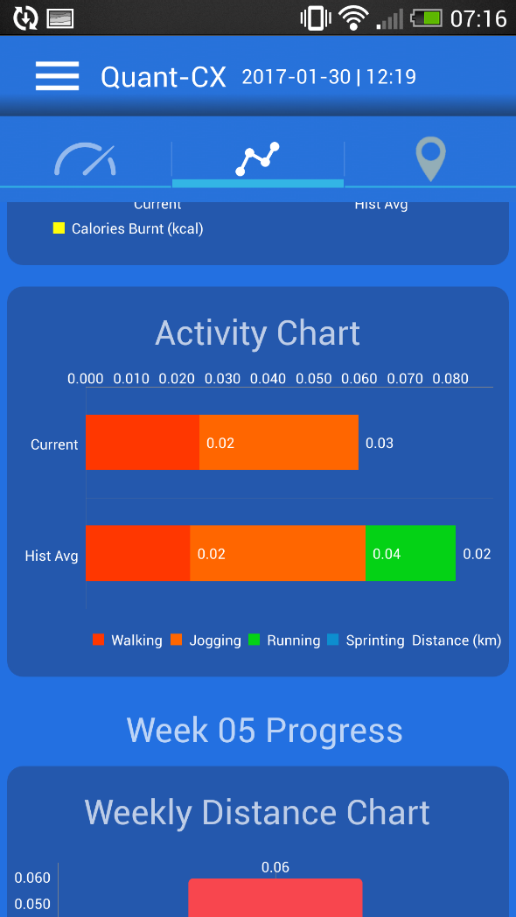
8
9
9
9

Slide 6
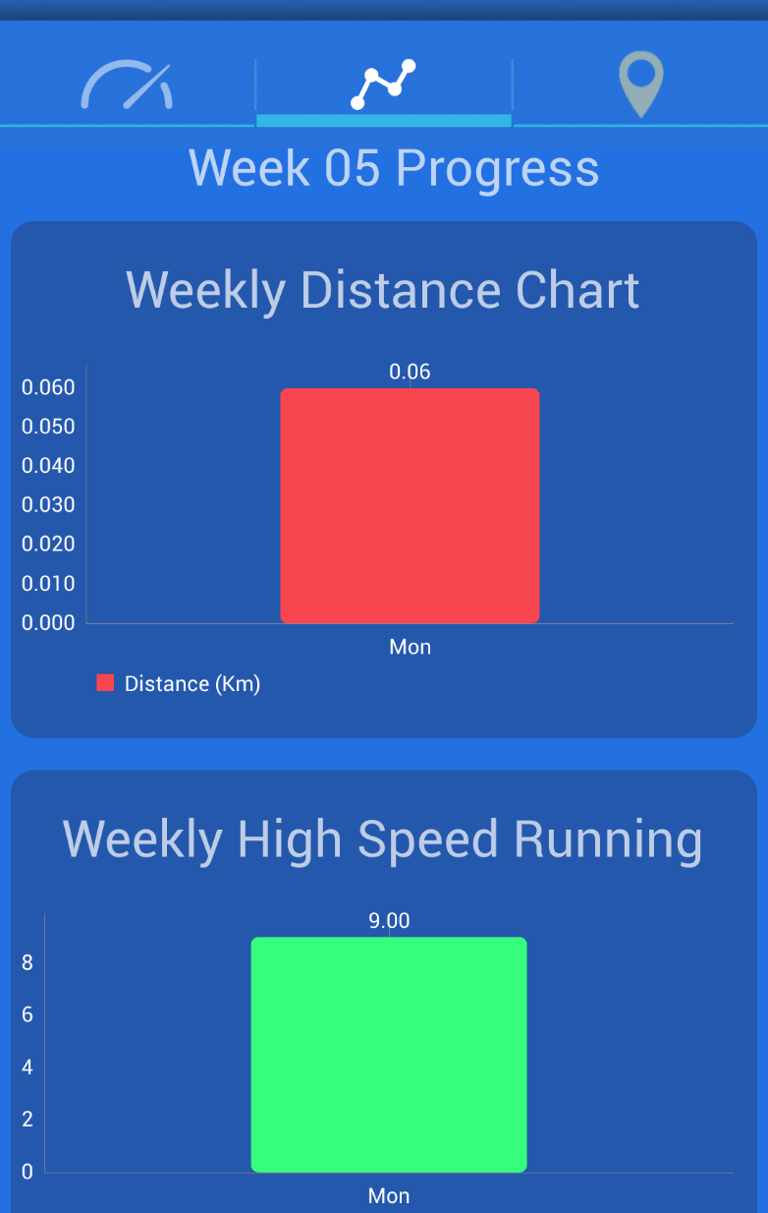
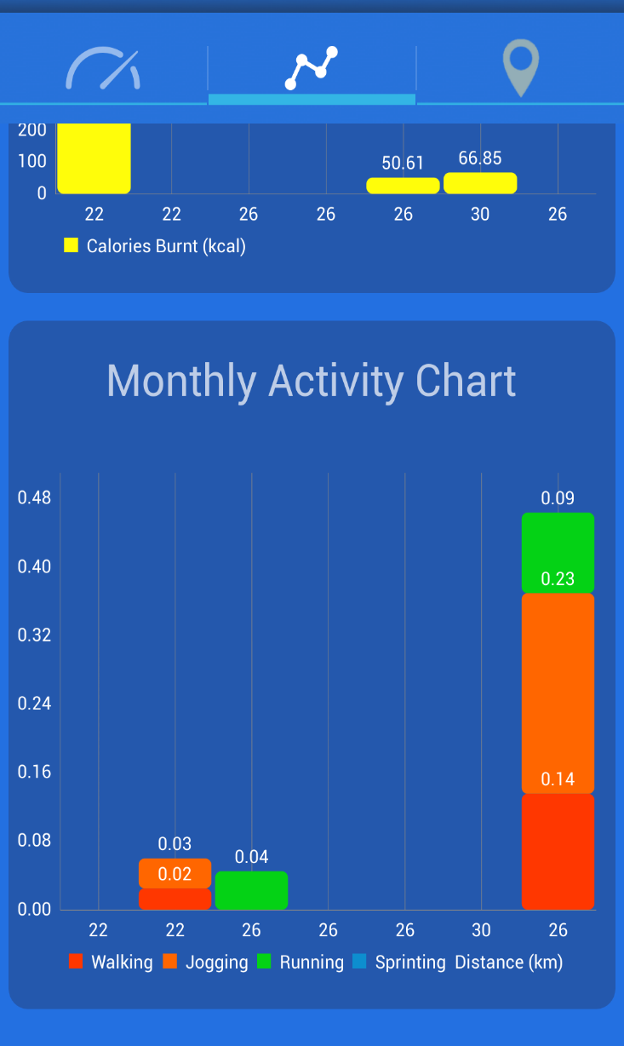
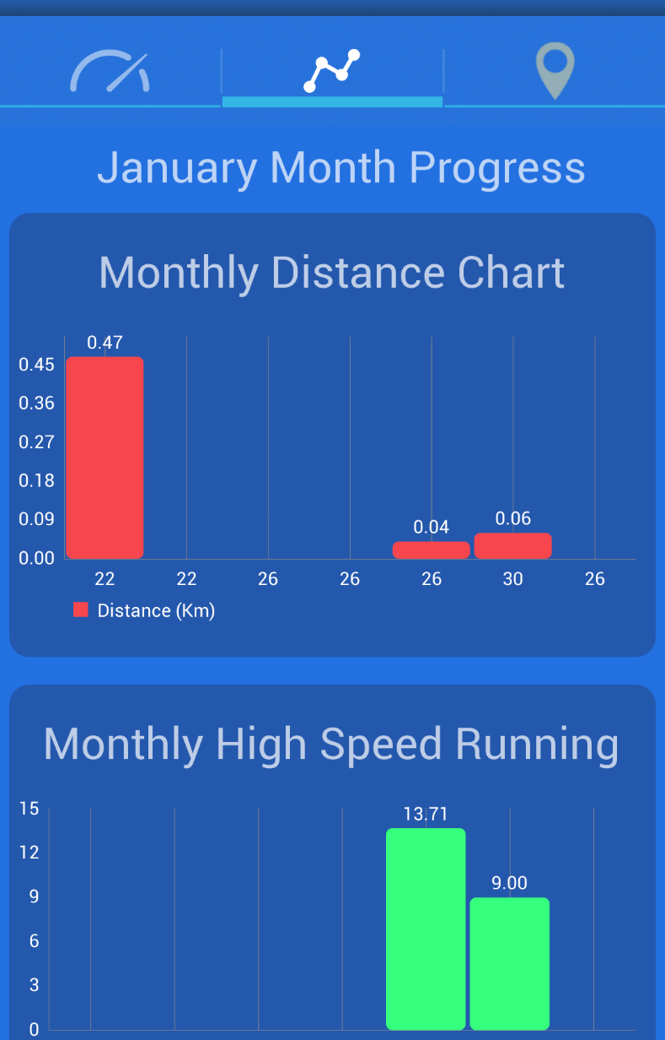
9
9
9

Slide 7
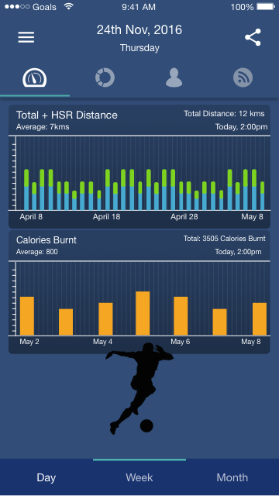
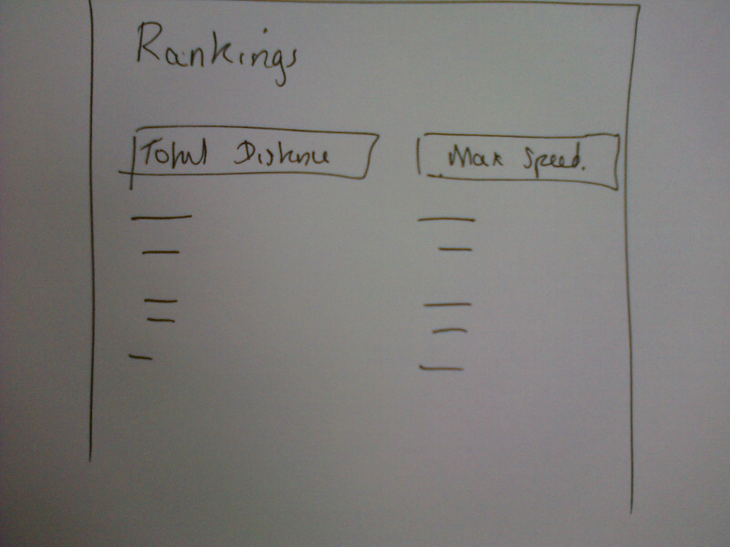
10
11
12

