Slide 1
IOS App trouble shooting guide

Slide 2
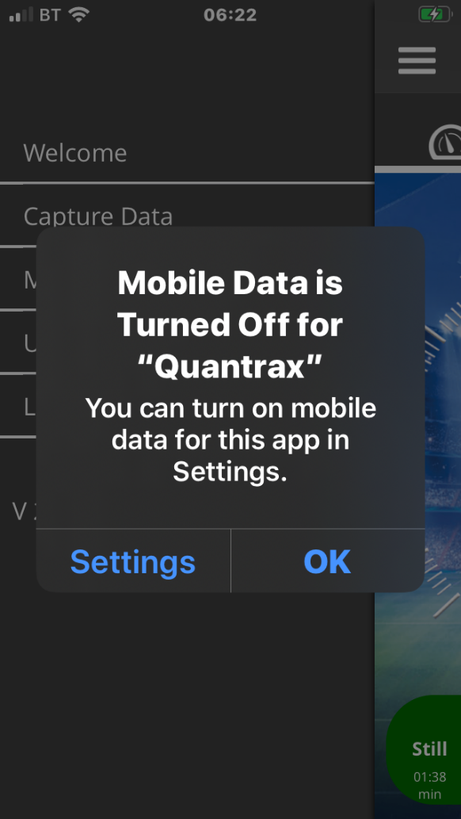
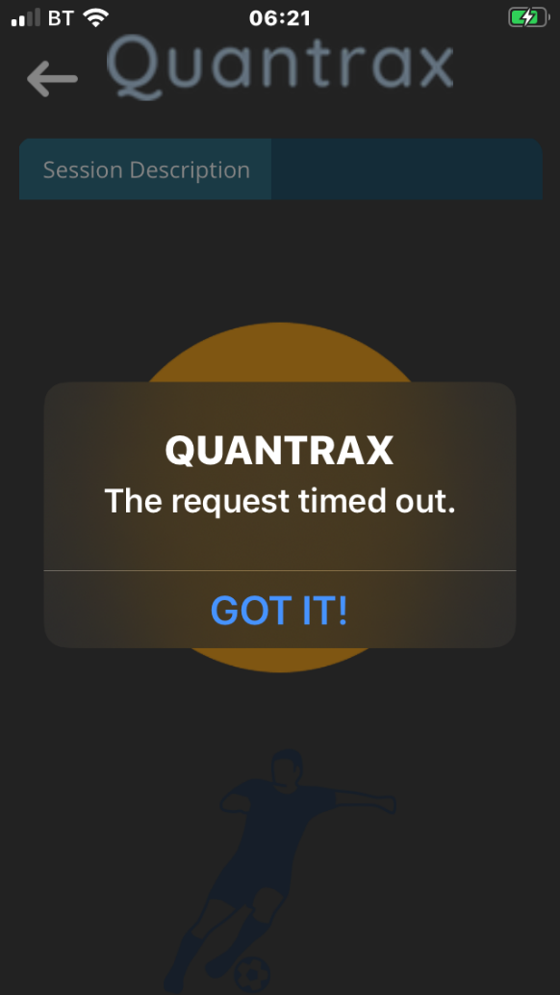
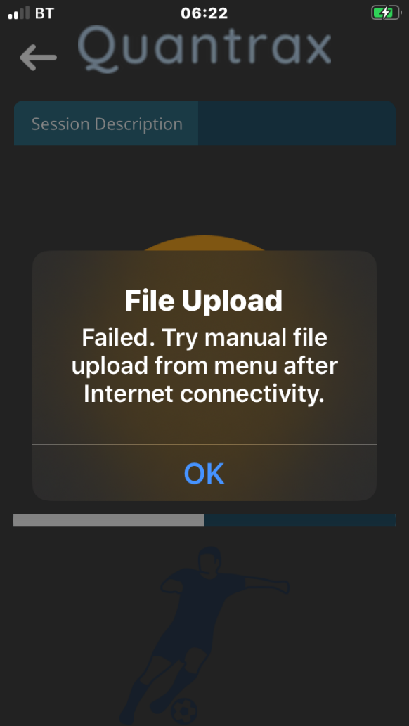
If your session fails to upload and you see one of these messages then please go to the trouble shooting guide at the end of this document
Or if after a few minutes your screen is still stuck on this page and you have not received a report, then go to trouble shooting guide

Slide 3
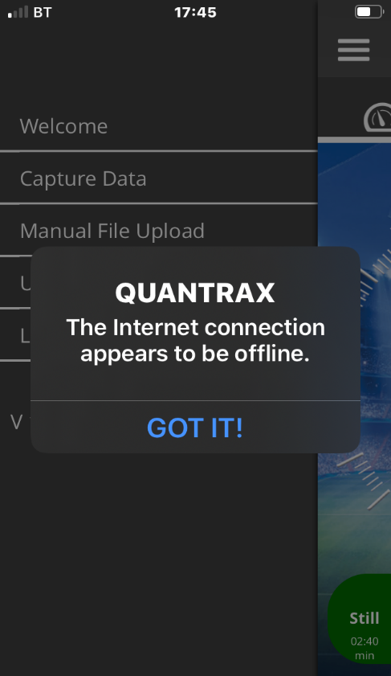
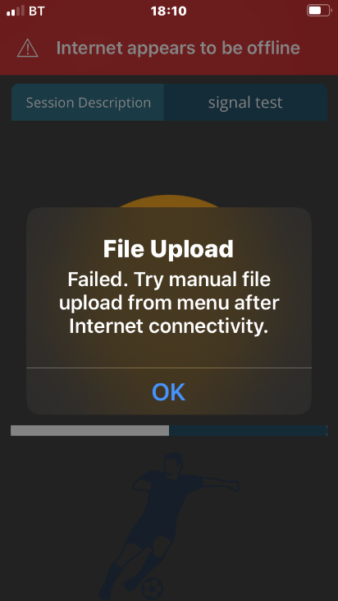
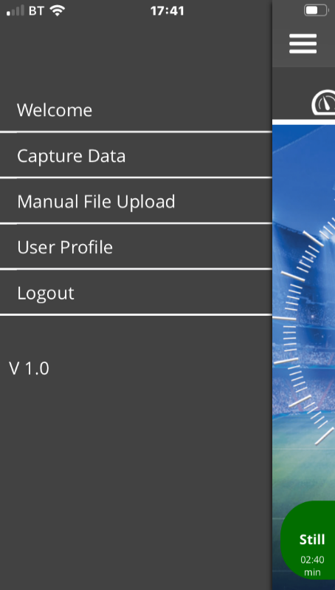
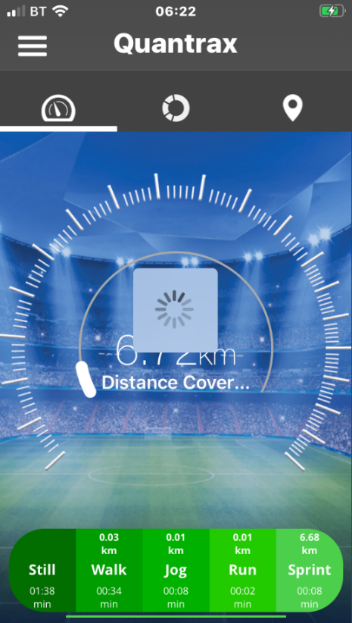
Trouble shooting with IOS. 1.
Problem
After several minutes you are still seeing this page
If this message appears then go to settings and ensure you are online
Go to home screen and press tab Manual file upload
This indicates that upload is being done Once completed you will get a report
If this message appears then follow on screen instructions
Solution
Kill application, Turn GPS unit on and if after 30 seconds the LED displays solid amber then repeat the download process, if nothing happens then follow 2 of trouble shooting guide

Slide 4
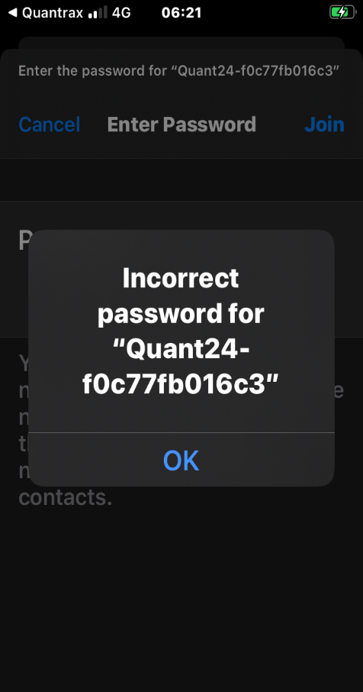
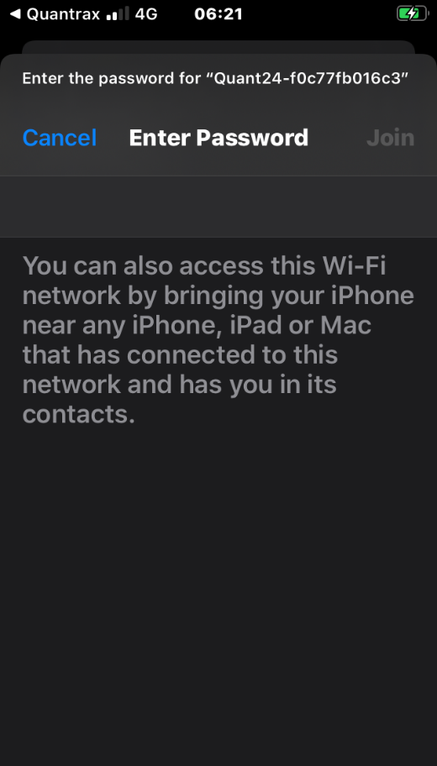
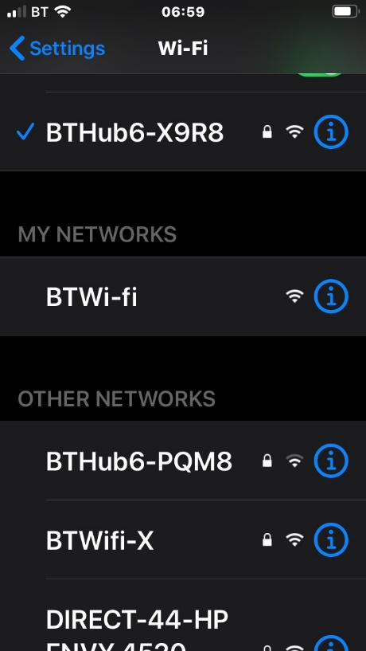
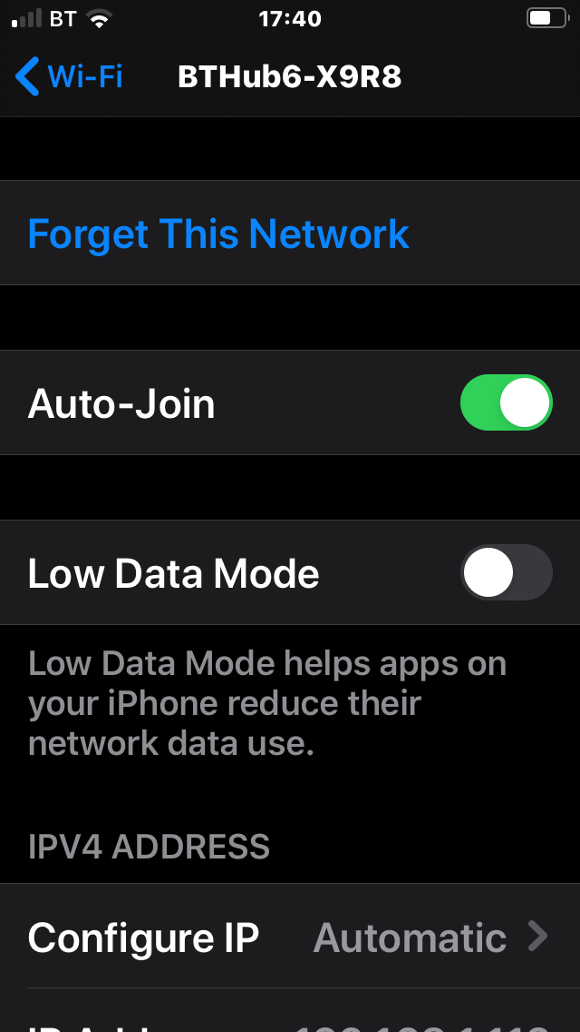
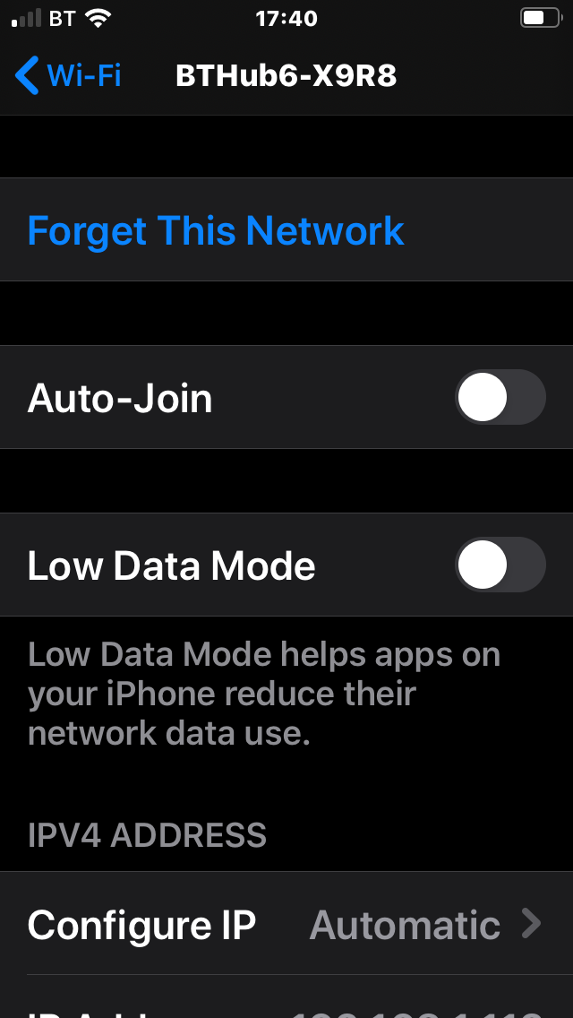
Trouble shooting with IOS. 2.
If you are in an area that has a wifi that you regularly use. Then your Phone can sometimes attempt to automatically connect to that, while downloading from your gps unit. Causing no download.
To prevent this from happening then go to settings and turn off the auto join of your regular wifi
If this is the first time use, you may be asked for a password. The default password for your unit is: 12345678

Slide 5
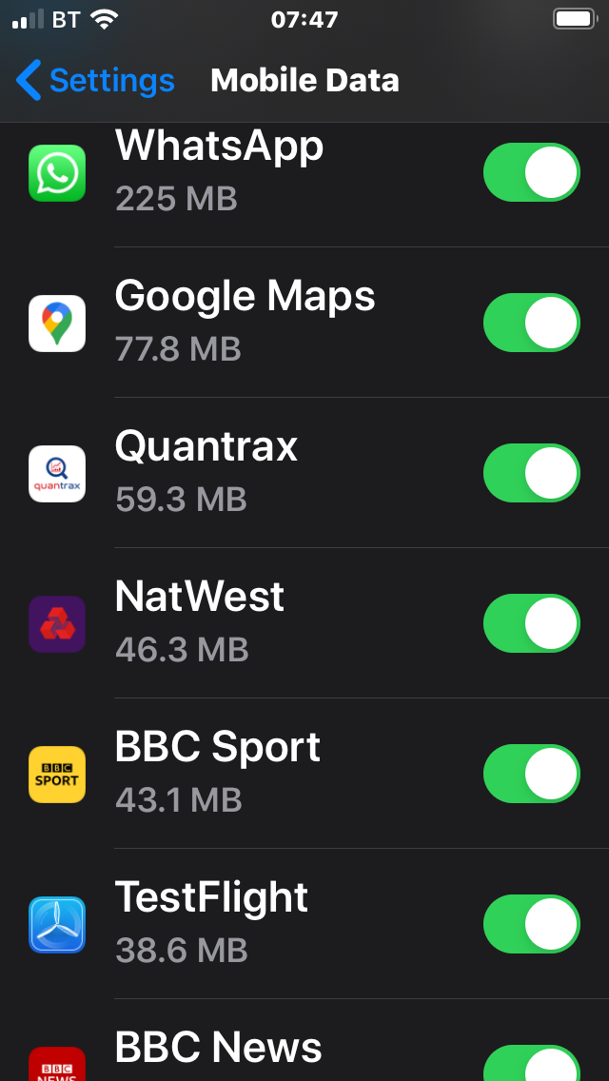
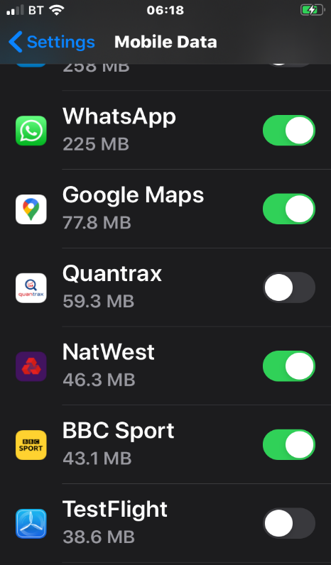
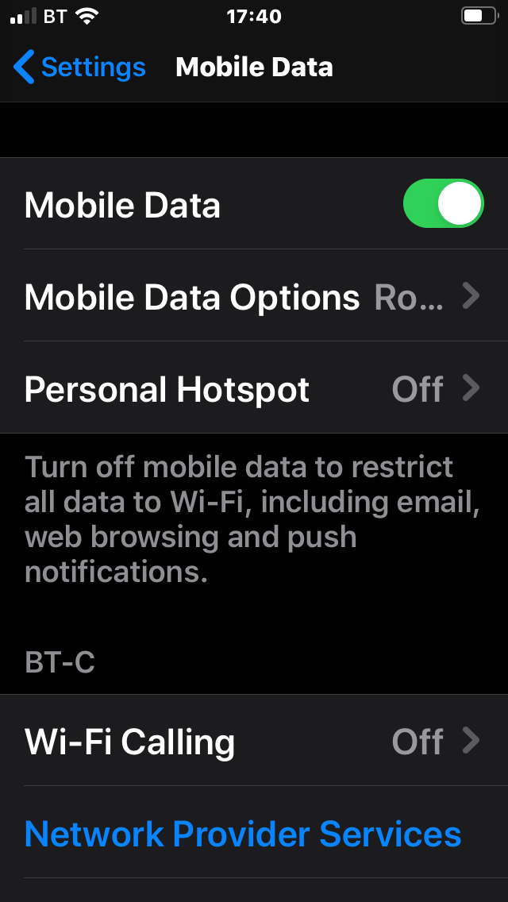
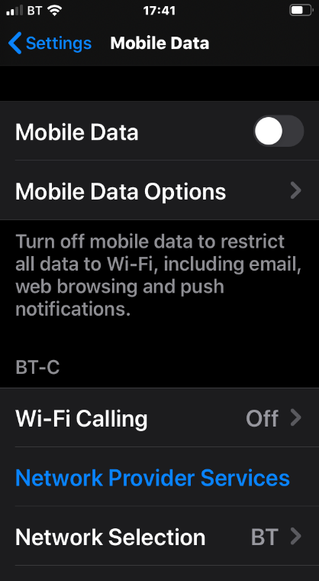
Trouble shooting with IOS. 3.
Slide tab to turn ON
If this screen appears then follow the on screen instructions
Make sure that you Allow access
Slide tab to turn ON
Mobile data is switched off

Slide 6
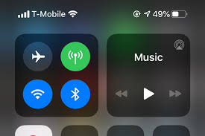
Trouble shooting with IOS. 4.
Power icon
WIFI icon
For more help here are our contact details
T: +44 (0) 2476993088
Email: contact@quantrax.co.uk support@quantrax.co.uk
Or write to us at
Unit 1a Sole End Business Park, Astley Lane, Nuneaton, CV12 0NE
UK
Please ensure you have sufficient battery life on your mobile. Whilst the App is using very little power, it does use the wifi signal
In some cases low power can disrupt wifi connectivity

