Slide 1
An Investigation into the use of wearable technology in Football in Further Education (FE) settings in England
The research outline
Why the research is needed
Football
Education
What is wearable technology
Its use in football
The changing landscape
detail of the studies

Slide 2
Aims
The primary aims of the Research is to examine the current use of wearable technology in football related fe and he settings, in order to design and develop a wearable technology product that can be applied in a football specific FE and HE environment.
Outcomes
scope the landscape
Inform the design and develop a wearable technology product and develop strategies to improve effectiveness of use of wearable technology in football related FE settings.
To propose, construct and disseminate an effective model in the use of wearable technology in football FE settings

Slide 3
Why is the research needed?
Review of literature on use in football and in Education
Football
Rapidly expanding
Performance
Support staff growing
Knowledge surrounding is limited
GDPR & Brexit
Elite and consumer
Education
Knowledge surrounding use
Ability to adapt to fast-paced changing
Disjoint between departments, fe, he and industry
Lack of research
Qualifications revamped now include technology components
Blended learning styles, teacher buy in
Accessibility
Education pedagogy

Slide 4
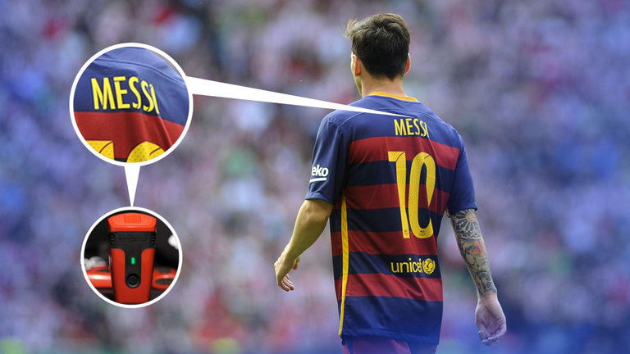
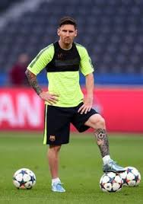
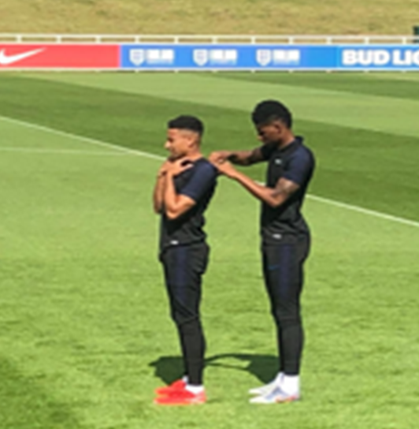
What is it in football
permitted devices in a purpose built garment/pocket that conforms to FIFA regulations, termed:
Elite Performance Tracking Systems (EPTS)
has become the norm in Professional game
2000s started to see on training ground in premiership clubs 2 most popular being heart rate & GPS type systems
2016 allowed in match play
98% of all pro clubs in England use in training and match play

Slide 5
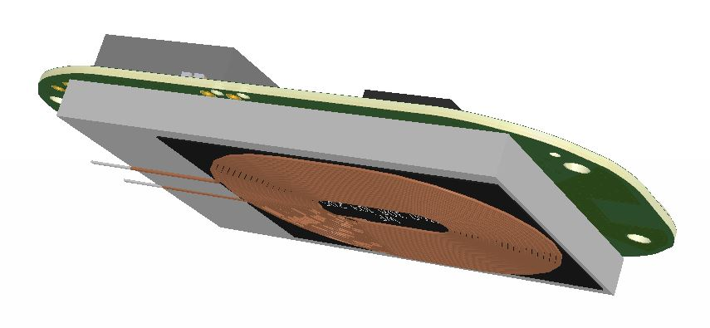
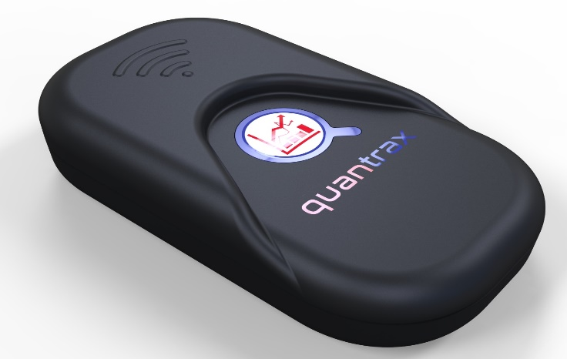
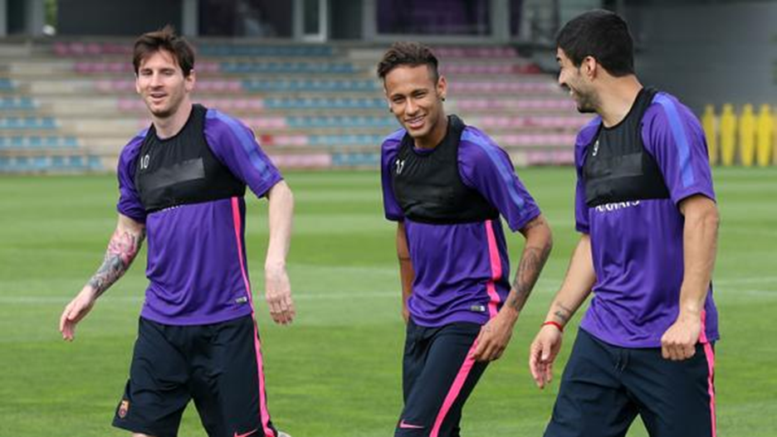
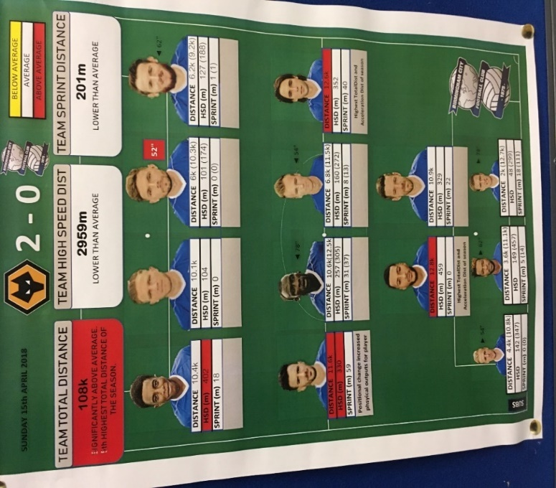
use in football Performance
Notes:
Wireless charger

Slide 6
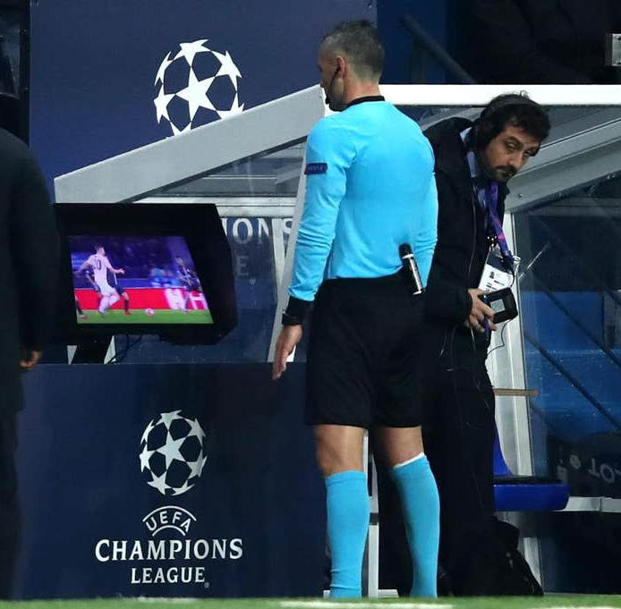
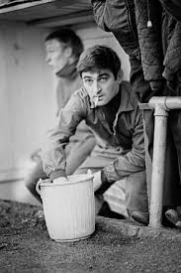
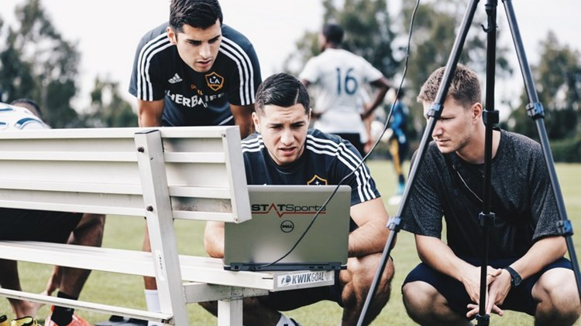
The changing landscape Football
~2012 Sport science
Now Video Assisted Referee
<1996 the magic sponge
Only 0.001% that participate in football play at an elite level (full time professional)
The ever growing team of technology related support staff
contribute to increased performance and reducing risk of injury (loss due to injury cost clubs est £41MM England premier league 2019)
Qualified sport science graduates, Benefits society and the public purse £7.8 billion annually est
Notes:
From 1880s to 1996 a stalwart at the side of the pitch the “Trainer” Since then qualified physiotherapist HPC registered
Recent unpublished data estimates that cost from injury across all football in the UK approximately ~£100MM per year

Slide 7
Assessment plans will identify one of four approaches to external quality assurance: • Institute for Apprenticeships • Ofqual • Professional Body-led model • Employer-led model Models are emerging
The changing landscape Further Education
Apprenticeship
BTEC Sport
More individualised approach to learning
Examples of end-point assessment methods
4 brand new suites of BTEC Level 3 Nationals
Reformed qualification after 10 years
Internally assessed
Industry specific and attract UCAS points
2 year project
Observation
Portfolio of evidence
Reflective journal
Apprentice showcase
Developed in collaboration with NGBs and Industry
mapped to industry standards, allowing for direct access to employment in some instances
Sport, Fitness and Personal Training
Sports Coaching and Development
Sport and Outdoor Activities
Sporting Excellence and Performance
To better equip students to be able to either advance to higher education or direct employment
Notes:
Apprenticeships set to grow further over next 3-5 years, finances with the shift of HE student loans

Slide 8
Studies
1.Identify the extent, type and approach to the use of wearable technology in football related education programmes in fe and he settings. Online questionnaire being launched in coming weeks
2. Describe and contrast the use of wearable technology in football elite performance and fe related settings. Seeking volunteers to participate
18+ support staff inc: lecturers across curriculum that have students enrolled on related football course anytime from April this wil be for approximately 6- 9 months, series of 1-1 interviews and focus group discussions.
3. To plan and The design and development of a wearable technology product for use in sport education in FE settings in the UK.
Seeking college/fe providers to participate
this can be anytime from May onwards that will involve; observation of a delivered lecture (from researcher) on wearable technology (student presentation 45 mins)
practical session- students wear tech and perform their normal football related session (30 mins-90 mis) followed by analysis and feedback (45mins-60 mins)
this will then be followed up at a later date with an online questionnaire to request participants to feedback on their experience
This will then be followed up with a further practical session, this time students perform their own analysis and feedback on experience
4. The application of a wearable technology system for use in a Further Education (FE) football related environment
Notes:
Since presenting the studies have changed as the project has developed following from results of studies 1 Study 2 then comprised of questionnaire, survey and 1-1 interviews that then helped to forming of focus group to take forward to study 3 and 4. Study 3 involved the focus group of experts selected from the larger focus group to help to develop the hardware, software and mobile application to accommodate study 4 pilot.

Slide 9
linking in with the wider curriculum
On your table-groups of 3+ Spend 30sec and list as many subjects that you feel can benefit from and how

Slide 10
If you would like further information or to participate in any of the studies then please contact me below Peter Tierney Doctoral student Liverpool John Moores University P.J.Tierney@2019.ljmu.ac.uk Tel: +447948800069

