Slide 1
Use of Wearable Technology in football related Further and Higher educational settings in UK

Slide 2
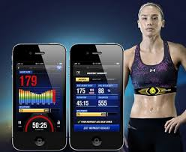
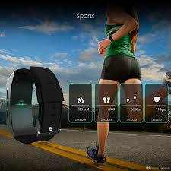
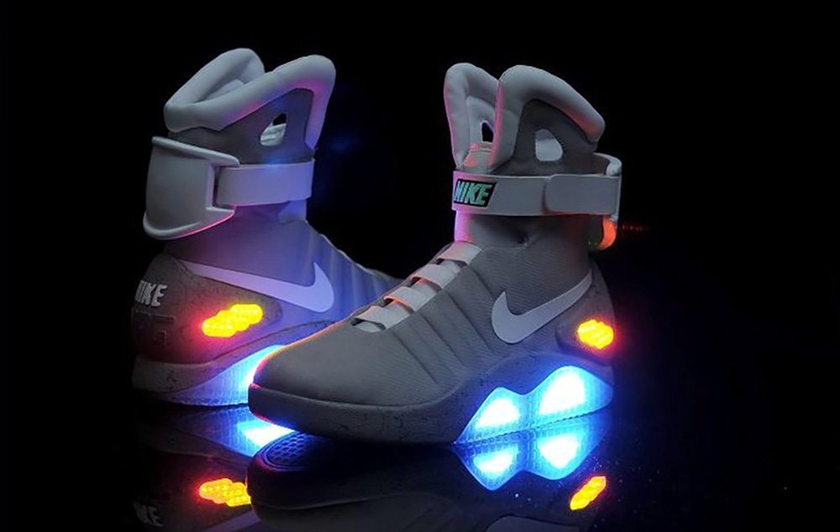
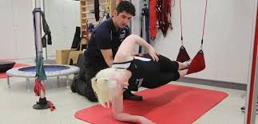
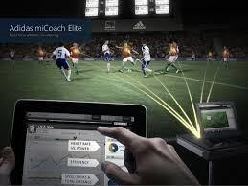
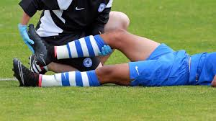
Sports industry Support in the UK
Sport & Exercise Science graduates added £3.9 billion to the economy 0.3%GDP
Estimated social and public purse benefits £7.8 billion
Around 71% are employed in directly related occupations 6 months after graduation 96% stay in UK
Every £1 student invests in SES yields £5.50 in future earnings
Estimated 15,000 SES graduates each year ill equipped to work in industry
Transferable skills
Need to put bit in here about FE and HE
Notes:
Equivalent to supporting over147,300 jobs
Football 1st team sport science support to community and occupational health
From birth to grave across the landscape
No barriers, culture, age, sex, disability, job……. Military, hospitals, sports, parks, wellness, teachers
this is added income to the uk every year including 1.3 billion tax
Approx £90 million in savings from NHS savings,
£160 million saving from unemployment and related benefits, less crime, fewer police

Slide 3
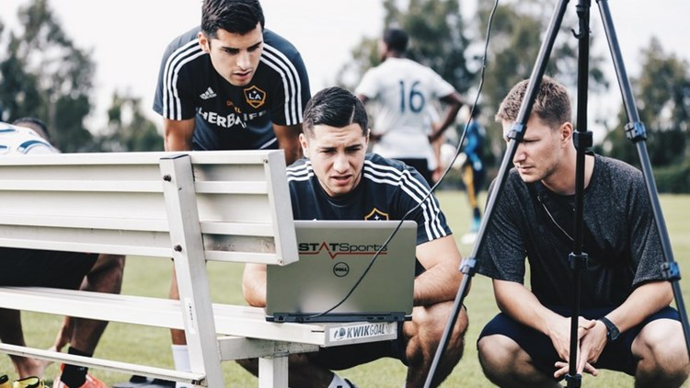
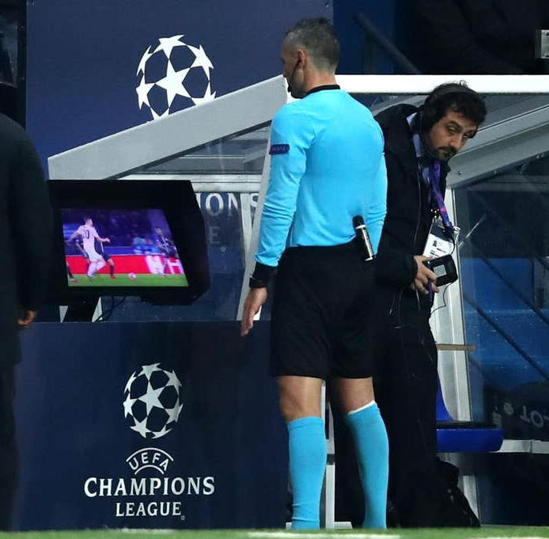
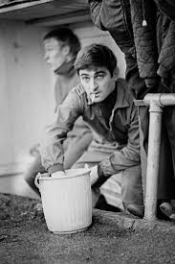
The changing Landscape
Now Video Assisted Referee
2012 Sport science
From 1880s to 1996 a stalwart at the side of the pitch the “Trainer” Since then qualified physiotherapist HPC registered
<1996 the magic sponge
EVOLUTION The most adaptive to change
sport industry is always moving and changing, making it essential for learners to have the drive and resilience to adapt.
Sport science In football contribute to increased performance and reducing risk of injury (loss due to injury cost clubs est £41MM England premier league 2019)
0.01% become professional players in the UK

Slide 4
Why is the research needed?
Further developing qualifications pathway,
Industry needs (employment),
FE & HE learning and teaching landscape changing (COVID-19, T - Levels),
Technology advances,
GDPR,
Lack of knowledge surrounding use in FE & HE settings
Research
An Investigation into the use of wearable technology in Football in Further Education (FE) settings in United Kingdom
Aims
The primary aims of the Research is to examine the current use of wearable technology in football related FE and HE settings, in order to develop a model, for the use of wearable technology in football related FE & HE environments. Studies
1. Identify the extent, type and approach to the use of wearable technology in football related education programmes in FE and he settings. 2. Describe and contrast the use of wearable technology in football elite performance and FE related settings. 3. To plan and design strategies and construct an effective model, to improve effectiveness of use of wearable technology, specifically communication and feedback mechanisms in football related FE settings. 4. To deploy and evaluate a model, in the use of wearable technology in football related FE settings. Outcomes
To Map the landscape of use in FE and HE
Construct an model for use within the FE and HE settings to enable increase in knowledge and better understanding of wearable technology uses in education and industry Thus enhance and expand student learning experience and better inform to benefit the sports and education industries

Slide 5
Assessment plans will identify one of four approaches to external quality assurance: • Institute for Apprenticeships • Ofqual • Professional Body-led model • Employer-led model Models are emerging
Main qualifications pathway in FE settings
Apprenticeship
BTEC Sport
Aim to provide an individualised
learning experience with end-point assessment
4 brand new (end of 2019) suites of BTEC Level 3 Nationals
Reformed qualification
Internally assessed
Industry specific and attract UCAS points
2 year project
Observation
Portfolio of evidence
Reflective journal
Apprentice showcase
developed in collaboration with NGBs and Industry
mapped to industry standards, allowing for direct access to employment in some instances
Sport, Fitness and Personal Training
Sports Coaching and Development
Sport and Outdoor Activities
Sporting Excellence and Performance
There are other related qualifications that offer a blended approach such as the two examples shown

Slide 6
New Apprenticeship
Sporting Excellence Professional (SEP)
Level 3 qualification
The employer should be confident that the apprentice will pass their end-point assessment
However, assessment plans may describe the gateway differently.
One size does not fit all (individualised longitudinal learning journey)
College-university-graduate employment (transferable skills cross curriculum use)
Creating a seamless transition (no big paper folders)
Optimising what they enjoy and relate to (mobile devices, technology)
Observation
Portfolio of evidence
Reflective journal
Apprentice showcase

Slide 7
New BTEC Sport qualifications
4 brand new suites of BTEC Level 3 Nationals for the sport sector:
1) Sport, Fitness and Personal Training 2) Sports Coaching and Development
3) Sport and Outdoor Activities 4) Sporting Excellence and Performance
Reformed qualification after 10 years
Are internally assessed
Help prepare learners for work but also attract UCAS points supporting progression to HE
Wearable technology complements all 4
Where can wearable technology directly fit?
Core unit & optional units examples being: Unit E the core research project, using the technology will give quantifiable data and scientifically underpin any project this being a 2 year unit on all courses. In more detail the example of Unit 6 - sporting injuries. technology allows for monitoring and highlighting imbalances, over training and undertraining,
Each suite contains different sizes - so there will be 14 qualifications in total.
Notes:
were developed in collaboration with professional bodies and key industry stakeholders
are mapped to industry standards, allowing for direct access to employment in some instances
Self employment in sport and physical activity, as per unit 1, in addition more and more is it being integrated within consumer sport and other aspects of physical activity

Slide 8
SFF Courses and pathways
NCFE- Project based learning approach
No exams, all coursework based
Closely related/aligned to BTEC
Individual within a team environment
Linking the sport to the lesson
Continuous ongoing assessment from lecturer
Specific historical pathways include
Academia with University, USA scholarship (playing and degree)
Industry direct employment, Football, Fitness, Leisure health and wellbeing, Business start ups, self employed e.g personal trainer/ lifeskills coach.

Slide 9
SFF Specific units of work in year 1
NCFE project based learning approach
Internal ongoing assessments of coursework no exams
Sports coaching module 3(5)
Preparing for a career in sport and physical activity module 2(14)
Practical team sports module 4 (8)
Training and programming module 15(7)
Assessing risk In sport (includes injuries) module 12(3)
(n) = indicates module in BTEC that is aligned to based on pre 2019 BTEC for Sports

Slide 10
SFF study August 2020 - December 2020
Observations at SFF. August-September 2020
Monitor and evaluate current working practices
1-1 interviews educators/coaches/players/support staff
pilot study October-December 2020
pre pilot assessment (understanding – staff and students)
Presentation & orientation
Deployment of wearable technology
3 week observation of individual use of WT
Evaluation

Slide 11
Supportive evidence if required to add to deck

Slide 12
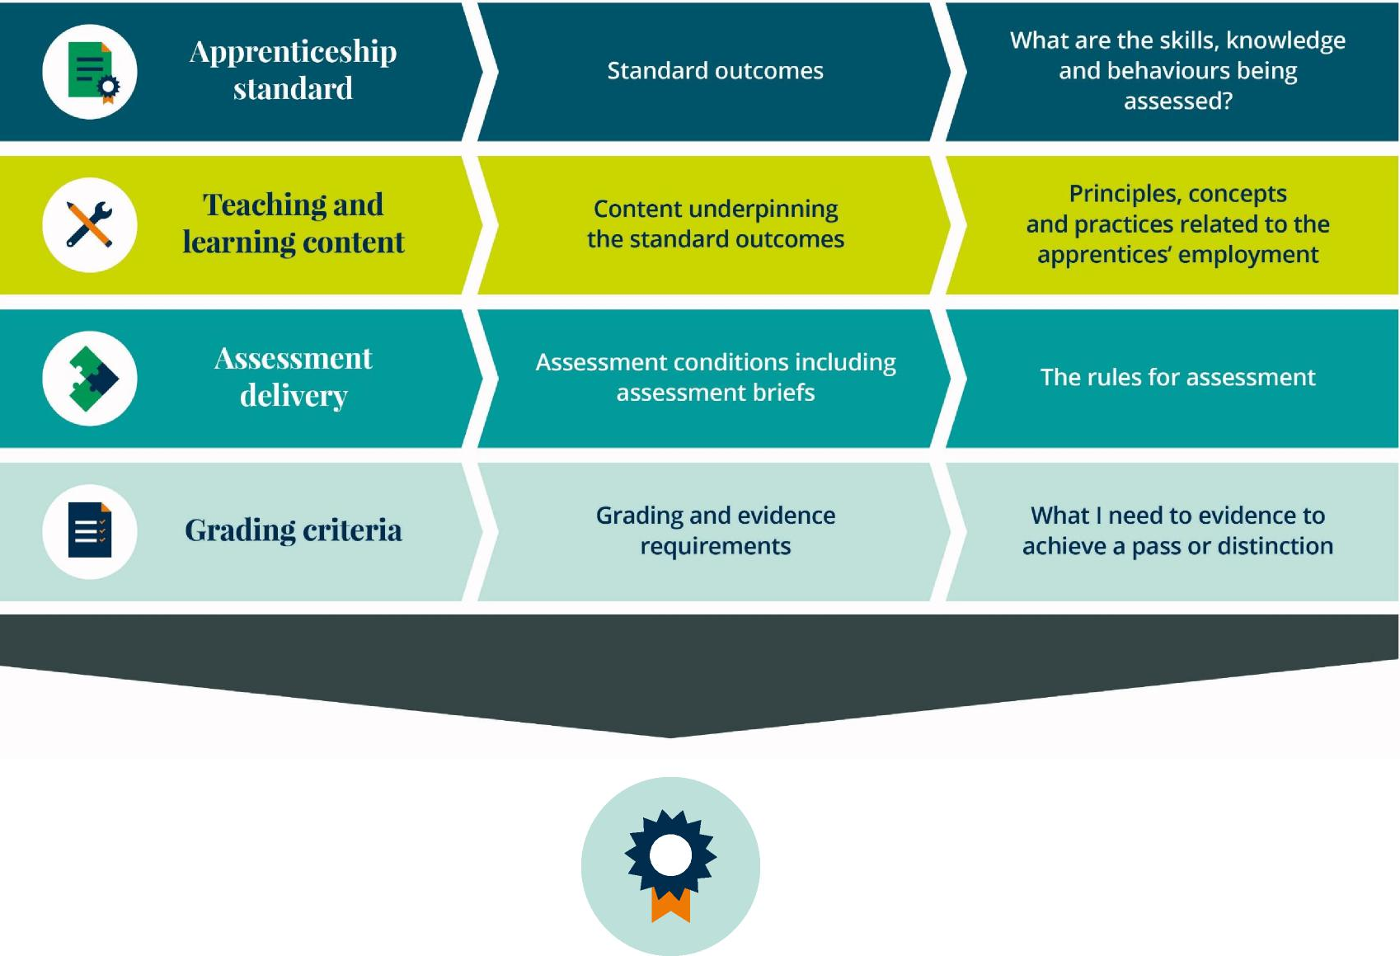
Assessment plans will identify one of four approaches to external quality assurance: • Institute for Apprenticeships • Ofqual • Professional Body-led model • Employer-led model Models are emerging
New Apprenticeship
Sporting Excellence Professional (SEP)
Level 3 qualification
More individualised approach to learning
Examples of end-point assessment methods
Observation
Portfolio of evidence
Reflective journal
Apprentice showcase

Slide 13
Sporting Excellence and Performance
Sporting Excellence and Performance 3 qualifications and pathways
BTEC Level 3 National Extended Certificate in Sporting Excellence and Performance
BTEC Level 3 National Diploma in Sporting Excellence and Performance
BTEC Level 3 National Extended Diploma in Sporting Excellence and Performance
Where does wearable technology directly fit?
Core unit
C3 professional sport performer, In football wearable technology is used commonly daily it is estimated that over 98.5% of professional players now use
E – research project, in line with (1) having exposure to wearable technology and software for analysis will enable students to quantify their project and underpin with scientific rationale.
Optional
Example 15- ethical and current issues in sport, this is an area that is new and therefore very current, added to this the use everyday with gathering all physiological and biophysical data and with advances in the technology there are ethical issues to consider and debate.

Slide 14
Sports Coaching and Development
Sports Coaching and Development 4 qualifications and pathways
BTEC Level 3 National Extended Certificate in Sports Coaching
BTEC Level 3 National Foundation Diploma in Sports Coaching and Development
BTEC Level 3 National Diploma in Sports Coaching and Development
BTEC Level 3 National Extended Diploma in Sports Coaching and Development
Where does wearable technology directly fit?
Core unit
Unit E the core research project, using the technology will give quantifiable data and scientifically underpin any project that uses Unit E is a 2 year unit on all courses Optional Unit
Example being 6 - sporting injuries technology allows for monitoring and highlighting imbalances, over training and undertraining,
Total
Unit A,B,D1,1,2,4,6,8,9,10,12,13

Slide 15
Sport development, wearable technology continues to grow at a exponential rate in the football and sport industry being the top trend for the last 3 years, this sector continues to be part of everyday life
8- fitness testing either stand alone or as in professional sport with the use of wearable technology then every training session becomes a test.
9- fitness training, by recording what doing for every session allows for periodisation of training and enables user to follow and quantify what doing
10- tech tact skills in sport, positional requirements based on formation and tactical play prior to and during in match play
12- practical sports application, something that is now the norm in all professional teams in Europe, in the UK alone all top 4 leagues every team has exposure to the technology
13-influence of technology in sport and physical activity, this is bringing cutting edge tech to the college environment
Indirectly?

