Slide 1
Viewing your data on your mobile phone

Slide 2
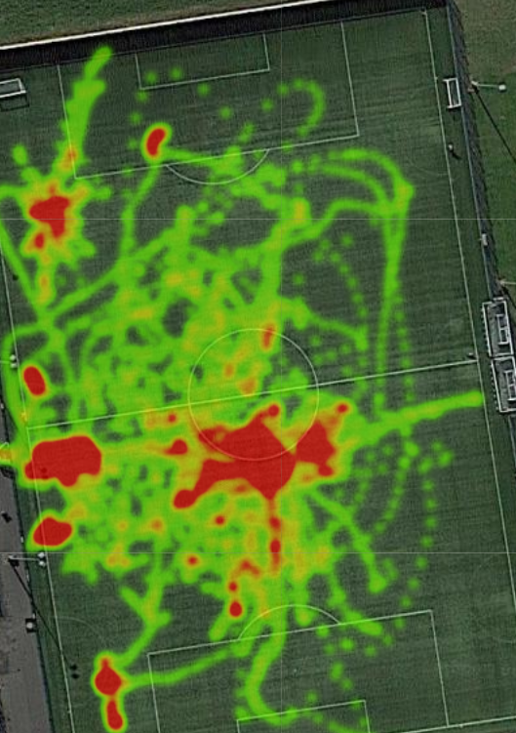
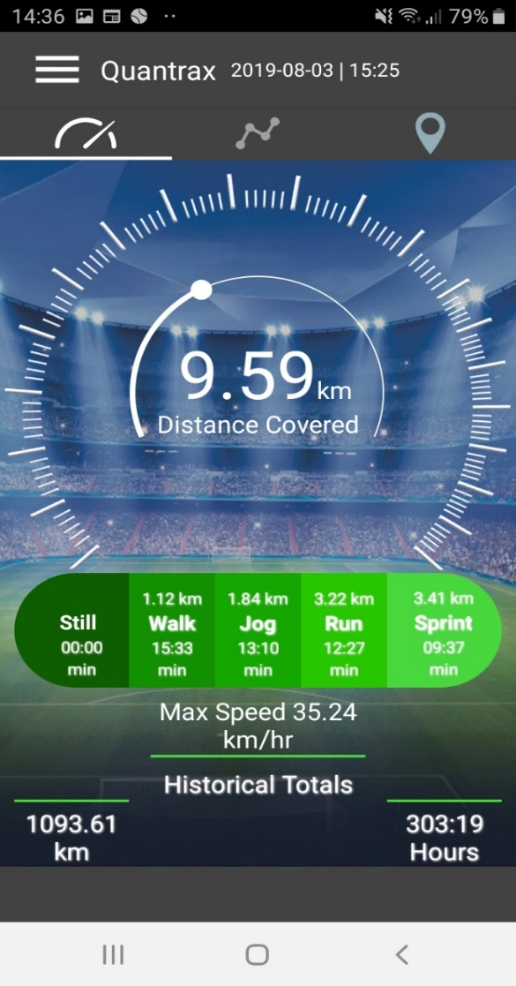
Your Quantrax home screen and the navigation tabs
Your Quantrax heat map feature
Total distance covered in your session
Home screen dashboard
Current and historical session charts
Main menu
Time spent and distance travelled in various speed zones
Current session heat map
Zoom in and out rotate for any view
Max speed
Your total cumulative to date

Slide 3
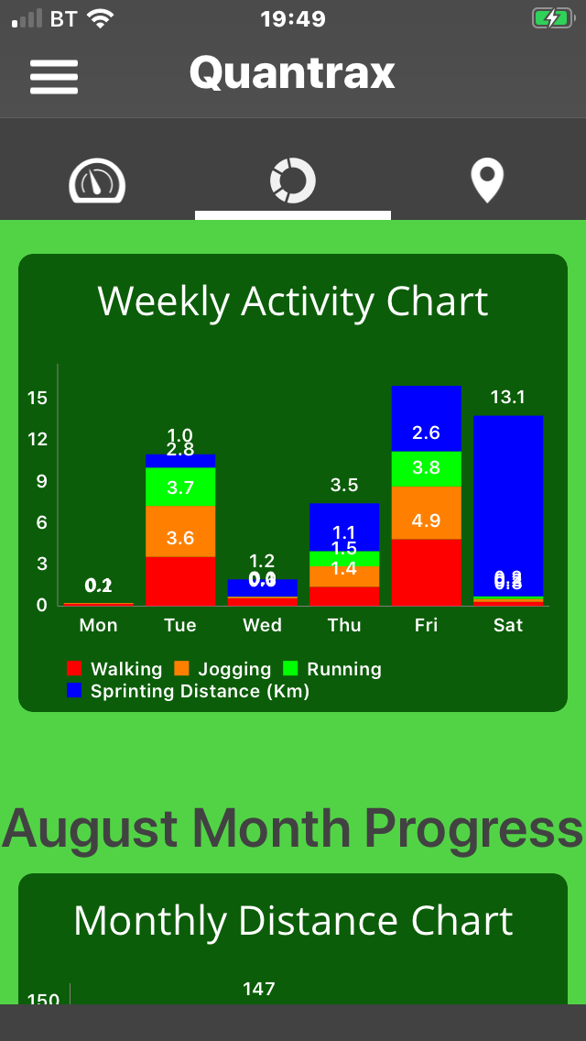
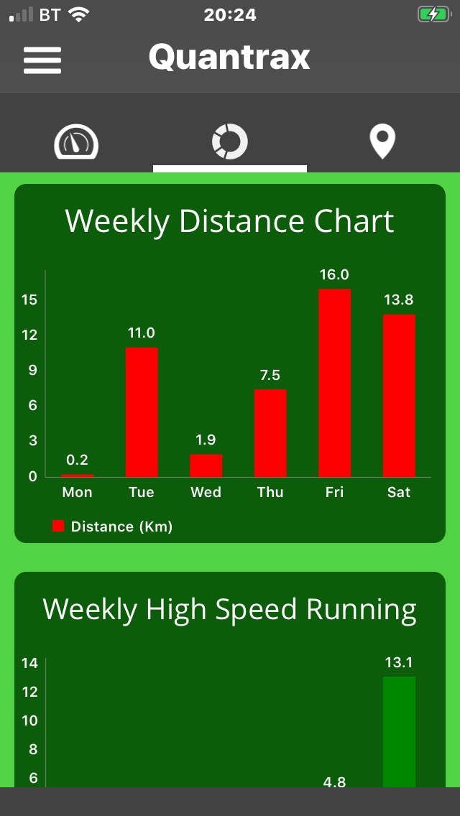
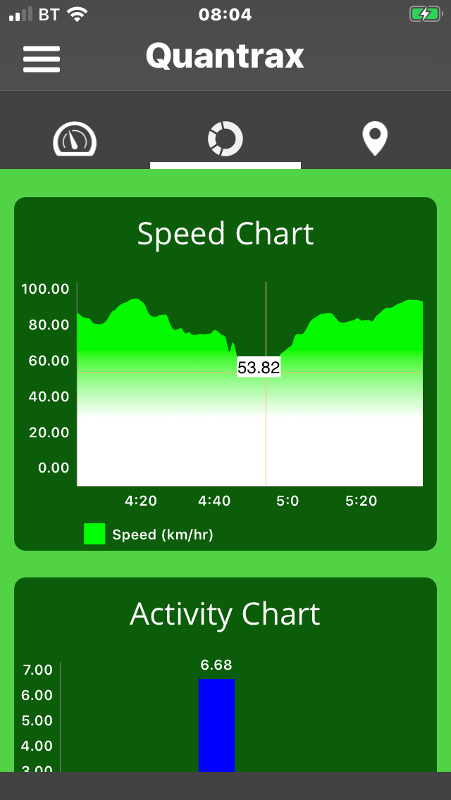
Activity Charts
Session speed chart zoom in and highlight various speeds at key points of your session
All activity for every day every session summarised here
Total distance covered and high speed running
Enabling you to monitor what you are doing throughout the week
High speed running as a key performance and potential injury marker if do too much or too little

Slide 4
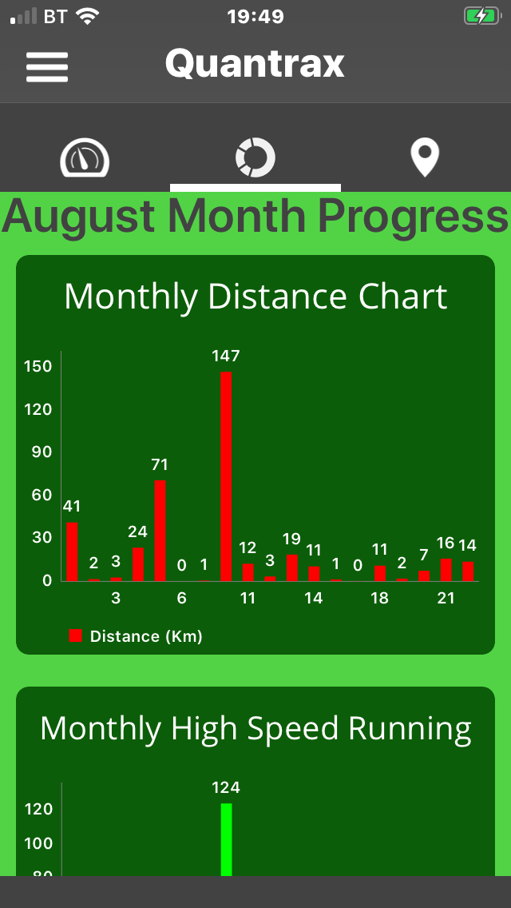
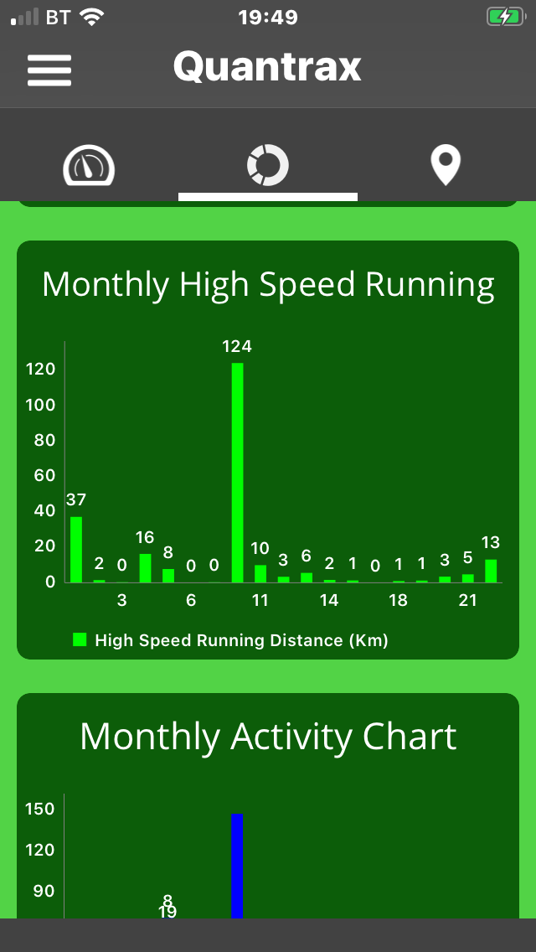
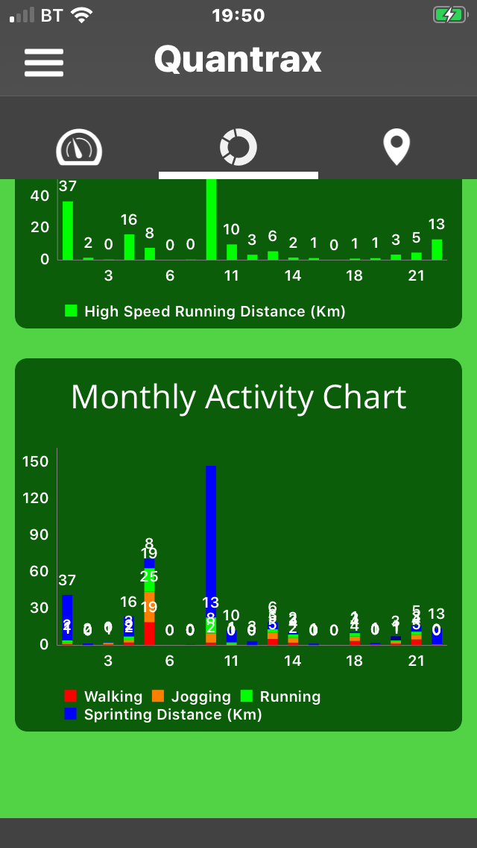
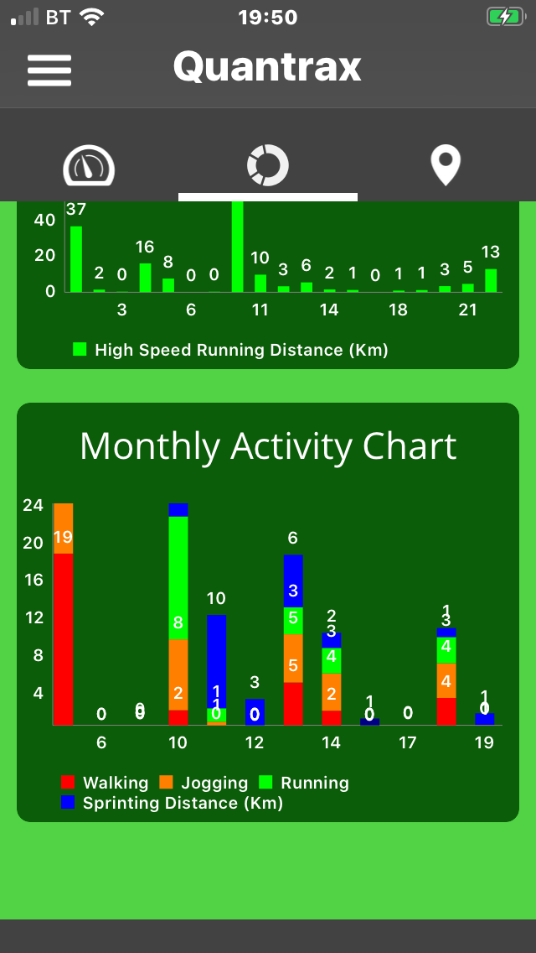
Being able to track all your key metrics daily, weekly, monthly. With the additional features of being able to highlight and zoom in to specific areas
Now go to your web browser for more in depth analysis
https://quant-cx.pi314.in/users/sign_in

