Slide 1



Open Data Week 2025: Choosing the Right Journal and Avoiding Predatory Publishers

Slide 2
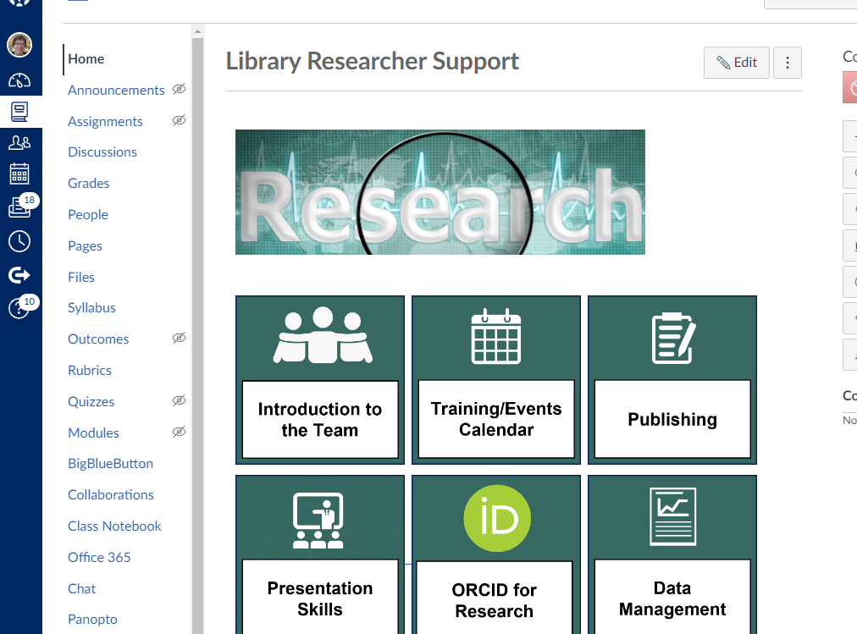
Library Researcher Support Canvas module
https://canvas.ljmu.ac.uk/enroll/7D3MPW ​
​
Notes:
All of our training materials: slides, notes, recordings and links you can find in our Library Researcher Support Canvas page: https://canvas.ljmu.ac.uk/enroll/7D3MPW

Slide 3






Today’s session
Before you Start
Choosing a ‘Home’ for your work
Open Access Options
Publishing Your Data
‘Predatory Publishers’
Think.Check.Submit.

Slide 4
Before you start: Have you published before?
Have you published before? What did you publish?
Why you would you like to publish?

Slide 5



Before you start: Meet your librarian
Resources for each subject area
Online or in-person appointments
Photo by Zaini Izzuddin on Unsplash
https://www.ljmu.ac.uk/library/students/academic-success

Slide 6

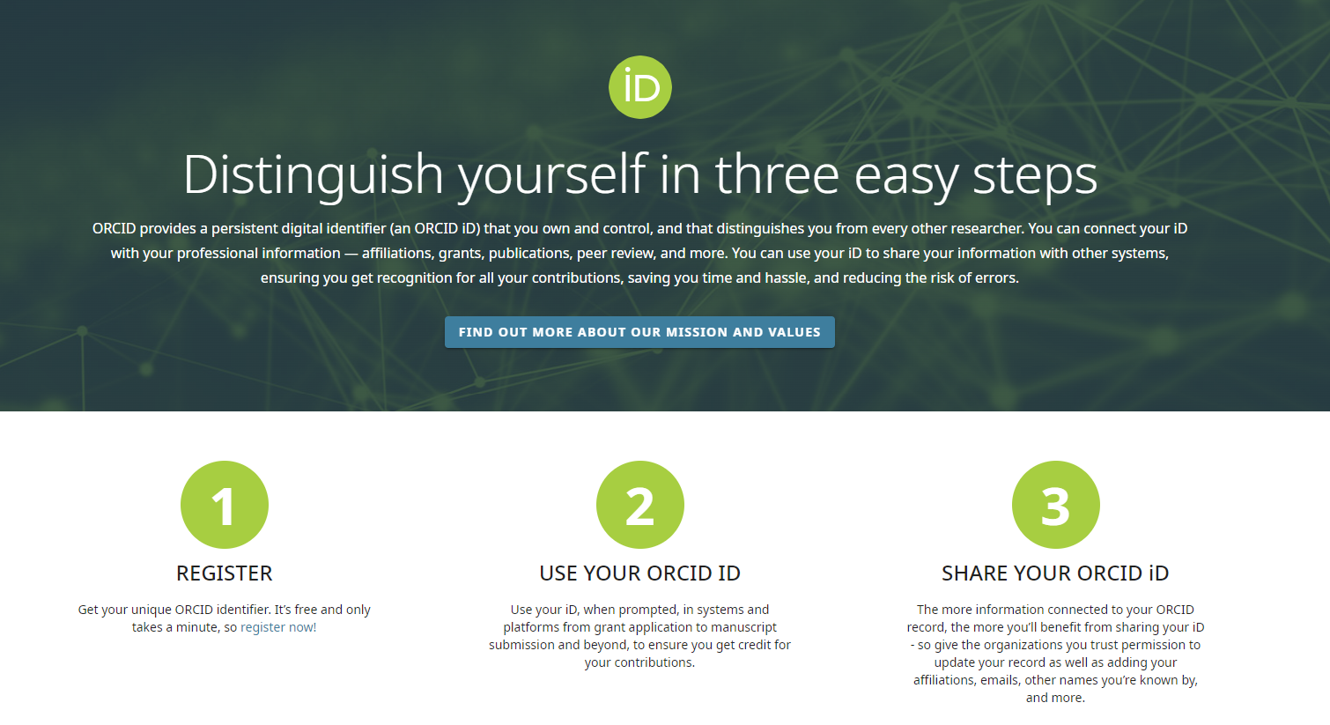

Before you Start: Get an ORCiD and Use it
Notes:
https://www.ljmu.ac.uk/~/media/library/orcid-guide.pdf
Before you start get an ORCID – but what is it and why?
An ORCID is a unique identifier for you. Your name isn’t enough to reliably connect you with papers you’ve written or contributed as others may have the same names as you. Or you may change your names through your career,
An ORCID can help with that – it alleviates mistaken identity as it’s unique to you and you can add all your name variants to it. Also when you move institution you can add you new institution to your ORCID profile

Slide 7
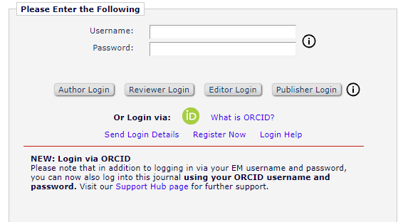
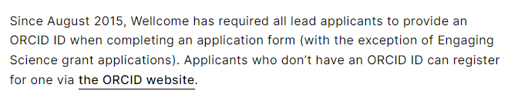
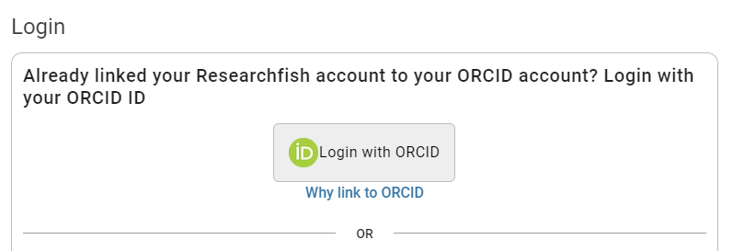
Get an ORCiD and Use it: Log In With It
Notes:
It might FEEL like something else you need to do but sincerely, ORCiD can make life easier. Some research organisations require you to have one, so it will save you time.
Other organisations and publishers allows you to login with your ORCiD-so one less account to create.

Slide 8
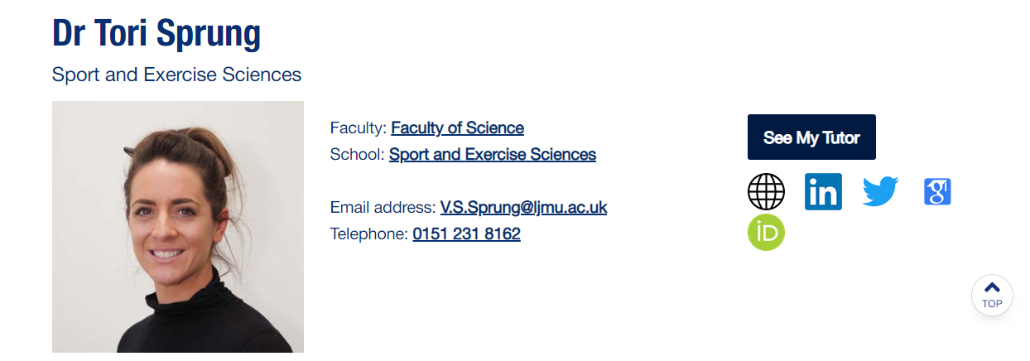
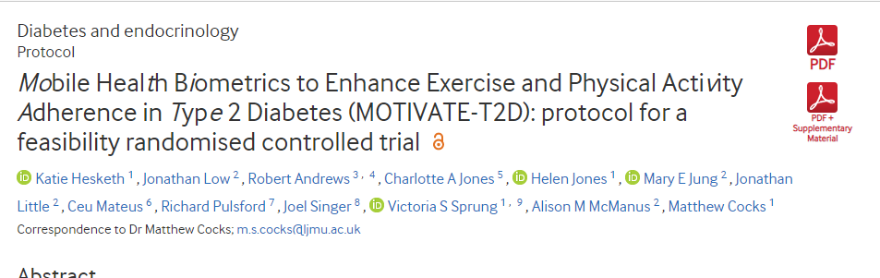
Get an ORCiD and Use it: Publish with It
Notes:
https://www.ljmu.ac.uk/~/media/library/orcid-guide.pdf
https://www.ljmu.ac.uk/library?utm_medium=301_redirect&utm_source=/microsites/library/researcher-engagement-and-outputs/open-research/using-orcid

Slide 9
Choosing a Home: Strategy
What is the best strategy:
Write articles for a specific journal
Write your article and then find a journal that fits it best
Not sure
Notes:
Poll

Slide 10



Choosing a Home: Pick one
Write articles for a specific journal
Target a journal (s) before you start writing
Tailor your writing to the journal’s requirements and readership
This can help increase your chance of acceptance
Notes:
https://authorservices.taylorandfrancis.com/publishing-your-research/writing-your-paper/writing-a-journal-article/

Slide 11



Choosing a Home: Three R’s
Readership
Reach
Rigour
Notes:
I summarise this as Readership, Reach, and Rigour:
Who would you like to read this?
How widely would you like be able to share it? Is open access important to you, your research and what you are talking about?
What is the quality of the publication? Is it peer reviewed? What are the editorial standards?

Slide 12


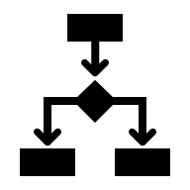
Choosing a Home: Why? What?
Why are you writing?
Who are you trying to reach?
Which part of your research to focus on?
Notes:
But the most important think to determine first is why you are writing? Who is the audience or audiences you are trying to reach? What do they have access to? You might even have different audiences from the same piece of research. You might write about the policy, the process, the findings, and within that, you might get different papers for different journals.
You need to keep these things in mind as you look for a suitable journal for your paper idea.

Slide 13



Choosing a Home: Audiences?
Who/where do you read?
Where do they publish?
Who/where do your colleagues/people you admire publish?
Notes:
I always say to authors the above:
Where are you reading? Where do the people you admire publish?
If you are approached by a journal that you’ve never heard of out of the blue, is that where you want to put your hard work?
How do you choose the right journal?
It’s important to get to know the journals in your field.
Things you can do:
Visit university library – see what journals they subscribe to
talk to your librarian/research support librarian about journals in your subject area
Look at publisher and journal website – many have journal finders which we’ll show you in a minute
Talk to your peers/supervisors to get ideas

Slide 14

Choosing a Home: Journal finders
Emerald Journal Finder: https://www.emeraldgrouppublishing.com/publish-with-us/publish-in-a-journal/find-a-journal​​
​​
Elsevier Journal finder tool - https://journalfinder.elsevier.com/ ​ ​
​​
IEEE Publication Recommender - http://publication-recommender.ieee.org/home ​​
​​
Sage Journal Recommender: https://journal-recommender.sagepub.com/​​
​​
Wiley Search a journal: https://journalfinder.wiley.com/search?type=select
​​
Taylor and Francis Journal Suggester: https://authorservices.taylorandfrancis.com/publishing-your-research/choosing-a-journal/journal-suggester/
​​
Examples that cover more than one publisher:​​
​​
Journal/Author Name Estimator (JANE): https://jane.biosemantics.org/index.php
Director of Open Access Journals: https://doaj.org / ​​
Chronos: https://journalfinder.chronoshub.io/ ​
Diamond Journal Discovery Hub: https://ddh.diamas.org/en
Notes:
Many publishers have journal finders to locate a ‘home’ for your work. Just remember that if it is a publisher journal finder, it will only suggest journals that it publishes. Some journal finders, like JANE and DOAJ, search multiple publishers.
If you find a title you are interested in, you still need to do those checks!
Aims and scope, if there is a cost, if you have checked on the editors, if there is peer review, etc.
This takes time and effort, but if you shortlist a few titles, then you have a few options.

Slide 15
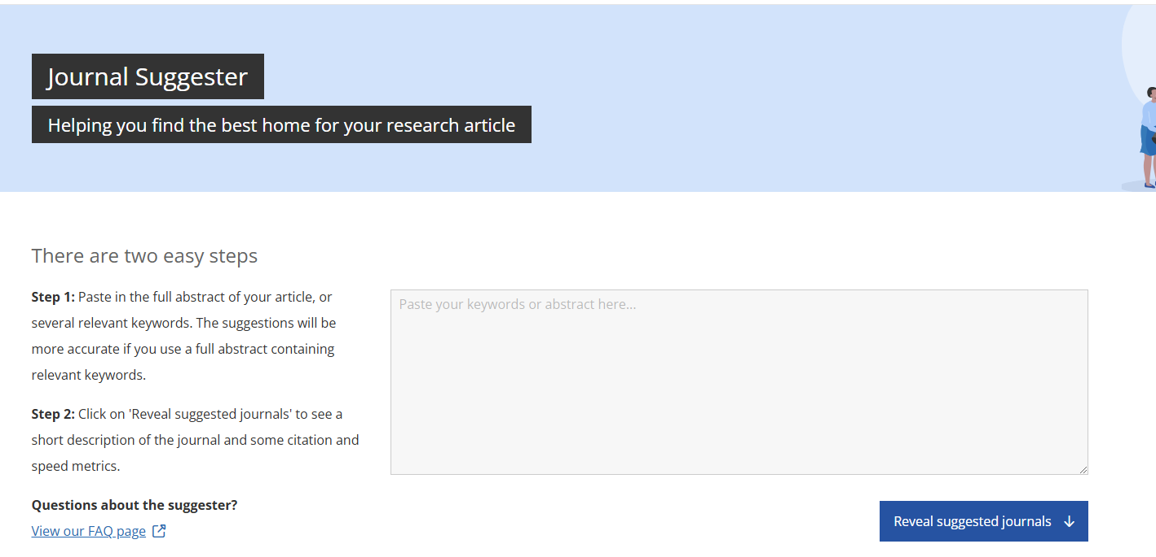
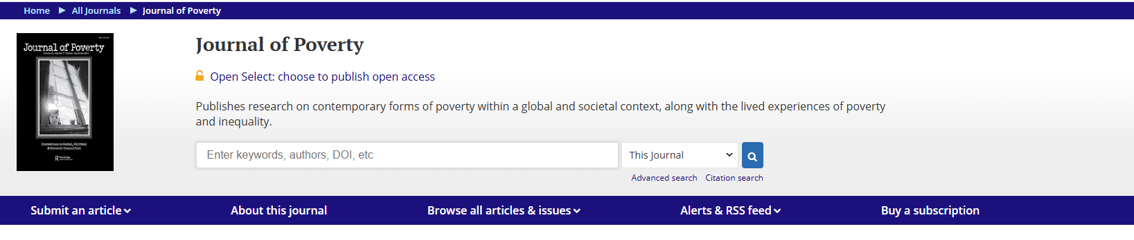
Choosing a Home: Taylor and Francis example
Notes:
Here is an example of a publisher journal finder, in this case, Taylor and Francis
https://authorservices.taylorandfrancis.com/publishing-your-research/choosing-a-journal/journal-suggester/
I have put in a few key words and then it suggests titles to me. On campus and signed in, it is showing that you can publish here OA at no additional charge.

Slide 16
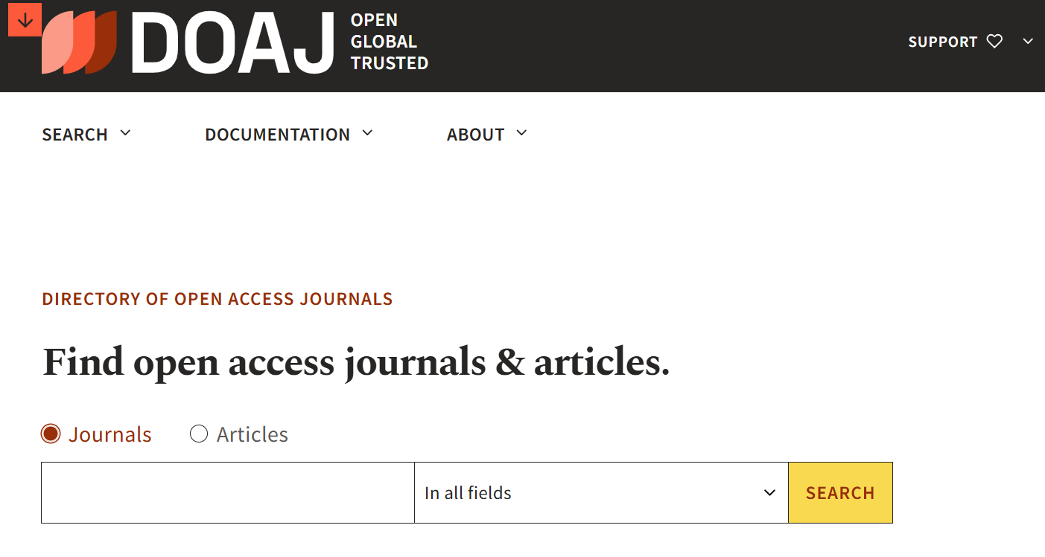
Choosing a Home: DOAJ example
Notes:
https://doaj.org/
The Directory of Open Access Journals is a great place to search for open access journals. It indexes journals from around the world. It has journals from commercial publishers as well as open journals, often hosted by universities.
I am going to search education. I can filter for OA options, for languages, countries

Slide 17

Aims and Scope
What are the aims and scope of the journal?​ ​ This information is usually readily available on the journal’s homepage, look for a section titled ‘About the journal’ or ‘Aims and scope’. Looking through this information will provide you with key information about whether your research might be a good match. ​

Slide 18

Similar Articles?
Has the journal published articles that are similar to yours?​ ​ Look to see if the journal has published work that is similar to yours. Aim to identify 3-5 papers published within the last 5 years and try to determine if these are similar in quality and scope to yours. ​

Slide 19

Information for Authors
It is essential to check the ‘Information for Authors’ section of the journal to determine the journal’s restrictions. ​ ​ If the journal does not accept the type of article you have written, e.g. case studies, you will be rejected immediately.​ ​ The cost of publication can also be viewed as a restriction as some journals charge very high article processing charges (APCs). ​ ​ Fees can also be charged for open access, additional pages beyond a certain limit or colour figures.​ ​ ​
Notes:
So at this stage, it might seem okay OR you might have some hesitancy. No problem.
This is what I do next
The first thing I always, always do is do a simple search and try and find the journal. I go to the journal homepage and I make sure the journal has:
Aims and scope: can I tell what they are writing about and what sort of articles they want?
Can you see older articles and issues archived? Are they organised and easy to access?
Are there editors listed? If there are-pick a few and search for them. Do they list editing this journal on their university webpage. Can you find them at the university? Does their university exist.
Do their pages highlight how quickly things are published as a selling point?
Many times, this is enough information for me to decide. If they above aren’t listed, I’m a bit sceptical.
If the above check out, I also check to see if there is any veracity to their metrics claims. Again, I’m not worried about the size of the metric, I’m checking to see if what they said, checks out. If they have listed a metric like Journal Impact Factor I might also see if this is corroborated within Journal Citation Reports.
Finally-can I tell what the costs are? Are these easy to locate and clear with regards to what and how much you are paying for?
If it only lists something I can’t check on-I proceed with caution.

Slide 20




Choosing a Home: Metrics
Publication metrics
Journal metrics
Author metrics
Alternative metrics
Caution!
Notes:
There are different metrics that can measure information about a particular journal. Broadly, we can think of this as publication, author, journal or altmetrics
These are good webpages to check out: https://www.ucl.ac.uk/library/research-support/bibliometrics/types-metrics
It is always important to use both quantitative and qualitative metrics when deciding where to publish.

Slide 21

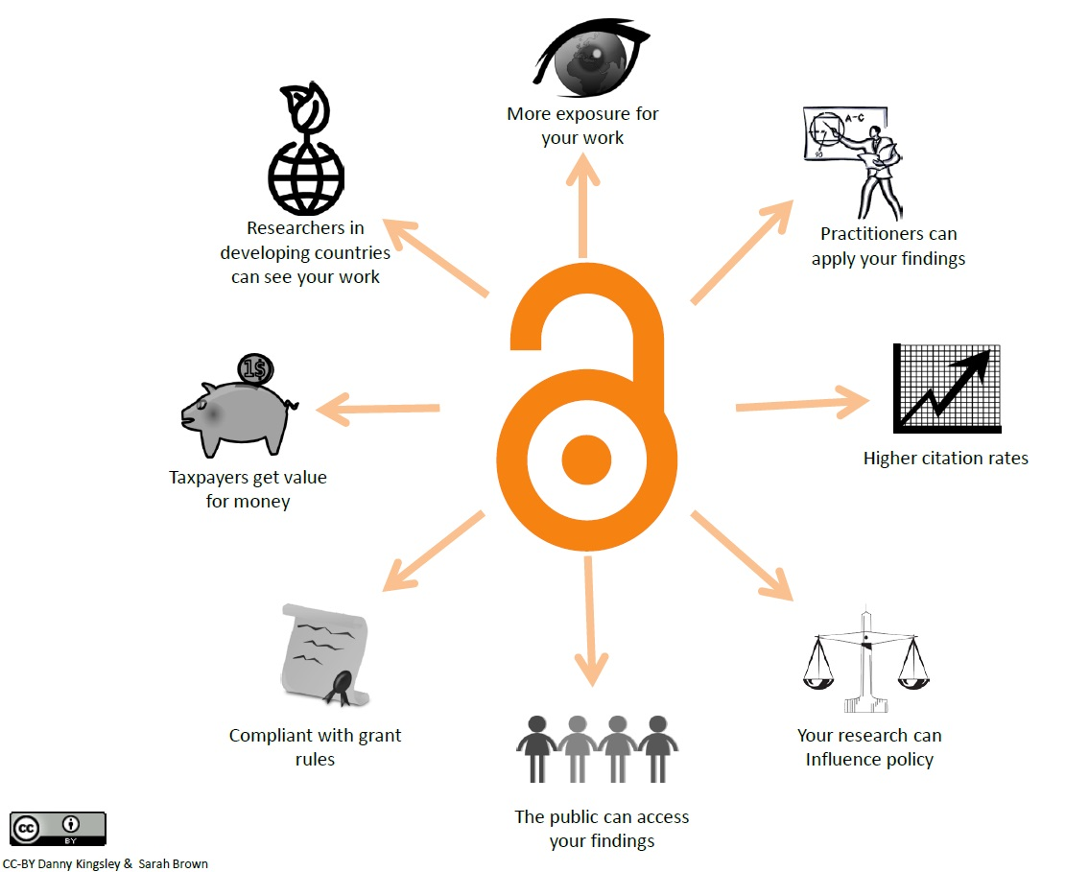
Benefits of Open Access publishing
Open Access Options: Benefits
Notes:
Benefits for researchers
If more people can read your work, they are more likely to cite it Most research funders require outputs arising from research they fund be made available on an Open Access basis.
More people having access to your research, means more opportunities to form new research collaborations.
Greater control over what you and other people can do with your own research outputs (subscription-based publishing often requires you to sign away all copyright in your outputs, limiting what you can do with them).
Benefits for readers and wider society
Those outside of academia have greater access to research such as practitioners, policy makers, charities, small businesses and independent researchers.
Smaller institutions and institutions in developing countries have access to research that they otherwise would not have been able to afford.
Ensuring that those who actually provide the money for publicly-funded research (i.e. tax-payers) have access to the outputs they have funded.
To put this into context, if you are not a member of an institution that is able to pay subscription charges, to purchase a single journal article will usually cost around $30.

Slide 22



Gold, Green, Diamond Open Access
Pure Gold: Often includes an article processing charge, ranging from £45 to £10,000. Your work is immediately open access for everyone to read at the publisher site. You often retain copyright, depending on your license.
Gold in a Hybrid Journal: You have the option to publish gold open access, usually at a cost. Your work will be open to subscribers unless you pay an article processing charge.. Some of our deals allow you to publish open access at no additional cost. .
Green: You publish under a subscription model, but you are allowed to self-archive your manuscript in a subject or institutional repository. You may have to apply an embargo.
Diamond: Open access but no charge for any authors. Often supported by universities via a ‘supporting’ model and/or hosted via an open journals service.

Slide 23
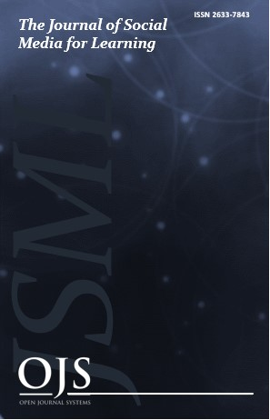


LJMU: Open Journals Service
LJMU host our own Open Journals Service, which has journals, conference proceedings and other sorts of publications. Journals are peer-reviewed and edited by LJMU staff (and beyond). https://openjournals.ljmu.ac.uk/
The Open Library of the Humanities is an example of a diamond journal service. It is supported by many universities and is open to read/publish to anyone. https://www.openlibhums.org/

Slide 24




















LJMU Open Access Agreements
https://www.ljmu.ac.uk/library/researchers/open-access-publishing/institutional-open-access-agreements
Notes:
We have agreements with all these publishers but be aware they are different depending on the publisher. Some cover both hybrid and fully open access agreements and others don’t. Some have a specific list so use the web page to get the full details. Also these are subject to change to always check our web pages for a full up to date list
​​
Note: Open access charges are different to page and colour charges and the deals do not cover them. Both of these are linked to where a journal produces a physical copy - Page charges are where the journal has a limit on the number of pages your article can be and if you go over that they charge you for the additional pages. Colour charges are for colour images/charts. Some journals charge colour charges. Bear this in mind when deciding where to publish. ​

Slide 25

Remember!
Are you funded? You may need to make your work open access immediately and this could impact on where you may publish.
Do we have a deal? Check our pages to discover where you can publish OA without paying an additional APC.
Use a journal finder to locate a publication if you aren't sure
Don't forget to be the corresponding author and use your LJMU address
Choose LJMU as your affiliation
If in doubt, ask!
Consider-is it worth paying when I could publish for free/take part in a deal we are a part of?
Photo by Michał Parzuchowski on Unsplash

Slide 26



Choosing a Home: Data Details
Some journals require you to make your data open.
Many journals require data access statements.
Many funders (and publishers) require you put your data in a repository.
Some funders require you to make your data open.
Notes:
This session is also about data, so it’s also worth considering data when you’re considering where you would like to publish.
Some journals require you to make your data open.
Many journals require data access statements.
Many funders (and publishers) require you put your data in a repository.
Some funders require you to make your data open.
So what does this mean to you as an author that may/may not have data in your research and may need to think about making your data open?

Slide 27

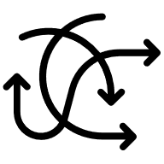

Choosing a Home: Data and Publishing
You need to check these requirements before you decide to publish (ideally, before you write your work!)
Most journal data requirements are listed in ‘instructions for authors’, ‘author guidelines’ or ‘submission guidelines’
Not checking before you publish can cause serious problems later (and possibly delay publication OR mean you can’t publish where you had hoped.
Not sure? Ask someone. Ask the library, ask a colleague, ask the journal.
Notes:
You need to check requirements, ideally before you start writing your paper. This can almost always be checked in the ‘instructions for authors’ section of each journal. If data is something you plan on having/making open/using, it’s very important to check the journal’s requirements!
Not checking before you publish can cause problems later on-it might mean that publication is delayed or you might not be able to be published.
If you’re not sure, ask someone! Asking the library is always a good starting point.

Slide 28
Choosing a Home: Data policy examples
Data Sharing Policy
This journal applies the Taylor & Francis Basic Data Sharing Policy. Authors are encouraged to share or make open the data supporting the results or analyses presented in their paper where this does not violate the protection of human subjects or other valid privacy or security concerns.
Authors are encouraged to deposit the dataset(s) in a recognized data repository that can mint a persistent digital identifier, preferably a digital object identifier (DOI) and recognizes a long-term preservation plan. If you are uncertain about where to deposit your data, please see this information regarding repositories.
Authors are further encouraged to cite any data sets referenced in the article and provide a Data Availability Statement.
At the point of submission, you will be asked if there is a data set associated with the paper. If you reply yes, you will be asked to provide the DOI, pre-registered DOI, hyperlink, or other persistent identifier associated with the data set(s). If you have selected to provide a pre-registered DOI, please be prepared to share the reviewer URL associated with your data deposit, upon request by reviewers.
Where one or multiple data sets are associated with a manuscript, these are not formally peer-reviewed as a part of the journal submission process. It is the author’s responsibility to ensure the soundness of data. Any errors in the data rest solely with the producers of the data set(s).
Introduction
PLOS journals require authors to make all data necessary to replicate their study’s findings publicly available without restriction at the time of publication. When specific legal or ethical restrictions prohibit public sharing of a data set, authors must indicate how others may obtain access to the data.
When submitting a manuscript, authors must provide a Data Availability Statement describing compliance with PLOS' data policy. If the article is accepted for publication, the Data Availability Statement will be published as part of the article.
Acceptable data sharing methods are listed below, accompanied by guidance for authors as to what must be included in their Data Availability Statement and how to follow best practices in research reporting.
PLOS believes that sharing data fosters scientific progress. Data availability allows and facilitates:
Validation, replication, reanalysis, new analysis, reinterpretation or inclusion into meta-analyses;
Reproducibility of research;
Efforts to ensure data are archived, increasing the value of the investment made in funding scientific research;
Reduction of the burden on authors in preserving and finding old data, and managing data access requests;
Citation and linking of research data and their associated articles, enhancing visibility and ensuring recognition for authors, data producers and curators.
Publication is conditional on compliance with this policy. If restrictions on access to data come to light after publication, we reserve the right to post a Correction, an Editorial Expression of Concern, contact the authors' institutions and funders, or, in extreme cases, retract the publication.
Notes:
https://journals.plos.org/plosbiology/s/data-availability
https://www.tandfonline.com/action/authorSubmission?show=instructions&journalCode=chos20#data-sharing-policy

Slide 29
Predatory Publishing: What is it?
Definition
Predatory publishers or journals are those which charge authors a fee for publication with no intention of providing the expected services – such as editorial or peer review – in return. Charging a fee is a legitimate business model, but the publisher should be providing a good publishing service in return. Authors, realising that they have submitted their paper to a questionable publisher, can find they are charged a large fee if they want to withdraw their article.
Known synonyms
The concept of ‘predatory’ journals has many names: fake journals, questionable journals, illegitimate journals, deceptive journals, dark journals, and journals “operating in bad faith”.
https://thinkchecksubmit.org/resources/about-predatory-publishing/

Slide 30




Predatory Publishing: What’s the problem
Unchecked research can give it undeserved credibility.​
Other researchers may build upon poorly conducted or even false research.​
Unsound articles may mislead the public who find that information online and reduce public trust in science.​
The research community may question good research if it is published in one of these journals, and this can harm the reputation and career of a researcher.

Slide 31





Predatory Publishing: Why is it your problem?
You might end up publishing in a ‘home’ that you no longer want
Your work might be ‘attached’ to a journal that is not reputable
Your work in this area might not be able to be published elsewhere (at least this paper)
You might now be liable for an article processing charge
This could be damaging to your academic reputation

Slide 32




Predatory Publishing: What to look out for?
A journal title which can be easily confused with another journal or that might mislead potential authors and readers about the journal’s origin, scope or association with other journals
Very wide scope
Displays of unofficial impact factors
False claims of being indexed in major services like PubMed or DOAJ
No publisher address or contact information

Slide 33




Predatory Publishing: What to look out for?
Unclear ownership of the journal
Spams researchers with many emails inviting submissions, often unrelated to expertise
Advertises very fast times from submission to publication
Publishes out-of-scope articles
Publishes nonsense articles

Slide 34




Predatory Publishing: What to look out for?
Poor or non-existent editing of articles (many spelling mistakes or very poor grammar)
Hides information on charges
No editorial board is listed, or the editorial board comprises dead or retired scholars or scholars who are not specialised in the topic
Lack of information on the policies of the journal, such as peer review, licensing and copyright

Slide 35
The solution
Think. Check. Submit. provides free tools and resources to help researchers identify reputable publishers and avoid predatory ones with free resources.

Slide 36
Here is the problem
Predatory publishing has become a major issue for researchers.
The increasing number of new journals and publishers launched each week, makes distinguishing between reputable and unethical publishers challenging.

Slide 37
Why not build a list of predatory publishers?
Lists of publishers to avoid are not always reliable or up-to-date and can be biased. Instead, researchers can use the tools provided by Think. Check. Submit. to make informed decisions about where to submit their work.

Slide 38
Do predatory publishers target researchers in specific countries or working in specific subject areas?
Predatory publishing is a global threat, with every country experiencing it at different levels. Researchers in all subject areas are at risk. Our checklist for books and chapters is available in over 20 languages and our checklist for journals is available in over 40 languages.

Slide 39
About
Think. Check. Submit.
This international, cross-sector initiative aims to educate researchers, promote integrity, and build trust in credible research and publications.
https://thinkchecksubmit.org/

Slide 40
The Association of Learned and Professional Society Publishers (ALPSP)
Association of University Presses (AUP)
Committee on Publication Ethics (COPE)
Directory of Open Access Journals (DOAJ)
ISSN International Centre
Association of European Research Libraries (LIBER)
OAPEN Foundation
Open Access Scholarly Publishers Association (OASPA)
International Association of STM Publishers (STM)
•
Contributing organisations
UKSG

Slide 41
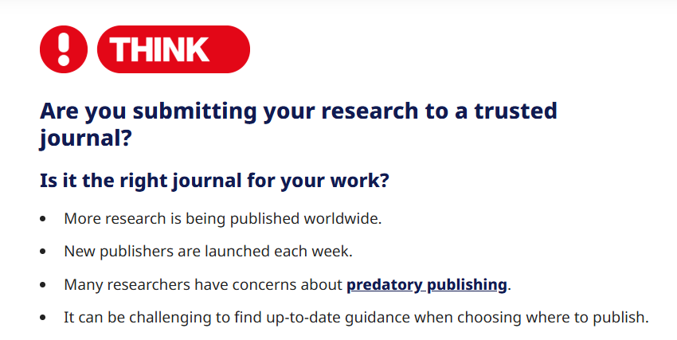
Predatory Publishing: Think

Slide 42
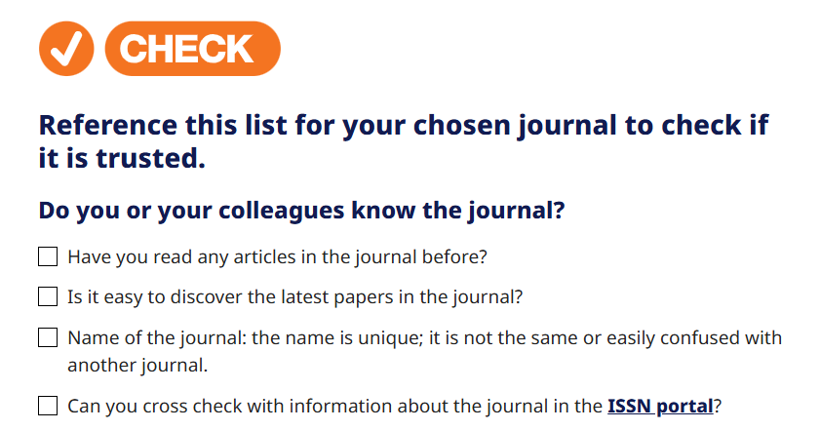
Predatory Publishing: Check

Slide 43
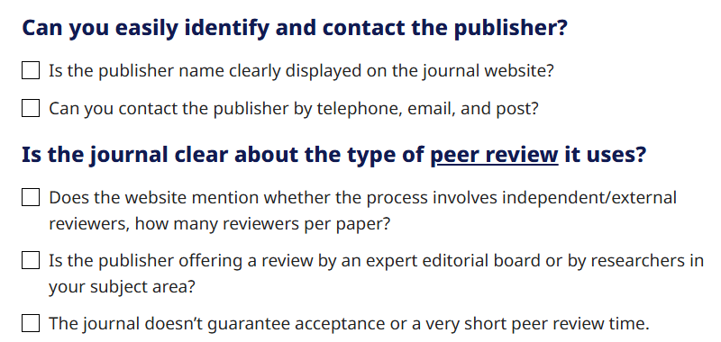
Predatory Publishing: Check

Slide 44
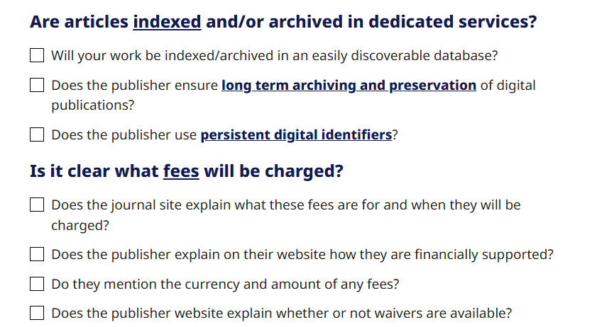
Predatory Publishing: Check

Slide 45
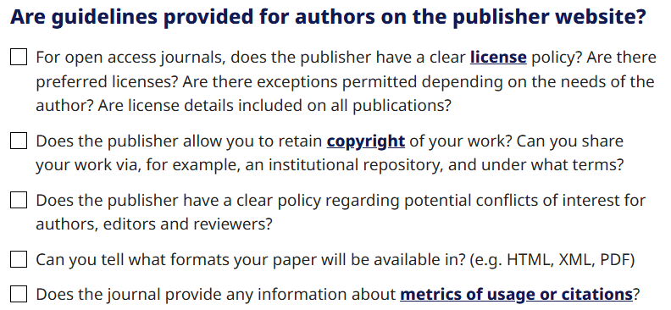
Predatory Publishing: Check

Slide 46
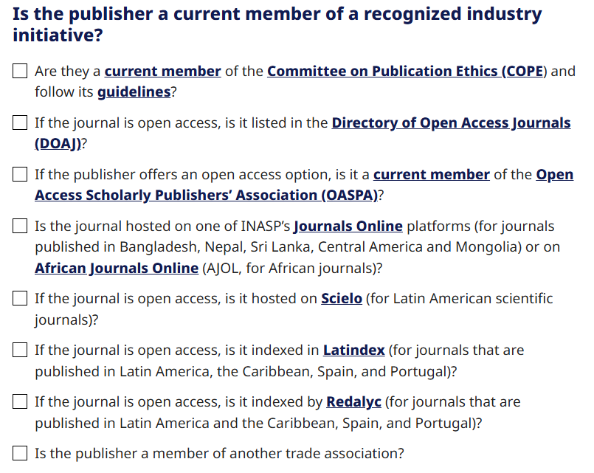
Predatory Publishing: Check

Slide 47
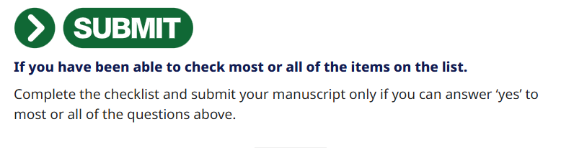
Predatory Publishing: Submit

Slide 48
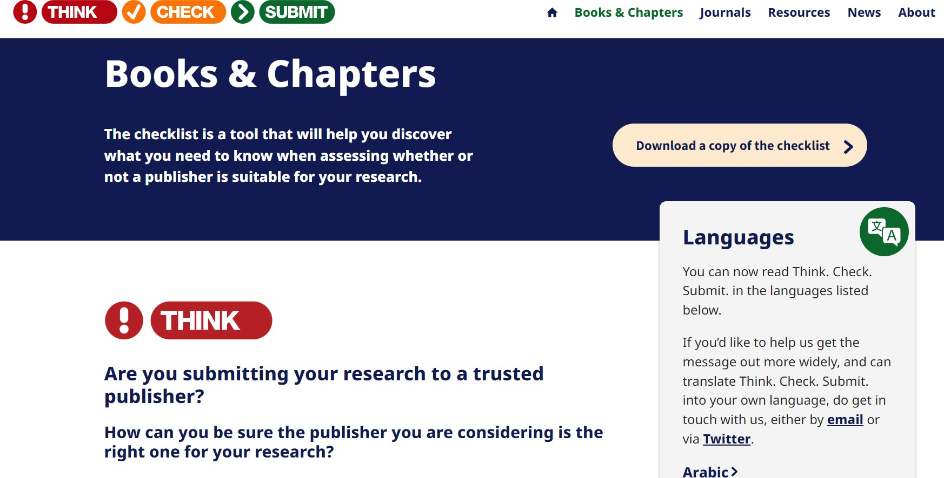
A checklist for Books & Chapters
“The website…helps authors to determine if a publisher is trustworthy, by providing a checklist for books and chapters.”
OAPEN

Slide 49
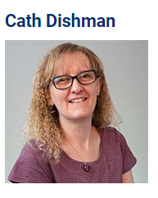
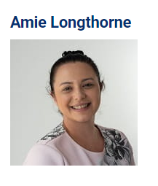
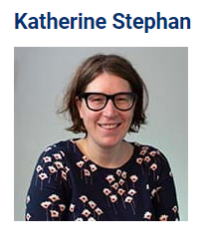

Open Research Librarian (Scholarly Communications)
Open Research Data Management Specialist
Open Research Librarian (Development)
lst_research_support@ljmu.ac.uk
Twitter/X: LJMUResearch
LinkedIn: LJMU Library Researcher Engagement Team
BlueSky: @ljmuresearch.bsky.social
Calendar of events: https://unical.ljmu.ac.uk/?team=re
Notes:
https://www.ljmu.ac.uk/library/researchers
https://unical.ljmu.ac.uk/?team=re @ljmuresearch

