Slide 1


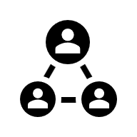
Open Data Week: Research Data Visibility and Metrics

Slide 2
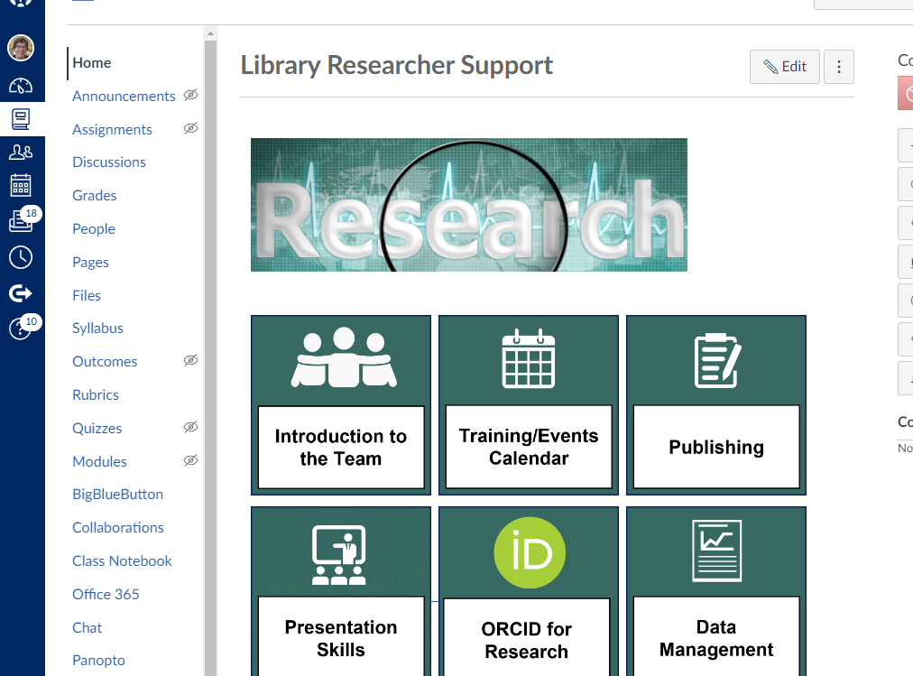
Library Researcher Support Canvas module
https://canvas.ljmu.ac.uk/enroll/7D3MPW ​
​
Notes:
All of our training materials: slides, notes, recordings and links you can find in our Library Researcher Support Canvas page: https://canvas.ljmu.ac.uk/enroll/7D3MPW

Slide 3



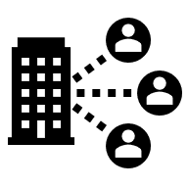

Today’s session
Your story, your way
At the start
Places to check: where to find evidence
How to see collaborations with others
Other tips

Slide 4




Your Story, Your Way: Which evidence?
Notes:
Depending on what you are trying to evidence, you may need to think about your ‘story’ differently and include different evidence to support that. You might have very different routes into promotion and you need to capture evidence to support the route that you take.

Slide 5

Your Story, Your Way: Create the narrative
What do you want to focus on?
What do you highlight?
What do you want people to know about you AND your work?

Slide 6
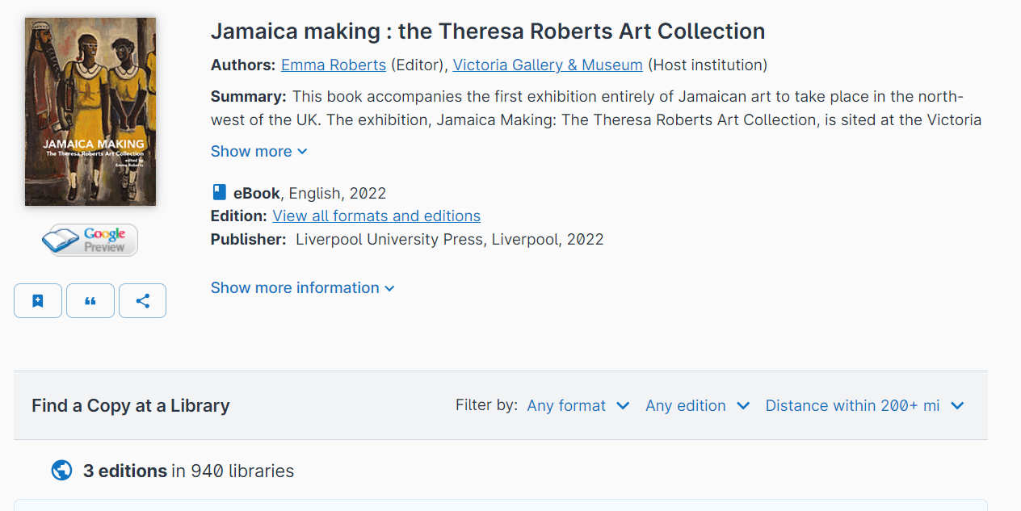

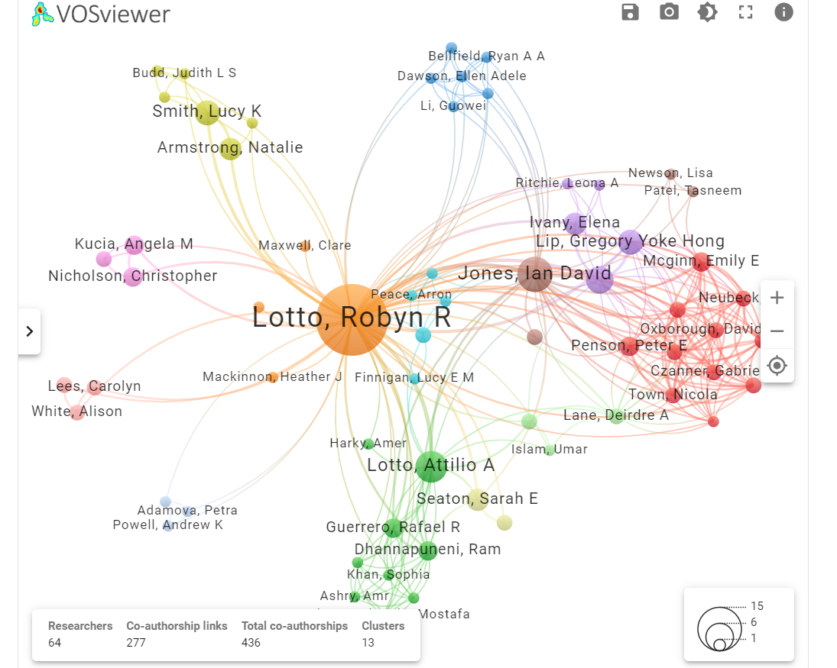
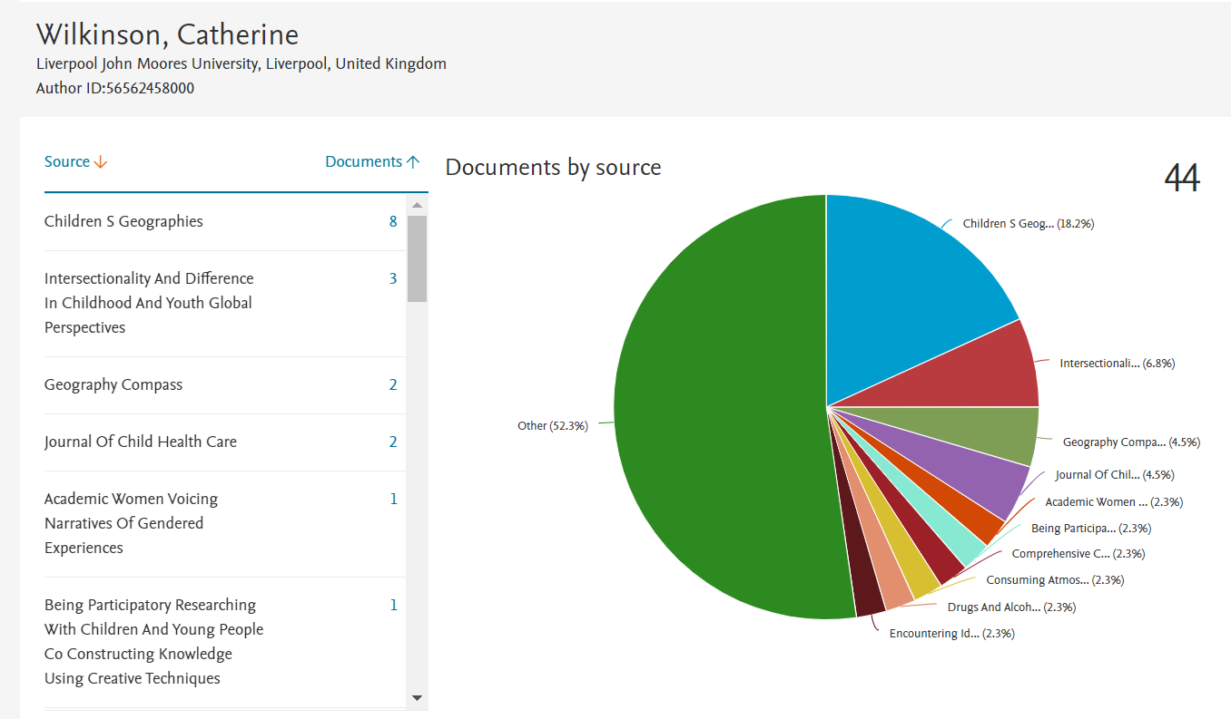
Your Story, Your Way: Which evidence?
Notes:
Depending on your narrative, make sure you have the evidence to support the story you are trying to tell about you and your work. There are lots of different places to look and we can help you locate the story you’d like to tell about you!

Slide 7

Your Story, Your Way: With caution
Not all metrics are suitable for use (too small, not appropriate, etc)
Not on there? Don’t panic
Talk to us about options.
Use quantitative and qualitative metrics

Slide 8
Your Story, Your Way: Data Metrics Are Not As Easy
Not all databases provide metrics on data
People are not as good at sharing or citing data (so makes it difficult to ‘track’)
Data metrics not used as frequently as publication metrics

Slide 9
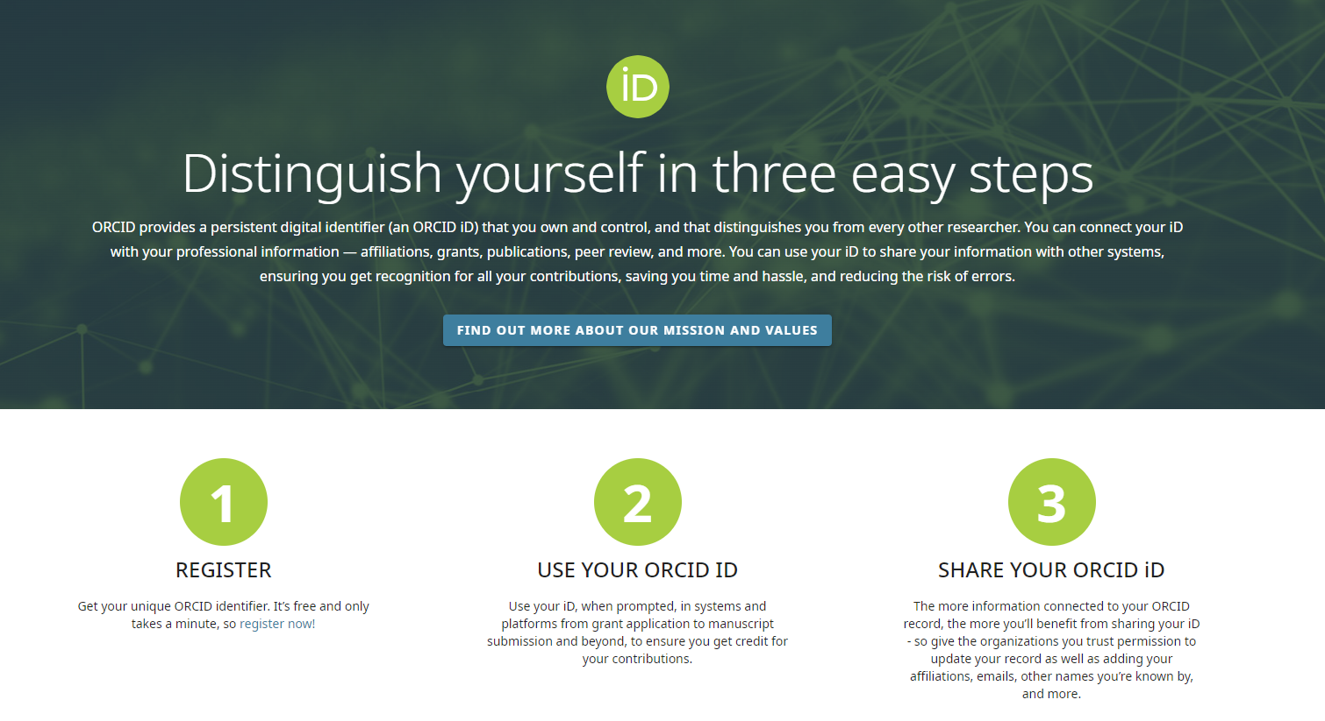

Get an ORCiD and Use it
Notes:
https://www.ljmu.ac.uk/~/media/library/orcid-guide.pdf
Before you start get an ORCID – but what is it and why?
An ORCID is a unique identifier for you. Your name isn’t enough to reliably connect you with papers you’ve written or contributed as others may have the same names as you. Or you may change your names through your career,
An ORCID can help with that – it alleviates mistaken identity as it’s unique to you and you can add all your name variants to it. Also when you move institution you can add you new institution to your ORCID profile

Slide 10
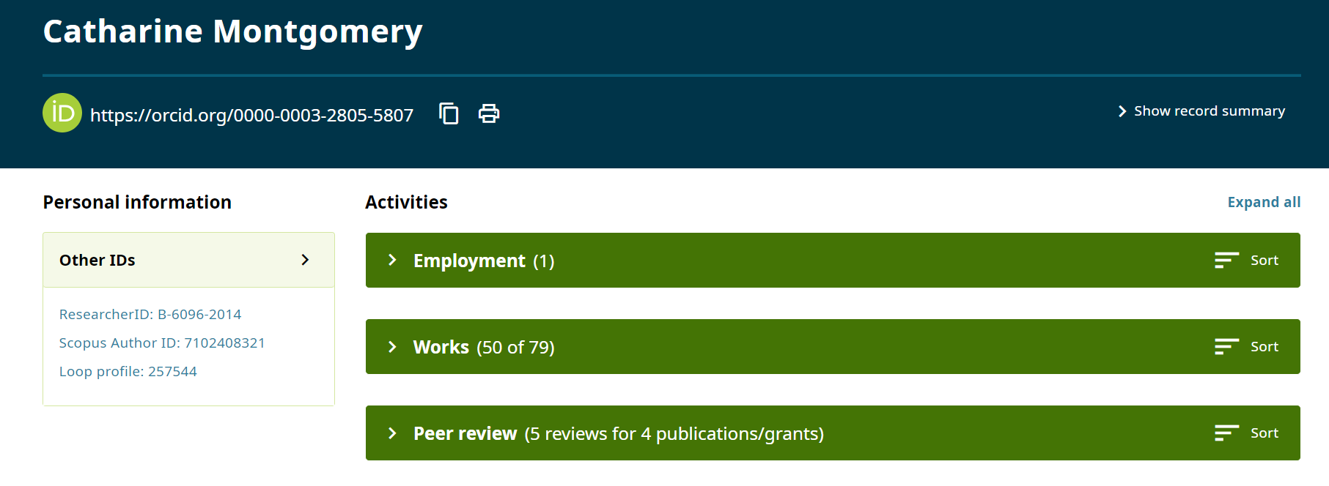
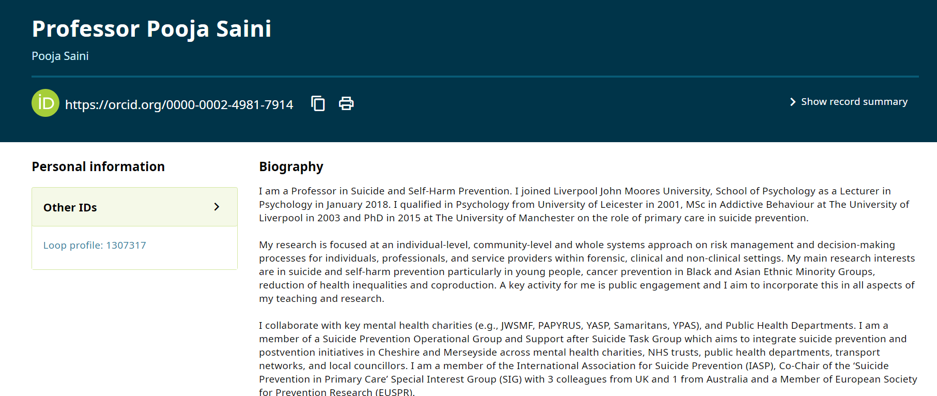
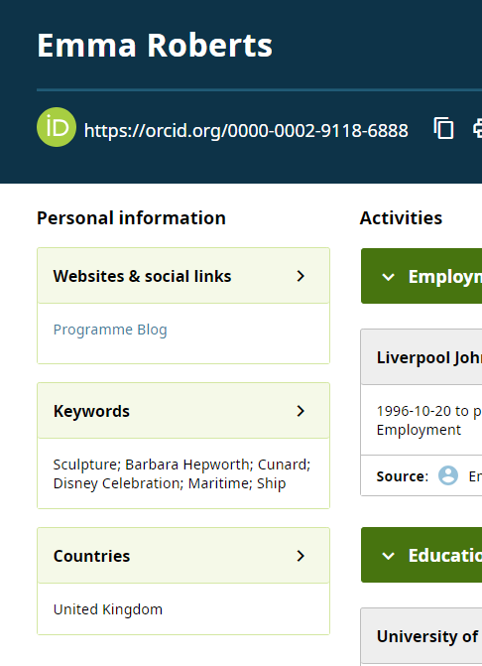
Get an ORCiD and Use it: Update it
Notes:
It can be enough to just get an Orcid, but to really make the most of it, use it. This can include a number of different things.
First off-populate it how you’d like. This is your area and you can include what you like. You can see some examples here of how people have extended their biographies, included keywords, to other profiles or even other names that you are known by.
These sections are controlled by you not just what is included but also by whom has access. You can lock/open as appropriate.

Slide 11
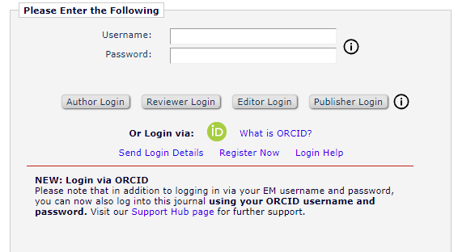
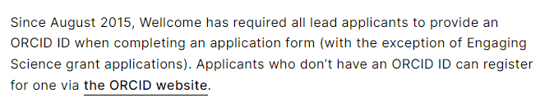
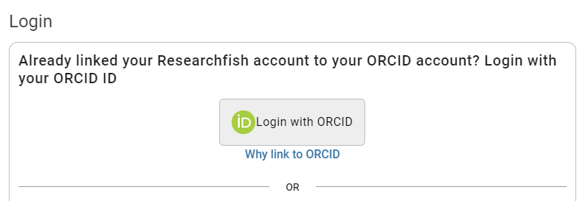
Get an ORCiD and Use it: Log In With It
Notes:
It might FEEL like something else you need to do but sincerely, ORCiD can make life easier. Some research organisations require you to have one, so it will save you time.
Other organisations and publishers allows you to login with your ORCiD-so one less account to create.

Slide 12
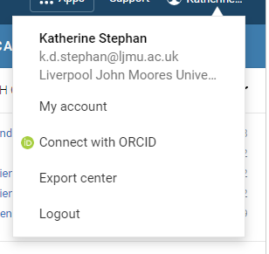
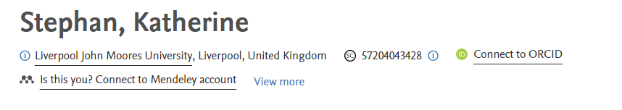
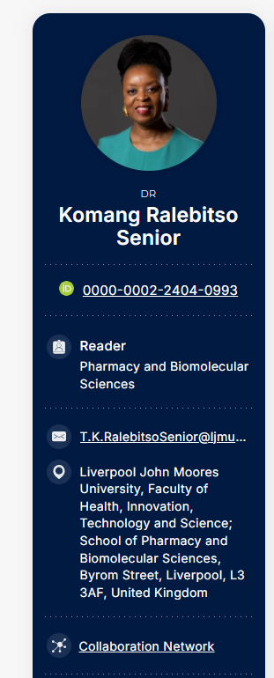
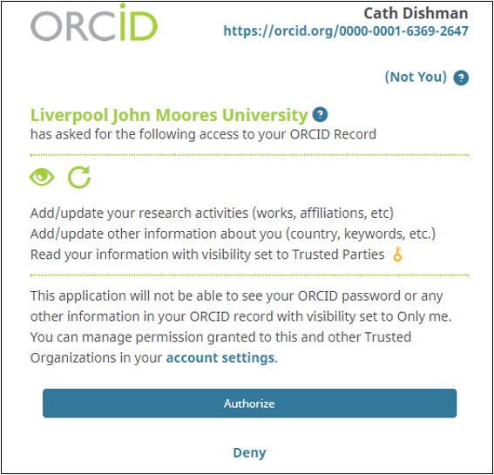
Get an ORCiD and Use it: Connect
Notes:
One of the best things about ORCiD is connecting you to your work. If you’re new to research, this is the perfect time to start. Use ORCiD and connect your work together. Different accounts will allow you to add ORCId-
For example, Dimensions, Scopus, Symplectic and also our webpages. Do this-it makes it easier for people to find you AND all of your work.

Slide 13
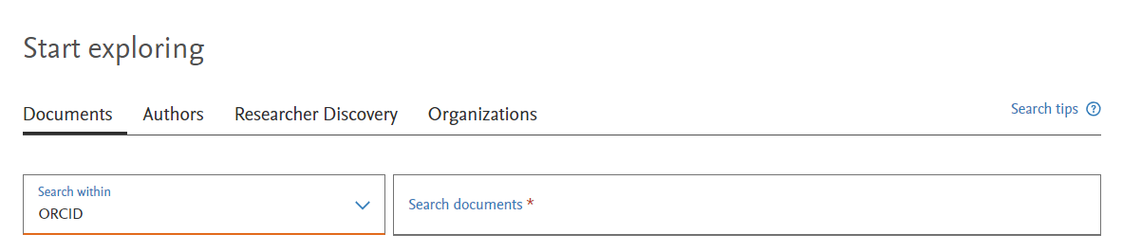
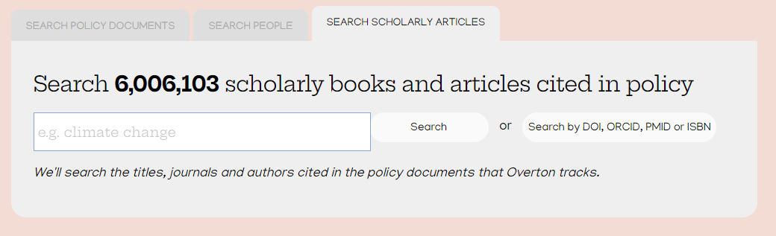
Get an ORCiD and Use it: Search with it
Notes:
As it is connected so well, many databases also allow you to search via ORCiD. Again, if you have been linking your outputs, also search for yourself in this way. It may well bring up outputs that you weren’t sure about. More and more databases are adding this option, so give it a try.

Slide 14

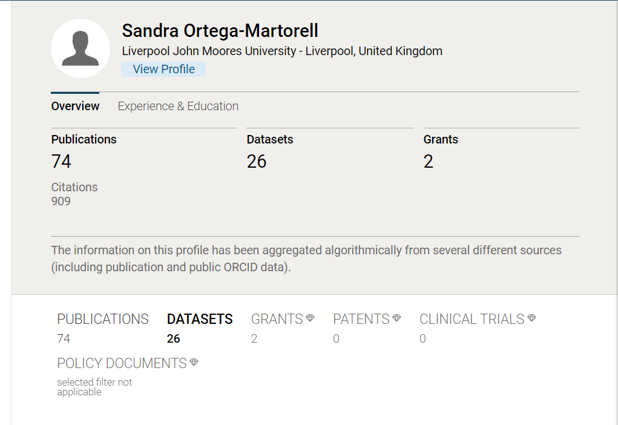
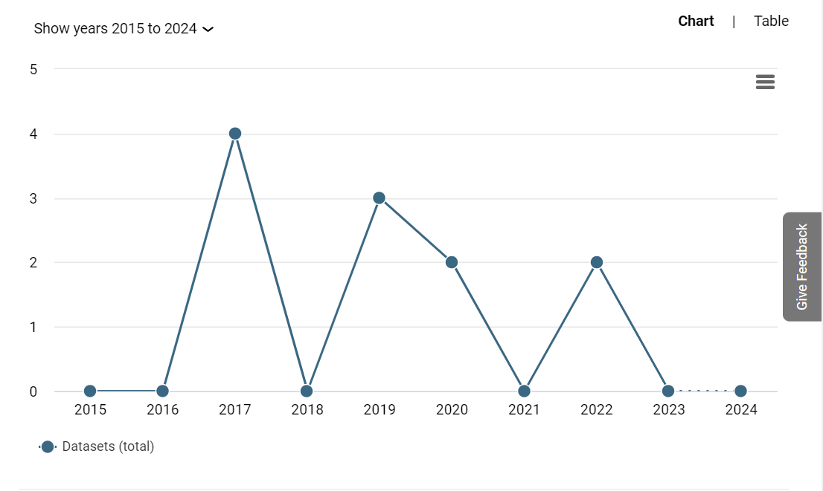
Reach: Dimensions
Notes:
Open Alex is a super catalogue
Sandra Ortega-Martorell
Ivan Olier
You can limit by datasets and search that way and be able to see all of the datasets linked to publications
You would still need to go out and check stats depending on where linked but can do this via the links here.

Slide 15
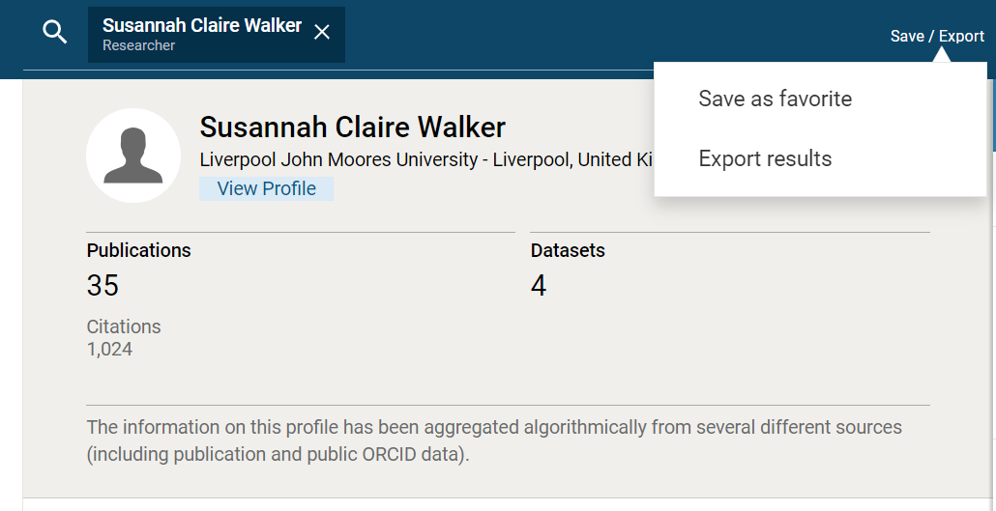
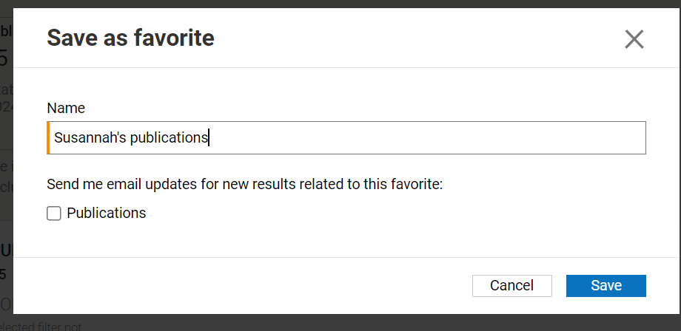
Check yourself/update: Dimensions
Notes:
It’s important to not just look at one database. Some databases do not cover everything, so it’s worth it to look in other places. You also need to check and make sure that the details are correct. We are using the free version of Dimensions but you can export your results (and limit them, too) and also do a ‘saved’ search to get alerts.
You will also want to link your ORCiD with Dimensions to make sure your account is up-to-date and accurately reflects ‘you’

Slide 16

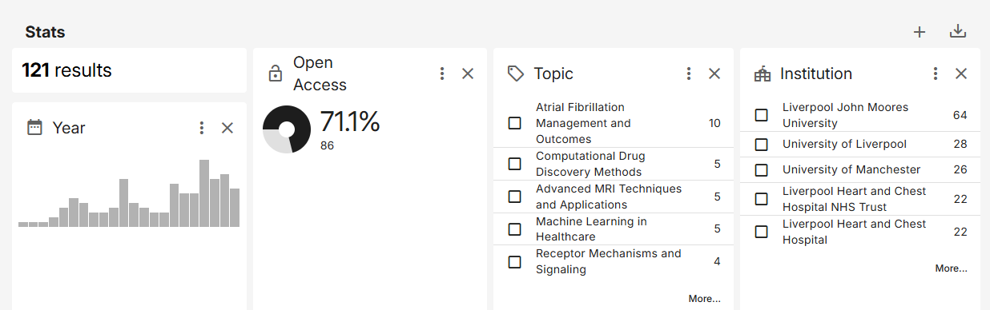
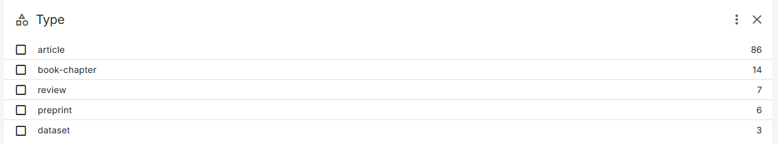
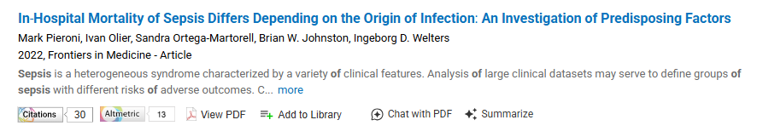
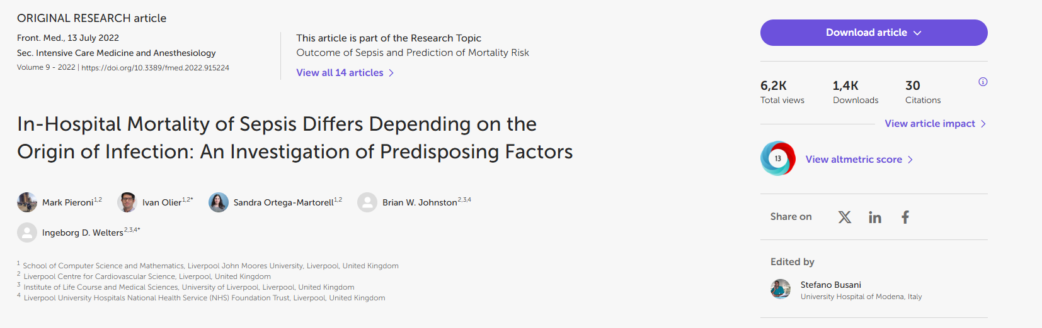
Reach: OpenAlex
Notes:
Open Alex is like a super catalogue of published works. It might ‘capture’ more of your datasets.
Ivan Olier: https://orcid.org/0000-0002-5679-7501
Searched in OpenAlex
Found datasets in Figshare
Checked Figshare and looked at downloads
This is data linked to this article: https://www.frontiersin.org/journals/medicine/articles/10.3389/fmed.2022.915224/full
Which was also listed in Dimensions

Slide 17
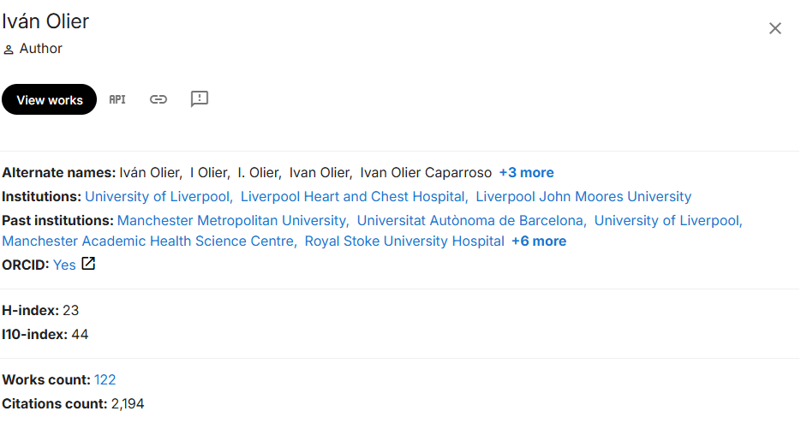
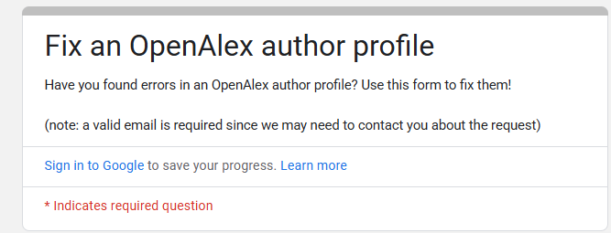
Check yourself/update: OpenAlex
Notes:
Need to go in and check your name/profile.
Here is a short video on how to link: https://www.youtube.com/watch?v=p0RqOj129b8
https://help.openalex.org/hc/en-us/articles/27283405287319-How-can-I-fix-errors-in-an-OpenAlex-author-profile
https://docs.google.com/forms/d/1WzSGs0AIPyghKuSHHzlh3uLJ2QOzz3UJ4feO8xZh_9o/viewform?edit_requested=true

Slide 18

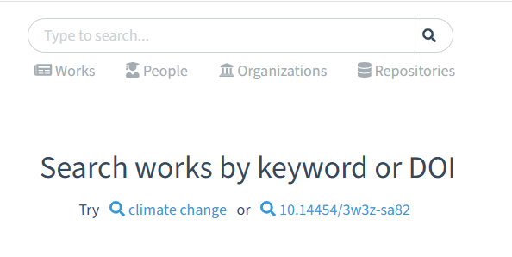
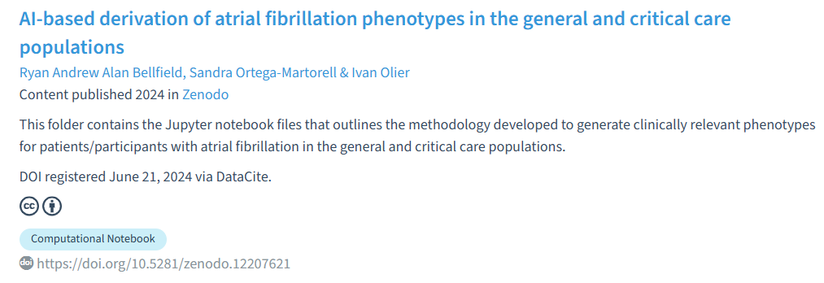
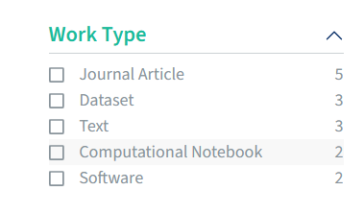
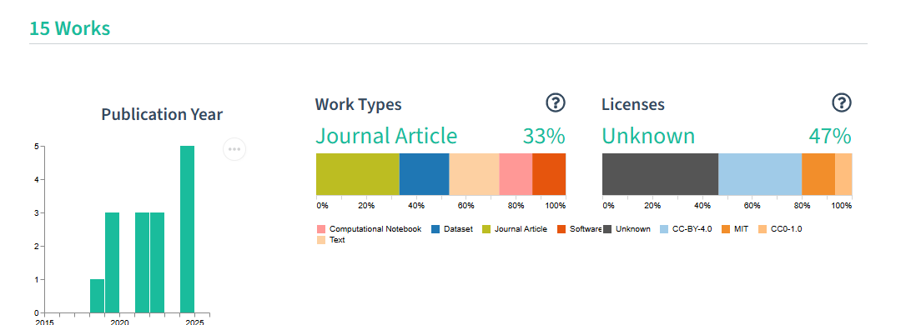
Reach: DataCite Commons
Notes:
https://commons.datacite.org/
This tool connects research outputs and their data-DOIs/to data. It might give you collective data about your data.
Ivan Olier: https://orcid.org/0000-0002-5679-7501

Slide 19
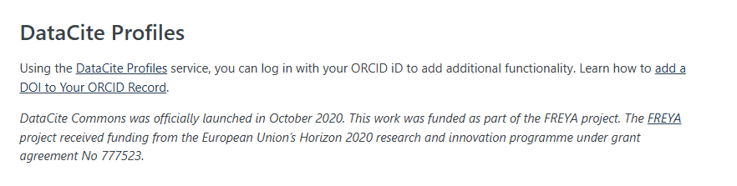
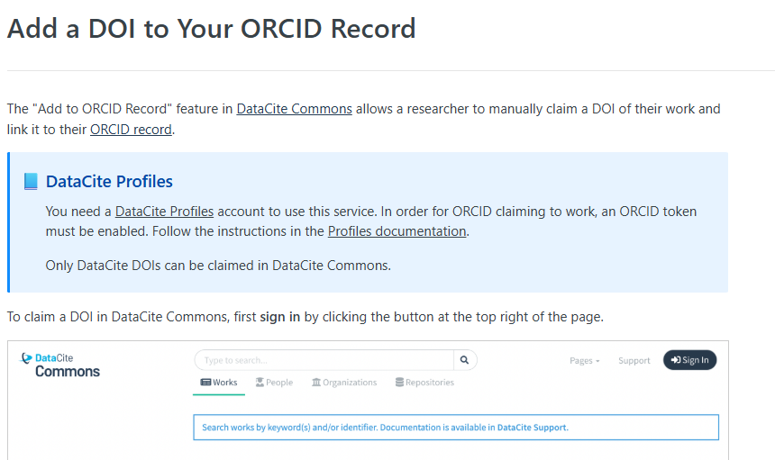
Check Yourself/Update: DataCite Commons
Notes:
Again, it’s useful to check/update your data. If you have research data, check. Having an ORCiD will also help reliably connect you to your work.
https://commons.datacite.org/
https://support.datacite.org/docs/datacite-commons
https://support.datacite.org/docs/orcid-claiming

Slide 20

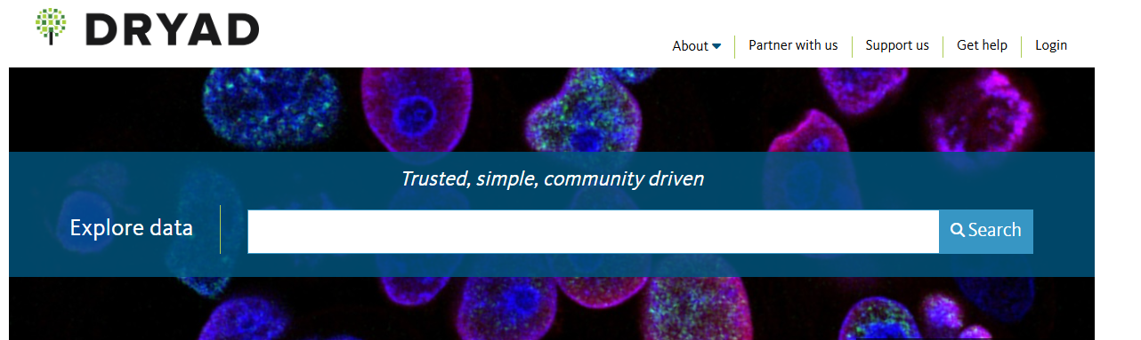
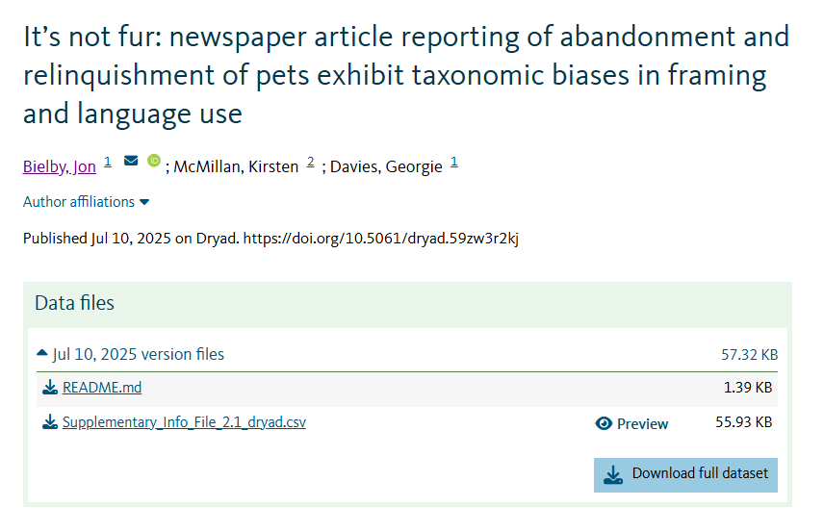
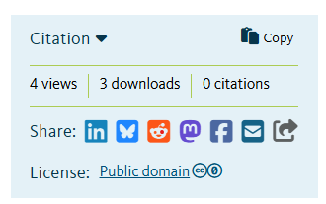
Reach: Dryad
Notes:
https://datadryad.org/
Can search for Liverpool John Moores University

Slide 21
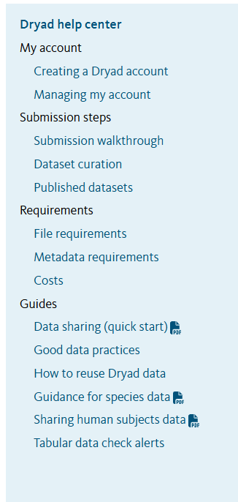
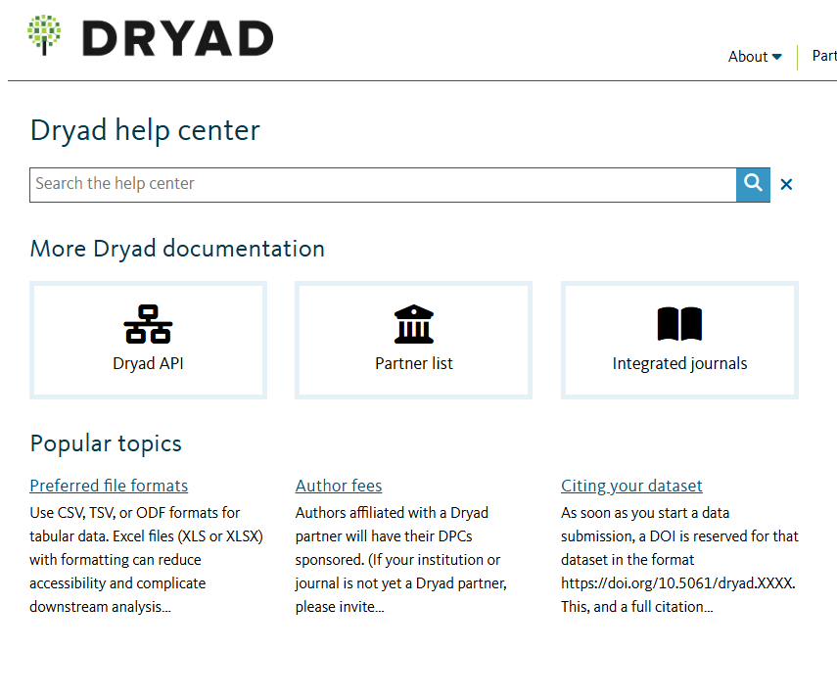
Check Yourself/Update: Dryad
Notes:
Lots of help here: https://datadryad.org/help

Slide 22


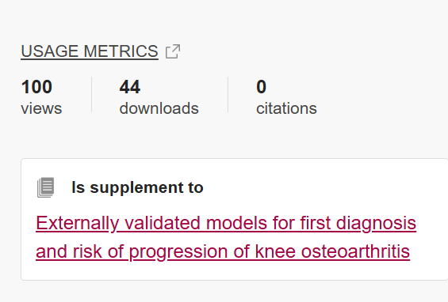
Reach: Figshare
Notes:
Figshare is an open research repository. Some institutions pay to store their data here but you can also use Figshare to store your data:
https://figshare.com/

Slide 23
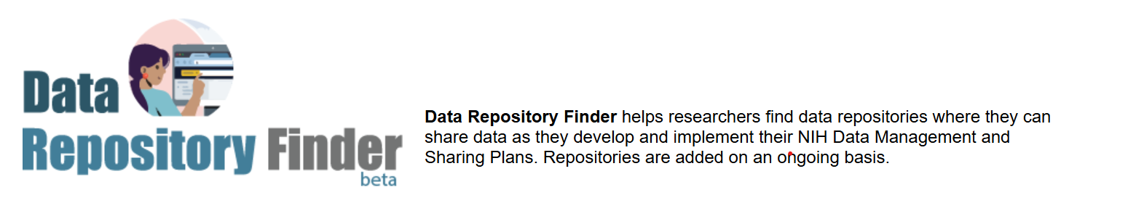
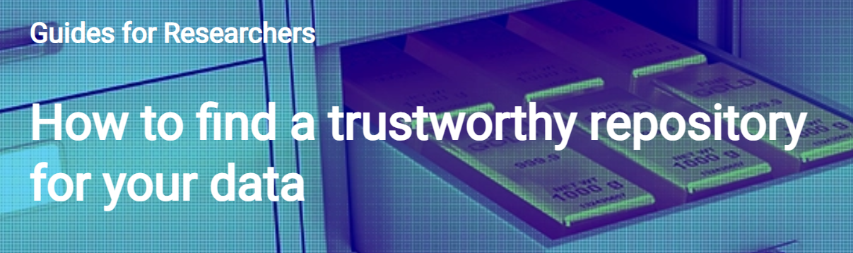
Check yourself/update: Data repositories
Notes:
There are lots of data repositories, so you’ll need to know where your data is and how to check on the metrics:
https://www.nlm.nih.gov/NIHbmic/domain_specific_repositories.html
https://www.ucl.ac.uk/library/open-science-research-support/research-data-management/learn-develop-teach/subject-specific-0
https://data-repository-finder.ll.mit.edu/
https://www.openaire.eu/find-trustworthy-data-repository

Slide 24
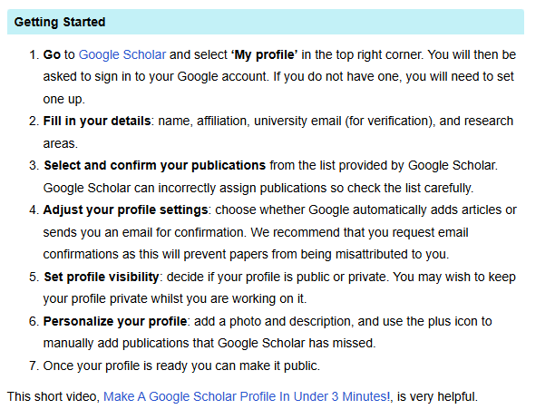
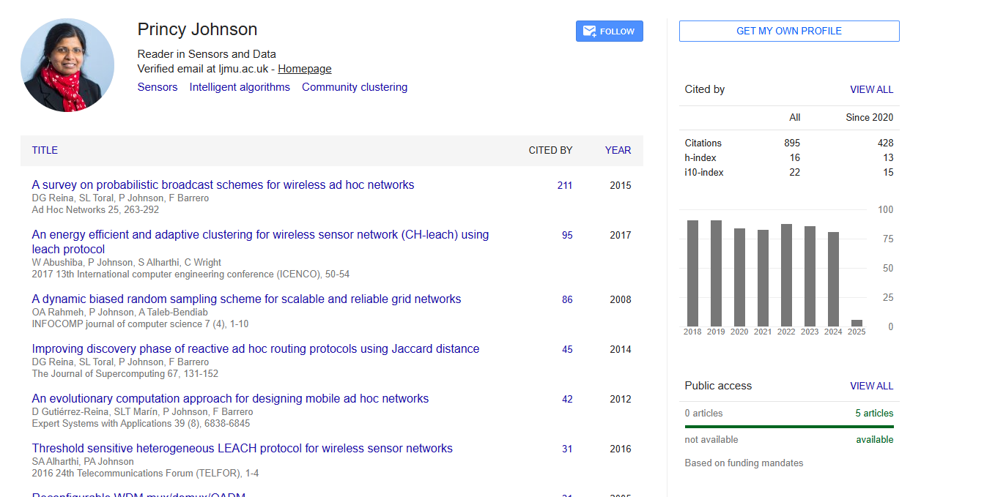
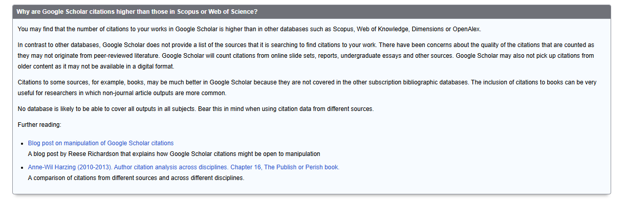
Check yourself/update: Google scholar
Notes:
https://library.bath.ac.uk/research-analytics/googlescholarprofiles https://libguides.reading.ac.uk/boost/google-scholar-profile

Slide 25


Check yourself/update: LinkedIn
Notes:
https://blog.ourresearch.org/7-tips-to-supercharge-your-academic-linkedin-profile/

Slide 26
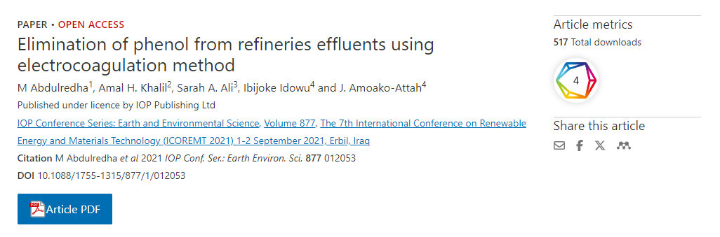
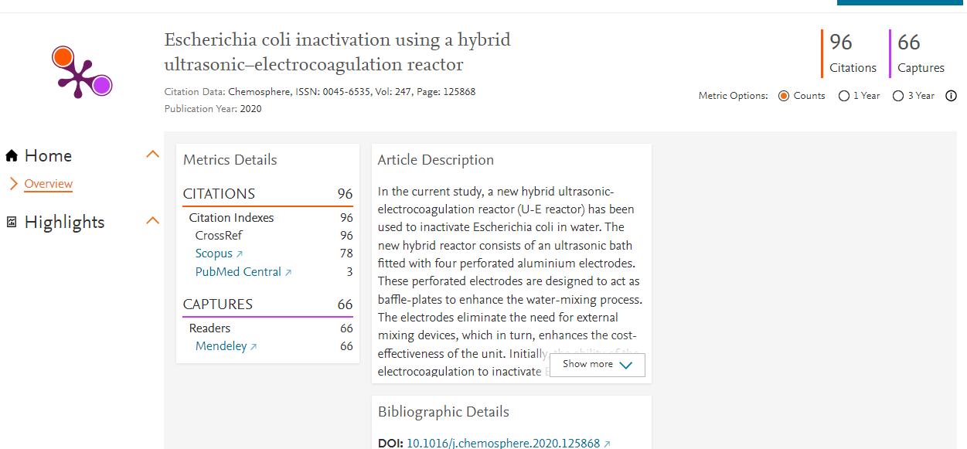
Reach: Publisher sites
Individual journals will have paper metrics
Not all publishers have them
Need to collate them yourself
Notes:
And stats from publisher sites, too-where you can usually find metrics related to downloads and citations, sometimes alternative metrics like policy citations, too! However-they don’t always have datasets listed-so have to dig a little bit!

Slide 27
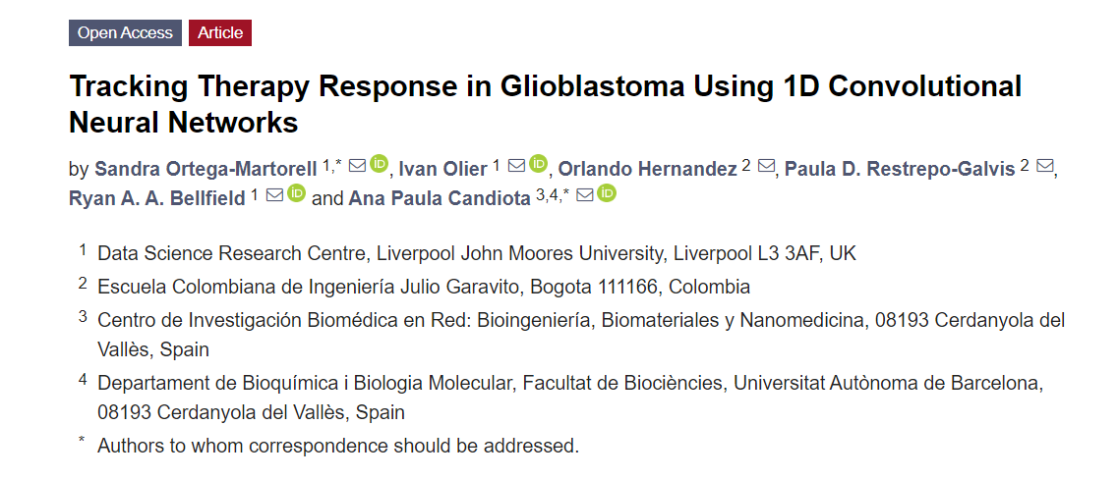
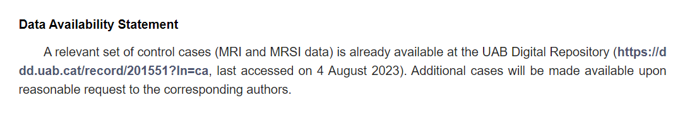


Reach: Data linked from articles
Notes:
Example article: https://www.mdpi.com/2072-6694/15/15/4002
Go to data availability statement, follow link to data: https://ddd.uab.cat/record/201551?ln=ca
https://ddd.uab.cat/record/201551/usage
Click where it says usage statistics

Slide 28



Reach: LJMU data repository
https://opendata.ljmu.ac.uk/
Notes:
LJMU has our own data repository. You can find this here: https://opendata.ljmu.ac.uk/
You can check on downloads on the statistics portion of the repository pages.

Slide 29

Reach: Overton
Shows policy mentions (and ones you might not know about)
Can show metrics for research group outputs
Need to search in multiple ways
Notes:
You can also set alerts on your work, to let the database ‘do work’ to see if being cited.

Slide 30


Reach: Overton policy citations
If you’ve left institution, might need to gather evidence in different ways
If not in a policy area, might not be in there
Notes:
It’s important that when you search within Overton that you search for yourself and your work in multiple ways: your name/your DOI/your ISBN/your ORCiD.
You can do this all at once and you can also set up saved searches.

Slide 31


Reach: Overton-set alerts
Notes:
It is also possible to do this for a group of papers/researchers. For more help on this, please let me know!

Slide 32


How to reach more: Publish Open Access
https://www.ljmu.ac.uk/library/researchers/open-access-publishing/institutional-open-access-agreements/
Notes:
You can do things to make your work more easily accessible. There is evidence that making your work OA means that more people can read/learn from/cite, etc.

Slide 33

How to reach more: Open Research
Notes:
Open research can mean different things for different areas of research. There are lots of reason why you can and should make your work open.
Benefits for researchers
If more people can read your work, they are more likely to cite it Most research funders require outputs arising from research they fund be made available on an Open Access basis.
More people having access to your research, means more opportunities to form new research collaborations.
Greater control over what you and other people can do with your own research outputs (subscription-based publishing often requires you to sign away all copyright in your outputs, limiting what you can do with them).
Benefits for readers and wider society
Those outside of academia have greater access to research such as practitioners, policy makers, charities, small businesses and independent researchers.
Smaller institutions and institutions in developing countries have access to research that they otherwise would not have been able to afford.
Ensuring that those who actually provide the money for publicly-funded research (i.e. tax-payers) have access to the outputs they have funded.
To put this into context, if you are not a member of an institution that is able to pay subscription charges, to purchase a single journal article will usually cost around $30.

Slide 34



How to Reach More: Data Availability Statements
Help people find your data
Data availability statements will tell you where and how to get to the data used (make it easy!)
These might be a requirement for the publication/funder
Not just: not available
Notes:
Make it easy for people to find your data associated with your paper. This might be a requirement but it’s also good practice.
Good examples: https://www.dundee.ac.uk/guides/data-access-statements
https://ljmu.libanswers.com/faq/277947

Slide 35



Data Availability Statements: Examples
Notes:
A data availability statement will allow people to easily find your data-no need to email you and ask (or not ask at all.) This can mean they learn from/cite/reuse.

Slide 36



How to reach more: Check yourself/update
Look for people in different databases
Check details are correct
Set alerts
Where to correct?

Slide 37


Check yourself/update: Staff webpages
Notes:
You might not have a staff webpage but it can be useful to look at others to see what to include. https://profiles.ljmu.ac.uk/

Slide 38






Published Datasets: Dryad Aug 2025
TOTAL VIEWS
18,025 (2014-2025)
Total Downloads
2,687 (2014-2025)
Highest Cited Dataset is:
Skull shape data for 188 species of living Carnivora 10.5061/dryad.2rbnzs7jx
Carlo Meloro ORCID: 0000-0003-0175-1706
Most downloaded: A catastrophic tropical drought kills hydraulically vulnerable tree species
10.5061/dryad.2rbnzs7jp
Filippo Aureli Orcid 0000-0002-0671-013X
In collaboration with: University of Minnesota, United States; University of Tasmania, Australia; University of British Columbia, Canada; Colby College, United States; Guanacaste Conservation Area, Costa Rica

Slide 39




Published Datasets: LJMU Data Repository Oct 2025
Most downloaded:
Understanding the extent of and limitations to conscientious objection by health care practitioners to abortion https://doi.org/10.24377/LJMU.d.00000101
Fleming, Valerie, Maxwell, Clare and Morecroft, Charles (2021) Understanding the extent of and limitations to conscientious objection by health care practitioners to abortion. [Data Collection]
Design, Development and Implementation of Wearable Technology in Football Further Education Settings in the United Kingdom. Dataset. DOI: https://doi.org/10.24377/LJMU.d.00000107
Tierney, Peter (2021) Design, Development and Implementation of Wearable Technology in Football Further Education Settings in the United Kingdom. Dataset. [Data Collection]
Top Deposits By Fields of Research
  Psychology (24)
  Health sciences (22)
  Creative arts and writing (11)
  Biological sciences (6)
  Built environment and design (6)
LJMU’s Top Data Contributors by downloads
1.Morecroft, Charles
2.Fleming, Valerie
3.Maxwell, Clare
4.Tierney, Peter
5.Montgomery, Catharine
6.Crotti, Matteo
7.Foweather, Lawrence
8.Jones, Andrew
9.Walker, Susannah
10.Kidd, Tara
Total Downloads
104,029 (2017-2025)

Slide 40





Published Datasets: Figshare Oct 2025
Total Downloads
TOTAL VIEWS
39,561
(2017-2025)
8664
(2017-2025)
24 Collections of data added between 2017-2025
Most downloads 2017-2025 goes to Robert Crain!
Most Cited Research Data Collection:
Andrew Denovan
https://orcid.org/0000-0002-9082-7225
Most Downloaded in 2025!
Prescott, Tash Leigh; Griffin, Benjamin W; Demuth, Oliver E; Gatesy, Stephen; Lallensack, Jens N.; Falkingham, Peter L (2025). Guineafowl traversing mud - speed, stride, video. figshare. Media. https://doi.org/10.6084/m9.figshare.28715216.v1

Slide 41




Published Datasets: UK Data Service Oct 2025
11 LJMU Associated Datasets only 1 is openly available:
Cowley, E. (2021). ‘Invisible Sportswomen’: The Gender Data Gap in Sport and Exercise Science Research, 2014-2020. [data collection]. UK Data Service.
DOI: 10.5255/UKDA-SN-854926
No data on downloads or citations
Top Funders:
Economic and Social Research Council
Engineering and Physical Sciences Research Council
Liverpool Clinical Commissioning Group
Community by Nature
Collaborations With :
Manchester Metropolitan University
University of Sheffield
University of Southampton
University of Leicester
University of Nottingham
Data Types Added
Cohort and Longitudinal Studies
Experimental Data
Qualitative and Mixed Methods Data
Main Topics
Law, crime and legal systems
Health
Social welfare policy and systems
Psychology

Slide 42



Your Story, Your Way: Remember
Your Work is Awesome
We’re here to help you shout
Hooray for You!

Slide 43













Get in touch: Where to look?
Notes:
There are lots of different places to look yourself up. What do you have time for? What can you commit to, properly?
Can we help you?

Slide 44




Open Research Librarian (Scholarly Communications)
Open Research Data Management Specialist
Open Research Librarian (Development)
openresearch@ljmu.ac.uk
Twitter/X: LJMUResearch
LinkedIn: LJMU Library Researcher Engagement Team
BlueSky: @ljmuresearch.bsky.social
Calendar of events: https://unical.ljmu.ac.uk/?team=re
Notes:
https://www.ljmu.ac.uk/library/researchers
https://unical.ljmu.ac.uk/?team=re
@ljmuresearch

