Slide 1

License to Share - Open Data and Creative Commons
Wednesday, 12 November 2025
Jan Ainali
Notes:
Add information about specific presentation/event and presenter.

Slide 2
OPENING QUESTIONS - PLEASE INTRODUCE YOURSELF IN THE CHAT
Are you a:
Researcher who has published data
Researcher who has used data from a public source
Publisher of data
Manager of data
Manager of an organization’s data policy
Something else (please specify)
Notes:
How open content helps solve the world’s most pressing problems.

Slide 3
OPENING QUESTIONS
How familiar are you with licenses?
🤷 Completely unfamiliar - I have never heard of licenses before.
👀 Aware - I have heard of licenses but don't know about them.
🤓 Somewhat familiar - I may have learned some or selected a license before, but my understanding is limited.
💯 Confident - I have applied a license and understand how they are used.
Notes:
How open content helps solve the world’s most pressing problems.

Slide 4

WHAT IS CREATIVE COMMONS?
Creative Commons (CC) is an international nonprofit organization that empowers people to grow and sustain the thriving commons of shared knowledge and culture. We aim to address the world’s most pressing challenges and create a brighter future for all.
Access to knowledge is necessary to solve big, complex problems, like the U.N. Sustainable Development Goal (SDG) for Climate Action.
Creative Commons Open Science works to promote open access to research and data, in order to accelerate equitable progress towards solving the climate crisis and preserve global biodiversity and ecology.
Notes:
CC is a nonprofit organization that supports the infrastructure that makes the public commons possible in today’s digital environment. The public commons is essential to enable us to address the world’s most pressing challenges and to create a brighter future for all.

Slide 5





EXAMPLE: BETTER INTERNET
Movement for a Better Internet is a collaborative effort to ensure that the internet’s evolution is guided by public interest values. Our movement brings together diverse voices, facilitates connections, shares resources, and drives policy change based on a shared public interest vision and agenda we will build together for an internet that benefits us all.
Notes:
How CC is addressing pressing problems example: The Movement for a Better Internet.

Slide 6




EXAMPLE: OPEN CLIMATE
If we are going to solve the world’s biggest problems,
the knowledge and data about them must be open.
Our multi-year open climate campaign promoting open access to research and data to accelerate progress towards solving the climate crisis and preserving global biodiversity.
Notes:
How CC is addressing pressing problems example: Open Climate Campaign.

Slide 7
URGENCY OF OPEN CLIMATE DATA
Immediate Global Impact
Climate change affects ecosystems, weather patterns, and sea levels. Immediate access to data is crucial for understanding and mitigating these impacts.
Informed Policy and Action
Policymakers need accurate data to make informed decisions quickly, develop effective climate policies, and implement action plans.
Disaster Preparedness
Open data improves the ability to predict, prepare for, and respond to extreme weather events, potentially saving lives and reducing economic losses.
Notes:
Immediate Global Impact:
Climate change poses an urgent, existential threat to the planet, affecting ecosystems, weather patterns, sea levels, and biodiversity. Timely access to data is critical for understanding and mitigating these impacts.
Policy and Decision-Making:
Effective climate policies require accurate and up-to-date data. Open access enables policymakers to make informed decisions quickly, respond to emerging threats, and implement effective climate action plans.
Disaster Preparedness and Response:
Climate change increases the frequency and intensity of extreme weather events such as hurricanes, floods, and wildfires. Open data allows for better prediction, preparedness, and response to these disasters, potentially saving lives and reducing economic losses.
Global Collaboration:
Climate change is a global issue that requires a coordinated international response. Open data facilitates collaboration among countries, researchers, and organizations, fostering a unified effort to address climate challenges.
Monitoring and Compliance:
Transparency in climate data is essential for monitoring compliance with international agreements, such as the Paris Agreement. Open data allows for independent verification and accountability of national commitments to reduce greenhouse gas emissions.
Public Awareness and Engagement:
Educating the public about the urgency and impact of climate change is crucial for fostering widespread support for climate action. Open data empowers citizens, NGOs, and the media to disseminate information and advocate for necessary changes.
Adaptive Management:
As climate conditions change rapidly, adaptive management strategies are essential. Open data enables continuous monitoring and adjustment of policies and practices to respond to new information and emerging trends.
Economic Implications:
Climate change has significant economic implications, affecting agriculture, infrastructure, health, and more. Open data helps businesses and governments assess risks, plan for climate resilience, and make informed economic decisions.
Health and Safety:
Climate change impacts public health through increased heatwaves, spread of diseases, and pollution. Open data helps health professionals and policymakers address these challenges proactively and protect public health.
Innovation and Technology Development:
Access to climate data can drive technological innovations aimed at mitigating and adapting to climate change, such as renewable energy solutions, carbon capture technologies, and sustainable agriculture practices.

Slide 8
IMPORTANCE OF OPEN CLIMATE DATA
Empowers Research and Innovation
Access to comprehensive data is crucial for validating climate models and developing innovative solutions to mitigate and adapt to climate change.
Informs Policy and Public Awareness
Policymakers rely on accurate data to create effective climate strategies. Open data also fosters a culture of environmental stewardship for the public.
Enhances Global Collaboration
Open data enables countries and organizations to share insights and strategies, ensuring a coordinated global response to climate challenges.
Notes:
Transparency and Accountability:
Open data ensures transparency, allowing the public, researchers, and policymakers to verify findings and hold governments and organizations accountable for their actions and commitments regarding climate change.
Scientific Research and Innovation:
Open access to climate data facilitates scientific research by providing researchers with the necessary information to study climate patterns, validate models, and innovate solutions to mitigate and adapt to climate change.
Informed Decision-Making:
Policymakers and planners require accurate and comprehensive climate data to make informed decisions on issues such as environmental protection, urban planning, agriculture, and disaster management.
Public Awareness and Education:
Making climate data publicly available helps raise awareness and educate the public about climate change, its impacts, and the urgency of taking action. An informed public is more likely to support and engage in climate initiatives.
Collaboration and Global Coordination:
Climate change is a global issue that requires coordinated efforts across nations. Open data facilitates collaboration among international scientists, governments, and organizations, fostering a unified approach to addressing climate challenges.
Economic and Commercial Opportunities:
Open climate data can drive economic growth by enabling businesses and entrepreneurs to develop new products and services, such as climate risk assessment tools, renewable energy solutions, and climate-resilient infrastructure.
Monitoring and Evaluation:
Continuous monitoring and evaluation of climate policies and interventions are necessary to assess their effectiveness. Open data allows for independent evaluations and adjustments based on empirical evidence.
Civic Engagement and Advocacy:
Access to climate data empowers citizens and advocacy groups to engage in climate action, participate in policy discussions, and advocate for stronger environmental protections.
Resilience and Adaptation Planning:
Communities can use open climate data to understand local climate impacts and develop strategies to build resilience and adapt to changing conditions, thereby reducing vulnerability to climate-related hazards.
Global Equity and Justice:
Open data helps ensure that all countries, especially developing nations, have access to crucial climate information. This promotes global equity and supports efforts to address climate justice by providing all nations with the resources needed to combat climate change effectively.

Slide 9
BENEFICIARIES OF OPEN CLIMATE DATA
Public and NGOs
Open data allows individuals and organizations to understand climate impacts, advocate for change, and hold authorities accountable.
Private Sector and Innovators
Businesses can leverage open data to create climate-resilient products and services, while entrepreneurs can drive innovation in sustainability.
Local and Global Decision-Makers
Local governments can tailor climate strategies to their regions, and global entities can coordinate efforts to address climate change effectively.
Notes:
General Public:
Individuals gain access to information that can help them understand climate change and its impacts, empowering them to make informed decisions and engage in climate action.
Non-Governmental Organizations (NGOs) and Advocacy Groups:
NGOs and advocacy groups can use open data to support their campaigns, inform their strategies, and hold policymakers accountable.
Educators and Students:
Teachers and students can incorporate real-world climate data into educational materials and research projects, enhancing learning and fostering a deeper understanding of environmental issues.
Journalists and Media Outlets:
Journalists can access reliable data to report accurately on climate-related issues, raising public awareness and facilitating informed debate.
Private Sector and Entrepreneurs:
Businesses can use climate data to innovate and develop new products and services, such as climate resilience solutions, renewable energy technologies, and sustainability initiatives.
Local Governments and Community Organizations:
Local authorities and community groups can access data to plan and implement climate adaptation and mitigation strategies tailored to their specific regions and needs.
Citizens Scientists and Amateur Researchers:
Enthusiasts and independent researchers can contribute to climate science by analyzing open data, conducting experiments, and sharing their findings.
International Organizations and Development Agencies:
Global institutions can utilize open data to coordinate efforts, develop policies, and provide support to countries in need, particularly in the context of international climate agreements and aid.
Disaster Response and Relief Organizations:
Organizations involved in disaster preparedness and response can use climate data to anticipate and mitigate the impacts of extreme weather events, enhancing their operational effectiveness.
Financial Sector and Insurance Companies:
Financial institutions and insurers can use climate data to assess risks, develop climate risk models, and create products that help manage and mitigate those risks.
Agricultural Sector:
Farmers and agricultural businesses can use climate data to make informed decisions about crop management, water use, and resilience to changing climate conditions.
Health Sector:
Public health officials and organizations can use climate data to understand and address the health impacts of climate change, such as heatwaves, vector-borne diseases, and air quality issues.

Slide 10
FACILITATING BETTER SHARING OF CLIMATE RESEARCH AND DATA
Supporting better data licensing, metadata, and database user-interface practices, so more people everywhere can find solutions to the climate crisis.
تعزيز التواصل بشكل أفضل فيما يتعلق بأبحاث وبيانات المناخ
دعم أفضل الممارسات لترخيص البيانات والبيانات الوصفية وواجهات مستخدم قاعدة البيانات حتى يتمكن عدد أكبر من الأشخاص حول العالم من إيجاد حلول لأزمة المناخ.
促进更好地交流气候研究和数据
支持数据许可、元数据和数据库用户界面的最佳实践，以便世界各地更多的人能够找到应对气候危机的解决方案。
Promouvoir une meilleure communication de la recherche et des données climatiques
Soutenez les meilleures pratiques en matière de licences de données, de métadonnées et d’interfaces utilisateur de bases de données afin qu’un plus grand nombre de personnes dans le monde puissent trouver des solutions à la crise climatique.
FACILITAR UN MEJOR INTERCAMBIO DE INVESTIGACIONES Y DATOS SOBRE EL CLIMA
Apoyar mejores prácticas de licencias de datos, metadatos e interfaz de usuario de bases de datos, para que más personas en todas partes puedan encontrar soluciones a la crisis climática.
Notes:
This led us into creating the recommendations for better sharing of climate data.
Available in many languages

Slide 11










CONSULTED INSTITUTIONS
Notes:
These recommendations for better sharing of climate data have been drafted by Creative Commons to provide guidance that maximizes access, sharing, and reuse of open climate data, with practical steps that can be implemented today. We developed these recommendations in consultation and collaboration with key members of government agencies and intergovernmental organizations that have taken a strong interest in open practices to produce and publish climate datasets (including observation records), data catalogs, and/or data products (including interpretations and analyses), including:
International Organization for Standardization (ISO)
World Resources Institute (WRI)

Slide 12
FACILITATING BETTER SHARING OF RESEARCH AND DATA
Generalizing the recommendations to apply to all fields.
Better data licensing, metadata, and database user-interface practices, so more people everywhere can find solutions to all sorts of problems.
Notes:
Generalizing and will share a new publication soon.

Slide 13
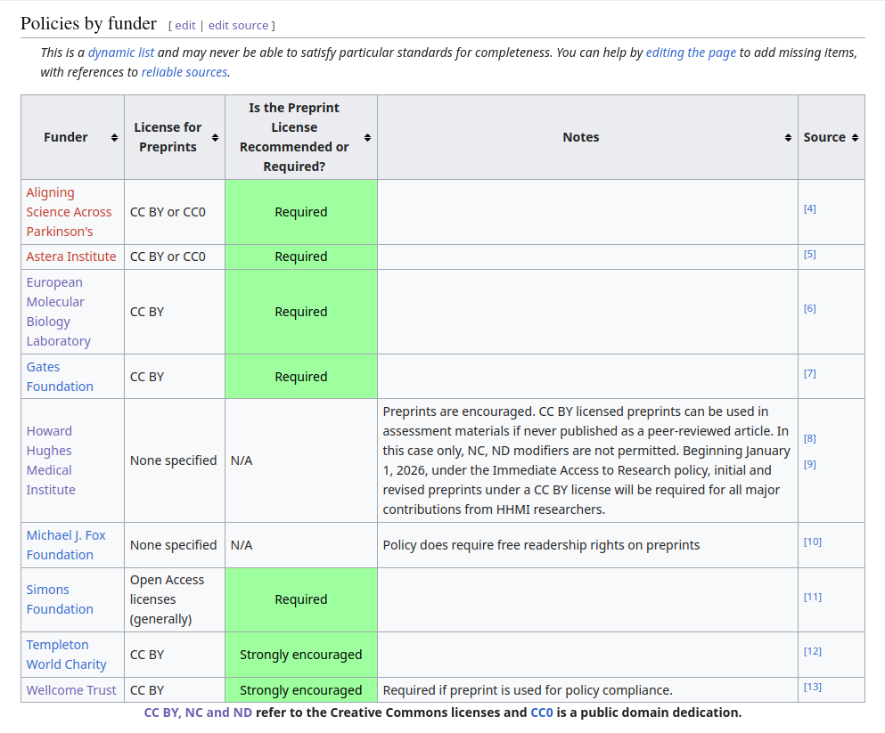
OPEN ACCESS MANDATES
An increasing number of funders and research institutions require research and data to be published with an open license.
Notes:
Generalizing and will share a new publication soon.

Slide 14




CC LICENSES: FOUR CONDITIONS
Attribution (BY): Credit must be given to you, the creator.
ShareAlike (SA): Adaptations must be shared under the same terms.
NonCommercial (NC): Only noncommercial use of your work is permitted, not primarily intended for monetary compensation.
NoDerivatives (ND): No derivatives or adaptations of your work are permitted.

Slide 15







CC LICENSES: FOUR OPTIONS
most freedom
Attribution (BY): Credit must be given to you, the creator.
ShareAlike (SA): Adaptations must be shared under the same terms.
NonCommercial (NC): Only noncommercial use of your work is permitted, not primarily intended for monetary compensation.
NoDerivatives (ND): No derivatives or adaptations of your work are permitted.
least freedom

Slide 16
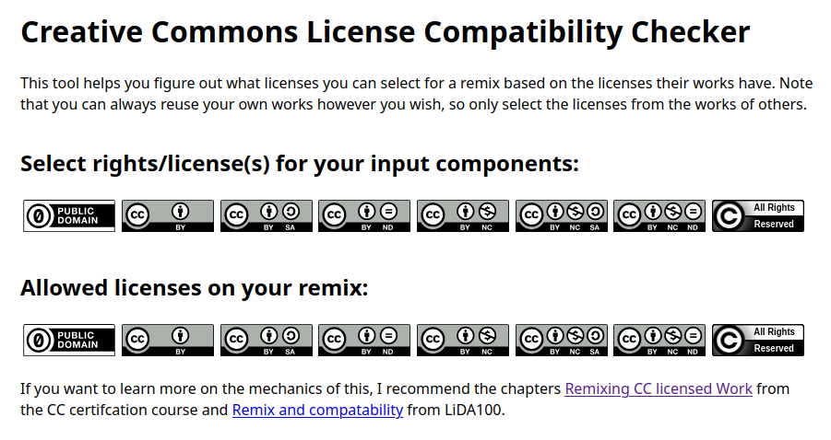
LICENSE STACKING
Notes:
Available in many languages

Slide 17
ATTRIBUTIONS: USE TASL
A complete, formal attribution should include:
Title
Author or Publisher
Source Link
License or Legal Terms
E.g., “Suggested Attribution: License to Share - Open Data and Creative Commons by Jan Ainali. Licensed CC BY 4.0.”

Slide 18

Recommended Licensing and Legal Terms that maximize free and unrestricted sharing
Recommended Metadata Values
that center licensing, attribution, and provenance

Slide 19
CC RECOMMENDED LEGAL TERMS
Option A: CC0 + Attribution Request
“This work is dedicated to the public domain, marked by CC0 1.0. Attribution is requested.”
Recommended for: Organizations developing new data policies; Those willing to share their data freely to maximally reduce the friction in use.
What it is: CC0 is not a license; It dedicates climate data to the global public domain. Attribution requests are added by default even though they are not legally required.
Benefits: Enables data distribution, remixing, and adaptation without legal restrictions; Encourages professional attribution; Eliminates legal complexities, releasing any burden on users.
Considerations: Address sensitive data proactively before sharing; Manage name trademarks if used.

Slide 20
CC RECOMMENDED LEGAL TERMS
Option B: CC BY 4.0
“This work is licensed under CC BY 4.0.” .
Recommended for: Producers and publishers that want to share and still own their copyrightable data, where allowed.
What it is: CC BY 4.0 is a highly permissive license that allows unrestricted reuse as long as proper attribution is given.
Benefits: Retains data ownership in permitting jurisdictions; Offers a legal mechanism for enforcing attribution and proper data use; Could provide a way to track data use via attributions.
Considerations: Sharing can become complex when users want to merge with other licensed data; May not apply in all jurisdictions or on non-copyrightable material.

Slide 21
CC BY 4.0 LANGUAGES AVAILABLE
Arabic - العربية
Bahasa Indonesia
Basque - Euskara
Chinese - 中文
Croatian - Hrvatski
Czech - Český
Danish - Dansk
Dutch - Nederlandse
Finnish - Suomen
French - Français
Frisian - Frysk
German - Deutsche
Greek - Ελληνική
Italian - Italiana
Japanese - 日本語
Korean - 한국어
Latvian - Latviešu
Lithuanian - Lietuvių
Norwegian - Norsk
Polish - Polski
Portuguese - Português
Romanian - Română
Russian - Русский
Slovenian - Slovenski
Spanish - Español
Swedish - Svenska
Turkish - Türk
Ukrainian - Українська
💬
If you or someone you know is available
to translate Creative Commons licenses into another language,
please contact jan@creativecommons.org.

Slide 22
Recommended Licensing and Legal Terms that maximize free and unrestricted sharing
Recommended Metadata Values
that center licensing, attribution, and provenance

Slide 23
RECOMMENDED METADATA VALUES
Metadata Value Label | Example Value
Title | Korean Land and Water Levels 2003
Author or Publisher | Korea Meteorological Administration
Source Link or Identifier | doi:XXXXXXX/kma.domain
License | http://creativecommons.org/publicdomain/zero/1.0
Attribution / Bibliographical Citation | Korea Meteorological Administration, Korean Land and Water Levels 2003, Issued 2004-01-01, Modified 2004-03-01, doi:XXXXXXX/kma.domain, http://creativecommons.org/publicdomain/zero/1.0, CC0 + Attribution Request.
Rights Statement | CC0 + Attribution Request. This work is dedicated to the public domain, marked by CC0, which allows users worldwide to distribute, remix, adapt, and build upon the material in any medium or format, with no legal conditions on reuse. Attribution is requested in a standard format to allow reusers to easily include this information.
Notes:
How open content helps solve the world’s most pressing problems.

Slide 24
STACKED CITATIONS
 | Metadata Value Label | Example Value
ABOUT MY DATA/ DATABASE/ PRODUCT My organization has something to share with you, and we want to make sure you attribute us and our sources. | Bibliographical Citation (equivalent to dcterms:bibliographicCitation) Here is how to cite us and our sources: [Our Citation: Title, Publisher, Identifier, License, etc.] [Our Source 1: Title, Publisher, Identifier, License, etc.] [Our Source 2: Title, Publisher, Identifier, License, etc.] … etc. | User’s Org, Land and Water Levels Across Asia 2003, 31/10/2024, doi:XXXXXXX/user.domain, CC BY 4.0. ; Climate Data Store (CDS), KMA Korean Land and Water Levels 2003, 21/05/2004, doi:XXXXXXX/cds.domain, CC0 with Attribution Request ; Korea Meteorological Administration, Korean Land and Water Levels 2003, 01/01/2004, doi:XXXXXXX/kma.domain, CC0 with Attribution Request ; Japan Meteorological Agency, Japanese Land and Water Levels 2003, 01/01/2004, doi:XXXXXXX/jma.domain, CC BY 4.0.
Notes:
How open content helps solve the world’s most pressing problems.

Slide 25
STACKED CITATIONS
 | Metadata Value Label | Example Value
ABOUT MY SOURCE(S) My organization got data from other sources, and we want to attribute our sources. | Source 1 Bibliographical Citation (dcterms:source1BibliographicCitation) Context: Here is the citation of our Source 1 and their sources: [Our Source 1: Title, Publisher, Identifier, License, etc.] [Source 1’s Source 1: Title, Publisher, Identifier, License, etc.] [Source 1’s Source 2: Title, Publisher, Identifier, License, etc.] … | Climate Data Store (CDS), “KMA Korean Land and Water Levels 2003”, 21/05/2004, doi:XXXXXXX/cds.domain, CC0 with Attribution Request ; Korea Meteorological Administration, “Korean Land and Water Levels 2003”, 01/01/2004, doi:XXXXXXX/kma.domain, CC0 with Attribution Request
Notes:
How open content helps solve the world’s most pressing problems.

Slide 26
METADATA: USE TASLAR
A complete, formal attribution should include:
Title
Author or Publisher
Source Link
License or Legal Terms
Attribution Statement or Bibliographic Citation
Rights Statement

Slide 27
WORKSHOP TASKS
Find your organization’s policy for sharing data.
Was it easy to find?
Is it publicly available? (If so, please paste links into the chat, so others can see)
Are you lacking a separate policy (perhaps it is bundled with other intellectual property policy) or lacking it completely?
Notes:
How open content helps solve the world’s most pressing problems.

Slide 28
WORKSHOP TASKS
Regarding your organization’s policy for sharing data:
Does the policy specify which license(s) to use?
Is it aligned with our recommendations?
For those of you who didn’t find a policy, did you find anything else interesting in this context?
Notes:
How open content helps solve the world’s most pressing problems.

Slide 29
WORKSHOP TASKS
Regardless if your organization has a policy for sharing data or not:
Do you know how to go about improving the existing or adopting a new policy?
Who are the key colleagues to raise the question with?
Would you like help?
Notes:
How open content helps solve the world’s most pressing problems.

Slide 30
DISCUSSION
What challenges do you face with your organization’s open data licensing, policies, and/or platforms, if any?
What support would be helpful for improving your rganization’s open data licensing, policies, and/or platforms, if any?
Notes:
How open content helps solve the world’s most pressing problems.

Slide 31
Q&A + DISCUSSION
Read the Report: Recommended Best Practices For Better Sharing Of Climate Data
التوصيات متوفرة باللغة العربية | 提供中文版推荐 | Recommandations en français | Recomendaciones en español
Notes:
Do you have any suggestions or takeaways?
Takeaways / Recommendations / Suggestions

Slide 32
THANK YOU!
Jan Ainali, Research Analyst, Creative Commons
jan@creativecommons.org

Slide 33
Open Images

Slide 34
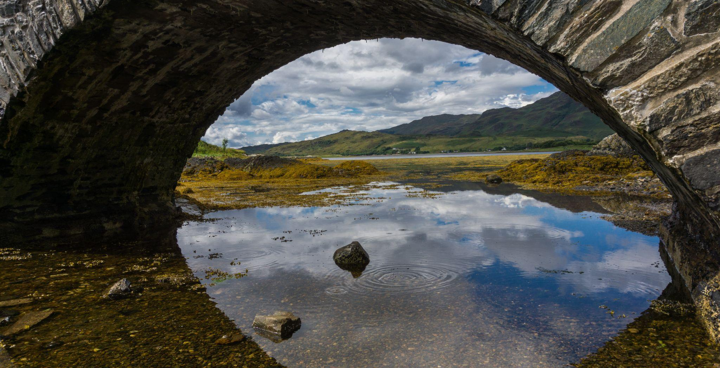
Scotland © 2017 by barnyz, slightly cropped, is licensed under CC BY-NC-ND 2.0.

Slide 35

Lone Cypress (HDR) © 2011 by Nagarajan Kanna, slightly cropped, is licensed under CC BY-NC-ND 2.0.

Slide 36

Mansion in the Santee/3 © 2018 by Trevor Marron, slightly cropped, is licensed under CC BY 2.0.

Slide 37
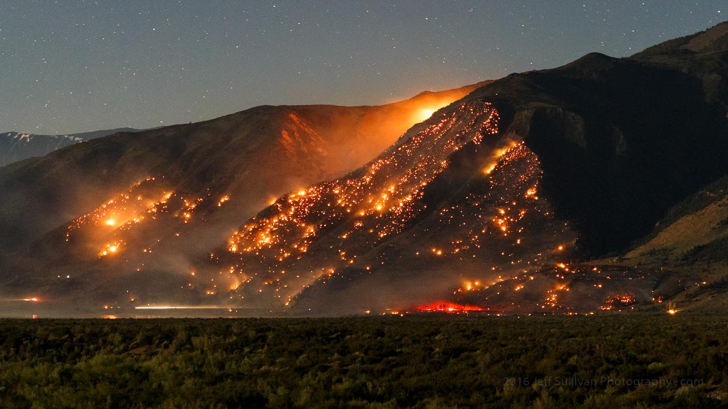
Marina Fire 12:25am Last Night © 2016 by Jeff Sullivan, slightly cropped, is licensed under CC BY-NC-ND 2.0.

Slide 38

Val D'Orcia © 2015 by John Weiss, slightly cropped, is licensed under CC BY-NC-ND 2.0.

Slide 39
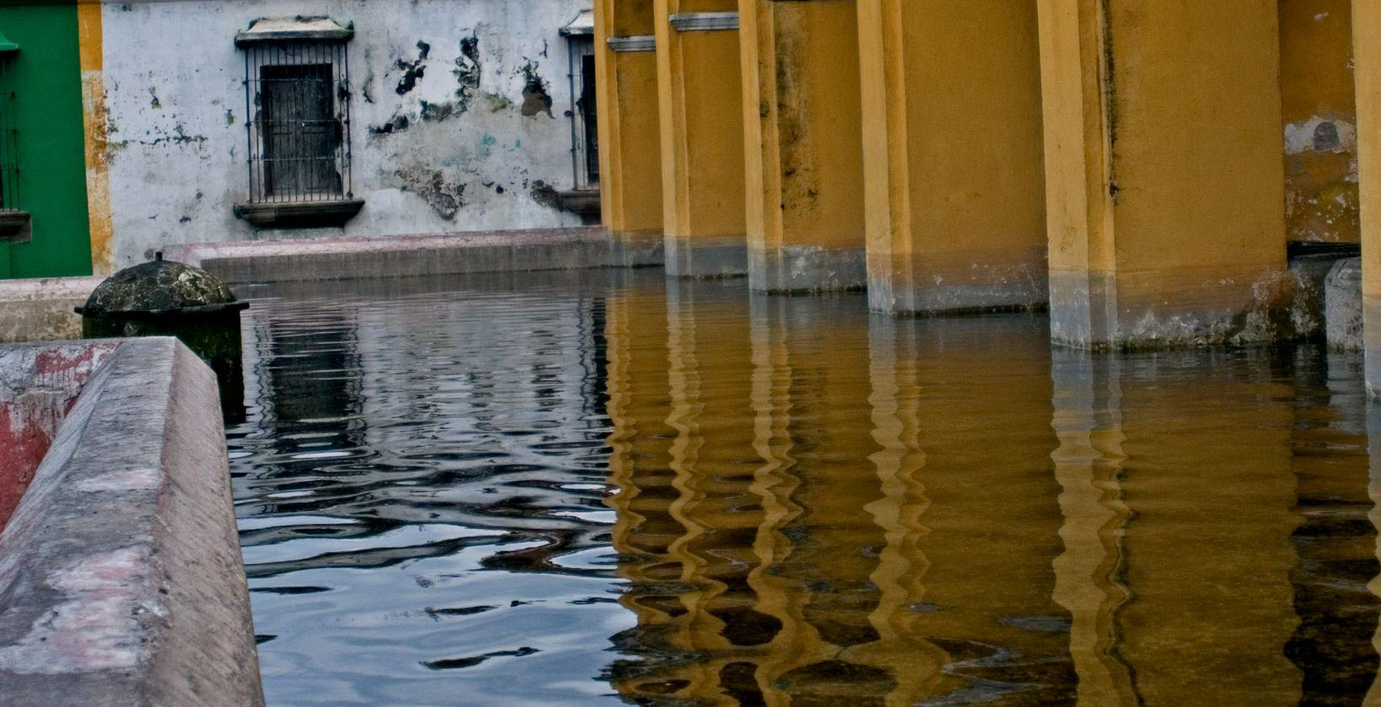
Tanque de Agua La Unión Antigua Guatemala © 2007 by PAL1970, slightly cropped, is licensed under CC BY-NC-ND 2.0.

Slide 40

Lantern Floating Festival 2014 © 2014 by Kyle Nishioka, slightly cropped, is licensed under CC BY-NC-ND 2.0.

Slide 41
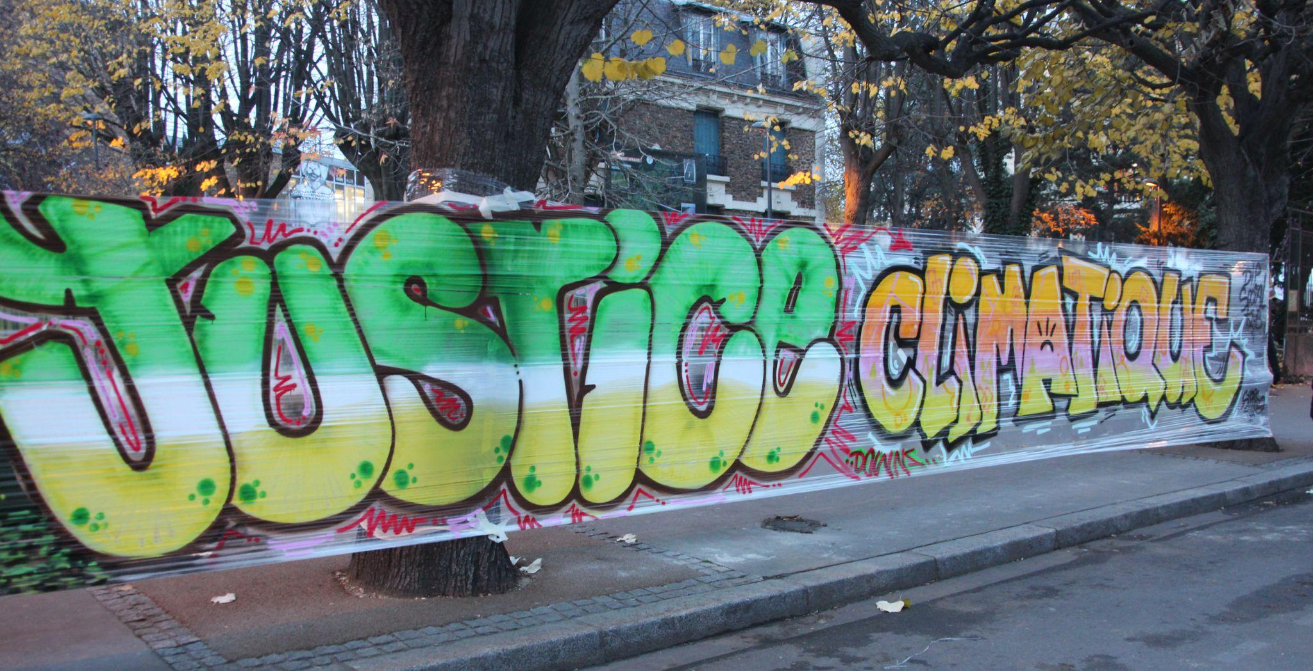
Justice Climatique Banner at the People's Climate Summit in Montreuil © 2015 by John Englart, slightly cropped, is licensed under CC BY-SA 2.0.

