Slide 1

Lucious Ofeni School of Law and Justice Studies

Slide 2
My talk will take you through my research journey with some reflections
An overview of my research project.
How I collect and manage my data.
Challenges or unexpected wins encountered.
How I plan to share my findings at the end of the project.
Reflections on public engagement.
Summary

Slide 3

my road
My journey started 9 years ago—
I have been interested in how things happen

Slide 4
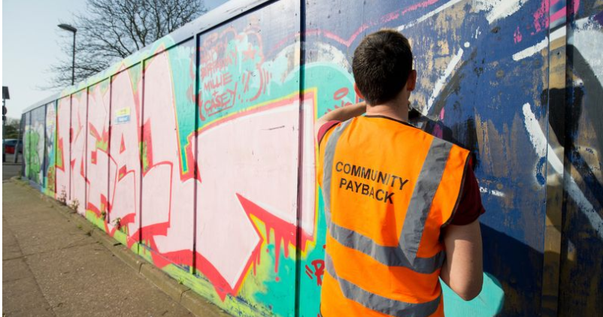
Research Overview
The aim of the research is to critically explore the rehabilitative potential of unpaid work and the role of the voluntary sector in building pro-social capital.
How?
By understanding the views, expectations, insight and experiences of different stakeholders

Slide 5
Data Collection method: Interviews
Placement Coordinators
Unpaid Work Supervisors
The voluntary Sector manager who supervise UPW
People on Probation

Slide 6
Challenges or unexpected wins encountered.
Costs and Life-work balance; balancing work, school and family has been challenging but rewarding.
Data collection: Accessing People on Probation, Staff due to time, location and getting informed consent has been a huge challenge
I have learnt new skills (both technical and personal) and new research perspectives;
It acts as the voice of those involved in unpaid work, creating mutual benefits,
Better understanding of the contribution of the VS to the rehabilitation process

Slide 7
How I manage my data
Ethical approvals, informed consent, and stewardship of sensitive data
Interview recordings were securely stored on OneDrive with access controls, encryption, and regular backups.
Transcripts were anonymised, coded, and stored separately.
University Secure place-- One Drive

Slide 8

How to use or share data
Through eThesis
Research findings with professionals through an executive summary
I try to make my data as open as possible and as restricted as necessary. Plan to deposit at the University trusted repositories

Slide 9
Public Engagement (Openness)
I have engaged with practitioners, Academia, and the voluntary sector
All these people have helped shape my research to be where it is now
I have shared the research in three research conferences feedback had been helpful that strengthen credibility

Slide 10
Summary
The research explore rehabilitative potential of UPW and role of the VS in social capital formation.
Public engagement has helped refined the proposal, research design, interview questions and data collection
Data has been securely stored and accessed through the University Servers. through One drive
Am still on this journey

Slide 11
.
Any questions
END

