Slide 1

Welcome to Open Data Week 2025

Slide 2

More from Open Data Week!
Choosing the right journal and avoiding predatory publishers, Tuesday 11 November, 2.30pm to 3.30pm https://unical.ljmu.ac.uk/Event.aspx?EventId=26355104-d687-f011-bf4c-005056abb76e&Wait=N
License to Share - Open data and Creative Commons, Wednesday 12 November, 2pm to 3pm https://unical.ljmu.ac.uk/Event.aspx?EventId=9185bf85-a288-f011-bf4c-005056abb76e&Wait=N
Research data visibility and metrics (Scopus, ORCID, DORA-aligned practices), Thursday 13 November, 10.30am to 11.30am https://unical.ljmu.ac.uk/Event.aspx?EventId=93bebfd3-da88-f011-bf4c-005056abb76e&Wait=N
Plus, much more! Please go to: https://unical.ljmu.ac.uk/

Slide 3
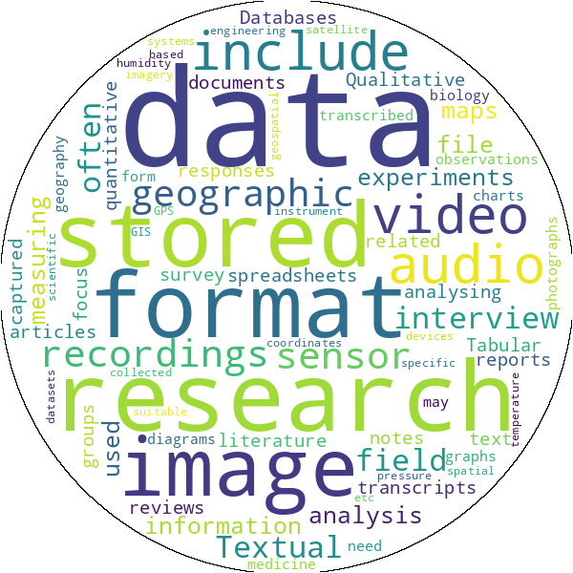
What is Open Data and Why It Matters
Notes:
Open Data refers to data that is freely available for anyone to access, use, modify, and share — without restrictions
To be truly open, data should be:
Accessible: Easy to find and download
Usable: Provided in formats that allow analysis and reuse
Licensed: Clearly marked with permissions (e.g., Creative Commons)
Open Data matters because it empowers transparency, innovation, and collaboration by making knowledge freely accessible to everyone.

Slide 4

LJMU’s open data support and data repository
LJMU’s Open Data Support
The Amie Longthorne (Open Research Data Specialist) provides guidance on data management, licensing, and sharing, plus training and events like Open Data Week.
Contact: a.l.Longthorne@ljmu.ac.uk or OpenResearch@ljmu.ac.uk for advice on open research practices and compliance.
Data Repositories
LJMU Research Data Repository (opendata.ljmu.ac.uk) is the institutional platform for storing and sharing research data openly. It supports FAIR principles (Findable, Accessible, Interoperable, Reusable) and allows embargoed storage if data cannot be shared immediately

Slide 5
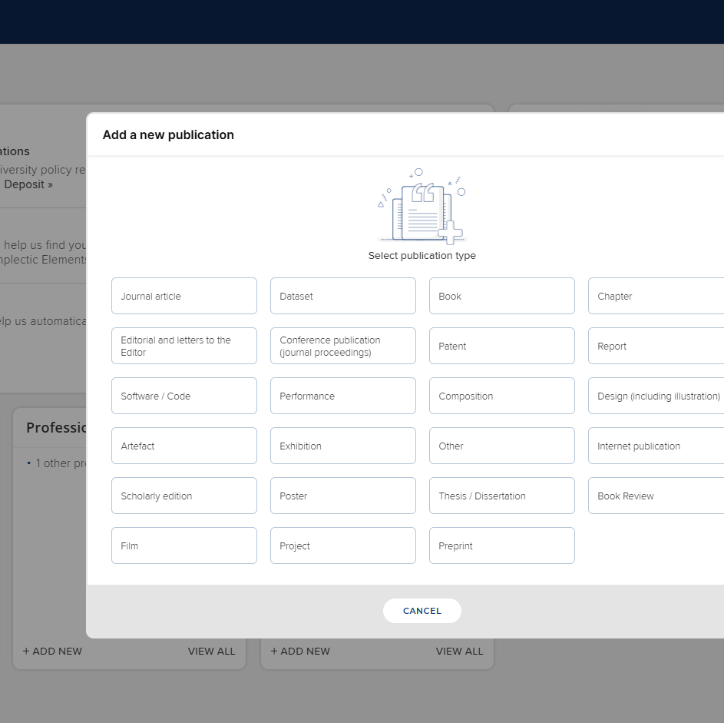
How to share datasets in LJMU’s data repository
Deposit via Symplectic by selecting “Dataset” and completing metadata fields (title, authors, abstract, keywords, methodology, licensing). Include a README file and apply an appropriate Creative Commons licence.

Slide 6
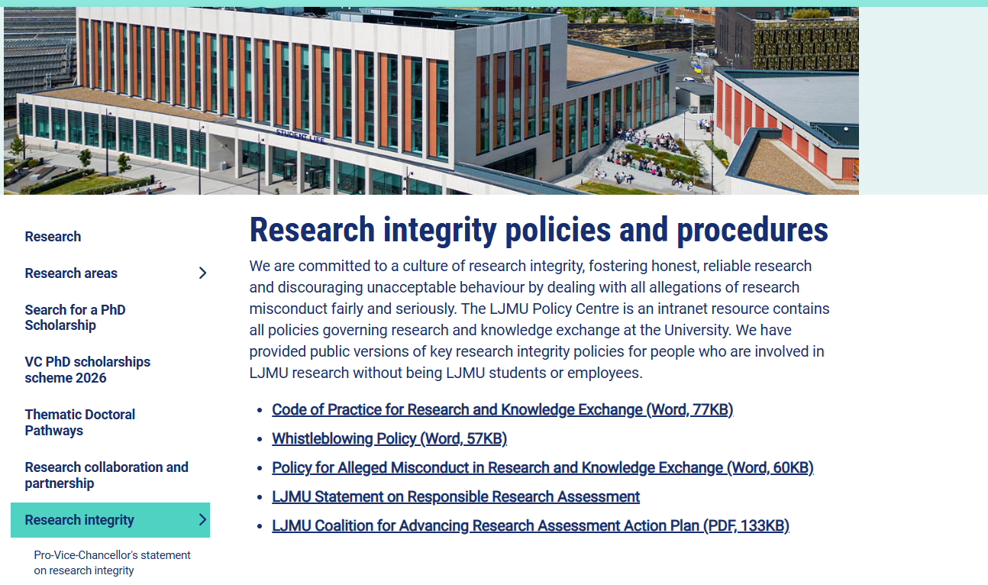
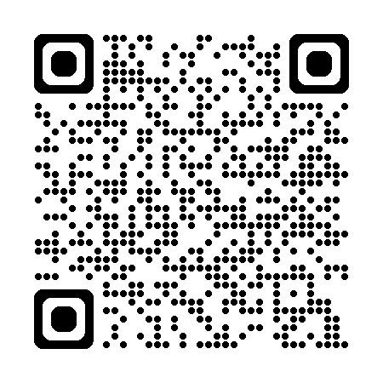
Research Integrity at LJMU
Liverpool John Moores University empowers intellectual curiosity and creativity in all who conduct research under its auspices.
We take great pride in a vibrant, empowering culture where staff, students, and collaborators pursue excellent research and knowledge exchange activity while being supported to uphold the highest standards of research ethics and integrity.
Scan QR Code for more information or go to:
https://www.ljmu.ac.uk/research/research-integrity

Slide 7


UKRIO Course
‘Introduction to Research Integrity’
This self-paced course has been developed by UKRIO in partnership with University College London. It offers a thorough and practical introduction to research integrity, suitable for all disciplines and all career stages—from PhD researchers to senior academics and professional services staff supporting research.

Slide 8
Take a Break for Integrity – UKRIO Training Time
Use your LJMU email address to sign-up to the course (Link will be sent to LJMU Staff and PGR’s) If you need further assistance, you can email UKRIO training or contact Amie Longthorne or Martin Brooks at LJMU with your questions.
If you would like a quiet space to engage with the UKRIO training platform and reflect on best practices in research, register for ‘Take a Break for Integrity – UKRIO Training Time’.
Taking place on Wednesday 12th November 11:30 AM - 1:30 PM at City Campus Library as part of Open Data Week, whether you're new to research integrity or just want a refresher, you can explore the UKRIO accredited training course at your own pace in this informal session. Pop in anytime – no need to stay for the full two hours! Only 6 spaces left , so be quick!
To book, please visit Home and look for the Researcher Engagement Calendar.

Slide 9
Introduction to the
Open Science Framework
Susi Zajitschek
School of Biological and Environmental Sciences

Slide 10





OSF – Open Science Framework
Center for Open Science
non-profit
Free, open-source platform
Supports research lifecycle
Planning to publication
Project Management
File organisation
Sharing
Version control
Combined funding sources
Preservation fund: 50yrs + accessibility
Notes:
OSF = Open Science Framework
Free, open-source platform developed by the Center for Open Science (COS)
Supports research lifecycle from planning to publication
Combines project management, sharing, and version control
federal agencies, private foundations, and commercial entities.
ONLY 10% US federal funding
How can it be free? How are you funded?
OSF is maintained and developed by the Center for Open Science (COS), a 501(c)3 non-profit organization. COS is supported through grants from a variety of supporters, including federal agencies, private foundations, and commercial entities.
What if you run out of funding? What happens to my data?
COS established a $400,000 preservation fund for hosted data in the event that COS had to curtail or close its offices. If activated, the preservation fund will preserve and maintain read access to hosted data. This fund is sufficient for 50+ years of read access hosting at present costs. COS will incorporate growth of the preservation fund as part of its funding model as data storage scales.

Slide 11
Reproducibility and transparency
reduce “reproducibility crisis”
Open practices
promote collaboration
efficiency
public trust
Funders
increasingly mandate openness
credible science

Slide 12

Collaboration
Sharing data
Sharing code
Sharing drafts
Sharing versions

Slide 13



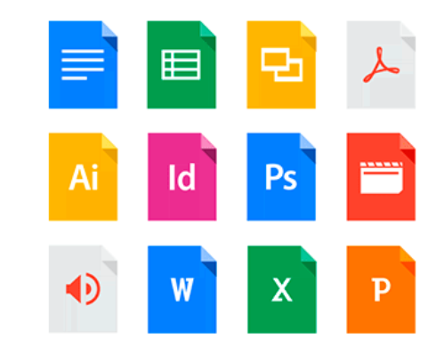





Many options
These Photos by Unknown Authors are licensed under CC BY-SA

Slide 14
Potential issues?
Accessibility
Organisation
where did that file go…?
Many single files
rather than project sharing
multiple collaborators
different platforms

Slide 15
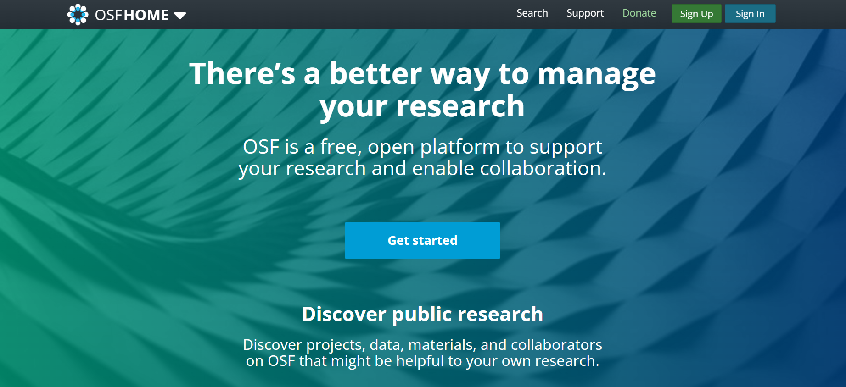
OSF.io
Home screen

Slide 16
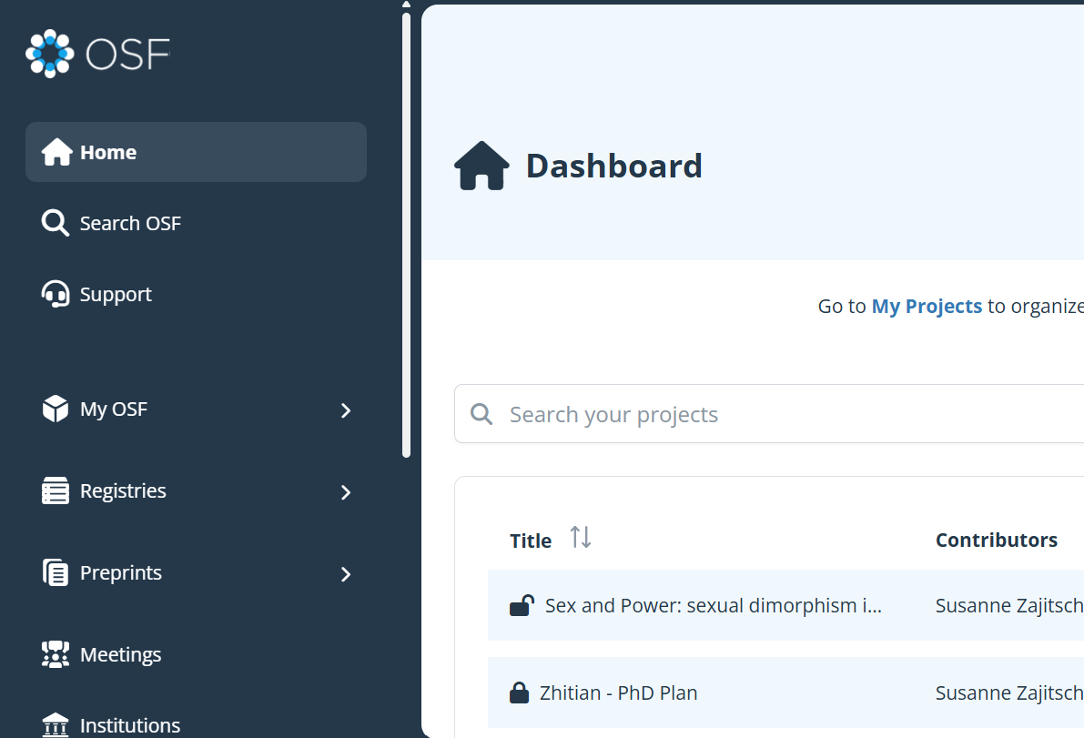
Key Features
Projects and components
File storage
Version control /File history
Collaboration

Slide 17
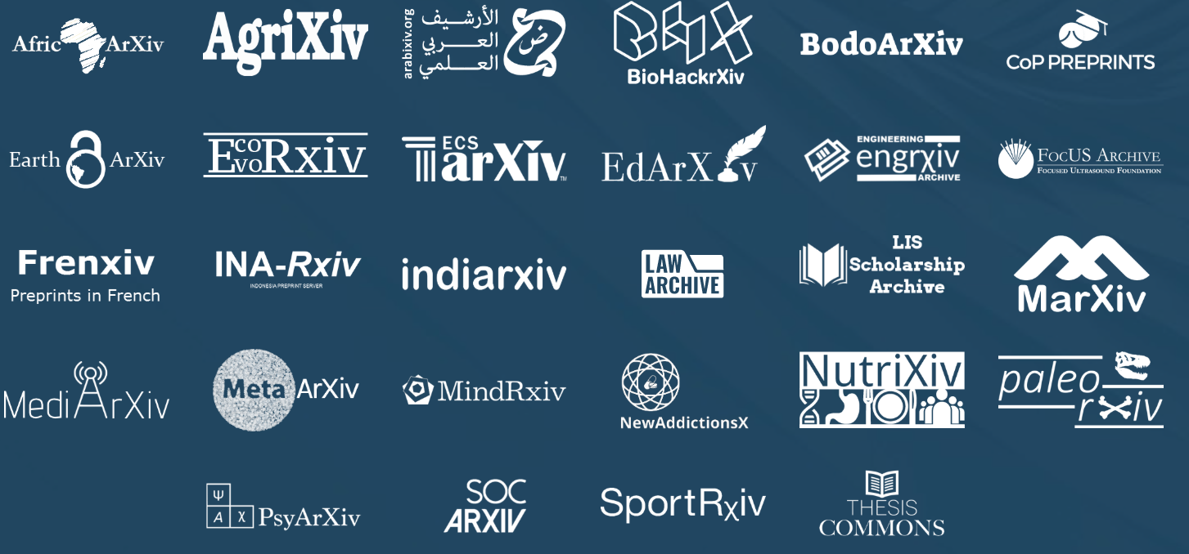
Preprints &
Pre-registration-registration
Study plan / methods
Documented
Pre-Reg: Peer-reviewed
Decouples study design from outcome

Slide 18
Pre-Registration
What:
Time-stamped record of study design
OSF Registries
Public, searchable
repository of registered studies
Why:
Improves credibility, reduces hindsight bias
How:
OSF pre-registration templates
- AsPredicted
- Prereg Challenge
- Standard Pre-registration
Domain-general
Permanent DOI
links for citation
Preprint Server
Domain-specific
PsyArXiv, BioArXiv, etc.
Promotes visibility and credit for study design
Options to embargo
Public, searchable

Slide 19
OSF and FAIR Principles
Findable
Accessible
Interoperable
Reusable
Projects and data indexed
DOIs available
Public sharing
Embargo options
Supports metadata
Common file types
Wikis
structured templates
Publications
Link preprints, published papers, supplements

Slide 20
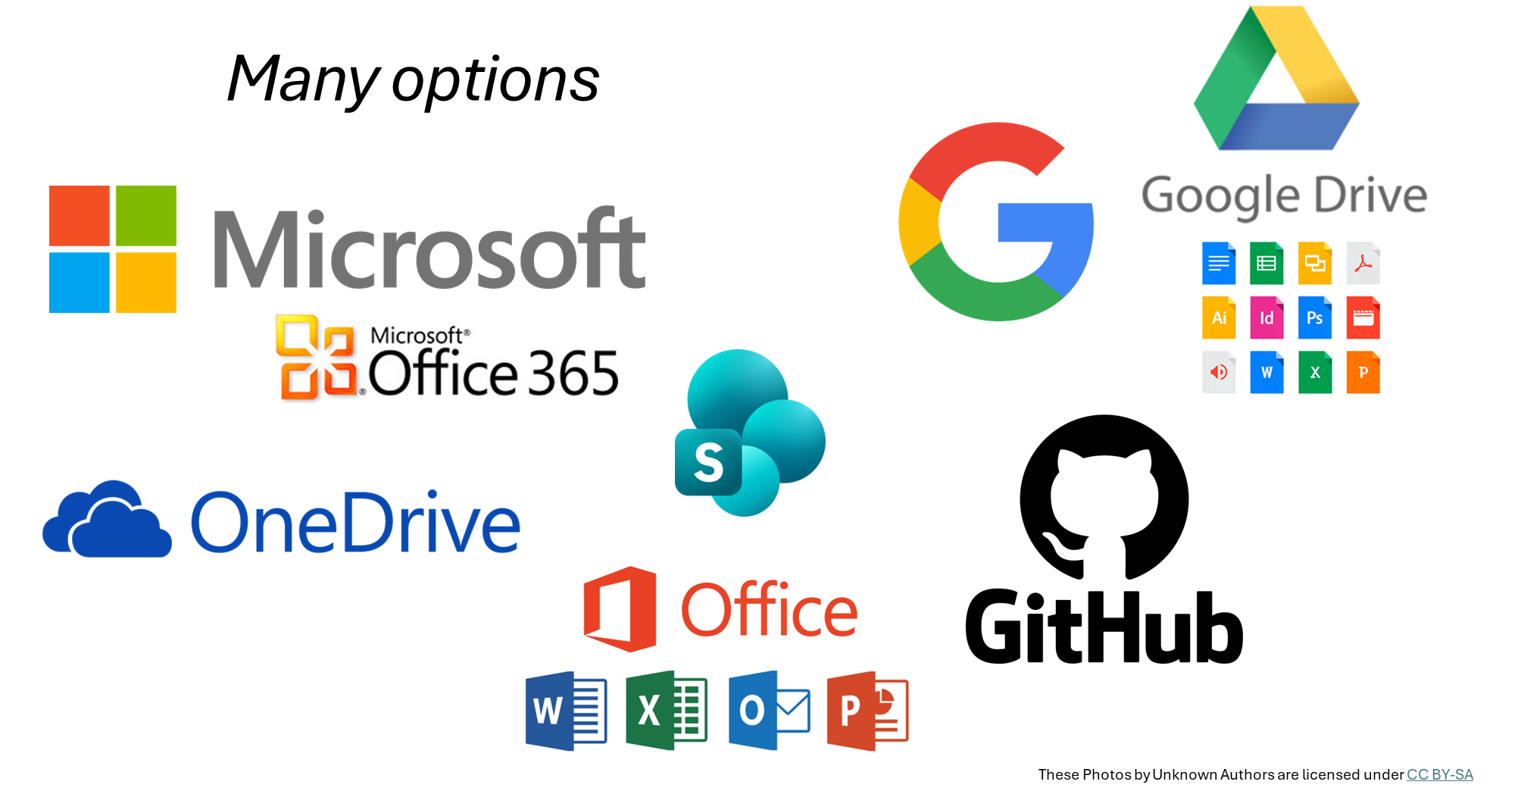
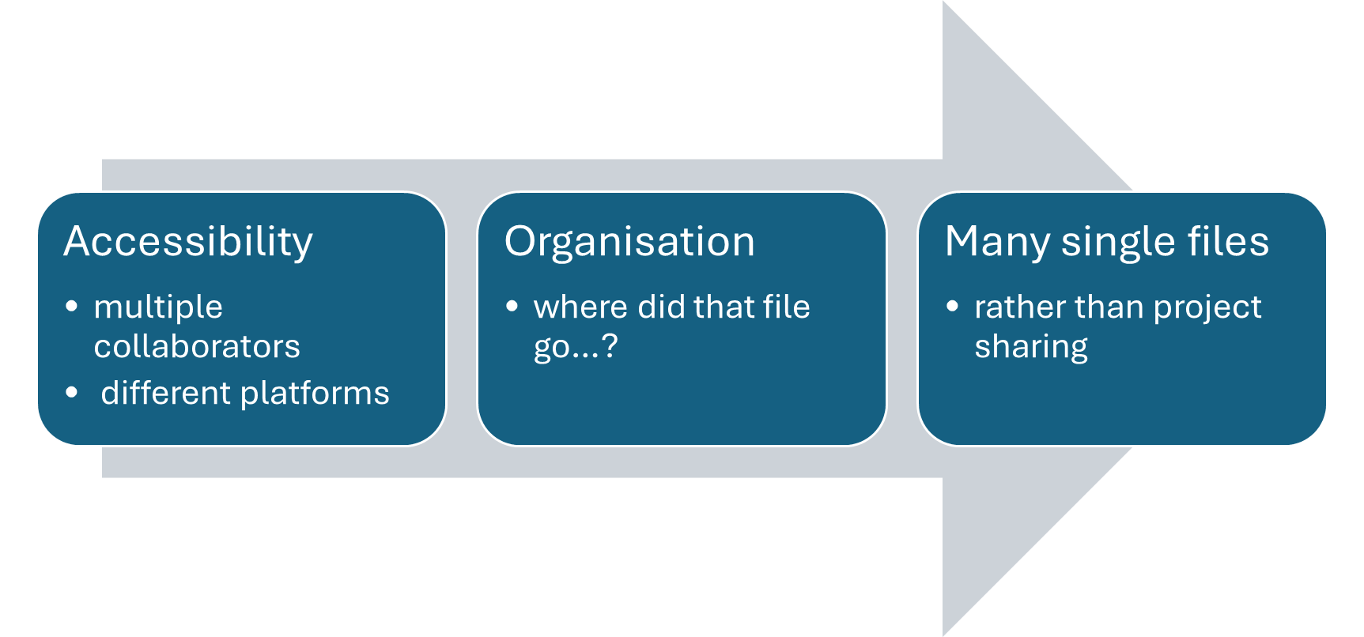
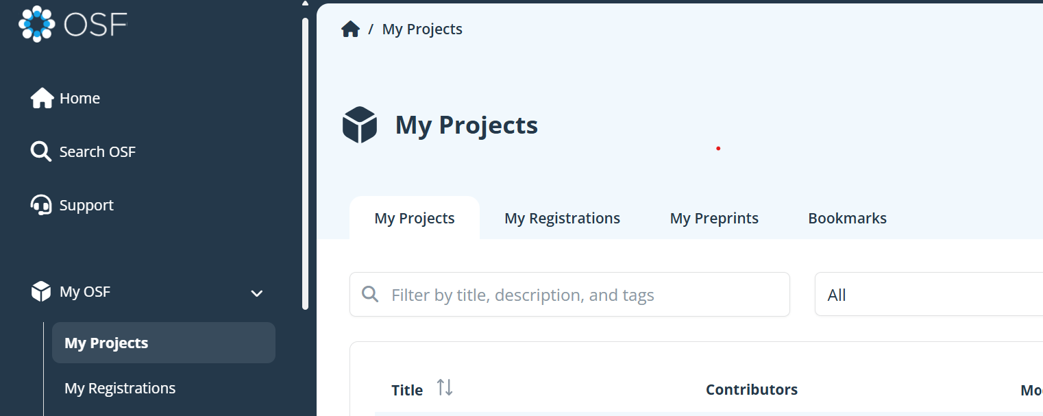

Slide 21

Individual project
Lab / Group Space
Collaborative Space
Manage Thesis
Analysis pipeline
Admin project
Centralise resources
Share protocols
Open access:
data
Link:
code
Protocols
preprints
papers
OSF in practise
supplements
Store shared files

Slide 22
Tour…
https://osf.io/dashboard
Wiki
Project overview
Files
Uploads
Linked services
Contributors
Manage permissions
Documentation
Key information
Activity
Automatic tracking
logs

Slide 23
Advantages
Facilitates reproducibility
Public projects
50 GB
limit each
Limitations
Single file limit: 5GB
Centralised
Free of charge
Community support
Modular
Private projects:
5 GB max

Slide 24
Thank you!
Resources and Support
COS Help Center: https://help.osf.io
Example projects: Browse featured OSF projects
OSF YouTube tutorials and webinars
COS Ambassadors and community forums

