Slide 1

Merseyside Exercise and Diet for Aggregation of LDL (MEDAL Trial)
Alex Amorginos
Notes:
Firstly good morning etc

Slide 2
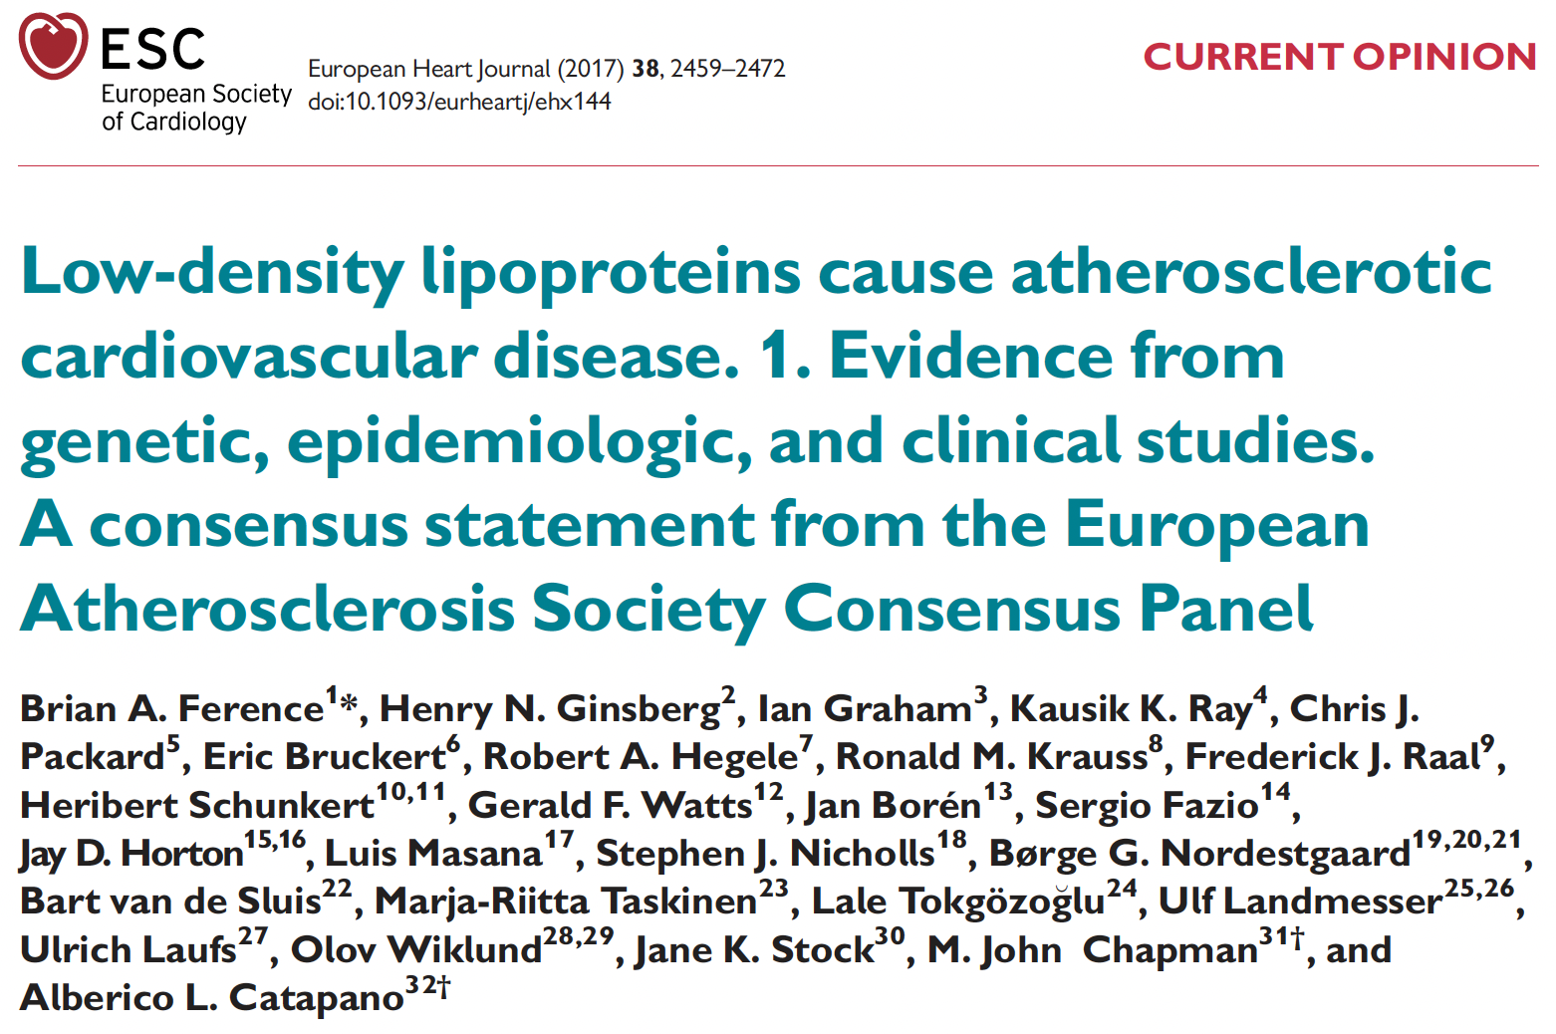
Notes:
As I am sure we all know, LDL has been recognised as a causal factor for atherosclerotic CVD (even if some individuals argue the opposite).

Slide 3











How does ASCVD occur?
LUMEN
Modified
+ROS
INTIMA
Linton et al., 2019

Slide 4


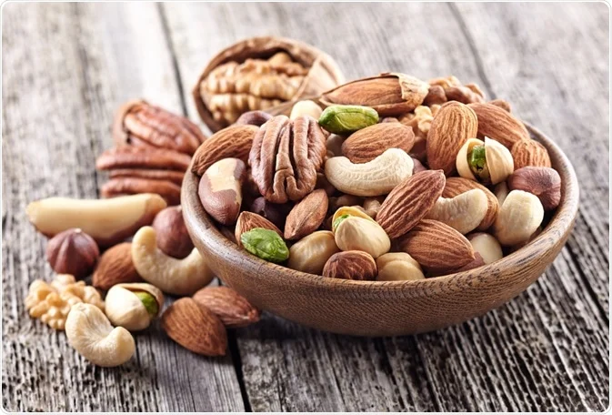






How does diet affect this?
Unsaturated fats
Fibre
Saturated fats
Notes:
This is mainly done through
- the upregulation of LDLR
- a reduction in LDL-C production rates
binding of fibre to bile acids.
Increased intake of saturated fats, trans fats, and alcohol can negatively impact an individual's standard lipid profile, specifically LDL.

Slide 5
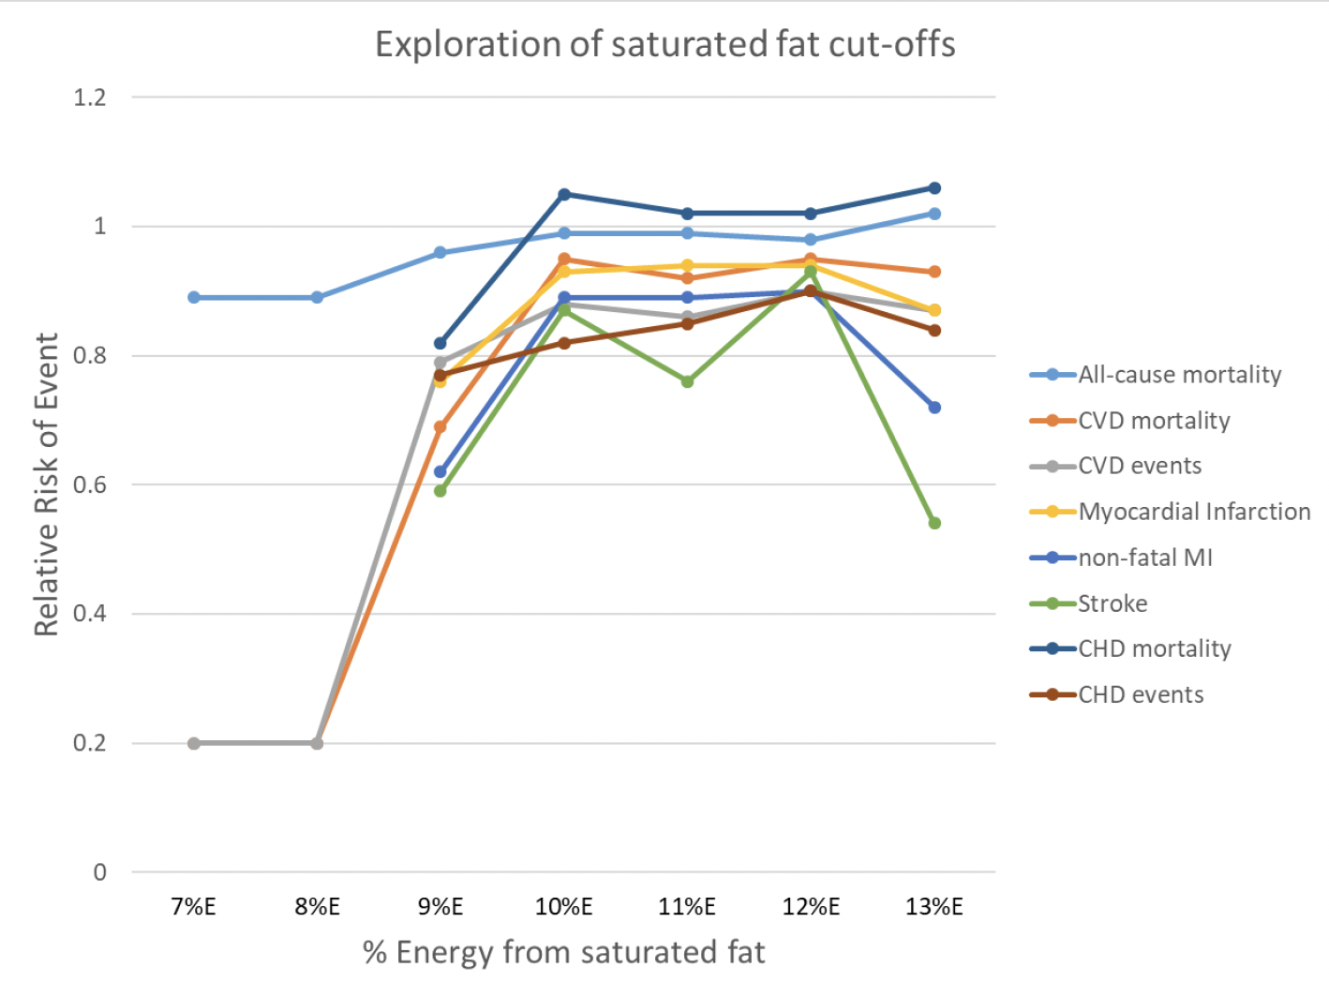
Hooper et al., 2020

Slide 6
Saturated fats and LDL aggregation susceptibility
A 2021 study from the Wihuri Research Institute’s lab has demonstrated that SFA overconsumption increases LDL aggregation susceptibility.
However, overconsumption of USFAs and simple sugars do not appear to have the same effect.
Ruuth et al., 2021
Notes:
The mediterranean diet is characterised as high in fruit, vegetables, beans and legumes (fibre), olive oil, nuts and seeds and fatty fish (USFAs) while low in fatty red meat (SFAs). This is why it is one of the best diets for cardiovascular disease.

Slide 7
What about exercise?
Resistance exercise (RE) has been shown to improve lipids in multiple populations.
Its effects are maximised when it is paired with aerobic training.
The effects of resistance training on LDL aggregation have not yet been investigated.
Ambrozi et al., 2022; He et al., 2023; Ihalainen et al., 2019; Zhou et al., 2022
Notes:
Possible mechanisms:
greater energy expenditure and fat utilisation leading to increased LDL clearance
another being an increase in lipoprotein lipase activity.

Slide 8


What does this have to do with me?
Notes:
So today I will be providing you with some insight on my project which explores how a Mediterranean style diet and resistance exercise can be combined to improve cardiac prehabilitation.

Slide 9



Our Project
Studies
Interventions
Systematic Review

Slide 10
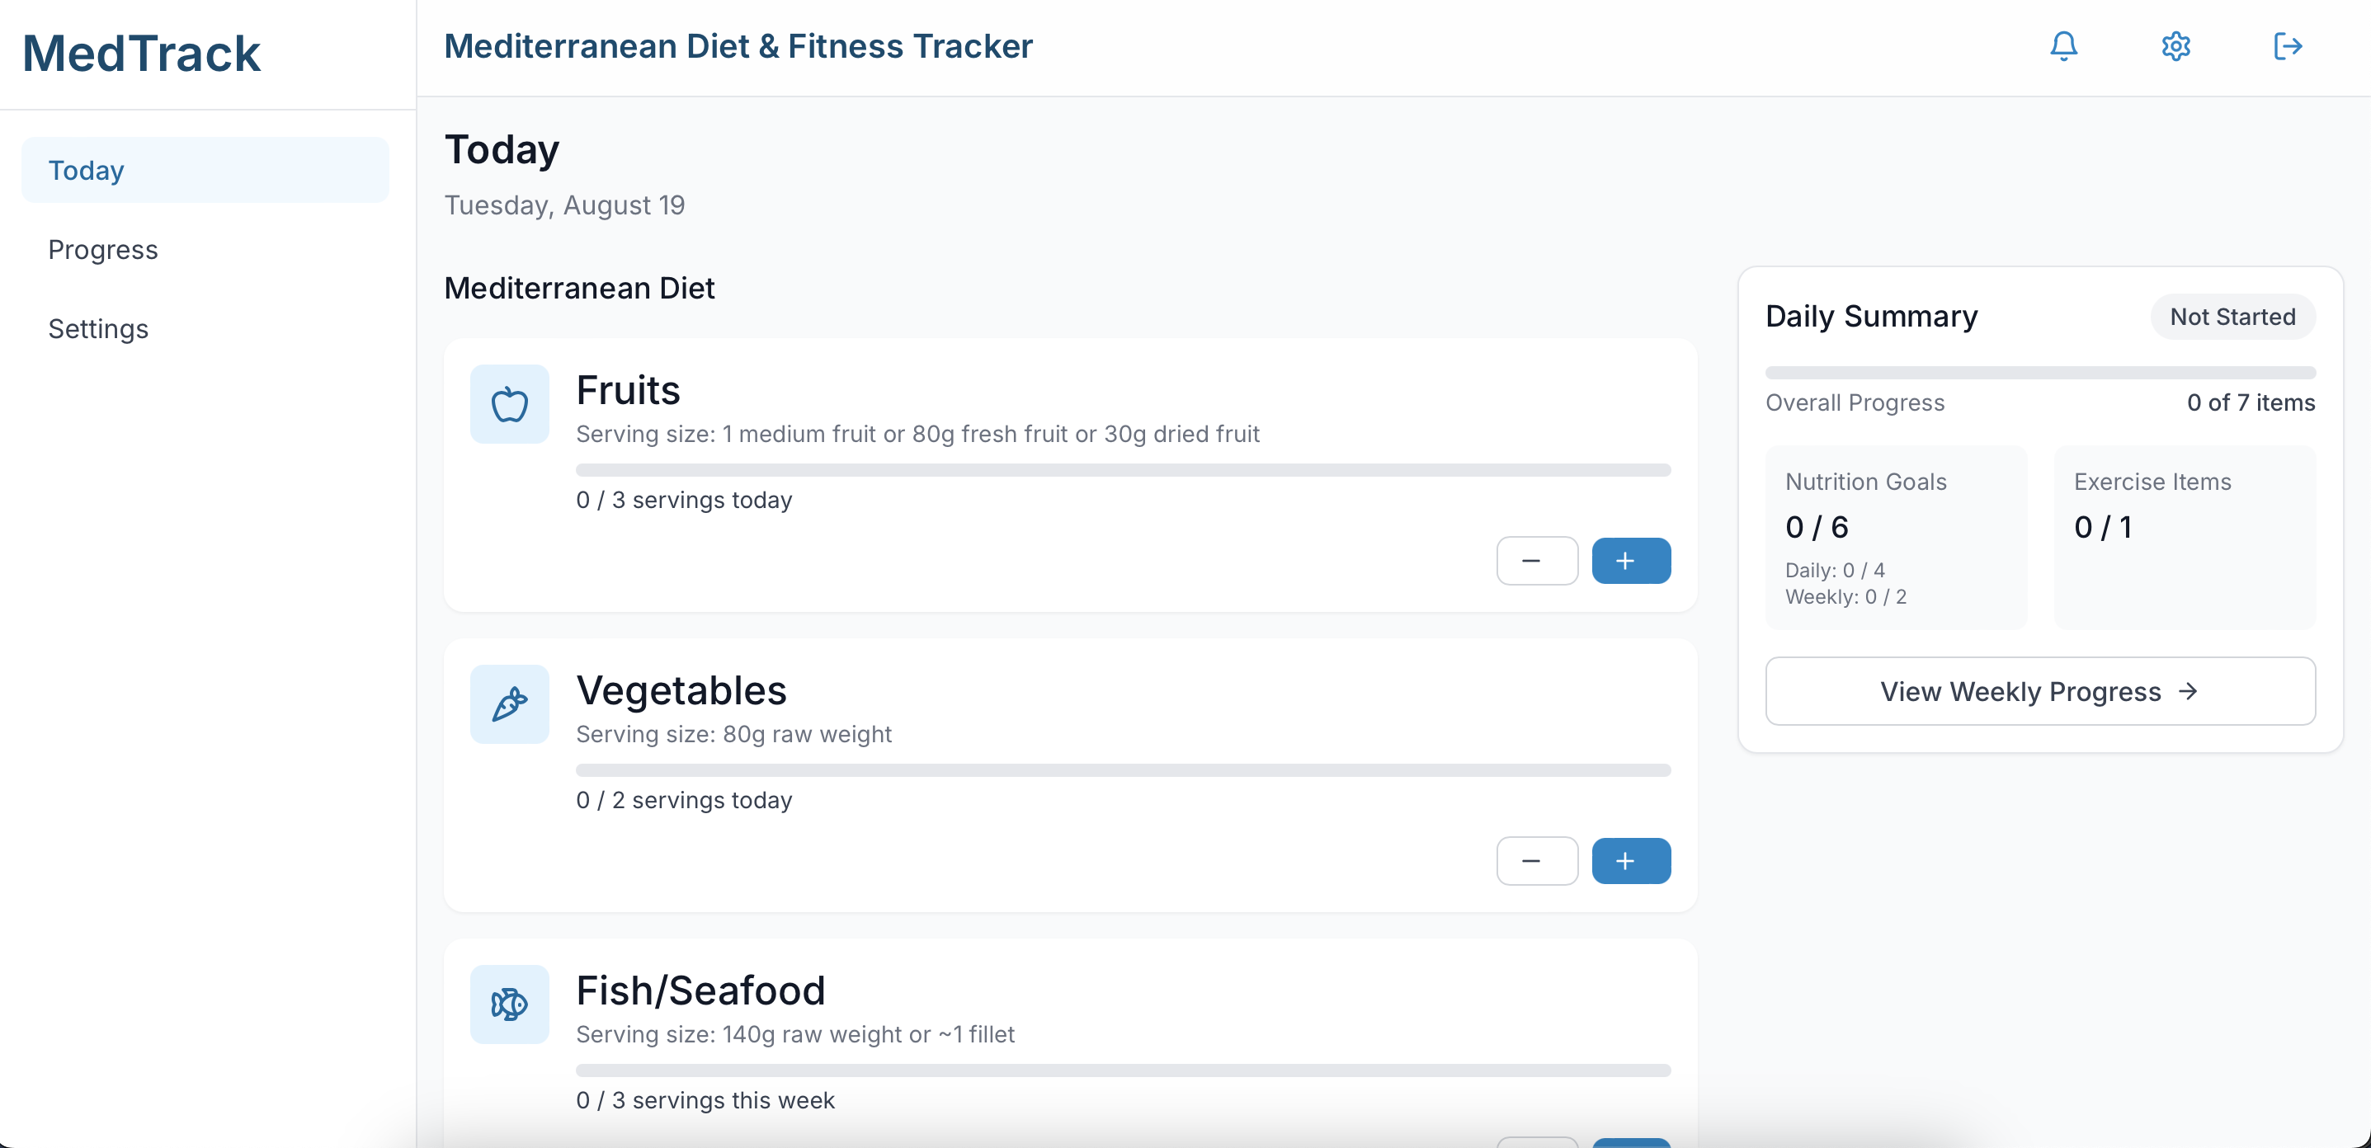
Our Project
A systematic review
A feasibility study for which an application will be developed to encourage the consumption of a mediterranean diet through notifications and a checklist
An 8wk 4-arm intervention to investigate the independent and combined effects of RT and the med diet
Notes:
on the efficacy of mobile applications to improve adherence to healthy behaviours (movement, exercise, nutrition)
2. daily and weekly checklist using the PREDIMED study as a basis

Slide 11



Our Population
80 total participants
30-55
years
Elevated LDL or non-HDL

Slide 12
Our Project
Control
High Protein Med-Style Diet – no change to exercise
Resistance Training – 3x p/w full body session
Combo (ProMed + RE)
Notes:
Our hypothesis is that the med diet will not only reduce LDL and ApoB but also improve aggregation. Due to the lack of research in the field, it is difficult to hypothesise what the effect of RT will be on LDL aggregation. That being said, we do expect to see a decrease in plasma LDL.

Slide 13
References
Ambroży, T., Rydzik, Ł., Obmiński, Z., Spieszny, M., Szczepanik, A., Ambroży, D., Basiaga-Pasternak, J., Spieszny, J., Niewczas, M., & Jaszczur-Nowicki, J., 2022. Effect of High-Intensity Strength and Endurance Training in the Form of Small Circuits on Changes in Lipid Levels in Men Aged 35–40 Years. Journal of Clinical Medicine, 11. https://doi.org/10.3390/jcm11175146.
Ference, B.A., Ginsberg, H.N., Graham, I., Ray, K.K., Packard, C.J., Bruckert, E., Hegele, R.A., Krauss, R.M., Raal, F.J., Schunkert, H. and Watts, G.F., 2017. Low-density lipoproteins cause atherosclerotic cardiovascular disease. 1. Evidence from genetic, epidemiologic, and clinical studies. A consensus statement from the European Atherosclerosis Society Consensus Panel. European heart journal, 38(32), pp.2459-2472.
Hooper L, Martin N, Jimoh OF, Kirk C, Foster E, Abdelhamid AS. Reduction in saturated fat intake for cardiovascular disease. Cochrane Database of Systematic Reviews 2020, Issue 8. Art. No.: CD011737. DOI: 10.1002/14651858.CD011737.pub3.
He, M., Hu, S., Wang, J., Wang, J., Găman, M., Hariri, Z., & Tian, Y., 2023. Effect of resistance training on lipid profile in postmenopausal women: A systematic review and meta-analysis of randomized controlled trials.. European journal of obstetrics, gynecology, and reproductive biology, 288, pp. 18-28 . https://doi.org/10.1016/j.ejogrb.2023.06.023.
Ihalainen, J., Inglis, A., Mäkinen, T., Newton, R., Kainulainen, H., Kyröläinen, H., & Walker, S., 2019. Strength Training Improves Metabolic Health Markers in Older Individual Regardless of Training Frequency. Frontiers in Physiology, 10. https://doi.org/10.3389/fphys.2019.00032.
Linton, M.F., Yancey, P.G., Davies, S.S., Jerome, W.G., Linton, E.F., Song, W.L., Doran, A.C. and Vickers, K.C., 2019. The role of lipids and lipoproteins in atherosclerosis. Endotext [Internet].
Ruuth, M., Lahelma, M., Luukkonen, P.K., Lorey, M.B., Qadri, S., Sädevirta, S., Hyötyläinen, T., Kovanen, P.T., Hodson, L., Yki-Järvinen, H. and Öörni, K., 2021. Overfeeding saturated fat increases LDL (low-density lipoprotein) aggregation susceptibility while overfeeding unsaturated fat decreases proteoglycan-binding of lipoproteins. Arteriosclerosis, thrombosis, and vascular biology, 41(11), pp.2823-2836.
Zhou, Y., Wu, W., Zou, Y., Huang, W., Lin, S., Ye, J., & Lan, Y., 2022. Benefits of different combinations of aerobic and resistance exercise for improving plasma glucose and lipid metabolism and sleep quality among elderly patients with metabolic syndrome: a randomized controlled trial.. Endocrine journal. https://doi.org/10.1507/endocrj.ej21-0589.

