Slide 1

Introduction into Pre-registration Andrew Jones (a.j.jones@ljmu.ac.uk) Full disclosure – I’ve adapted these slides from a colleague (Charlotte Pennington)

Slide 2
Psychology’s Recent History
2005
Ioannidis publishes “Why most published research findings are false”.
2011
Bem provides ‘evidence’ of pre-cognition; Stapel is found guilty of academic fraud. Simmons et al. show how researchers can present ‘anything as significant’.
2012
John et al. reveal that researcher QRPs are prevalent. Talks about a ‘crisis’ start emerging in a special issue led by Pashler & Wagenmakers in the journal PoPs.
2014
‘Many Labs 1’ publish the results of their large-scale replication efforts in a special issue on ‘replications of important results in Social Psychology.’
2015
The OSC (2015) publish results from 100 replications, showing a 36% success rate.
2016
Baker (2016) encourages 1,500 scientists to lift the lid on the crisis.

Slide 3
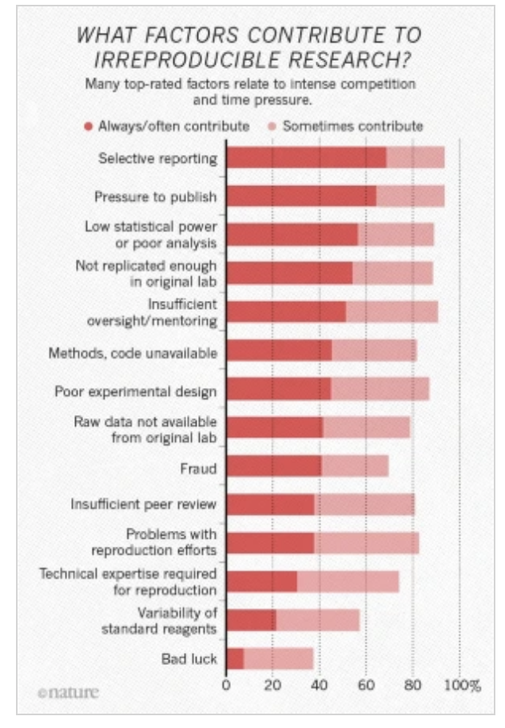
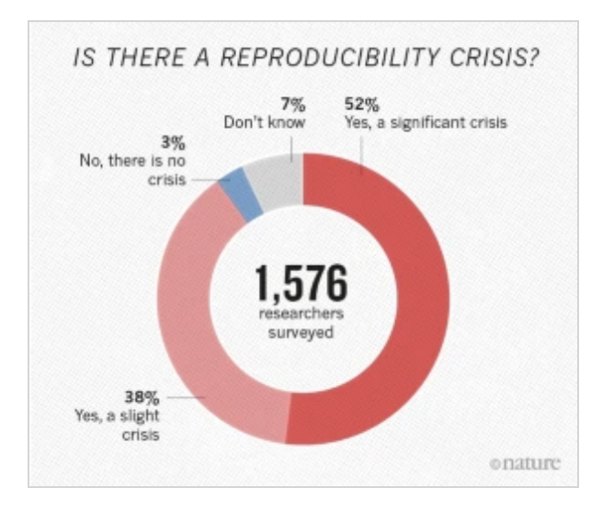
A survey on open science

Slide 4
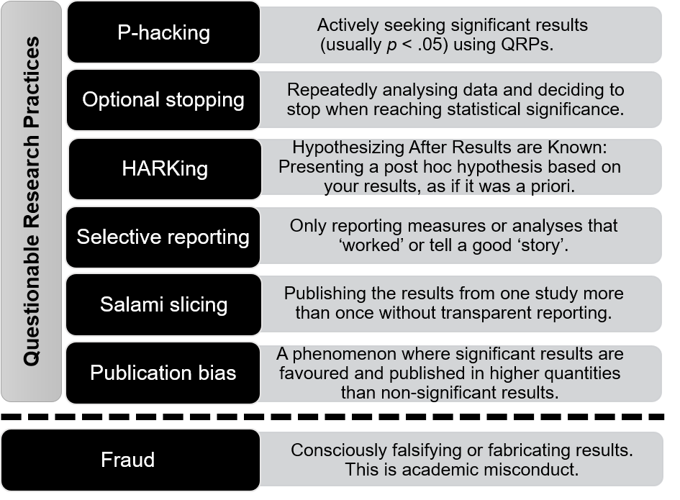
Questionable Research Practices

Slide 5
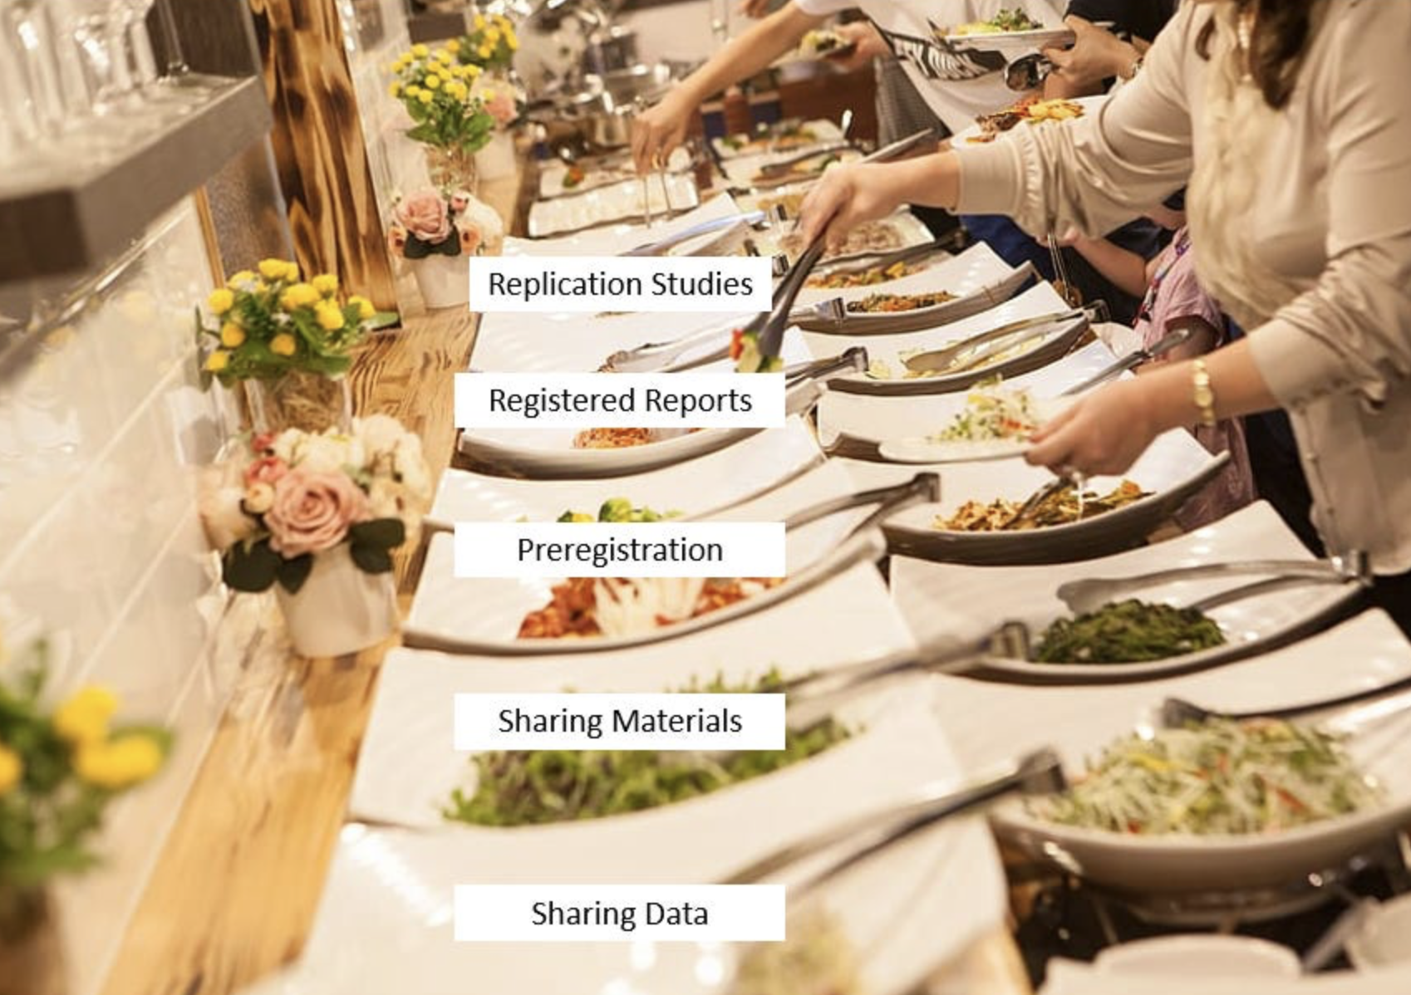
Open Science Buffet
Not all practices will be relevant or possible – you can decide what’s best (‘buffet style’)

Slide 6
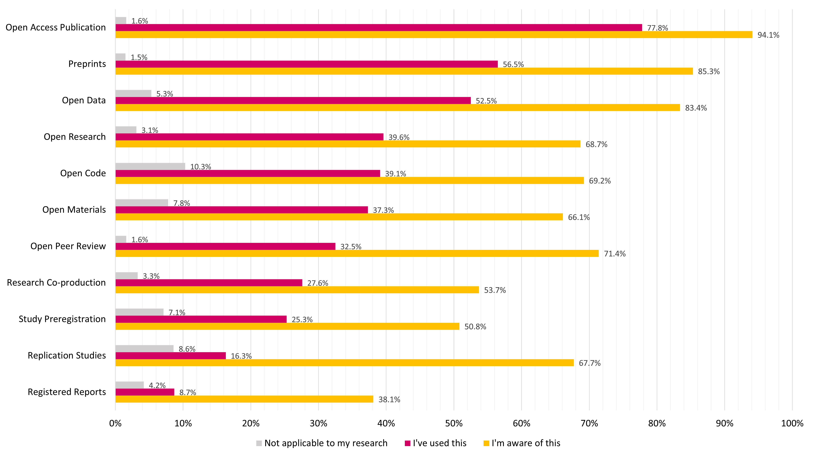
Prevalence of open science practices

Slide 7
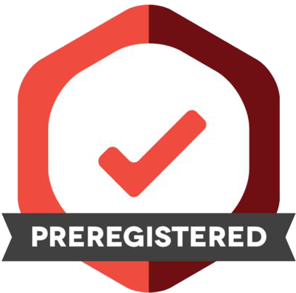
Pre-registration
A public, timestamped outline of the research questions, hypotheses, method, and analysis prior to data collection and/or analysis
Can be initiated for both quantitative and qualitative research, as well as primary and secondary data
Distinguish confirmatory (‘prediction’) from exploratory (‘postdiction’)

Slide 8
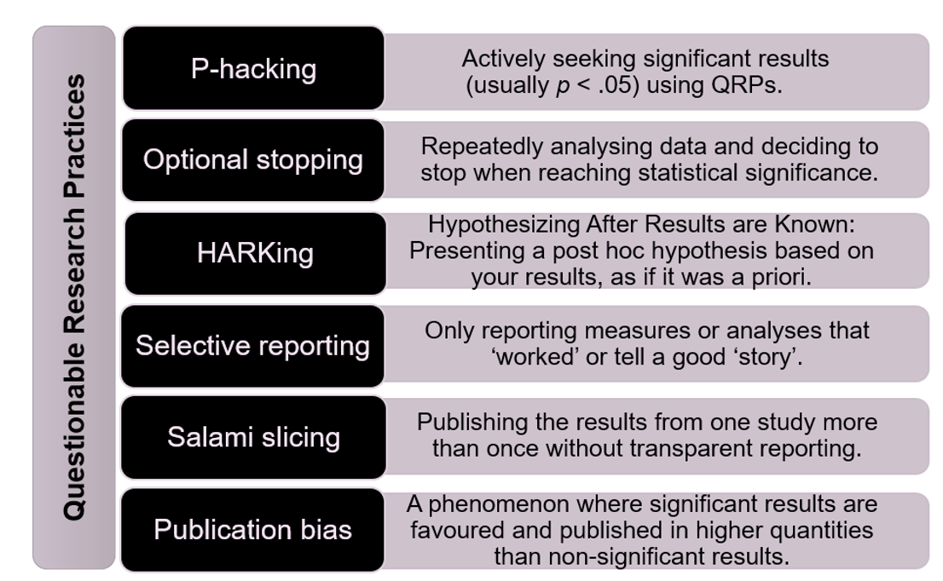

Slide 9
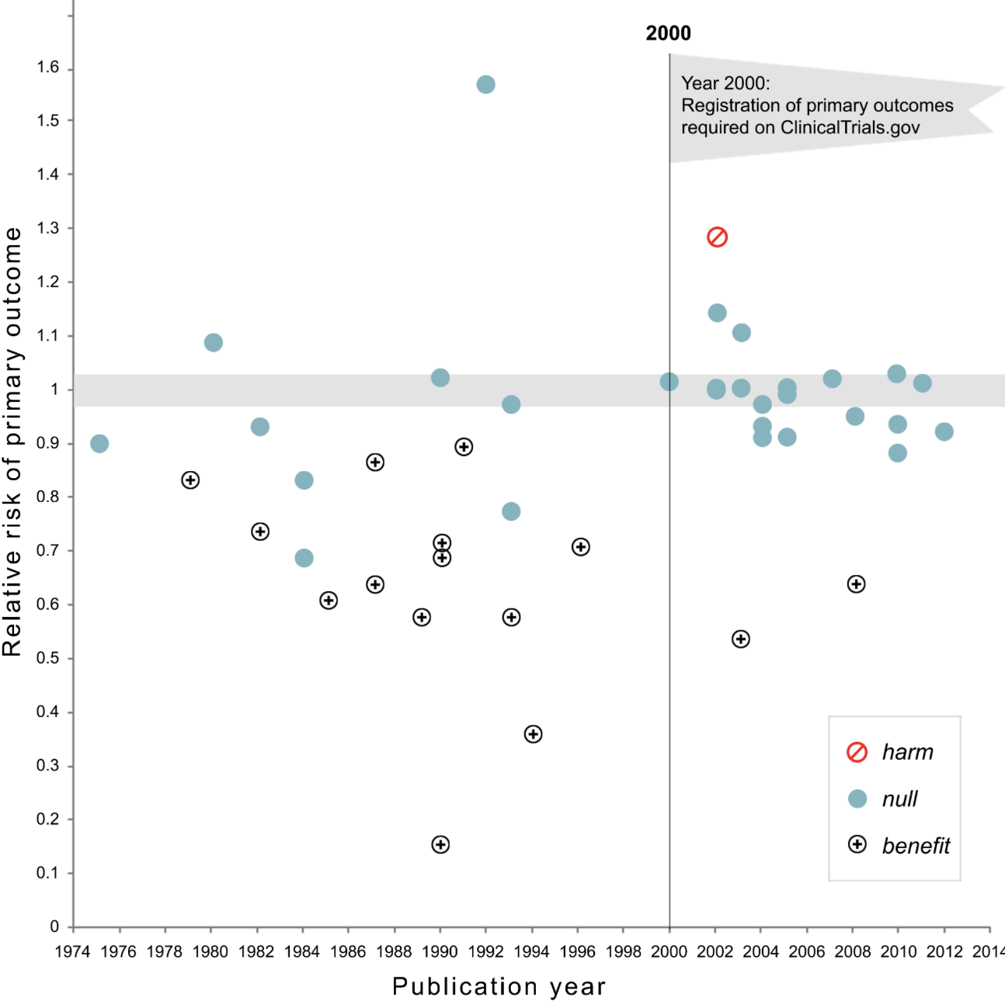
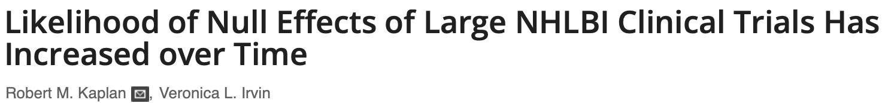
Not a new thing.

Slide 10

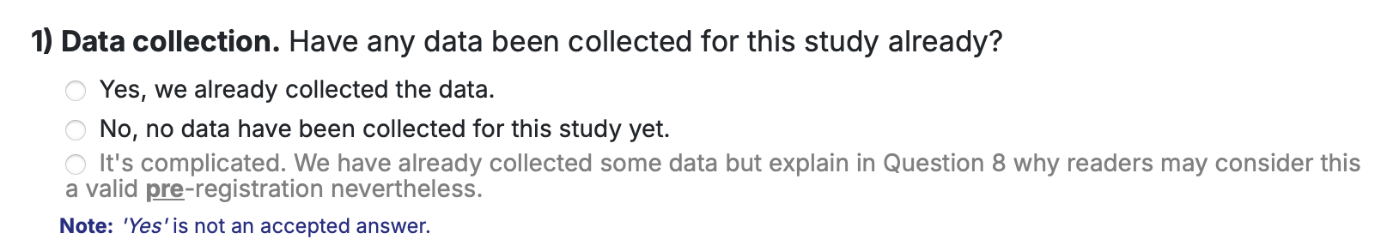
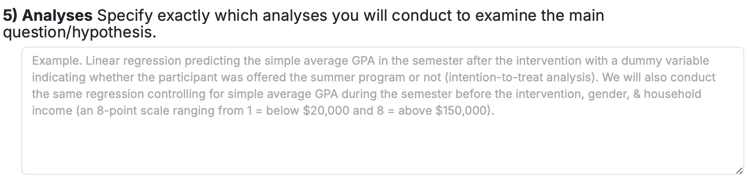
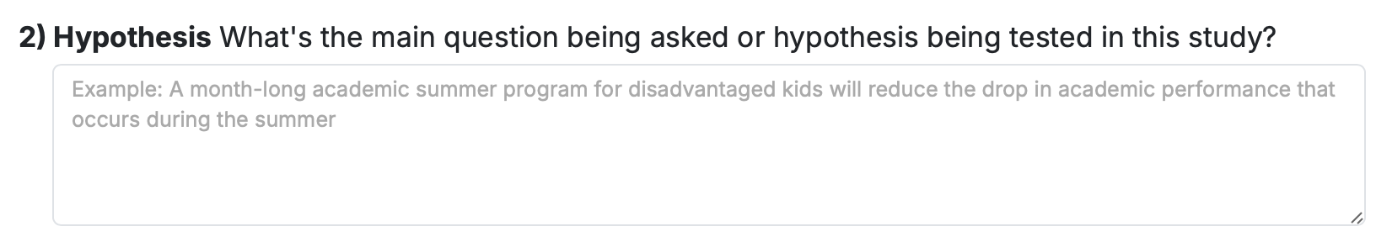
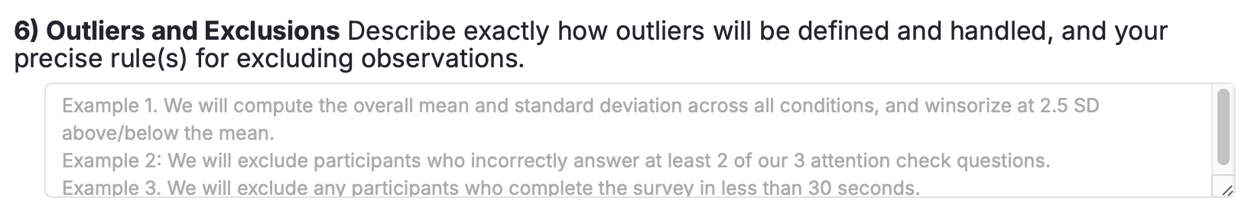
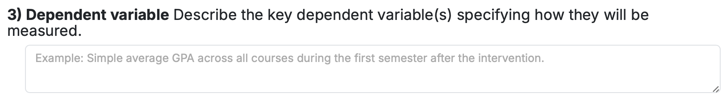
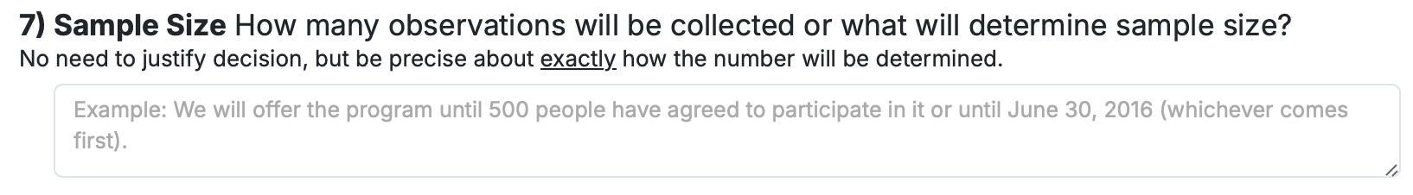
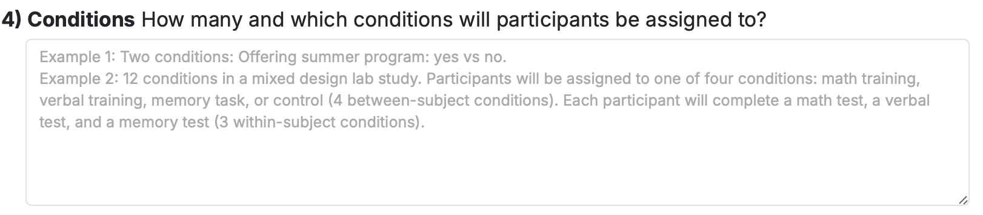
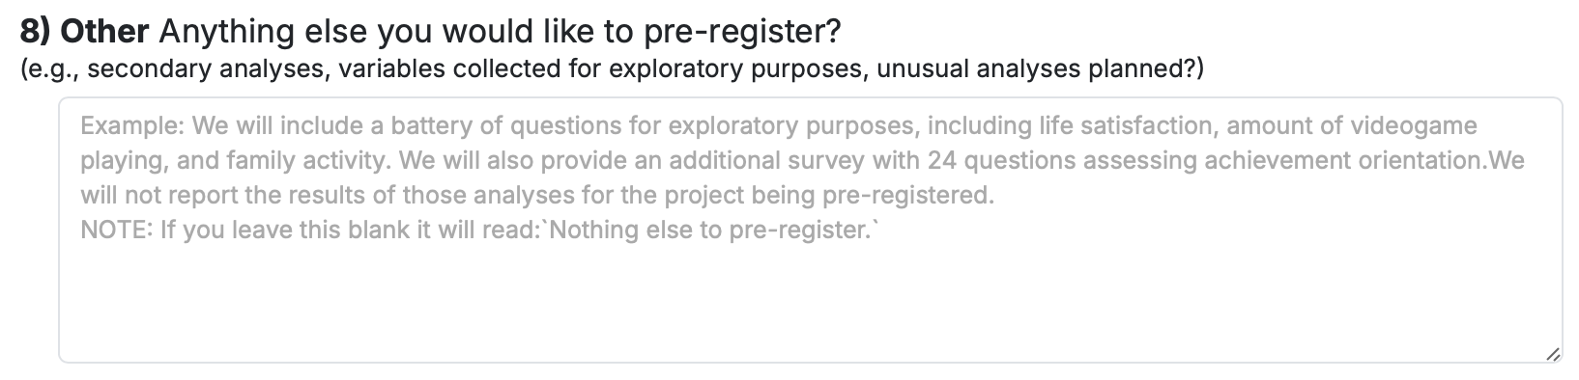
Where to start?

Slide 11
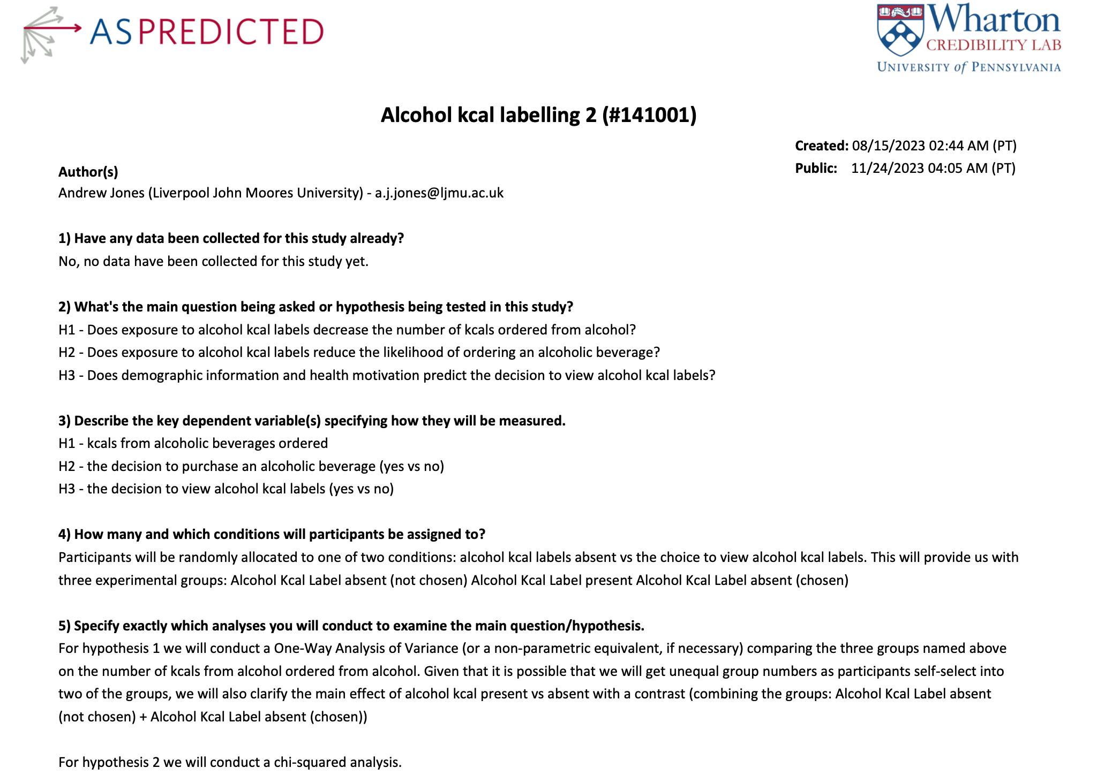
What this does
PDF you share with reviewers and your published paper

Slide 12
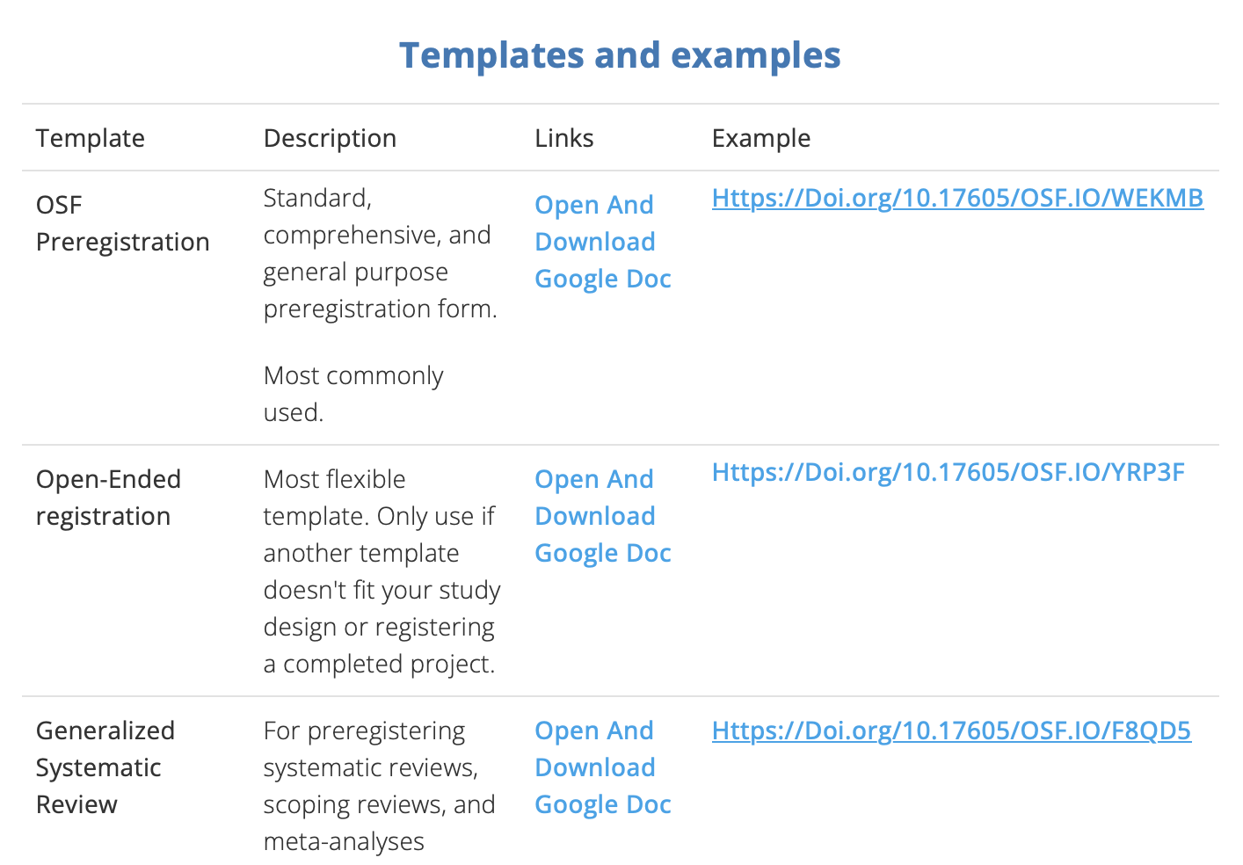
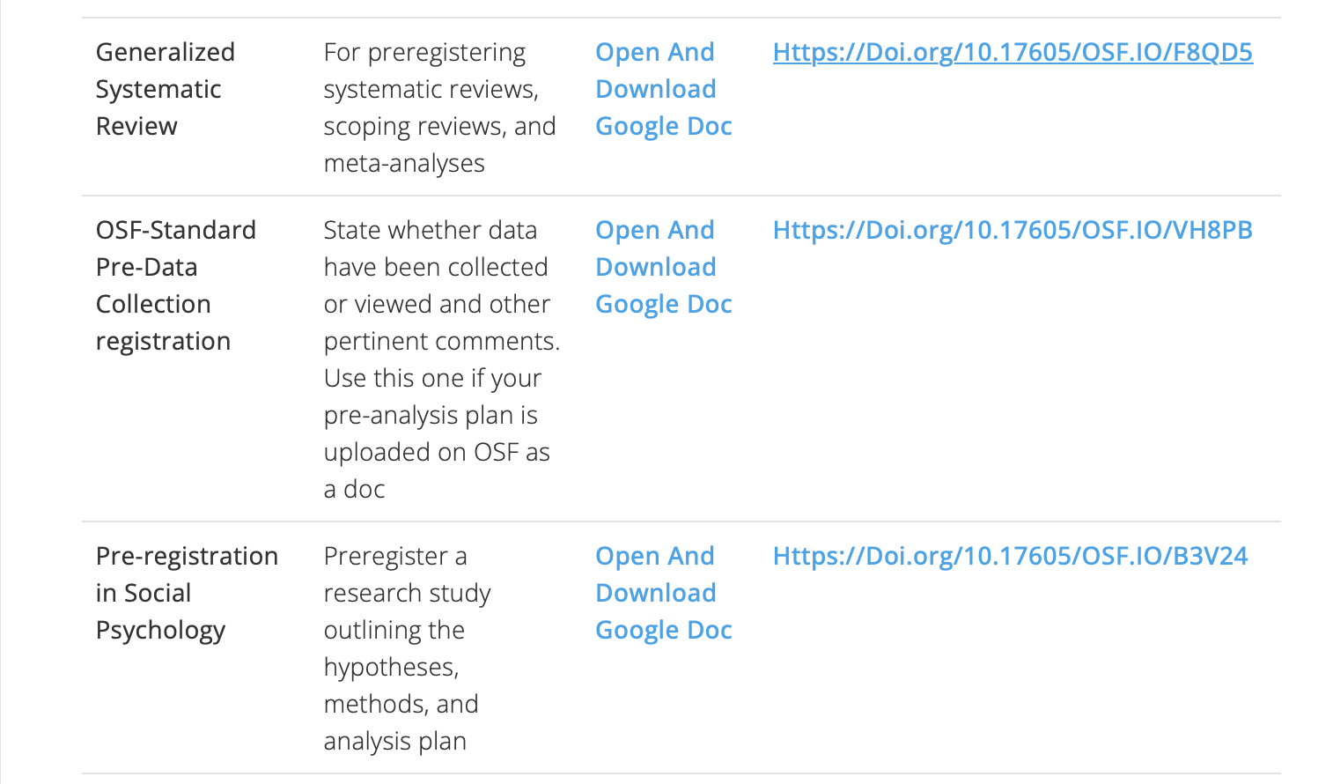
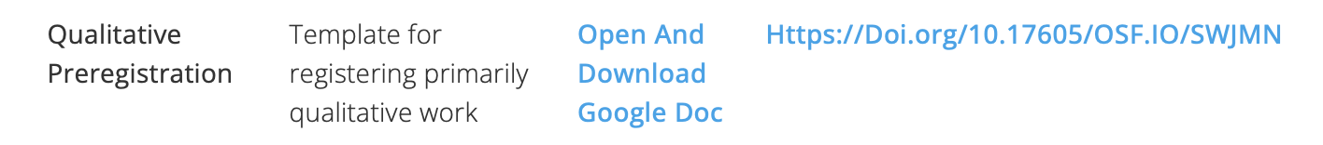

Open Science Framework
https://help.osf.io/article/330-welcome-to-registrations

Slide 13

Scooping
There’s a worry that your idea might get scooped.
If you’re scooped you’re less likely to be published as your work looses the novelty factor.
Mainly early career, but more senior researches not immune to this idea.
Pre-registrations can be embargoed

Slide 14


What makes a good pre-registration?
Timing: Ideally before data collected (but useful at any stage)
Specificity: avoid ambiguity or possible interpretation issues
Comes with practice.

Slide 15
Some ambiguities?
“For the four levels of memory recall, we will use a one-way ANOVA test on each dependent variable. Significant ANOVAs will be followed up with between-subject t-tests, which will also be assessed for significance.”
What are the dependent variables.
Any multiple comparison corrections
Significance levels

Slide 16
Some ambiguities (2)
“We aim to recruit 100 participants based on previous effect sizes for the effects of alcohol consumption on cognitive performance. This is with power set at 80%, and alpha at .05”.
What is the effect sizes?
One-tailed or two-tailed
What is the test for the power?

Slide 17
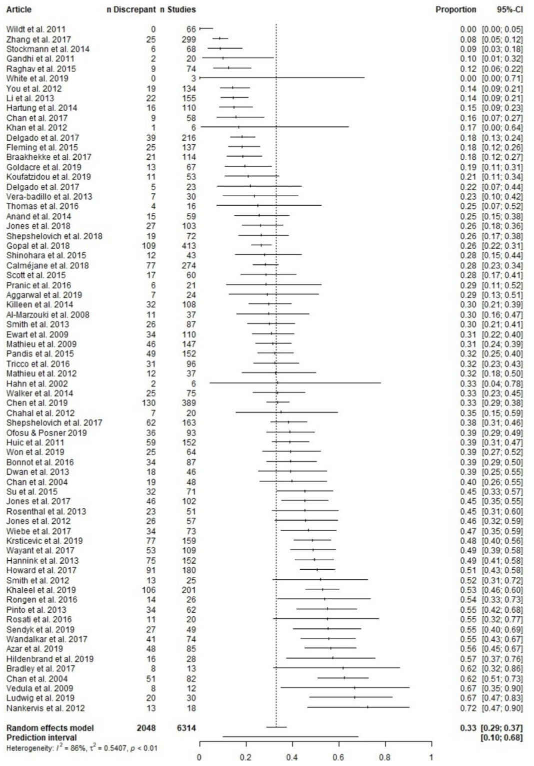
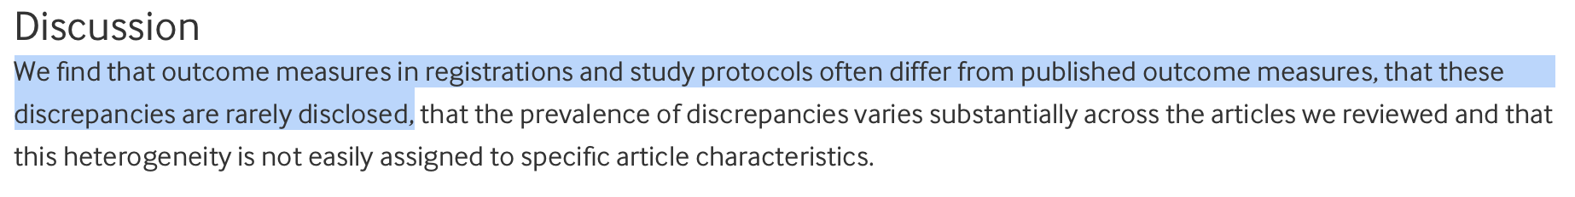
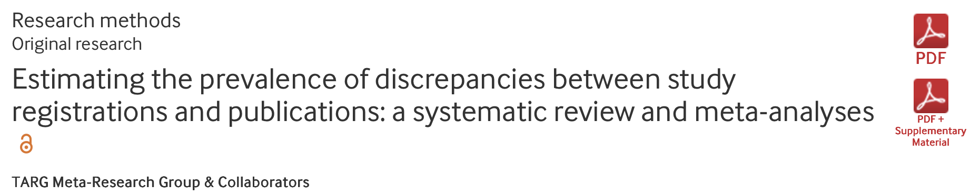
Sticking to the plan….

Slide 18
A plan, not a PRISON
Part of science involves the unexpected
We can ALWAYS make changes
It’s just about being transparent about what they are!
Examples:
A couple participants did something weird and unexpected – new exclusion criteria required
You didn’t reach your target sample size but had good reason to stop
Include a “Deviations from Protocol” section in your Results

Slide 19
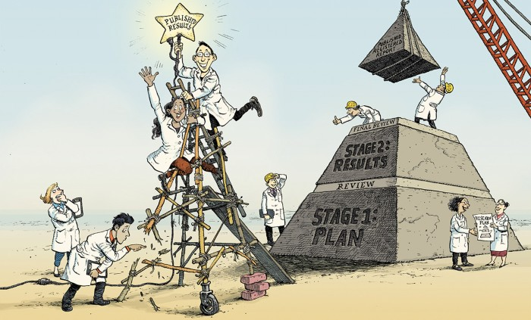
Beyond pre-registration.

Slide 20
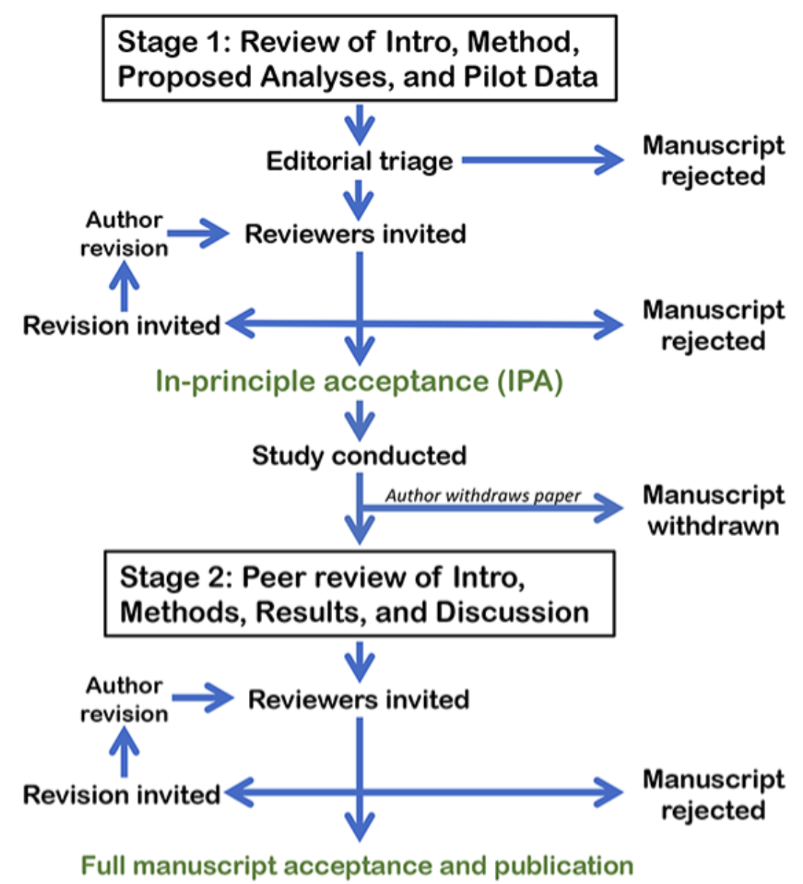
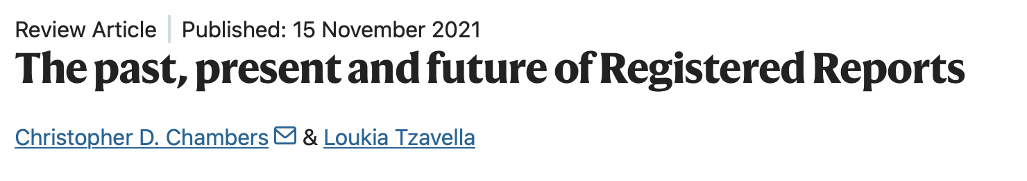
‘Registered Reports are a form of empirical publication in which study proposals are peer reviewed and pre-accepted before research is undertaken.’
Peer-reviewed and given “in principle acceptance” (IPA) — journal guarantees to publish, regardless of results, so long as the accepted protocol is followed

Slide 21
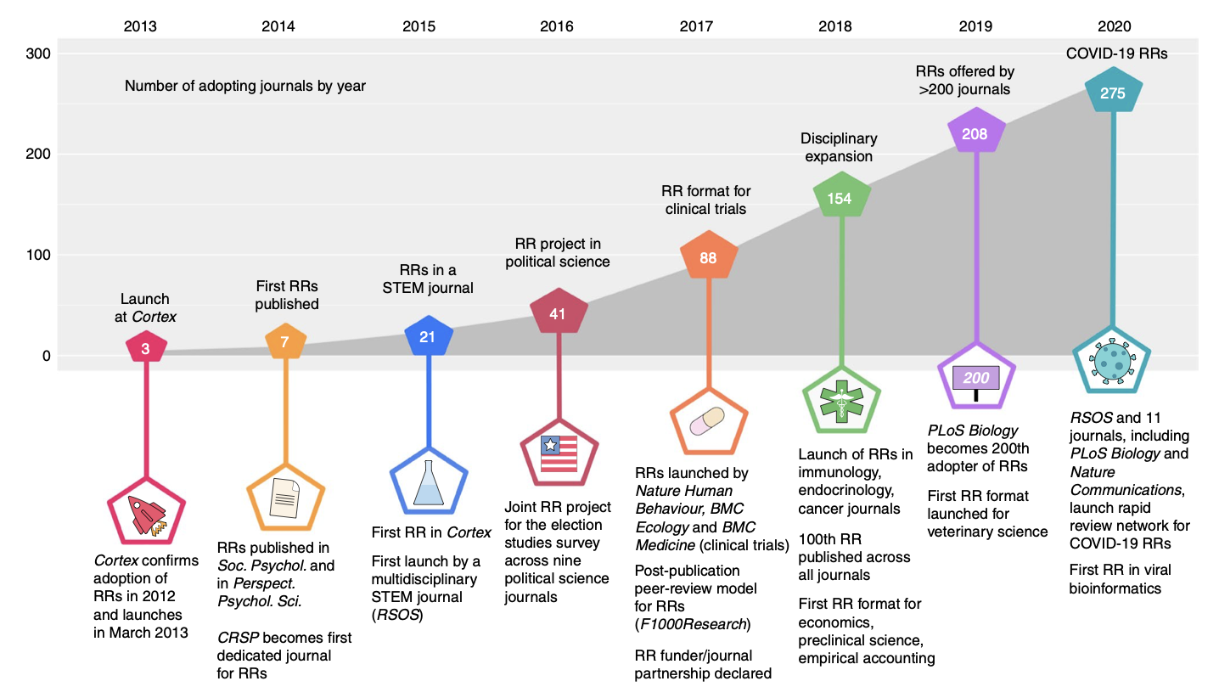
Increased momentum

Slide 22



Barriers to RRs?
Time pressure – Stage 1 review times might be challenging.
Different journals, editors, reviewers = Heterogeneity in RR policy and evaluation.
Tied to a journal. Rejection = further time lag.
V. Difficult for ECRS

Slide 23



PCI-RR (https://rr.peercommunityin.org/PCIRegisteredReports/)
‘A community dedicated to ‘recommending’ RRs across STEM, medicine, social sciences and humanities.’
+
=

Slide 24
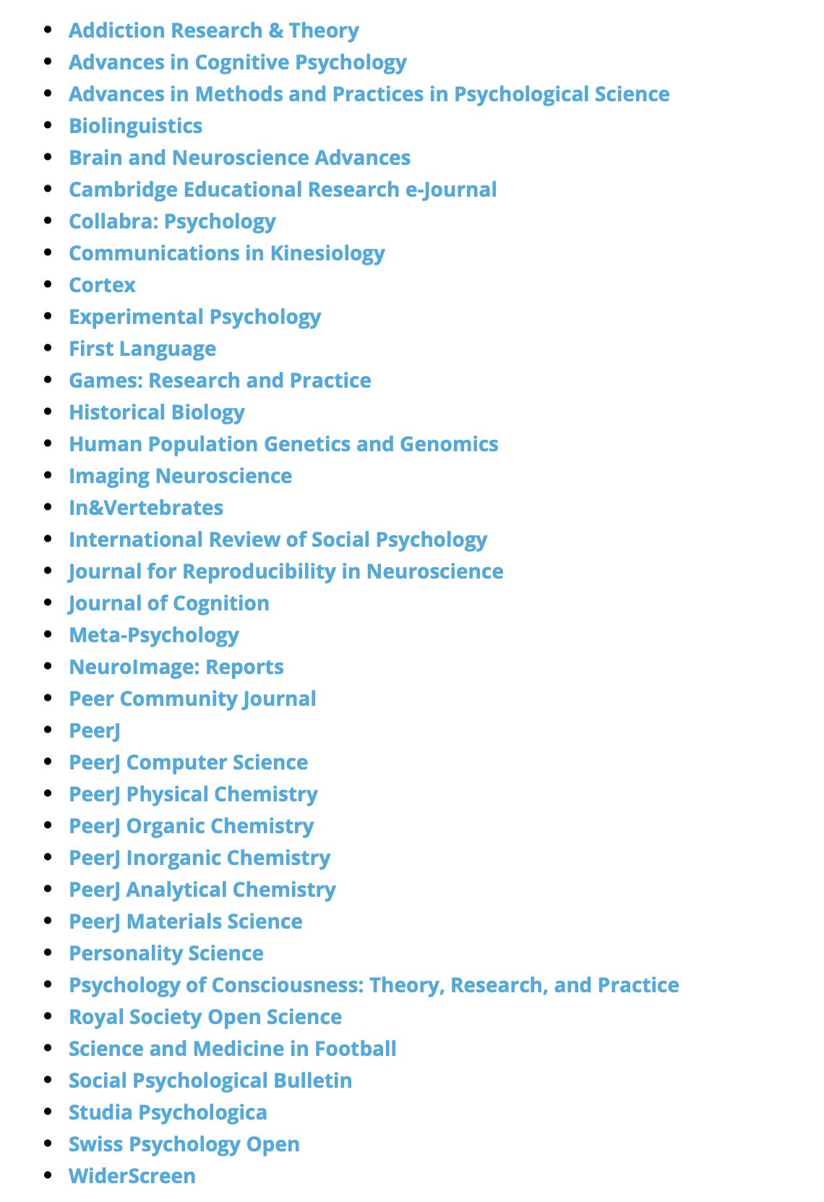
After stage 2.
A PCI RR-friendly journal endorses the PCI RR review criteria and commits to accepting without further peer review any manuscript that achieves a positive final recommendation from PCI RR while also meeting any additional procedural requirements that do not require further scientific evaluation by the journal.

Slide 25
A PCI RR-interested journal does not automatically accept PCI RR recommendations but has signed up to be alerted (with the consent of the authors) when a new Stage 1 in-principle acceptance (IPA) or Stage 2 acceptance is recommended by PCI RR.
AUTHOR choice

Slide 26
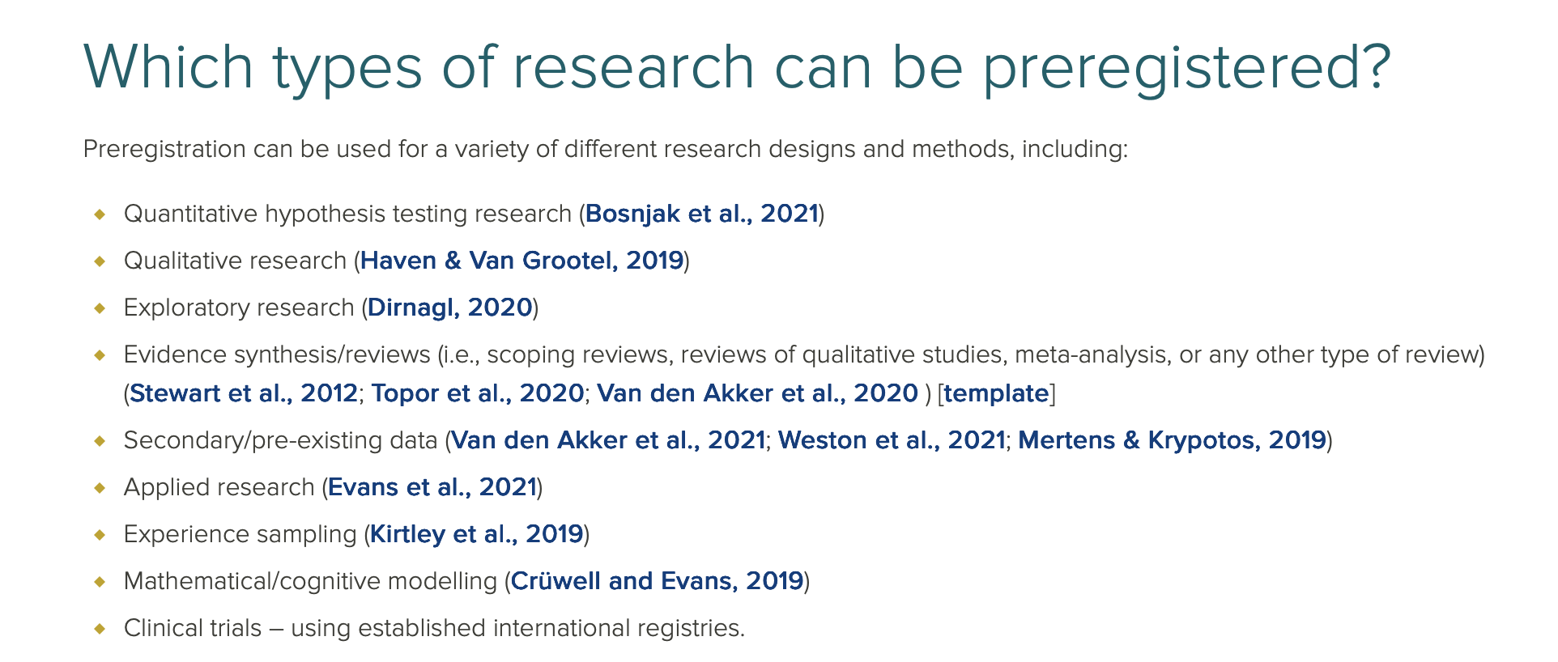
https://www.surrey.ac.uk/library/open-research/preregistration-and-registered-reports#reports

Slide 27
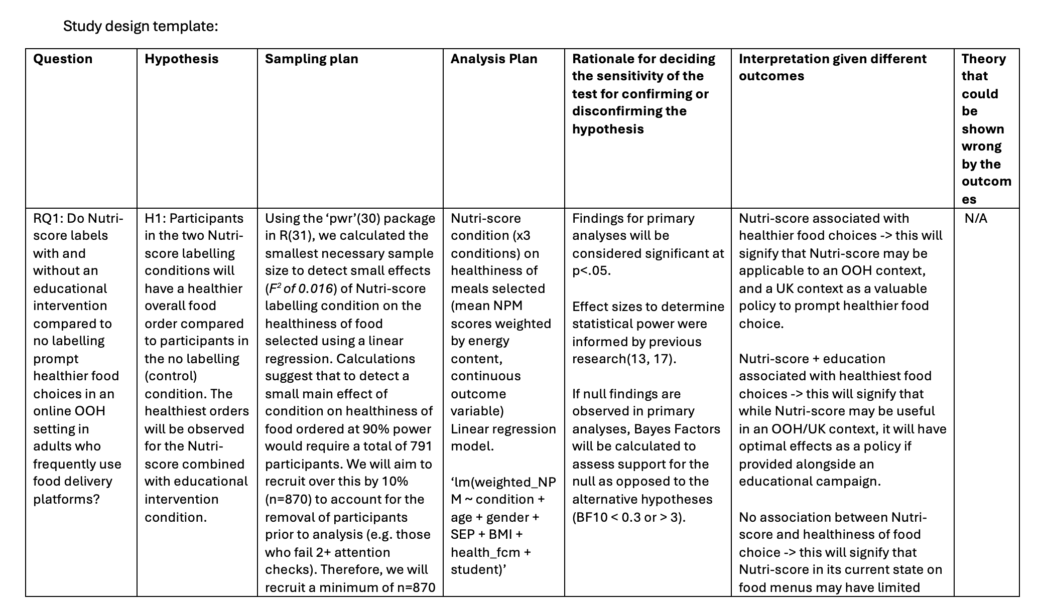

Slide 28
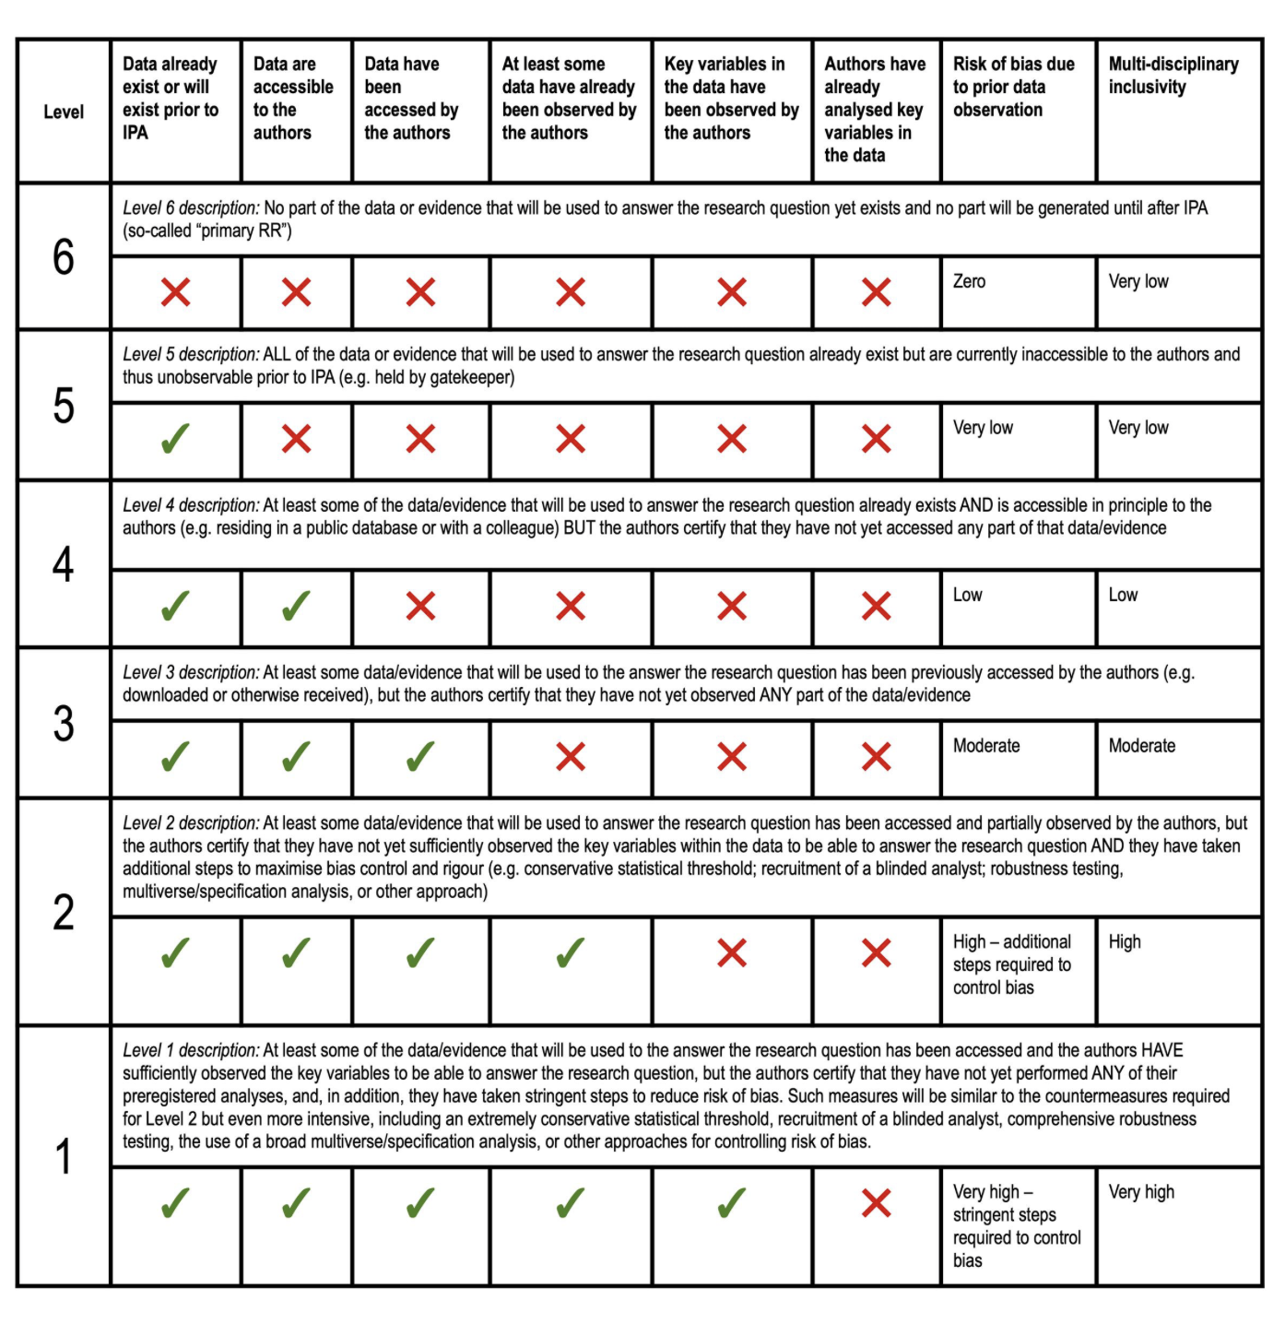
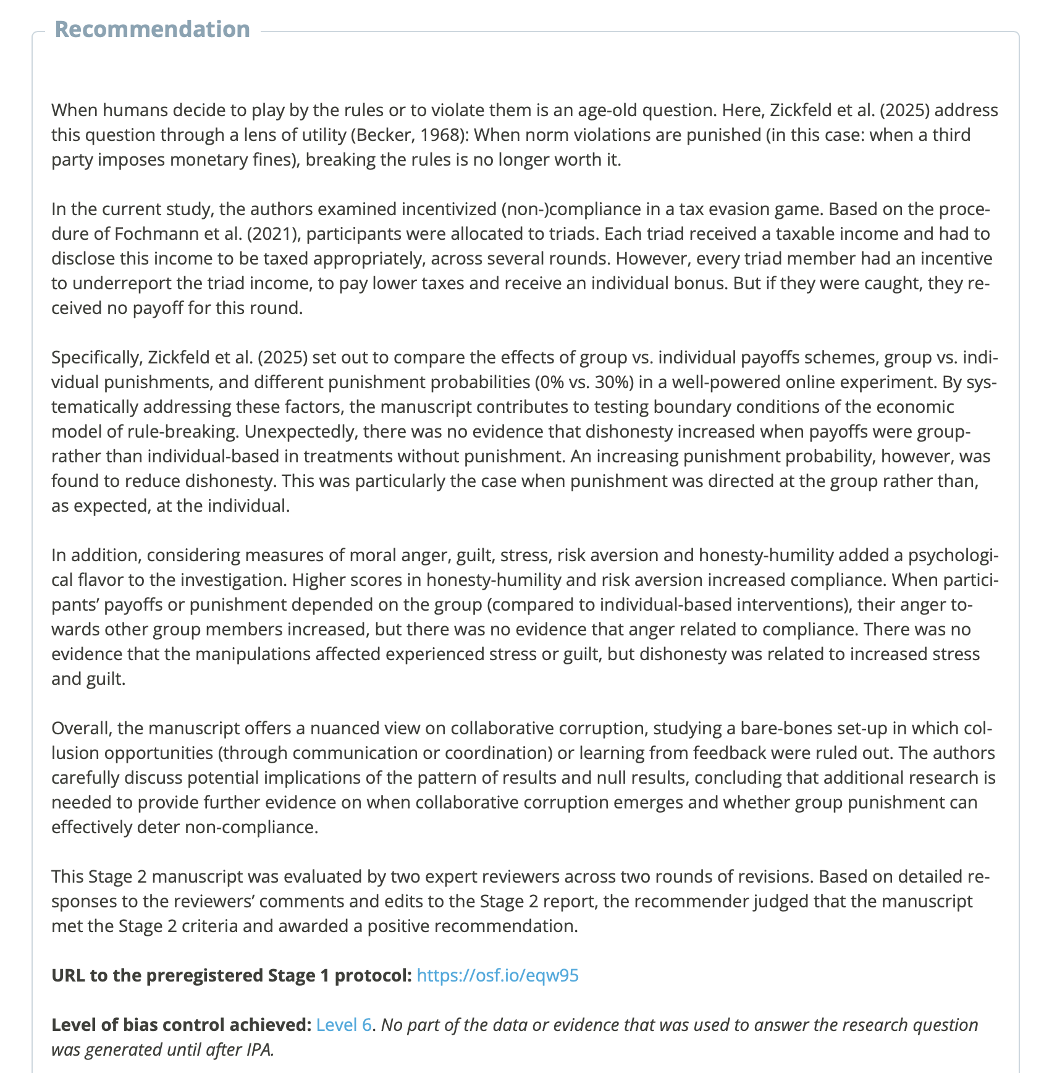

Slide 29
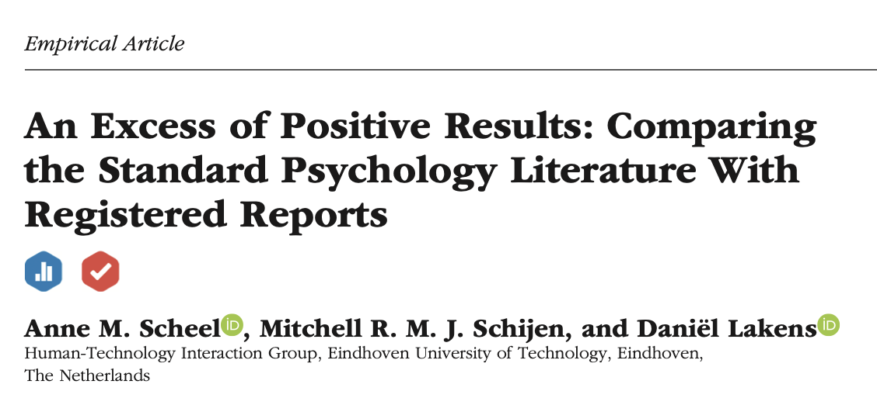
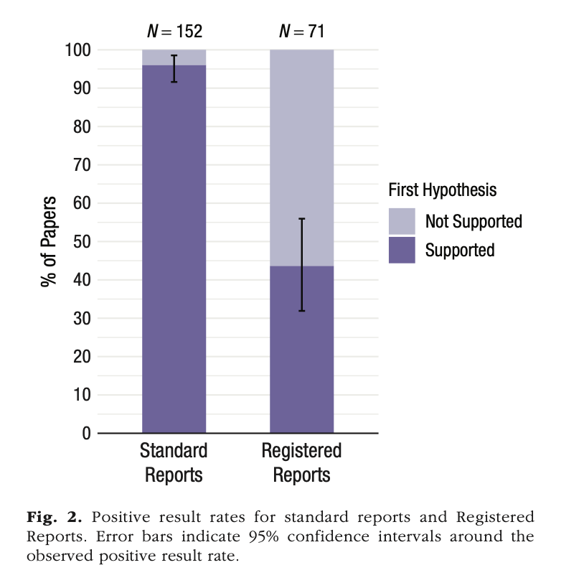
Do these things work?

Slide 30
Summary
Some of the dishes in the open science buffet are PRE-REGISTRATION and REGISTERED-REPORTS.
Time-stamped plans of research design, hypotheses and analysis plans.
As long as they’re specific!
Front-load the work you already need to do?
A barrier against HARKING, p-hacking etc if done well.

