Slide 1

Anonymisation Techniques
Dr Sam Burton & Dr Patsy Irizar
S.P.Burton@ljmu.ac.uk
p.Irizar@ljmu.ac.uk

Slide 2

Why is anonymisation important?
Protects the privacy of participants – confidentiality!
Protects participants from harm (stigma, discrimination)
Enables research to be shared and re-used – reproducible!
Encourages participants to provide more honest answers (especially for sensitive topics)
Builds public trust
Complies with data protection laws, such as GDPR
Notes:
Patsy - https://www.sigmacomputing.com/blog/data-anonymization

Slide 3

Introduction to anonymisation
To understand anonymisation, you must first understand what personal data is…
Anonymisation is the process of turning personal data into anonymous information so that a person is no longer identifiable
UK GDPR defines personal data as
“Any information relating to an identified or identifiable natural person; an identifiable natural person is one who can be identified, directly or indirectly, in particular reference to an identifier” (e.g., name, location)
Notes:
Patsy

Slide 4
Examples of personal data
Identifiable Data
Special category data
Personal characteristics (e.g., name, age)
Identification documents (e.g., passport)
Contact information (e.g., email, phone number)
Online identifiers (e.g., IP address)
Race or ethnicity
Political opinions
Religious beliefs
Trade union membership
Genetic data
Health information (physical & mental)
Sexual orientation
Notes:
Patsy

Slide 5

Introduction to anonymisation
Anonymous information is defined as
“Information which does not relate to an identified or identifiable natural person or to personal data rendered anonymous in such a manner that the data subject is not or no longer identifiable”
What is anonymisation?
The way in which you turn personal data into anonymous information
Effectively anonymised if people are not (or are no longer) identifiable
Notes:
Patsy

Slide 6

Key indicators of identifiability
Two key indicators for determining whether information is personal data or not:
Singling out
  You can single out the same person across records, or isolate records related to a person
  The risk of singling out depends on contextual factors
  Consider the richness of data and how potentially identifying different categories are
Linkability
  Combining multiple records about the same person or group of people
  Anonymised data can be combined with publicly available information to become identifiable
Notes:
Patsy

Slide 7

The Netflix Prize
In 2006, Netflix released a dataset for a competition to improve its move recommendation algorithm
100 million movie ratings from 500,000 anonymous subscribers
Researchers used a separate, publicly available database: IMDb
By cross-referencing the ratings on Netflix and IMDb, researchers could link the anonymous Netflix profiles to known IMDb profiles
Consequences:
  Revealed potentially sensitive information about users’ movie preferences

Slide 8
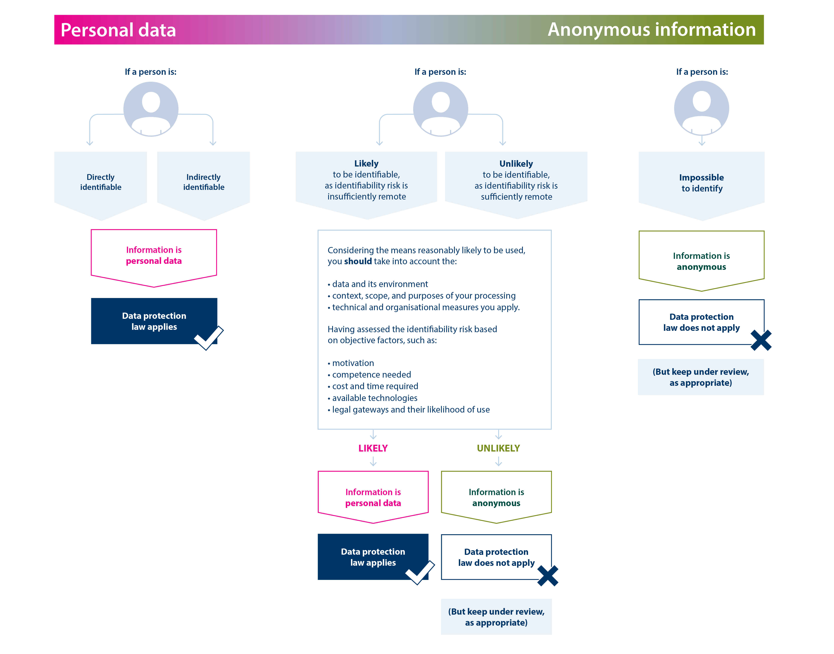
Spectrum of Identifiability
Information Commissioner’s Office (2025)
Notes:
Patsy

Slide 9
Anonymisation vs Pseudonymisation
Pseudonymisation is defined in UK GDPR as:
“the processing of personal data in such a manner that the personal data can no longer be attributed to a specific data subject without the use of additional information, provided that such additional information is subject to technical and organisational measures to keep it separate”
This can involve replacing identifiable information with pseudonyms (e.g., numbers or codes).
Pseudonymised data will still constitute personal data in the hands of the organisation that holds both the pseudonymised data and the key.
Notes:
Patsy
Pseudonymisation enables the personal data to become unidentifiable unless more information is available whereas anonymization allows the processing of personal data to irreversibly prevent re-identification.

Slide 10

Generalisation Methods
Generalisation
  Reducing precision (e.g., age ranges instead of exact age)
Aggregation
  Combining individual-level data to show trends without individual details
Suppression / redaction
  Removing data for small numbers of participants
K-anonymity
A dataset is k-anonymous if every possible combination of indirect identifiers appears at least K times
Notes:
Patsy

Slide 11

Randomisation Methods
Noise addition
  Add random noise to the data but preserve the mean (SD)
  E.g., 10 height measurements, add noise in the form of +/- 10cm to each measurement, the average is the same
Data swapping / shuffling / permutation
  Observations in the data are swapped, so that some data is associated with a different individual than originally
Differential privacy
  Noises added after the analyst as presented the question of interest
  Response is representative without the analyst knowing if data has changed
  Results must be the same regardless of whether a particular person is in the database or not
Notes:
Patsy

Slide 12
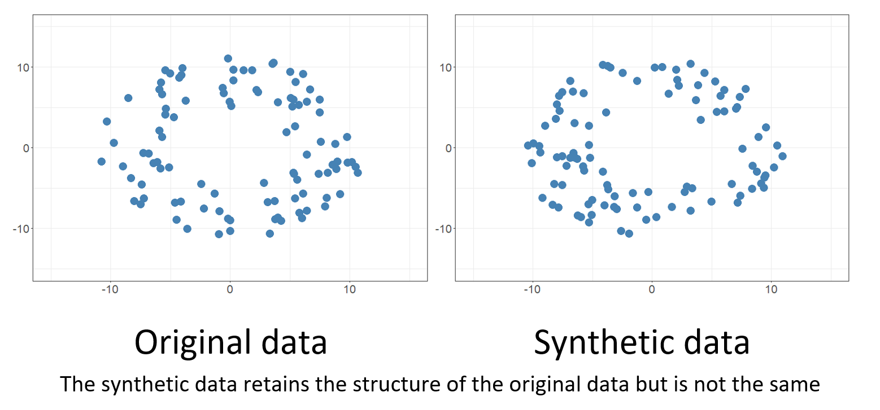
Data Masking
Replacing sensitive data with fictious but realistic data
Protects participant identities whilst keeping data reproducible
Synthetic data generation
Creates artificial data that mimics statistical patterns of a real dataset
Uses AI / Machine Learning to create high-quality, bias-free, and scalable data
Enables safe data sharing
R package: synthpop
Notes:
Patsy

Slide 13

The Motivated Intruder Test
A motivated intruder is someone who wishes to identify a person from the anonymous data
This test assesses whether the motivated intruder is likely to be successful
Need to consider the nature of the data
  Rarity of measures recorded
  Size of geographical areas
  Access to other data that could be linked
Conducting a motivated intruder test
Conducted by staff with appropriate knowledge, understanding of your anonymisation techniques, and other data that could be used for identification (internal or external)
Determine the likelihood of datasets being matched with publicly available data
You must have a degree of certainty that information is about one person and not another
Notes:
Patsy
This involves using individuals described as “friendly intruders” to try and see if they are able to re-identify anyone in the dataset. These intruders should have some background knowledge of the data similar to that of a typical user. However, they do not need to be specialist hackers with the capability of employing advanced data exploration techniques. The aim of intruder testing is to attempt to replicate the particular method of an opportunistic attacker, not a well-stocked professional.

Slide 14
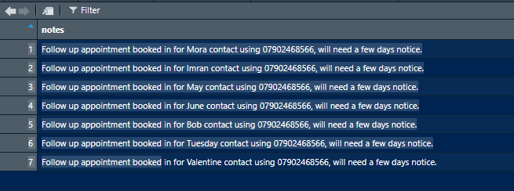
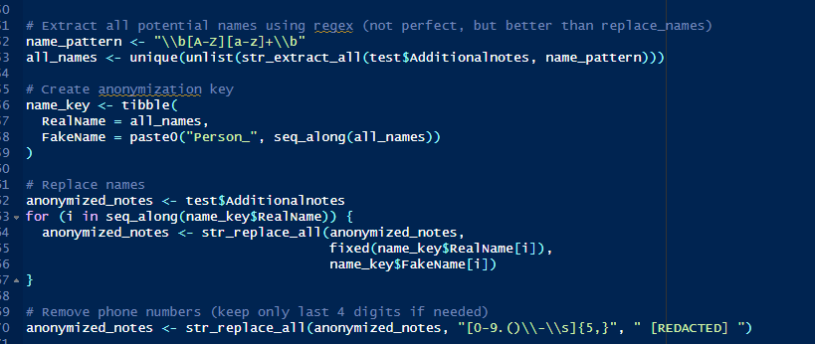
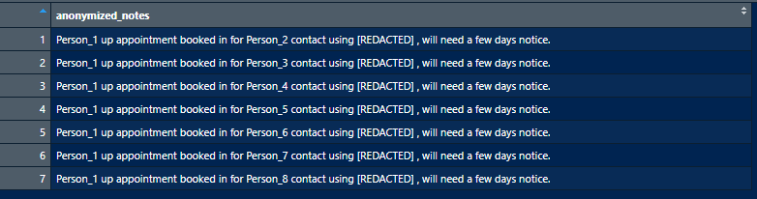
Anonymisation using R
Packages such as textclean

Slide 15

Five Safes Framework
Safe data
Safe projects
Safe people
Safe settings
Safe outputs
Notes:
Sam

Slide 16



Safe Project
A Safe Project is legal, feasible and ethical
A feasible project has a clear scope, uses sound and clearly explained methodology, is time-bound, uses the right data and variables and commits to make the results publicly available.
A legal project uses an suitable legal gateway to access the data and complies with all applicable legislation. Although you don’t need to be an expert you need to be aware of the legal environment of your project.
This includes data protection legislation but also any other applicable legislation depending on the data and the scope of the project.
Legal
Feasible
Ethical
A ethical project has evidence (ethics application and decision) of been reviewed by an recognised ethics committee and demonstrates a clear and realistic public benefit whilst considers any potential harm.
Notes:
Sam

Slide 17
Safe Setting
A Safe Setting is an environment that appropriately prevents the misuse of data.
This means an environment with data security proportional to the sensitivity of the data it holds. Simply said, you would not store publicly available data in a secure facility as you won’t attach personal information to an email.
Notes:
Sam

Slide 18
Safe People
Safe people are researchers who can be trusted to work safely with data. Safe researchers:
Have sufficient experience and skills to conduct research as indicated in Section B of on the Research Code of Practice and Accreditation Criteria
Demonstrate safe attitudes towards data access as evidenced by the training assessment and your behaviours in a secure environment
Have proven record of using data safely as evidenced by your behaviours in a secure environment
Notes:
Sam

Slide 19


Safe Data
Safe data are proportional to its use.
Multiple datasets
Single dataset
Specify the minimum level of detail. Why do you need this specific dataset and which variables you need to safely conduct your research? Nothing less and nothing more.
Consider the privacy risk of using, linking or matching multiple data. Why you need this combination of data and how much detail is required. The risk of indirect identification raises exponentially the more data you use
Notes:
Sam

Slide 20
Safe Outputs
A Safe Output is non-disclosive & safeguards the confidentiality of individuals and businesses.
In order to enable innovation in the SRS we decided to follow a principle-based approach to check outputs. We treat each output on a case-by-case basis.
This requires collaboration with researchers and does not introduce redundant barriers to research.
A good output:
Is within the scope of the research project
Meets threshold levels set by data owners
Respects Statistical Disclosure Control rules and practices
Is worked in its entirety or mostly within in a secure environment
Offers sufficient information and time to the support team to clear it for release
Clearly specifies where it will be published
Notes:
Sam

Slide 21
What is SDC?
Addressing residual risk in results for publication
    Look at data
    Identify risk of re-identification
    Risk = Remove / or use statistical techniques to hide it
Being precautionary, but…
    → Utility is important – balance with risk
    → Consistent with good research

Slide 22

SDC: our example dataset
Which of these variables might
  Be sensitive?
  Help to identify someone?
Ethnicity Ethnic group

Slide 23
SDC Example: Small Counts
Potential problems with this table?
Table 2. Existence of ‘FragileX’ Gene
 | Has fragileX gene? |  | Total
 | No | Yes
Male | 85 | 6 | 91
Female | 58 | 1 | 59
Total | 143 | 7 | 150
x

Slide 24
SDC Example: Small Counts
Potential problems with this table?
Table 3. Diabetes vs FragileX Gene
Diabetes diagnosed? | Has FragileX Gene? |  | Total
 | no | yes
Yes | 114 | 2 | 116
no | 29 | 5 | 34
total | 143 | 7 | 150
x

Slide 25

3 is the magic number….
N = 1
For the SRS, we bump our threshold of unweighted counts up to 10 to be extra safe
N = 2
N = 3
£40k
£30k
????
????
Average income: £40,000
Average income: £35,000
Average income: £40,000

Slide 26
SDC Example: Small Counts
Potential problems with this table?
Table 4. No. of imputed values in dataset
gender | Imputed values? |  | Total
 | no | yes
female | 89 | 2 | 91
male | 58 | 1 | 59
Total | 147 | 3 | 150

Slide 27
SDC Example: Class Disclosure
Potential problems with this table?
Table 5. Income distribution
Highest Qualification | Income quartile (lowest to highest) |  |  |  | Total
 | 1 | 2 | 3 | 4
Postgrad | 1 | 1 | 8 | 18 | 28
Degree | 2 | 6 | 14 | 17 | 39
College | 8 | 18 | 16 | 3 | 45
School | 13 | 9 | 0 | 0 | 22
None | 13 | 3 | 0 | 0 | 16
Total | 37 | 37 | 38 | 38 | 150
x
Notes:
"Class disclosure" risk: A specific risk where an individual can be identified by combining general knowledge with a specific class or category of data.

Slide 28
SDC Example: Class Disclosure
Which of these statements is disclosive?
  “All of the students aged 14+ said that they had tried cannabis at least once”
  “No nurse in the survey earns over £30.50/hour”
  “No-one in Shetland earns over £50,000/year”
  “No-one in Shetland earns over £5m/year”
  “No-one in Shetland earns over £500m/year”

Slide 29
Primary Disclosure: Structural Zeros
Table 6. Breakdown of Education Level by Age Band:
 | 0-15 | 16-20 | 21-25 | 26-30 | Total numbers
Higher Education | 0 | 0 | 165 | 148 | 313
Secondary Education | 0 | 152 | 210 | 318 | 680
None | 324 | 65 | 42 | 15 | 446
Disclosive?
Structural Zeros: Sometimes low numbers are less of a problem

Slide 30
What can we do with this table?
Suggest at least four solutions
Table 5. Income distribution
Highest Qualification | Income quartile (lowest to highest) |  |  |  | Total
 | 1 | 2 | 3 | 4
Postgrad | 1 | 1 | 8 | 18 | 28
Degree | 2 | 6 | 14 | 17 | 39
College | 8 | 18 | 16 | 3 | 45
School | 13 | 9 | 0 | 0 | 22
None | 13 | 3 | 0 | 0 | 16
Total | 37 | 37 | 38 | 38 | 150

Slide 31
Option 1: hide the offending results
Cell suppression - blanking offending cells
Table 5. Income distribution
Highest Qualification | Income quartile (lowest to highest) |  |  |  | Total
 | 1 | 2 | 3 | 4
Postgrad | - | - | 8 | 18 | 26
Degree | - | 6 | 14 | 17 | 37
College | 8 | 18 | 16 | 3 | 45
School | 13 | 9 | - | - | 22
None | 13 | 3 | - | - | 16
Total | 34 | 36 | 38 | 38 | 146

Slide 32
Option 1: hide the offending results
Detail reduction on offending cells
Table 5. Income distribution
Highest Qualification | Income quartile (lowest to highest) |  |  |  | Total
 | 1 | 2 | 3 | 4
Postgrad | <3 | <3 | 8 | 18 | 26
Degree | <3 | 6 | 14 | 17 | 37
College | 8 | 18 | 16 | 3 | 45
School | 13 | 9 | <3 | <3 | 22
None | 13 | 3 | <3 | <3 | 16
Total | 34 | 36 | 38 | 38 | 146

Slide 33
Calculate totals afterwards!
before
after
Highest qualification | Income quartile (1-4)
 | 1 | 2 | 3 | 4 | Total
Postgrad | 1 | 1 | 8 | 18 | 28
Degree | 2 | 6 | 14 | 17 | 39
College | 8 | 18 | 16 | 3 | 45
School | 13 | 9 | 0 | 0 | 22
None | 13 | 3 | 0 | 0 | 16
Total | 37 | 37 | 38 | 38 | 150
Highest qualification | Income quartile (1-4)
 | 1 | 2 | 3 | 4 | Total
Postgrad |  |  | 8 | 18 | 26
Degree |  | 6 | 14 | 17 | 37
College | 8 | 18 | 16 | 3 | 45
School | 13 | 9 |  |  | 22
None | 13 | 3 |  |  | 16
Total | 34 | 36 | 38 | 38 | 146

Slide 34
Option 2: change the offending results
Rounding
Table 5. Income distribution
Highest Qualification | Income quartile (lowest to highest) |  |  |  | Total
 | 1 | 2 | 3 | 4
Postgrad | 0 | 0 | 10 | 20 | 30
Degree | 0 | 10 | 15 | 15 | 40
College | 15 | 15 | 15 | 5 | 50
School | 10 | 10 | 0 | 0 | 20
None | 10 | 5 | 0 | 0 | 15
Total | 35 | 40 | 40 | 40 | 155

Slide 35
Option 2: change the offending results
Make the data into something less disclosive
  ratios
  growth rates
  calculating proportions (but limit decimal places)
  Etc.

Slide 36
Option 3: redesign the output
Why do we recommend this?
Table 5. Income distribution
Highest Qualification | Income quartile (lowest to highest) |  |  |  | Total
 | 1 | 2 | 3 | 4
Postgrad
Degree+ | 3 | 7 | 22 | 35 | 57
College | 8 | 18 | 16 | 3 | 45
School | 13 | 9 | 0 | 0 | 22
None | 13 | 3 | 0 | 0 | 16
Total | 37 | 37 | 38 | 38 | 150
Highest Qualification | Income quartile (lowest to highest) |  |  |  | Total
 | 1 | 2 | 3 | 4
Postgrad | 1 | 1 | 8 | 18 | 28
Degree | 2 | 6 | 14 | 17 | 39
College | 8 | 18 | 16 | 3 | 45
School | 13 | 9 | 0 | 0 | 22
None | 13 | 3 | 0 | 0 | 16
Total | 37 | 37 | 38 | 38 | 150

Slide 37
Which option is best?
Depends on the output – not all approaches will work all of the time
Depends on the message you want to present
You know what’s important - you decide what SDC methods to use
User support team can advise if needed

Slide 38
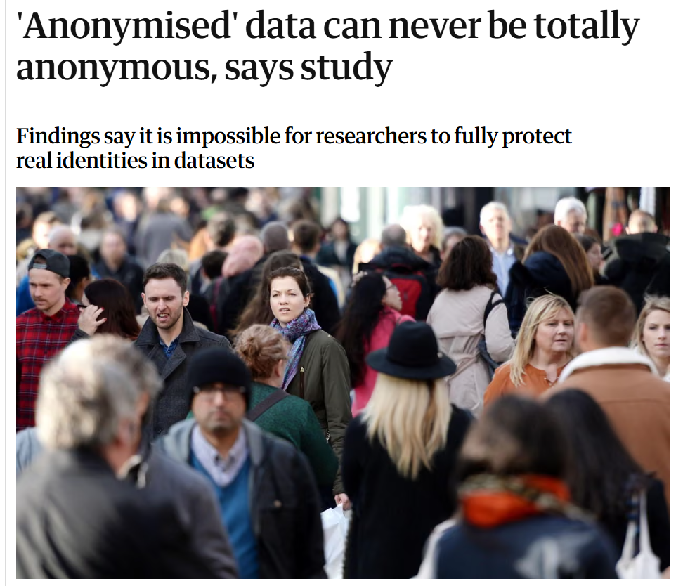

Slide 39
Thank you!
Any questions?

