Slide 1

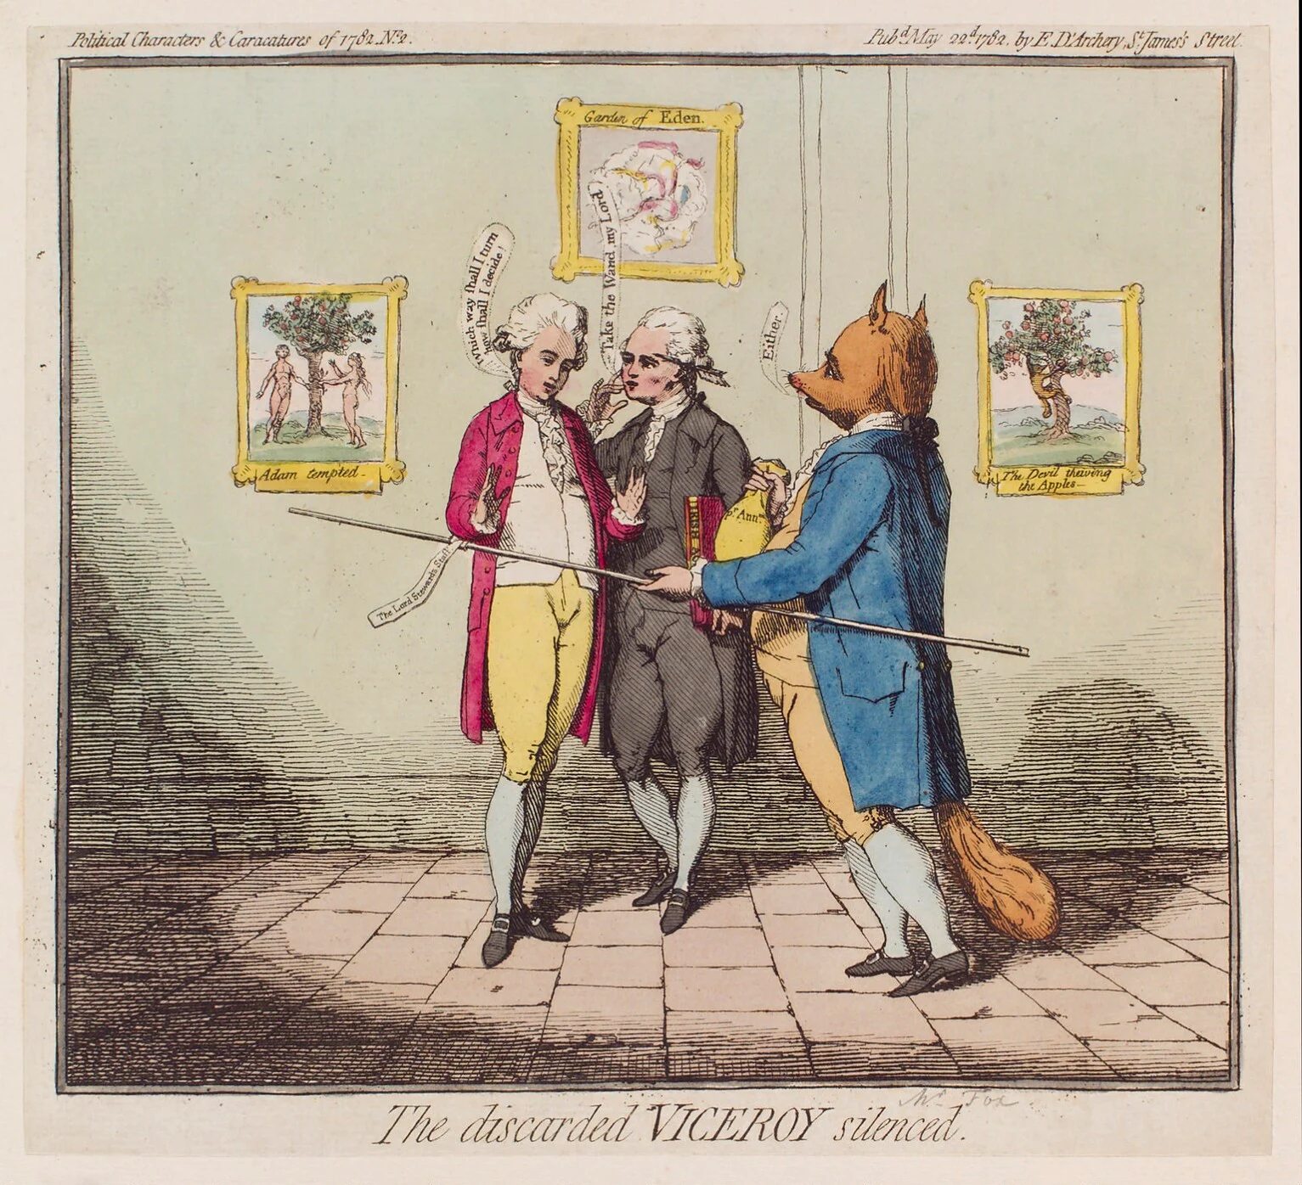
It makes sense to be open: experiences from a historical researcher Dr Sarah Fox, Edge Hill University

Slide 2
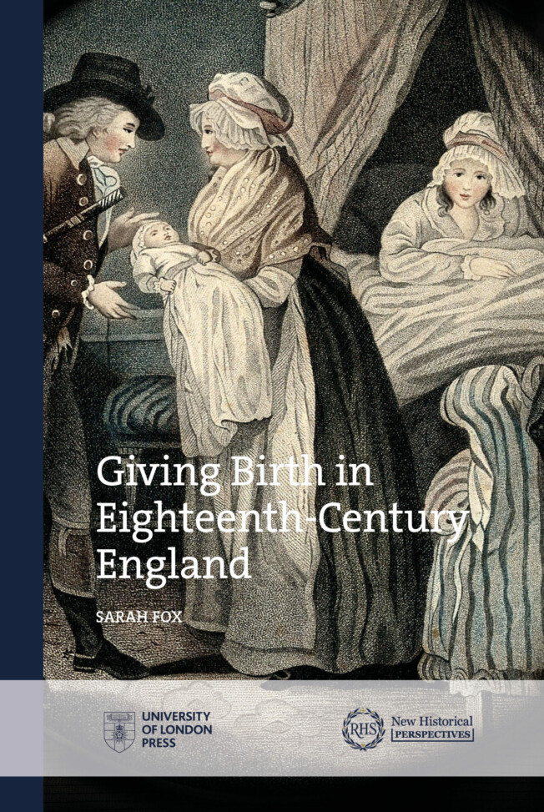
What have I published Open Access?
Giving Birth in Eighteeth-Century England
University of London series supported by the Royal Historical Society
Designed for historians publishing their first book

Slide 3
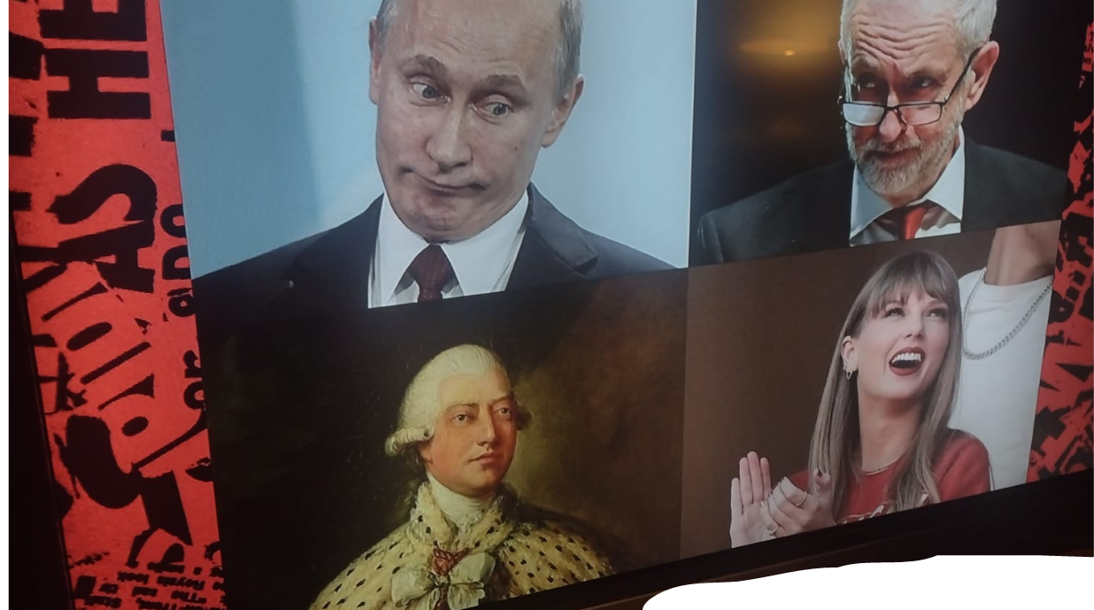
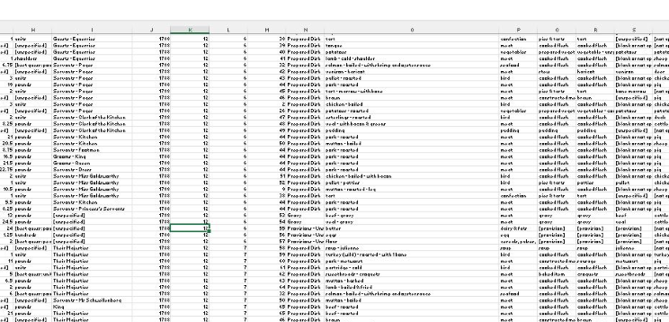
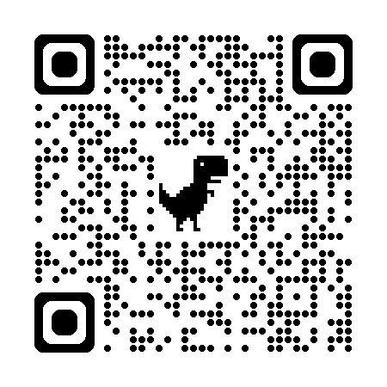
What have I published Open Access?
Three Thousand Dishes on a Georgian Table, 1788-1813
Funded by the British Academy
40,358 dishes served
3,351 unique dish constructions
1.3 million points of scholarly data
Available on Zenodo

Slide 4
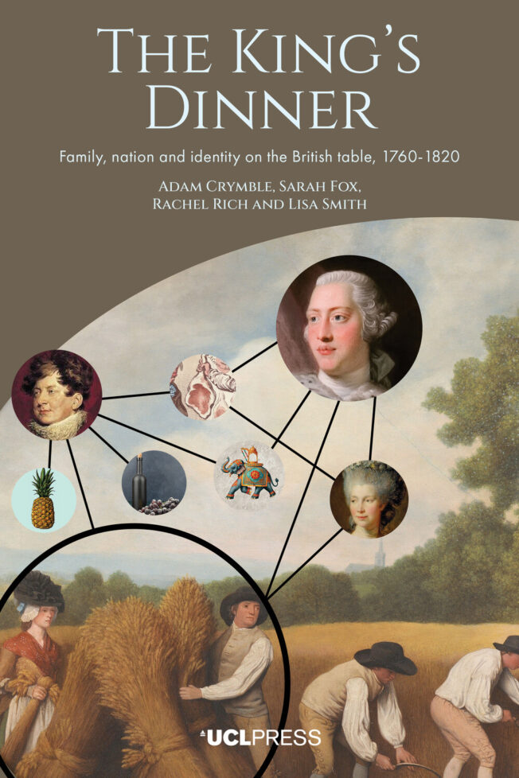
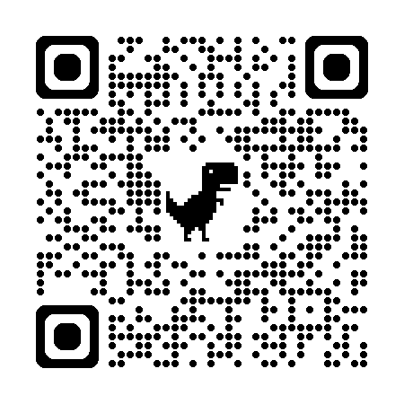
What have I published Open Access?
Adam Crymble, Sarah Fox, Rachel Rich, Lisa Smith,The King’s Dinner: family, nation, and identity on the British Table, 1760-1820
UCL Press
Available to pre-order now uclpress.co.uk/book/the-kings-dinner/

Slide 5
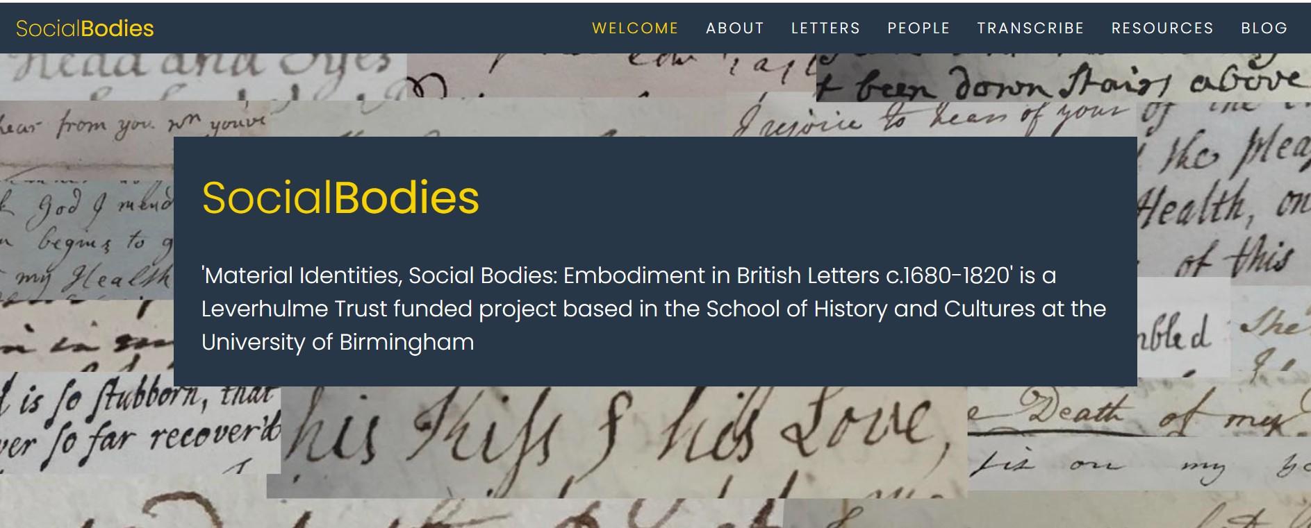
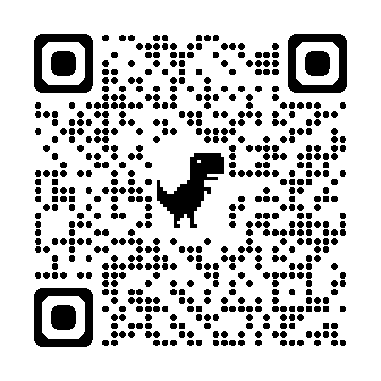
What have I published Open Access?
‘Material Identities, Social Bodies: Embodiment in British Letters, c.1680-1820’
Leverhulme funded
www.socialbodies.bham.ac.uk

Slide 6
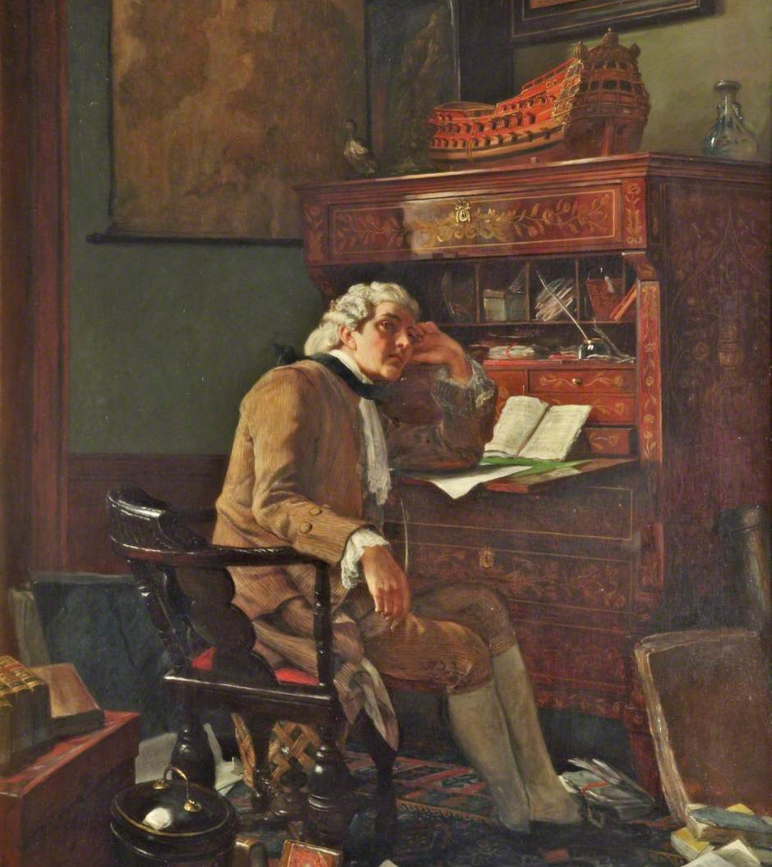
Disciplinary Barriers to Open Access
Ideas of hierarchy and ‘prestige’
4* research is partly determined by the prestige of the journal that publishes it
Cost
The lone historical researcher (and ownership of data and of intellectual property)
Copyright issues or ownership of our sources

Slide 7
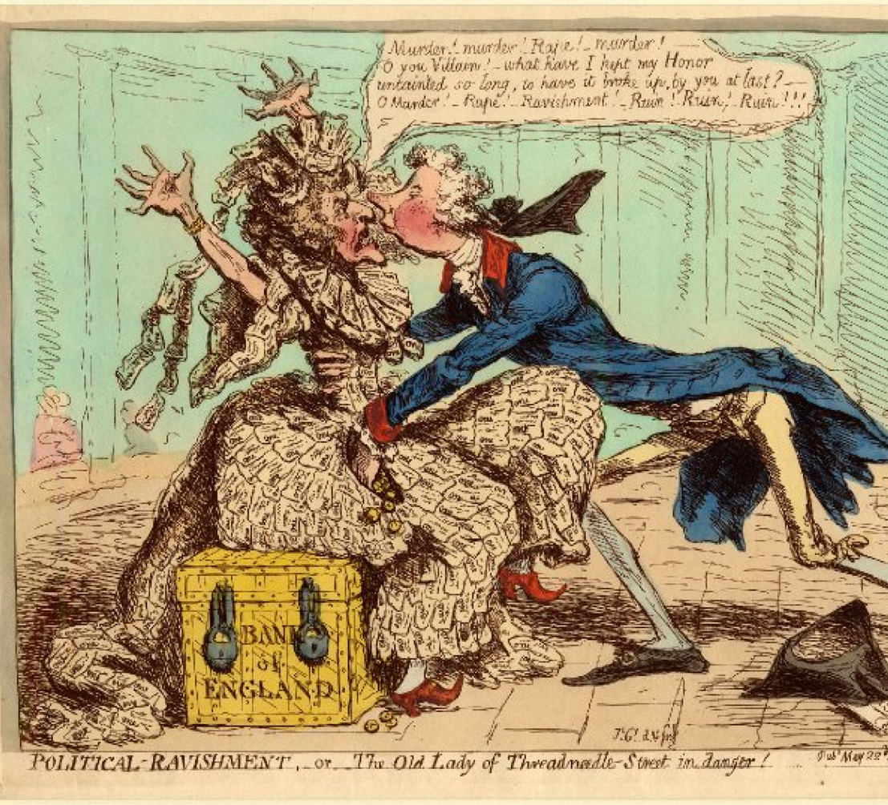
Individual Barriers to Open Access
Money!
GenAI and Large Language Models

Slide 8
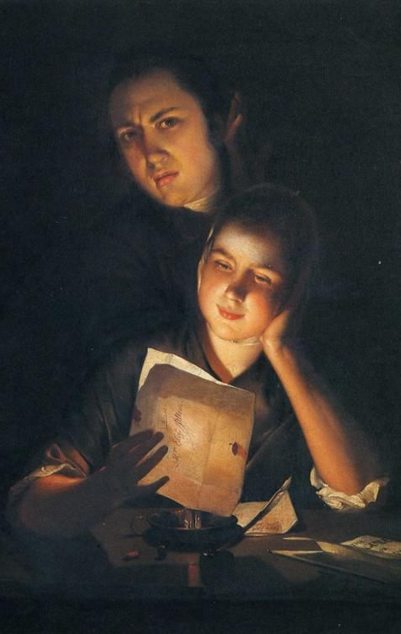
Benefits of Open Access: readership
Cost
Dwindling library budgets
Accessibility
Students
Precariously employed academics
Academics without institutional affiliation
Maybe non-academic audiences?

Slide 9

Benefits of Open Access: reach
Citations
Range of disciplines
International citation
Download data
Majority in English-speaking countries
Europe: France, Netherlands, Germany, Poland, Italy, Austria, Spain, Sweden
But ALSO China, India, Indonesia, Japan, Bulgaria, South Korea, Hong Kong

Slide 10

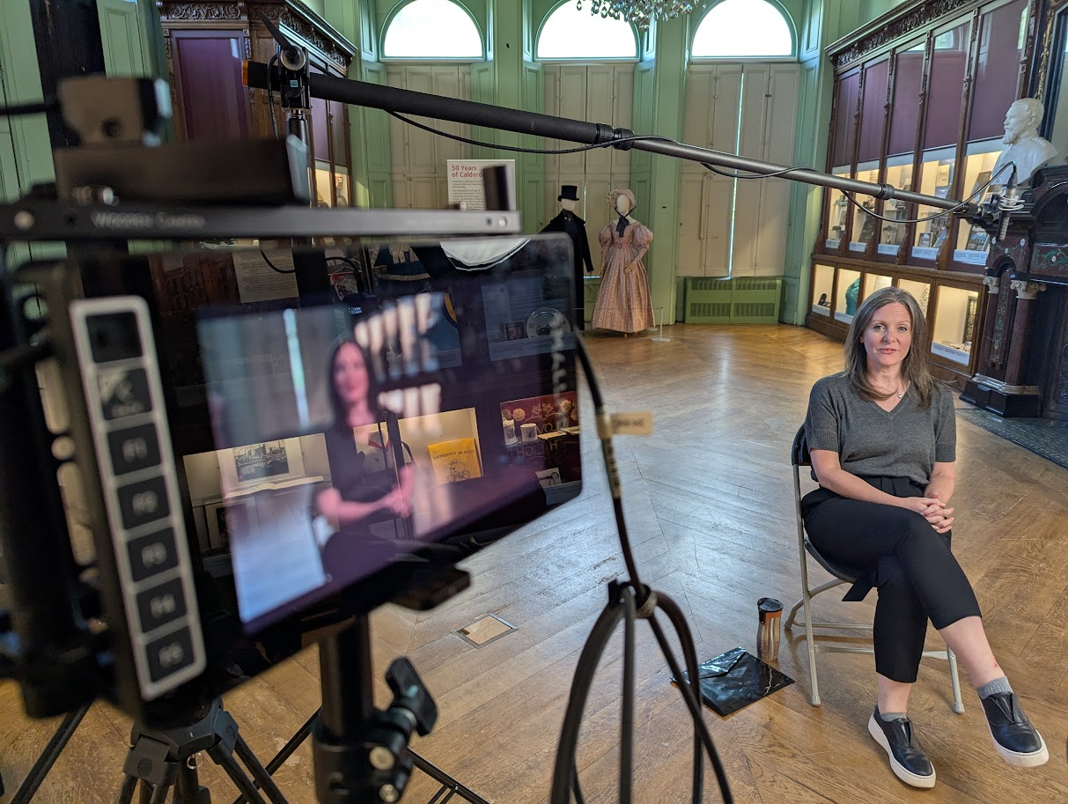
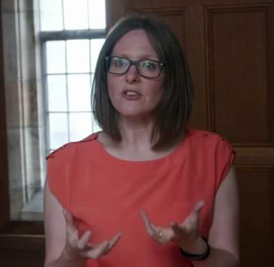
Benefits of Open Access: unexpected opportunities
Since publishing the book I have been contacted by:
Podcasts
Television producers
Film producers
Novelists

Slide 11
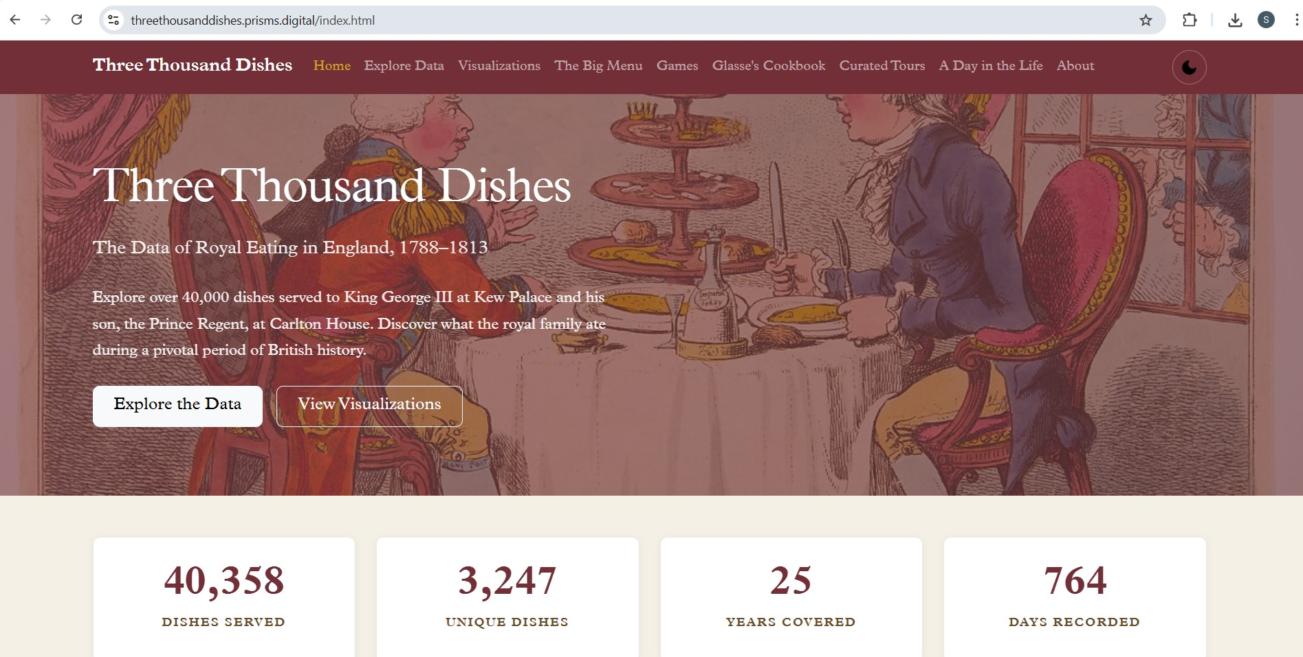
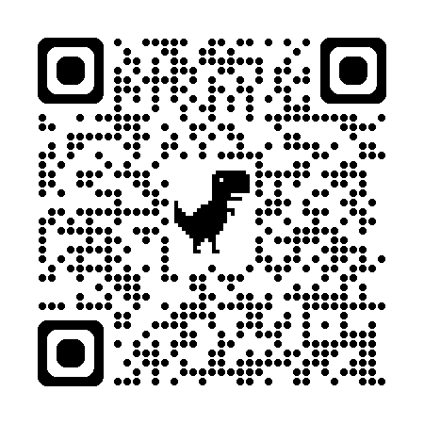
Benefits of Open Access: collaboration
‘George’ dataset was published in 2023
Discoverability?
Panel on data at the British Society for Eighteenth-Century Studies conference
https://threethousanddishes.prisms.digital/index.html

Slide 12
Thank you for listening! Sarah.fox@edgehill.ac.uk

