Slide 1
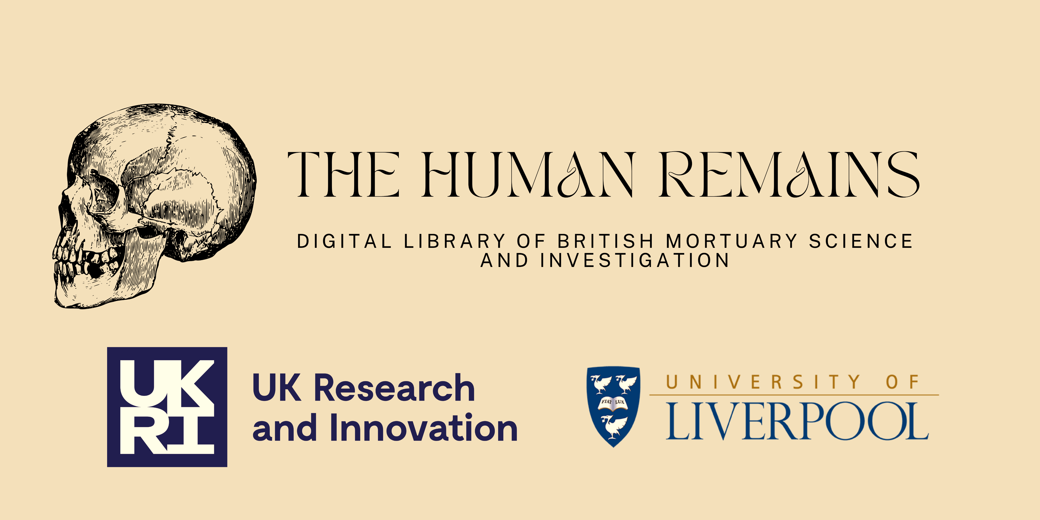
Dr Ruth Nugent & Dr James Butler

Slide 2
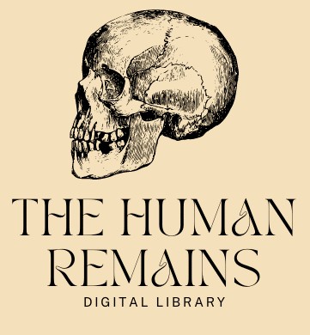

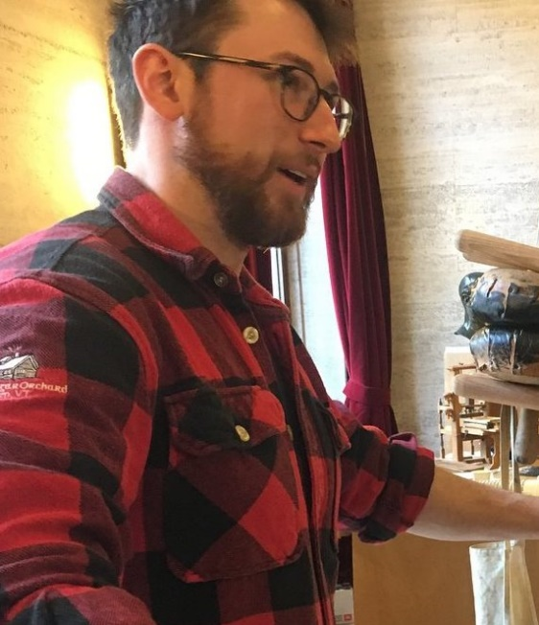

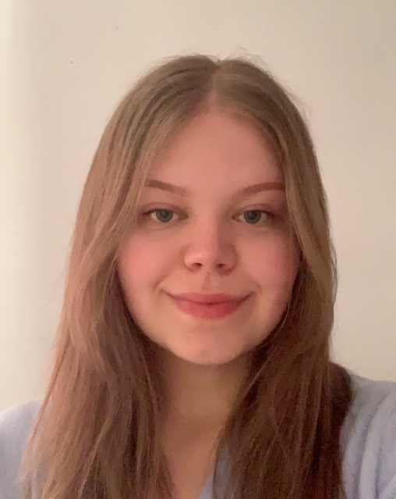
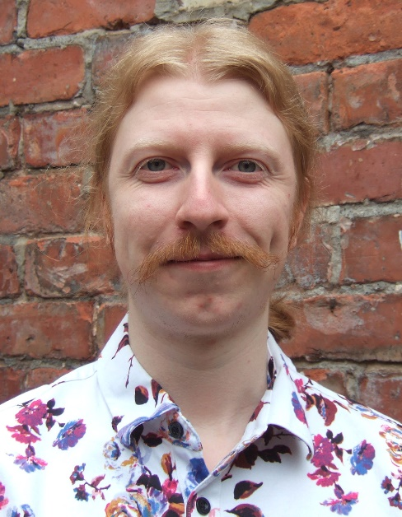
The Human Remains Project Team
9
remains@liverpool.ac.uk
Dr James
Butler
Digital Humanities
Linguistics
Spatial Humanities
Dr Glenn
Cahilly-Bretzin
Medieval Texts &
Languages;
Craftspeople
Dr Adam
Daubney
Archaeology & Heritage;
Small Finds
Katherine
Foster, MA
Project Administrator;
Heritage
Dr Tom Farrow
Postmedieval Charnel;
Antiquarianism

Slide 3
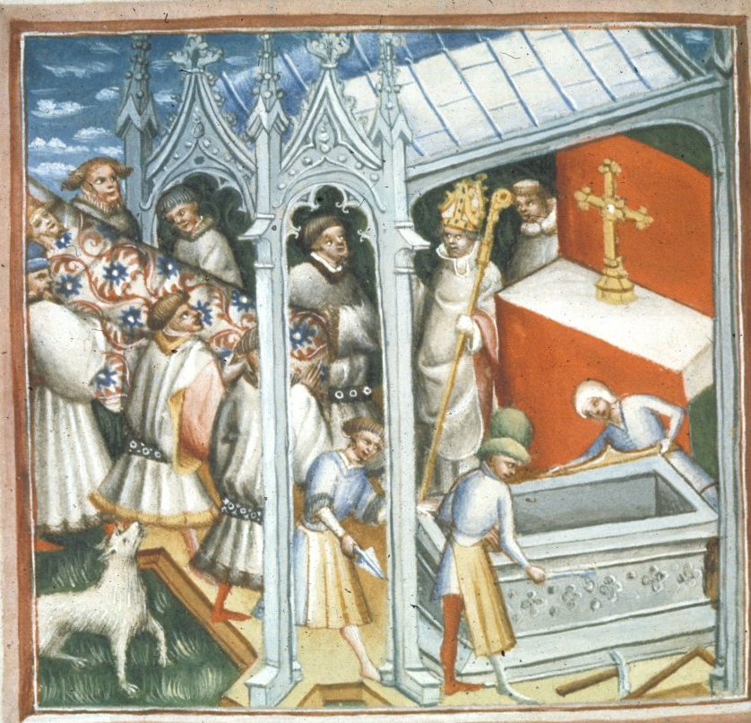
Archaeology, Classics & Egyptology (ACE)
Ruth.Nugent@liverpool.ac.uk
James.Butler@liverpool.ac.uk
Project
The first large-scale study of the history of exhumation and reburial in British churches, using writings from 7th - 19th centuries and modern archaeology reports.
Methods
Use Digital Humanities tools to find, collate, and analyse a new and unique large thematic collection.
Goal
Use the long history of exhumation beliefs and practices to assist historic burial management by informing best practice, policy, and public perceptions with findings from the past.
Develop innovative methods and models.
St Edmund's body moved to his tomb-shrine from John Lydgate's (c. 1434 - 1439) The Lives of Saints Edmund and Fremund. (Source: The British Library, Harley 2278, Public Domain)

Slide 4

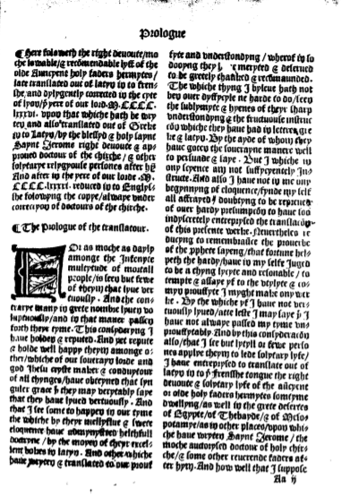
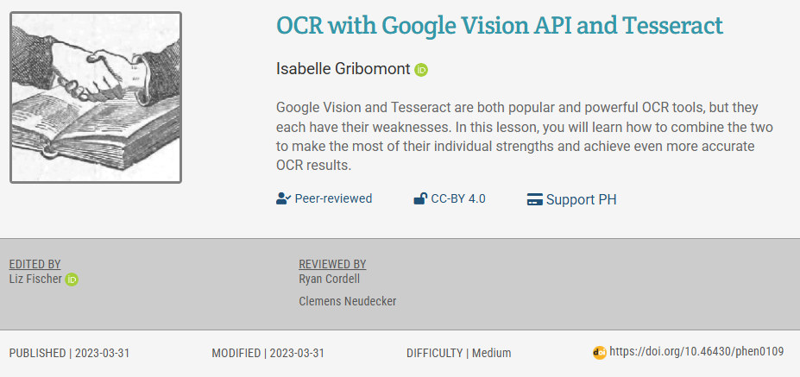
Research Innovations
Standardising historical data
Building HRDL
Cleaning historical texts
Translating historical texts
Analysing HRDL
Notes:
The sources we find will be made available online as the Digital Library of Historic Mortuary Science & Investigation - the first digital mortuary reference library of its kind – so others can add to the library, use it for their own research, and support the work of modern church and cathedral staff, archaeologists and other disinterment professionals.

Slide 5
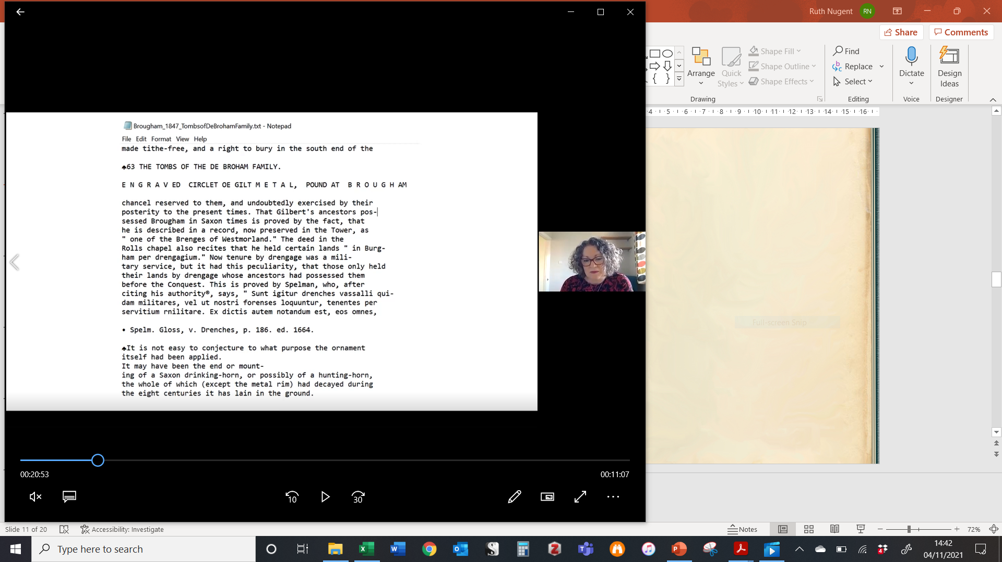
Research Innovations
Standardising historical data
Building HRDL
Translating historical texts
Cleaning historical texts
Analysing HRDL
Multilingual Corpora
  Old English
  Middle English
  Medieval Welsh
  Anglo-Norman French
  Latin
  Early/Late Modern English
  Modern Welsh
  Scots Gaelic
  Greek, French, German, Old Norse etc.
Translate into modern British English for library users
Original languages available for download
Notes:
The sources we find will be made available online as the Digital Library of Historic Mortuary Science & Investigation - the first digital mortuary reference library of its kind – so others can add to the library, use it for their own research, and support the work of modern church and cathedral staff, archaeologists and other disinterment professionals.

Slide 6
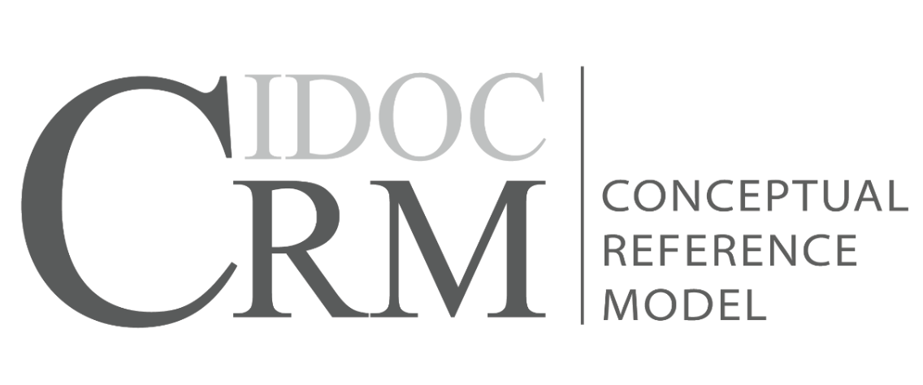
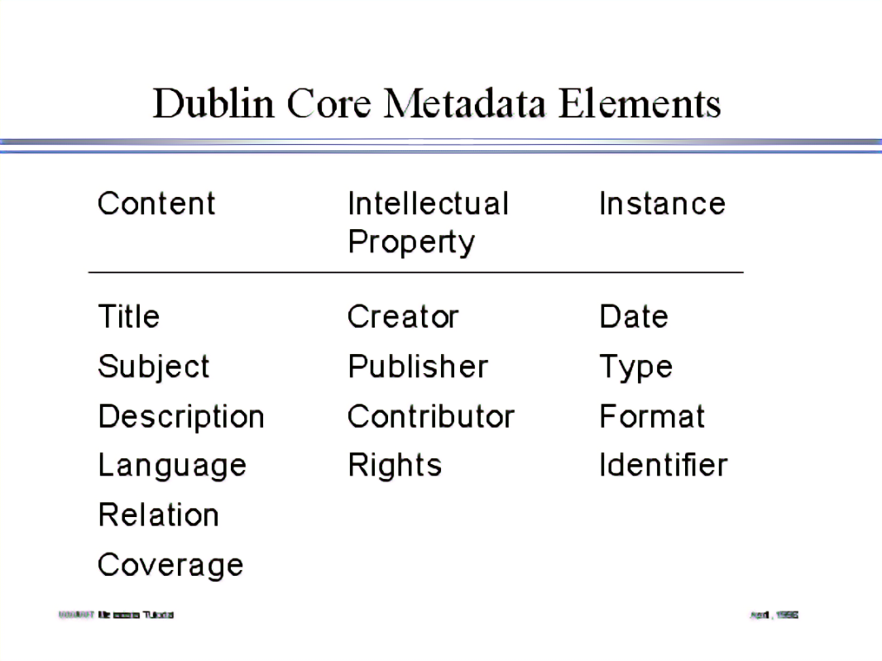
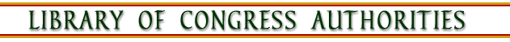
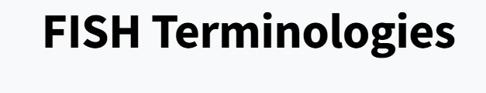
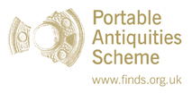
Research Innovations
Standardising historical data
Building HRDL
Cleaning historical texts
Translating historical texts
Analysing HRDL
Ontology
Bespoke metadata
Metadata
Controlled Vocabularies
Bespoke vocabulary
Notes:
The sources we find will be made available online as the Digital Library of Historic Mortuary Science & Investigation - the first digital mortuary reference library of its kind – so others can add to the library, use it for their own research, and support the work of modern church and cathedral staff, archaeologists and other disinterment professionals.

Slide 7
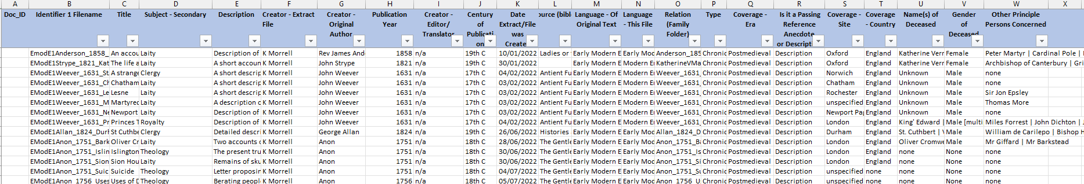
Trackers: Record Metadata
Dublin Core metadata - about creation of the TXT file
  https://github.com/HumanRemainsDL/HRDL/blob/main/metadata_capture_values.md
Contextual - metadata (about the contents of the extract)
  Preliminary created (names, gender, site, country, other persons)
  Further contextual metadata to be developed next
  Additional metadata for Archaeology
  https://hrdl.liverpool.ac.uk/Guidance
Standardised spellings and abbreviations across all corpora

Slide 8
Corpus Workflow for HRDL
Texts Collected
Handlist
Family Folders
Extracts Created
AstroGrep/Extract
Translated
Webscraping
TXT
Library Populated
Files uploaded
Metadata standardised
Cleaned
Metadata (Tracker)

Slide 9
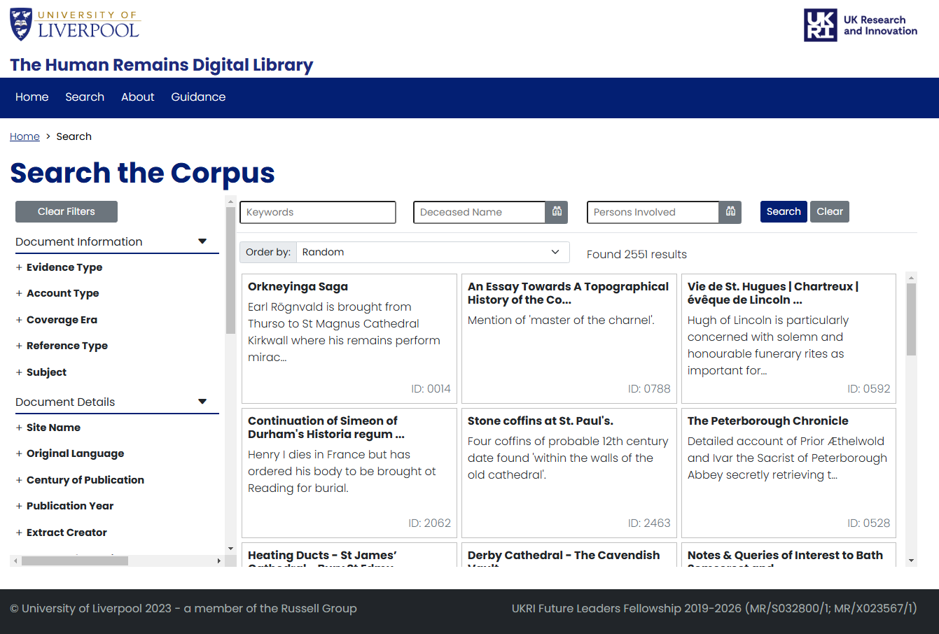
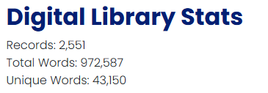
Research Innovations
Building HRDL
Cleaning historical texts
Translating historical texts
Standardising historical data
Analysing HRDL
7th-19th C (2,287)
Written records
20th-21st C (264)
Archaeology
35 account types
Blazor framework
hrdl.liverpool.ac.uk
Launch event: 21 February 2025
Notes:
The sources we find will be made available online as the Digital Library of Historic Mortuary Science & Investigation - the first digital mortuary reference library of its kind – so others can add to the library, use it for their own research, and support the work of modern church and cathedral staff, archaeologists and other disinterment professionals.

