Slide 1
Research4Life: Networks, Equity and Engagement in Action for 25 Years
Daniel Dollar (Yale University)
Carol Hollier (University of Iowa)
Open Research Week 2026 | March 5, 2026
Notes:
Daniel
Welcome
Any housekeeping items
Introductions
Abstract:
For 25 years, Research4Life has worked to build a more equitable research ecosystem that fosters full participation by researchers in the Global South. When it was founded Research4Life focused on the key barrier at that time, access to high-quality and current research literature. Research4Life’s strategic direction has grown to encompass multiple elements critical to the success of researchers in lower-income countries. This presentation will focus on recent Research4Life initiatives which support researchers’ increased participation and inclusion in the international research community, including the recently formed Academic Alliance. The Research4Life Academic Alliance is a collaboration of academic libraries and information professionals to advance the mission and vision of the partnership.

Slide 2
What is Research4Life?
Research4Life exists to cultivate an inclusive, diverse, and equitable scholarly environment that enables researchers from lower-income countries to address societal challenges.
United Nations-led public-private partnership of WHO, FAO, UNEP, WIPO, ILO; Cornell and Yale Universities; the International Association of Scientific, Technical & Medical Publishers, training and outreach organizations, and 200+ international publishers.
Notes:
Research4Life – What is it?
United Nations-led public-private partnership to provide researchers and students at more than 11,500 institutions in 125 low and middle-income countries with access to academic and professional peer-reviewed content.
These countries include 85% of the world’s population but only .2% of world’s researcher
To face goal challenges we need global solutions
Research4Life consists of five programs – Hinari, AGORA, OARE, ARDI and GOALI
More than 230,000 resources – including journals, books, databases and research tools. Content extends beyond the five broad subject areas covered by the programs to include social science, and humanities literature.

Slide 3
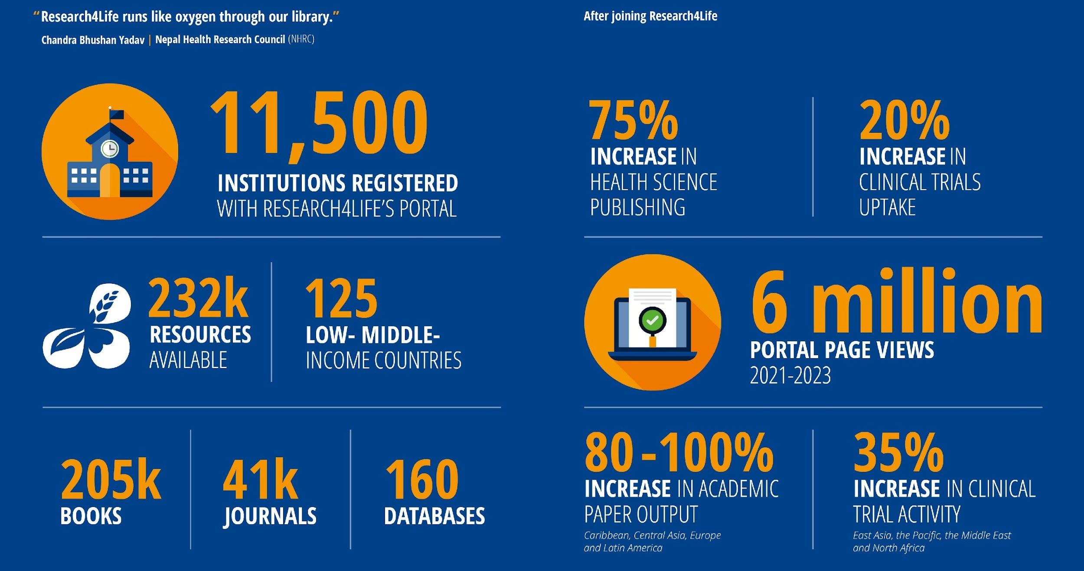
Research4life in numbers

Slide 4

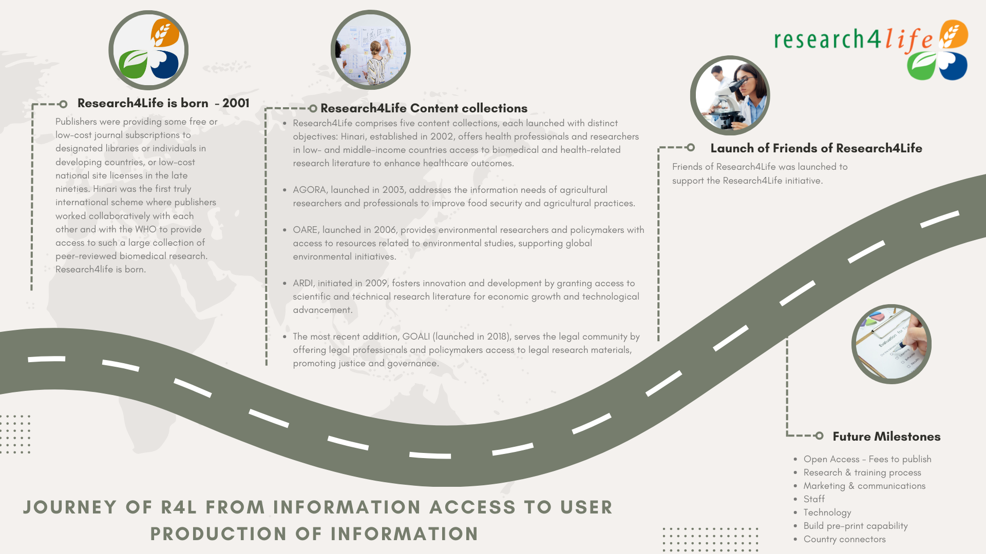
Our Journey

Slide 5
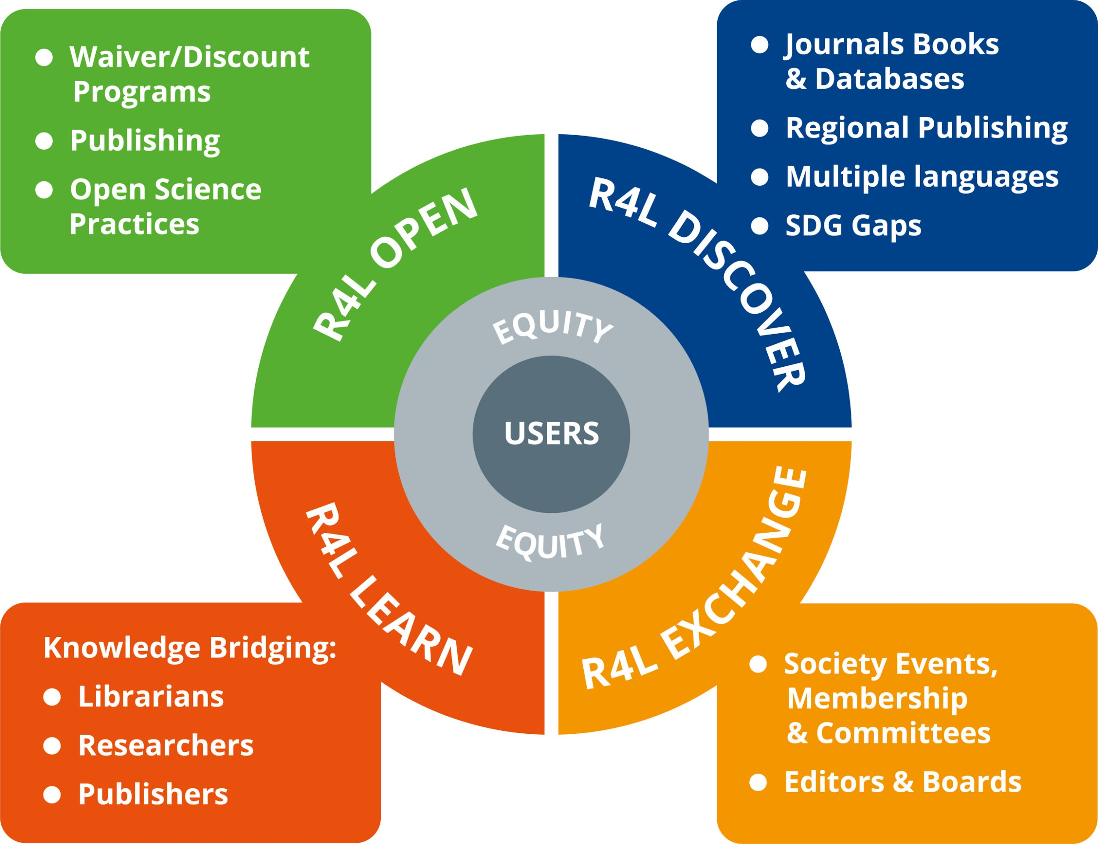
Vision for 2030
Notes:
Research4Life’s current strategic plan – Vision for 2030.
We aim to contribute to the UN Decade of Action for accelerating the Sustainable Development Goals by increasing research participation from the Global South.
By 2030, we aim to have significantly increased the participation of researchers as both consumers and producers of critical research, providing the necessary capacity building through local networks and partnerships.
Beyond Donation: Transitioning from content donation to fostering reciprocal engagement, nurturing a rich and diverse scholarly exchange.
Global Participation: Aiming to significantly elevate voices and the presence of researchers from lower-income countries to the fore of global research dialogue.
Local Empowerment: Dedicated to strengthening local research networks and enhancing their role in promoting sustainable development.

Slide 6
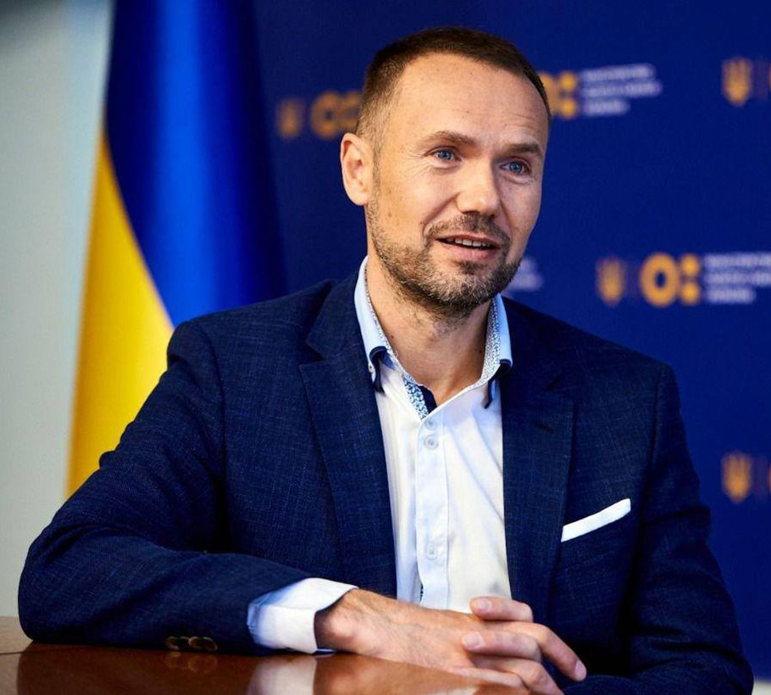
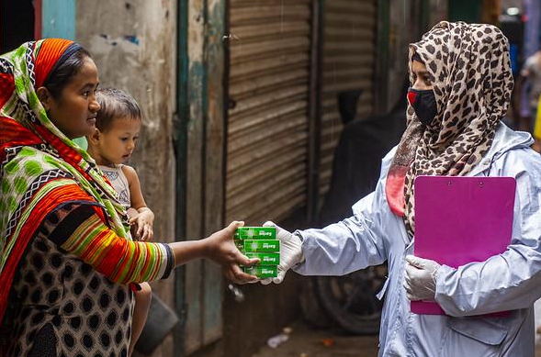
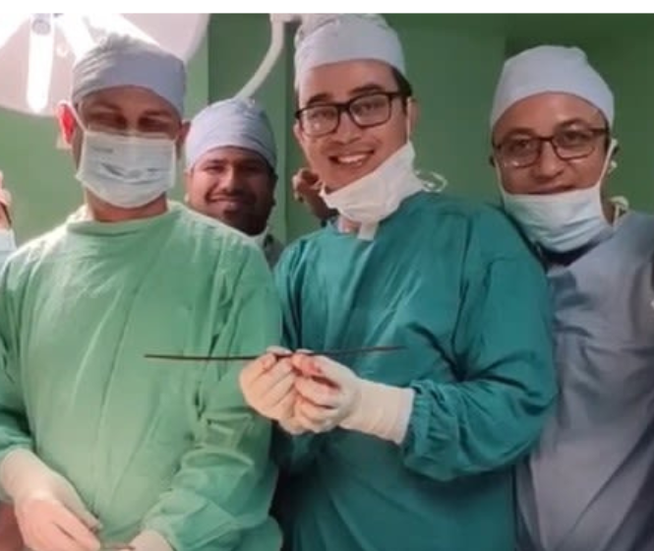
Our Impact
Ukraine
Bangladesh
Nepal
The output of research publications has steadily increased since the introduction of Research4Life. Nazim Uddin is the Senior Manager at the International Centre for Diarrhea Disease Research in Bangladesh, an institution leading the fight against cholera since 1962.
The Ministry of Education and Science of Ukraine is grateful for the support provided for Ukrainian scientists through the Research4Life partnership.
Thanks to the full text that I got via Research4Life, I was able to make a plan for surgery. Dr. Shrestha, a neurosurgeon from Nepal, on how Research4Life helped save a patient on his neurosurgery ward.

Slide 7
Our Impact – Research Studies
A study by the World Intellectual Property Organization (WIPO), the University of the Bundeswehr Munich, and the German Economic Institute reveals that free or low-cost online access to scientific publications — as provided by Research4Life programs — results in a surge in scientific output, particularly in health sciences, by up to 75% in low- and middle-income countries.
A WIPO research paper found online access to research significantly increases how much women in low- and middle-income countries (LMICs) contribute to scientific publishing.
Notes:
https://www.research4life.org/press-releases/wipo-study-research4life-program-spikes-research-output-75-percent-low-middle-income-countries/
https://www.research4life.org/press-releases/wipo-study-on-women-in-science/

Slide 8

R4L OPEN
Bridging the transition from access to Open Access
Ensuring that Open includes LIMC scholars as both consumers and producers of research

Slide 9
Initiatives and Programs
Notes:
Carol

Slide 10
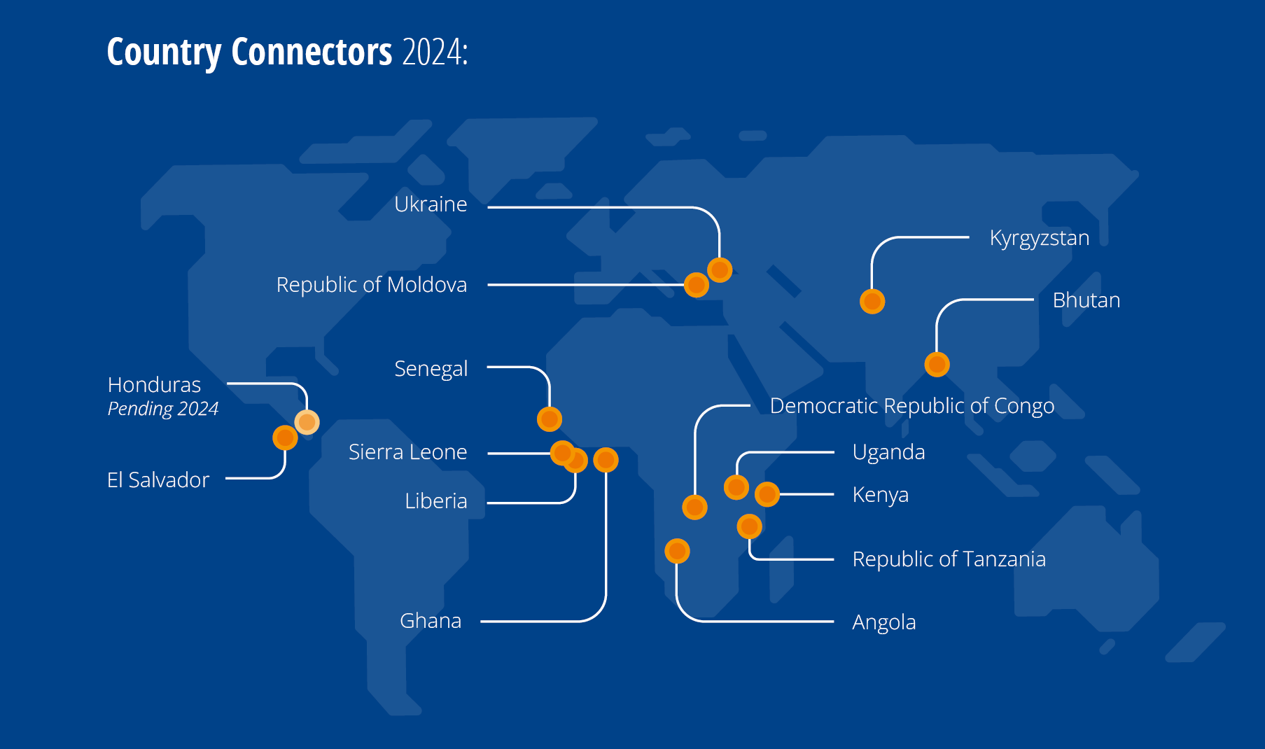
Country Connectors: Bridging the gap
Customizing research capacity-building programs to meet local needs
Collaborating with regional partners to boost research output and practical implementation
Providing support and guidance in local languages
Training and capacity-building in native languages to increase accessibility
Guiding local publishers in joining the Research4Life network for broader visibility
Offering quick one-on-one support and fast response times for all inquiries

Slide 11
Capacity Development
Virtual and in-person training sessions and workshops
Translating training matters into more languages
Modernizing interactive online training offerings using Rise 360 platform
Increasing the number of webinars and virtual courses, including with Think.Check.Submit
Collaboration with DOAJ on training for publishers, journal editors, managers, and others supporting journals and journal infrastructures
Training led to Bhutan Health Journal being indexed in DOAJ

Slide 12
Committees
Equity Committee
Strategy and Content Committee
Technology
Fundraising
Marketing & Communications
Financial Oversight
User Group

Slide 13
Challenges
Volunteer organization
Reliant on in-kind contributions
Minimal cash budget
Disrupted international development support

Slide 14

Friends of Research4Life
Established in 2020
Raised more than 1.5 million to date
Consider donating
Friends site, https://friendsofresearch4life.org/

Slide 15
Research4Life Academic Alliance
Notes:
Mary Ellen

Slide 16
Research4Life Academic Alliance
The Research4Life Academic Alliance is a collaboration of academic libraries and information professionals to advance the mission and vision of the partnership to develop and enable diverse and rich scholarly exchange between researchers, librarians, authors, and students in higher and lower-income countries.

Slide 17
Alliance Initiatives
Impact study on Country Connector Program
Subject guides starting with subjects not covered by existing programs.
Develop the organizational structure of the Academic Alliance
Please consider joining us!
Volunteer Interest Form

Slide 18
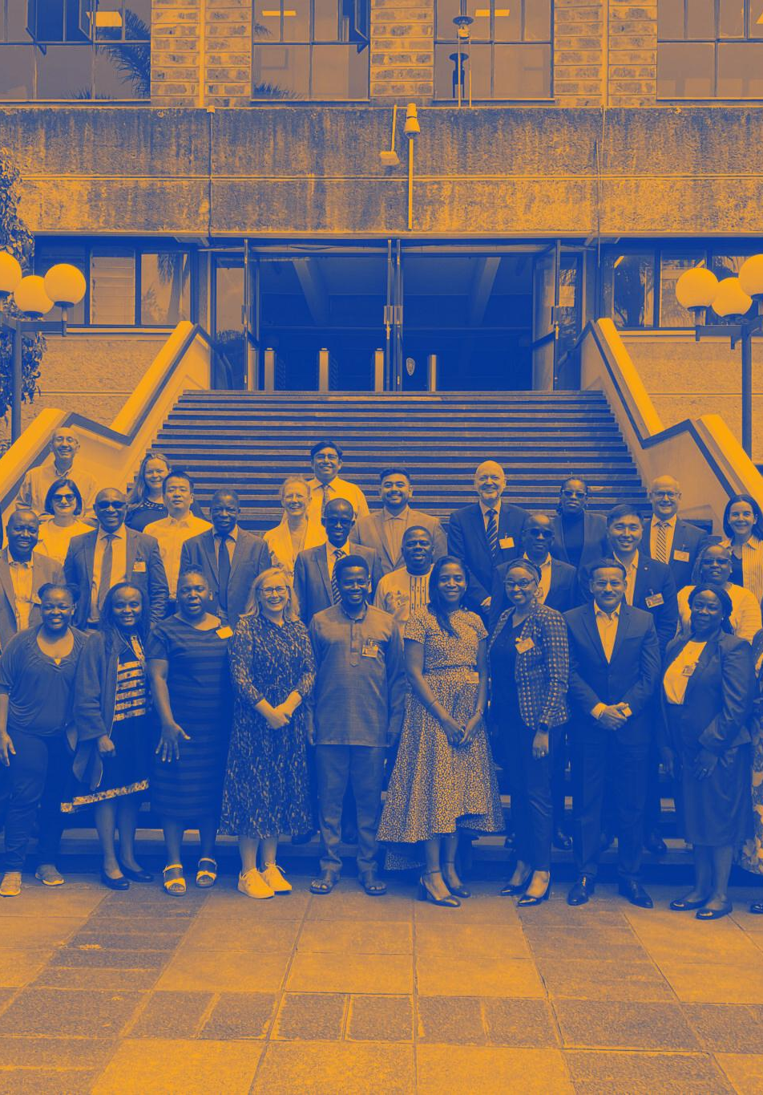
Change the face of global research
Thank you!

Slide 19
Questions
Contact us!
Daniel Dollar, daniel.dollar@yale.edu
Carol Hollier, carol-hollier@uiowa.edu

