Slide 1



Open Research and Open Education Hide and Seek?
Nick Sheppard & Chrissi Nerantzi
University of Leeds & Knowledge Equity Network
5 March 2026
Notes:
20 minutes with Nick
https://www.research4life.org/
statics.teams.cdn.office.net/evergreen-assets/safelinks/2/atp-safelinks.html

Slide 2

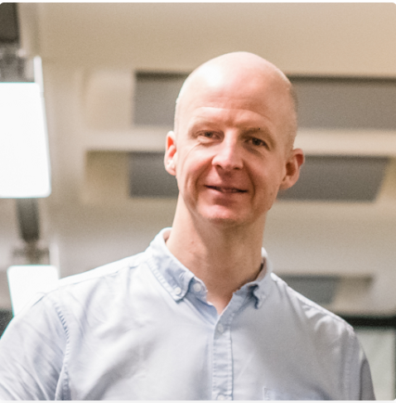

Introductions
Nick Sheppard​
Open Research Adviser, University of Leeds Libraries, Senior Lead of the Knowledge Equity Network
UK Wikimedian of the Year 2023
Prof. Chrissi Nerantzi​
(PFHEA, NTF, CATE)
Professor in Creative and Open Education, Senior Lead of the Knowledge Equity Network
Director of the Imaginative Curriculum Research and Scholarship Centre, School of Education
Co-chair of the ICDE Open Education Network

Slide 3
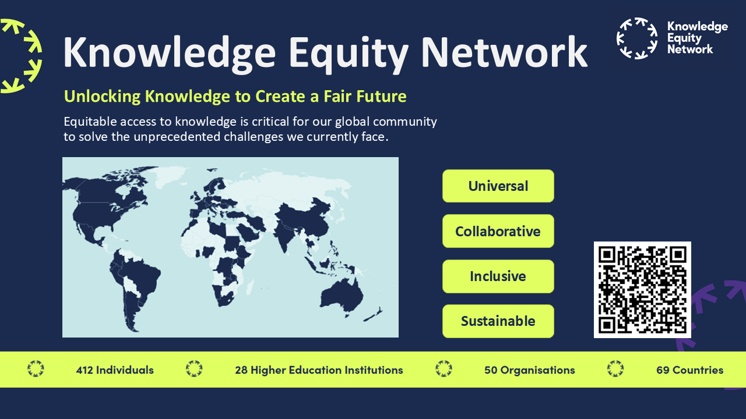
Notes:
Principles set out in the Declaration are that Knowledge are summarised as…
Universal – for the good of all
Collaborative – prioritise collaboration over competition, transdisciplinary
Inclusive – should consider all potential beneficiaries of the knowledge HE creates
Sustainable – these practices should be carried out in a sustainable manner for providers, funders and participants.
Current signatories (as of end of January):
435 Individuals, 28 HEIs, 52 Orgs… across 69 countries
QR code leads to the website ‘Sign the Declaration’ page. Please invite people to read the Declaration and if they agree with it, sign and join us in the Knowledge Equity Network.
And then reach out and collaborate with us!

Slide 4
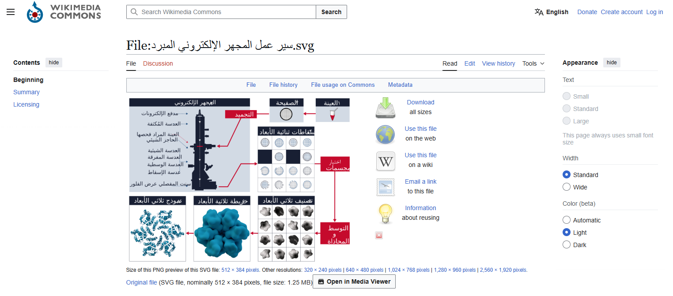
Open Research
and Open Education
Problems – Practices - Empowerment
Image:
Cryogenic electron microscopy workflow – original image by Hira Khan.
Arabic translation by Salha Abdo.
Notes:
https://commons.wikimedia.org/wiki/File:Cryogenic_electron_microscopy_workflow.svg

Slide 5
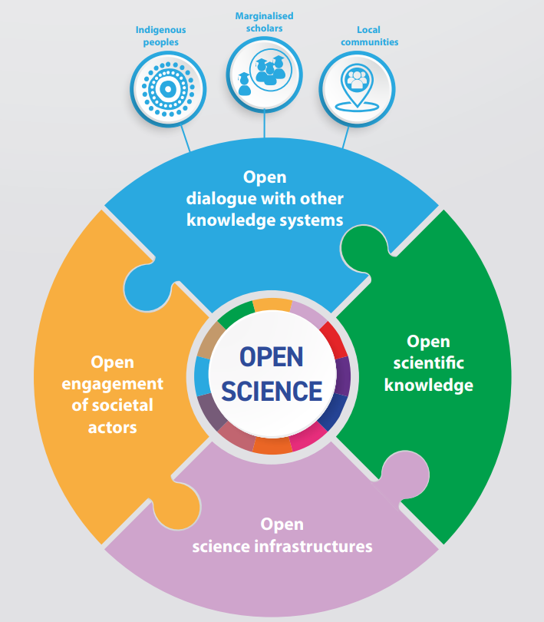
Problems
Research Culture
Incentives – publish or perish
Questionable Research Practices (QRP)
QS Ranking
Cost
Commercial publishing
APC model of open access
Infrastructure – FAIR data
Misinformation
Artificial Intelligence
Reinforced bias
Pace of change

Slide 6
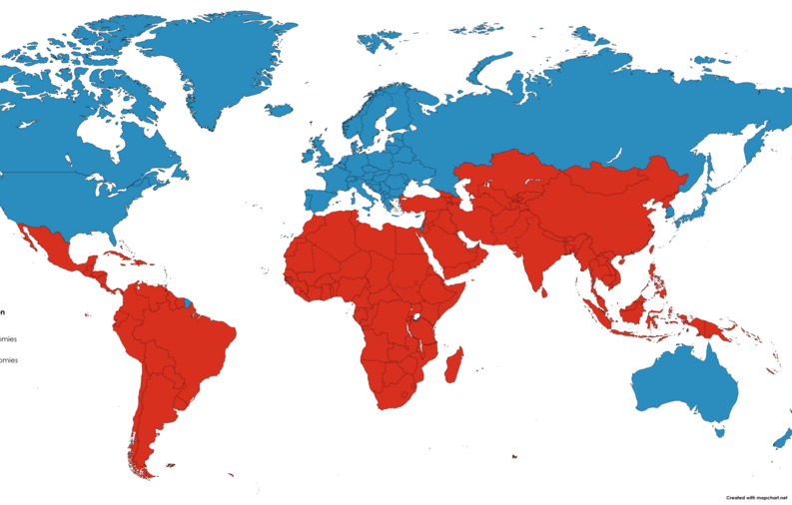
Practices
“The challenges facing our society today can only be solved through global cooperation, collaboration and openness.”
Knowledge for all: University of Leeds Libraries Vision for 2030
Reproducible and transparent research
Data sharing | Software & code
Preprints | Preregistration
Bibliodiversity | Diamond Open Access
Information and digital literacy
Specialgst, CC BY-SA 4.0, via Wikimedia Commons

Slide 7

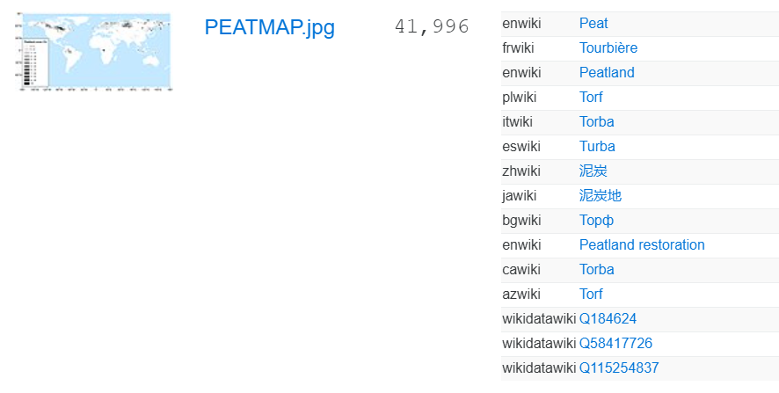
Empowerment
“Our mission is to set knowledge free. We work to ensure that everyone, everywhere has equitable access to create and consume information.”
“We are building Grokipedia @xAI. Will be a massive improvement over Wikipedia.
Frankly, it is a necessary step towards the xAI goal of understanding the Universe.”
Elon Musk, 2025
Wikimedia as bridge:
Academia / global commons
open research / open education
Human curated knowledge
Ethical AI
Information and digital literacy
Collaboration and co-creation
Example of openly licensed research output used on 12 Wikipedia articles in 10 different languages
Notes:
Our mission is to set knowledge free. We work to ensure that everyone, everywhere has equitable access to create and consume information.
We support the United Nations’ Sustainable Development Goal (SDG), to “ensure inclusive and equitable quality education and promote lifelong learning opportunities for all.”

Slide 8

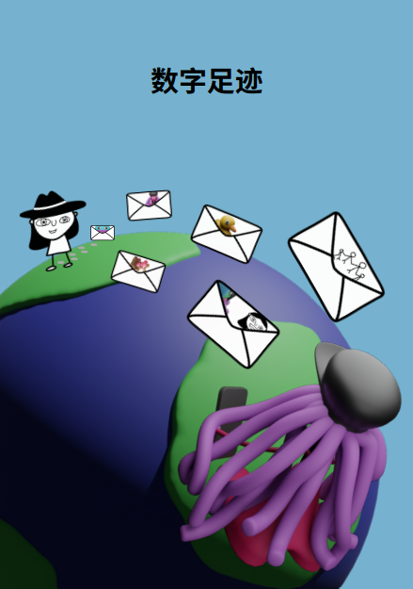
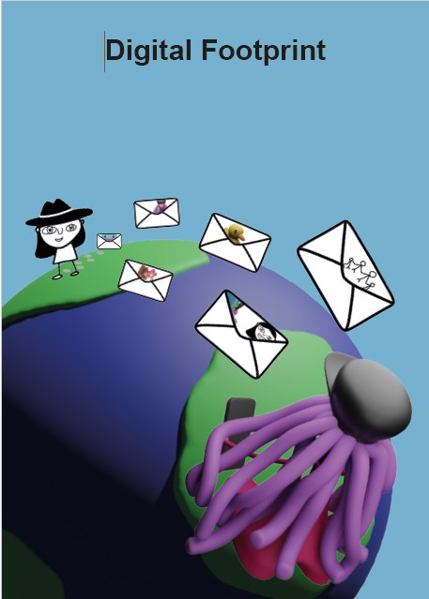
Open Education
and Open Research
Problems – Practices - Empowerment
Images:
Co-production of digital cultural knowledge with primary school children: fostering early digital literacy development, Research England and Durham University, Participatory Research, led by Dr. Cristina Costa n collaboration with Nicole McIlvaney, and Jen Simpson, Durham University; Prof. Chrissi Nerantzi (Picture book consultancy), University of Leeds and Odysseas Frank, Norwich University of the Arts.
Notes:
Co-production of digital cultural knowledge with primary school children: fostering early digital literacy development, Research England and Durham University, Participatory Research, led by Dr Cristina Costa in collaboration with Nicole McIlvaney, and Jen Simpson, Durham University; Prof. Chrissi Nerantzi (Picture book consultancy), University of Leeds and Odysseas Frank, Norwich University of the Arts, https://sway.cloud.microsoft/ZpzedqtnHYd6zuk4?ref=Link&loc=play Outputs: 3 picture books available in English, Greek, Mandarin (forthcoming in German, Portuguese, Spanish)

Slide 9
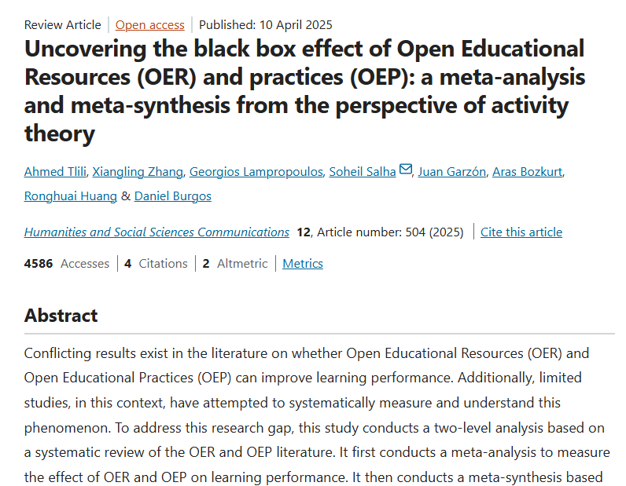
Problems
Common practice: replacing closed with open resources exclusively
(Tlili et al., 2025, 9)
Expecting advocacy to do all the hard work
(Bacsich, 2025)
Digital tech seems to be driving “innovation”
(UNESCO, 2023)
Notes:
Purpose of learning, assessment
Bacsich, P. 2025. A Timely and Thought-Provoking Analysis of the OER Landscape: A Call for Strategic Re-evaluation. 18 December 2025. LinkedIn. https://www.linkedin.com/pulse/timely-thought-provoking-analysis-oer-landscape-call-paul-bacsich-cdzce/
Henke, J. and Pasternack, P. 2025. Hochschule in der ungesicherten Demokratie. Ansatzpunkte zur Stärkung der Resilienz. Institute für Hochschulforschung. Halle-Wittenberg. 10.5281/zenodo.17951293
Tlili, A., Zhang, X., Lampropoulos, G. et al. 2025. Uncovering the black box effect of Open Educational Resources (OER) and practices (OEP): a meta-analysis and meta-synthesis from the perspective of activity theory. Humanities and Social Sciences Communications. 12, 504. https://doi.org/10.1057/s41599-025-04644-y
UNESCO 2023. Global education monitoring report summary, 2023: technology in education: a tool on whose terms? https://doi.org/10.54676/HABJ1624
“Education is criticized as being slow to change, stuck in the past and a laggard when it comes to innovation.” (UNESCO, 2023, 6)
“There is little robust evidence on digital technology’s added value in education. […] A lot of the evidence comes from those trying to sell it.” (UNESCO< 2023, 1) “An der übergroßen Mehrheit der Hochschulen dominiert Ratlosigkeit, wie demokratische Orientierungen und Handlungsfertigkeiten durch das Studium gefördert werden könnten.“ (Henke und Pasternack, 2025, 5)
-
OER for transmission is limiting!
“The results highlighted that in almost 97% of the studies, the creation and distribution of OER was solely by the teacher. […] our results revealed that most of the analyzed studies simply changed the content license to open and continued to rely on traditional teaching practices, wherein students primarily act as consumers of knowledge. Indeed, such an approach does not fully leverage the potential of OER and OEP to transform educational experiences. Instead of fostering active learning and engagement, these studies maintained conventional pedagogical methods, thus limiting the potential benefits that open resources and practices could offer. This explains the low effect on students’ learning performance since simply changing a content license from commercial to open does not imply a change in performance.” (Tlili et al., 2025, 9)
Advocacy is not enough!
There is “… a need to re-evaluate the effectiveness of advocacy-led approaches and to focus more on the structural conditions required for policy success in the various educational sectors.” Bacsich (2025, online)
Digital tech seems to be driving: What are the implications?
“There is little robust evidence on digital technology’s added value in education. […] A lot of the evidence comes from those trying to sell it.” (UNESCO< 2023, 1)

Slide 10
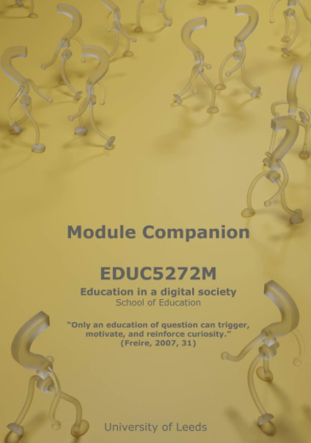
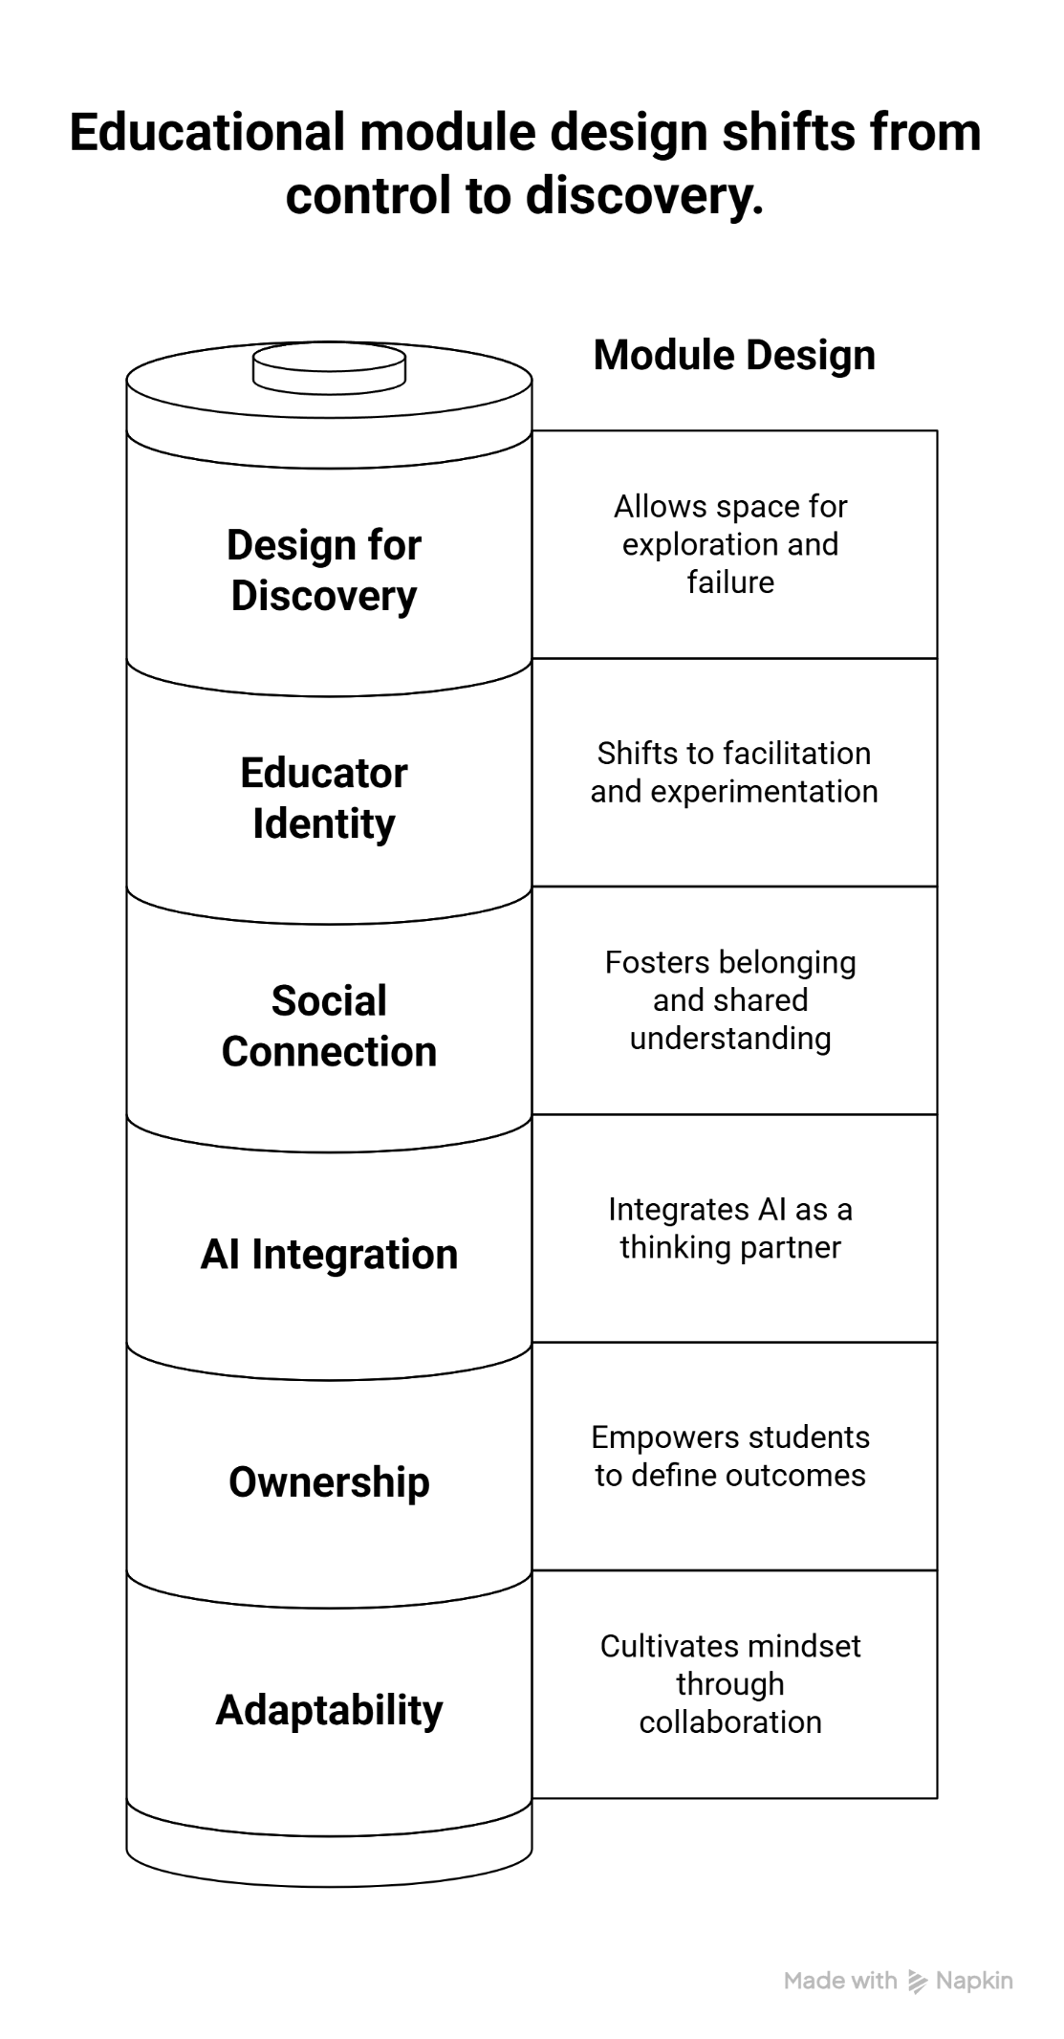
Practices
Imagining the AI-enabled open curriculum with students (Nerantzi, 2025)
Open, problem/challenge-based collaborative learning
Co-designed with students
Scholarship and research with students (Nerantzi et al. 2025)
“I felt really empowered… it builds trust between tutors and students.” Alexandra
3D art by Ody Frank
Notes:
Also implementing, trying it out
PBL, with students in partnership
Openness and collaboration build in
Focus on thinking, discovery learning
experimenting
Embrace AI – but we have traffic lights (Dignan towards evolutionary organisation – fluidity, not hard stops)
John Palfreyman (tutor) a roundabout not just for assessment, for learning… not just for students, also for staff
Parnership
Reimagining how we teach, how we learn
With our students
Module example, using PBL, AI-enabled
Human-to-human collab and human-machine
Building trust
Building relationships
---
Nerantzi, C. 2025. Module companion. EDUC5272M Education in a digital society. 2025/26. School of Education. University of Leeds. DOI: doi.org/10.63560/moco8986
On successful completion of the module you will have demonstrated the following Learning Outcomes (LO) relevant to the subject:
LO1: Critically assess key contemporary debates of digital technology, education and society in your professional context.
LO2: Apply specific learning theories relevant to digital education in your professional context.
LO3: Critically reflect on a range of digital technologies and practices in your professional context.
Nerantzi, C. 2025. Module companion. EDUC5272M Education in a digital society. 2025/26. School of Education. University of Leeds. DOI: doi.org/10.63560/moco8986
Nerantzi, C., Chai. Z. F., Poradowska, A. and Pavlopoulou, M. 2025. Mission possible. Media and Learning Association. 22 September 2025. https://media-and-learning.eu/type/featured-articles/mission-possible/

Slide 11

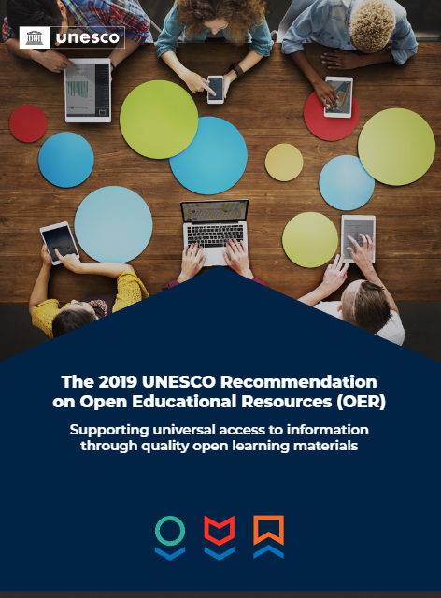
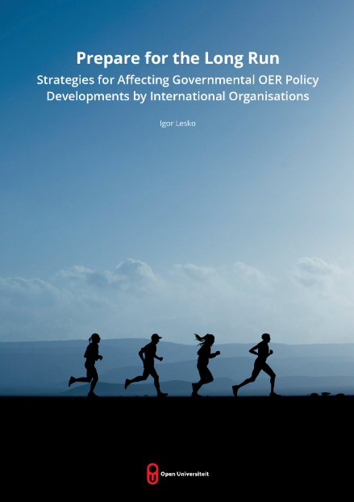
Empowerment
We must adapt, link to sustainability vital (Korosec and Ford, 2025, 24)
The ripple effect of sharing
“Open educational resources represent a unique tool to foster learning and knowledge sharing, which are essential to build inclusive knowledge societies and to achieve the Sustainable Development Goals.” (UNESCO, 2022, 4)
Networks and communities play key role in normalising open (Lesko, 2025, 133)
Notes:
Korosec, M. and Ford, C. 2025. Rewiring UK higher education: Urgent strategies for surviving and thriving in a disrupted sector, D2L. https://www.d2l.com/wp-content/uploads/2025/06/14-july-184198-D2L-Guide-Rewiring-HE-Superside.pdf
Lesko, I. 2025. Prepare for the long run. Strategies for affecting governmental OER policy. Developments by international organisations. Open Universiteit. https://doi.org/10.71583/20251127il https://research.ou.nl/en/publications/prepare-for-the-long-run-strategies-for-affecting-governmental-oe/
UNESCO 2022. The 2019 UNESCO Recommendation on Open Educational Resources (OER): supporting universal access to information through quality open learning materials. https://unesdoc.unesco.org/ark:/48223/pf0000383205?posInSet=8&queryId=a2ef199f-3c2f-4ca8-abcb-1c685737ee72
We must adapt, linked to sustainability vital
“Higher education is standing at a pivotal moment - where inertia is no longer an option and transformation is a strategic necessity. Across the globe, institutions are contending with intersecting forces: financial instability, shifting learner expectations, rapid technological change and rising digital threats. The question is no longer if higher education must adapt - but how, how quickly and how sustainably.” (Korosec and Ford, 2025, 24)
The ripple effect of sharing
“Open educational resources represent a unique tool to foster learning and knowledge sharing, which are essential to build inclusive knowledge societies and to achieve the Sustainable Development Goals.” (UNESCO, 2022, 4)
Networks and communities play key role in normalising open
“Future collaboration strategies could focus on supporting the creation of OER or Open Education coalitions or networks that could serve as a vehicle for mainstreaming OER in respective countries, states and provinces.” (Lesko, 2025, 133)

Slide 12
References
Bacsich, P. 2025. A Timely and Thought-Provoking Analysis of the OER Landscape: A Call for Strategic Re-evaluation. 18 December 2025. LinkedIn. https://www.linkedin.com/pulse/timely-thought-provoking-analysis-oer-landscape-call-paul-bacsich-cdzce/ Henke, J. and Pasternack, P. 2025. Hochschule in der ungesicherten Demokratie. Ansatzpunkte zur Stärkung der Resilienz. Institute für Hochschulforschung. Halle-Wittenberg. 10.5281/zenodo.17951293
Korosec, M. and Ford, C. 2025. Rewiring UK higher education: Urgent strategies for surviving and thriving in a disrupted sector, D2L. https://www.d2l.com/wp-content/uploads/2025/06/14-july-184198-D2L-Guide-Rewiring-HE-Superside.pdf
Lesko, I. 2025. Prepare for the long run. Strategies for affecting governmental OER policy. Developments by international organisations. Open Universiteit. https://doi.org/10.71583/20251127il
Nerantzi, C. 2025. Module companion. EDUC5272M Education in a digital society. 2025/26. School of Education. University of Leeds. DOI: doi.org/10.63560/moco8986
Nerantzi, C., Chai. Z. F., Poradowska, A. and Pavlopoulou, M. 2025. Mission possible. Media and Learning Association. 22 September 2025. https://media-and-learning.eu/type/featured-articles/mission-possible/
Tlili, A., Zhang, X., Lampropoulos, G. et al. (2025) Uncovering the black box effect of Open Educational Resources (OER) and practices (OEP): a meta-analysis and meta-synthesis from the perspective of activity theory. Humanities and Social Sciences Communications. 12, 504. https://doi.org/10.1057/s41599-025-04644-y
UNESCO 2023. Global education monitoring report summary, 2023: technology in education: a tool on whose terms? https://doi.org/10.54676/HABJ1624 UNESCO 2022. The 2019 UNESCO Recommendation on Open Educational Resources (OER): supporting universal access to information through quality open learning materials. https://unesdoc.unesco.org/ark:/48223/pf0000383205?posInSet=8&queryId=a2ef199f-3c2f-4ca8-abcb-1c685737ee72

