Slide 1
Empirical Inquiries into the Public Value of Openly Accessible Research
Ameet D. Doshi, PhD
Princeton University Library
Open Research Week 2026

Slide 2
Definitions
“Public Value” (economistic) vs “How the Public Values” (sociological)
“Public” “Non-researcher” “Laypersons”
US Taxpayers
“There should be no delay between taxpayers and the returns on their investments in research.”
– Ensuring Free, Immediate, and Equitable Access to Federally Funded Research, Dr. Alondra Nelson, Office of Science and Technology Policy (OSTP), August 2022.

Slide 3
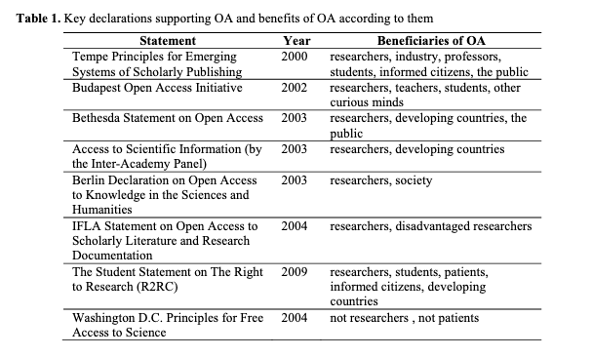
OA Policy Statements
(ElSabry, 2017)
ElSabry (2017). “Claims About Benefits of Open Access to Society (Beyond Academia)” in Expanding Perspectives on Open Science. https://ebooks.iospress.nl/pdf/doi/10.3233/978-1-61499-769-6-34

Slide 4
OA Policy Statements
(ElSabry, 2017)
ElSabry (2017). “Claims About Benefits of Open Access to Society (Beyond Academia)” in Expanding Perspectives on Open Science. https://ebooks.iospress.nl/pdf/doi/10.3233/978-1-61499-769-6-34

Slide 5



Policy Relevance
Open access repositories require significant resources, technological, financial and human, to develop, sustain and innovate. For example:
PubMed Central server (NIH): $4M per year to operate.¹
arXiv.org OA archive (Cornell): $4M per year.²
PLoS One technology and production costs: $32M in 2021.³
The aggregate costs in 2021-22 for the transition to open access for the 46 institutions that responded to a recent Association of Research Libraries (ARL) survey was $32 million (Vitale & Ruttenberg, 2022).
Elsevier open access author fees (APCs): “approximately $150 to $9,900.”
¹ https://scholarlykitchen.sspnet.org/2013/07/16/the-price-of-posting-pubmed-central-spends-most-of-its-budget-handling-author-manuscripts/
² https://arxiv.org/about/reports-financials
³ https://plos.org/wp-content/uploads/2023/03/Public-Library-of-Science-Dec21-AR-Final.pdf

Slide 6
Data Sources for Empirical Investigation
Repository | Type | Observations
National Academies Press | National Academies consensus reports | 1,076,133 downloads 6,271 reports published 2010 or earlier
Harvard DASH | Article and book chapter pre-prints | 3548 user “stories” from Oct 2012 to Dec 2018
Univ. of Michigan Press Fulcrum OA repository | OA monographs | 7,813 user comments

Slide 7
Contributions
Empirical insight into whether, and how, non-researchers use research.
High-frequency data on OA use pre- and post-policy treatment are limited.
LIS literature about non-researcher use of OA are varied, drawing from multiple theories.
Qualitative data regarding OA use are rare.*
R scripts and Python code publicly available.

Slide 8
Research Questions
What is the effect of open access on non-researcher use of National Academies (NASEM) reports?
Who are Harvard DASH OA users (typology classification)?
What is the sociocultural context of non-researcher use of Harvard DASH OA research?
What motivates public uptake of openly accessible monographs from university publishers?

Slide 9
Literature and Theory

Slide 10
Key Literature
Given the scope of the OA movement, empirical investigation of lay use of OA is somewhat limited:
Zuccala (2009) – literature review
Alperin (2015) – dissertation / mixed method focused on Latin American OA repositories
ElSabry (2017) – framework for societal uses of OA
Nunn (2020) – dissertation
Hicks, et al (2022) – first large scale analysis of non-researcher use of OA

Slide 11
Key Literature: Theory
Public Sphere and Communicative Rationality
(Habermas, 1962)
Democracy flourishes when there are spaces and institutions, such as libraries, that facilitate access to knowledge so deliberation and debate can occur.
Habermas argues that the “ideal speech situation” requires that basic facts are agreed upon in order for consensus to happen, even among parties whose core beliefs may differ. Access to information and research advances such democratic deliberation.

Slide 12
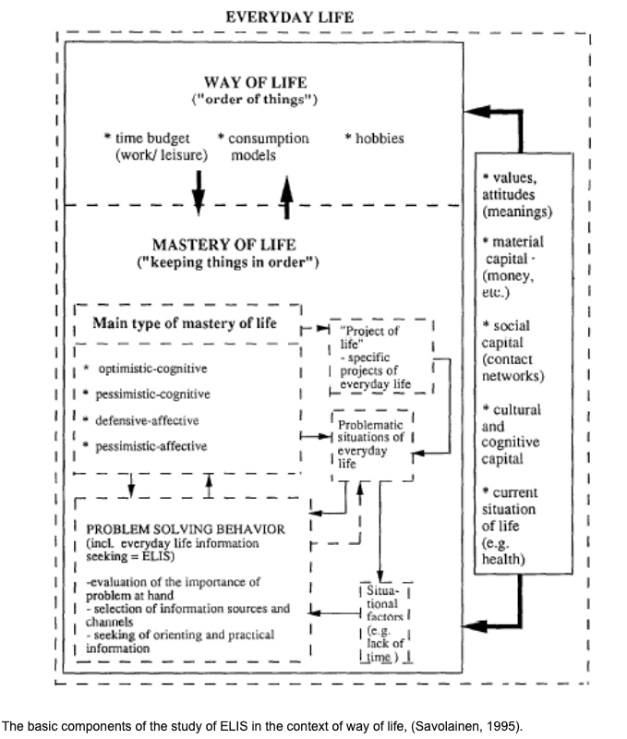
Key Literature: Theory
Everyday-Life Information Seeking (Savolainen, 1995)
Contexts:
personal values
material capital
cultural / cognitive capital
current situation of life

Slide 13
Additional relevant theory
Stebbins (2001), Serious Leisure
Garrison (1997), Self-Directed Learning
Bandura (1977), Self-Efficacy
Zipf (1949), Least Effort Principle

Slide 14
Questions, Data and Methods

Slide 15

RQ1a: What is the effect of OA on non-researcher use of high-quality science?
Data source: National Academies of Science, Engineering and Medicine (NASEM) report downloads.
Data description:
2006-2020 (5107 days)
n=1,076,133 downloads
6,271 reports published 2010 or earlier
Metadata: time stamp (to the second), title of the NASEM report that was downloaded, and the email domain
Identification of non-researcher is obtained by limiting to 32 personal email domains including Gmail, Yahoo and Hotmail downloaders.

Slide 16
RQ1a: What is the effect of OA on non-researcher use of high-quality science?
Method is Interrupted Time Series (ITS) quasi-experimental design*:
Y_{reportDownloads} = b0 + b1_{timeOverall} + b2_{treatmentEffect} + b3_{timePassedSinceOA} + e
Hypothesis 1a: There is a positive effect of NASEM’s OA policy on non-researcher downloads of NASEM reports.
Bernal, J. L., Cummins, S., & Gasparrini, A. (2017). Interrupted time series regression for the evaluation of public health interventions: a tutorial. International Journal of Epidemiology, 46(1), 348-355.

Slide 17
RQ2a: What is the typology of Harvard DASH OA use?
DASH Story Examples:
I'm doing research for a novel to be set in the 1890's. Needed some idea of single women's job options. Thank you for making this information available (“The Work and Wages of Single Women, 1870-1920”).
I am fascinated by lizards, and this research being available helps me expand my own knowledge about them. Having research like this available online to everyone is so much more effective in spreading knowledge than having to pay for an article from a journal publication. Thank you Harvard for making learning more accessible! (“Detective Work in the West Indies: Integrating Historical and Experimental Approaches to Study Island Lizard Evolution”).

Slide 18
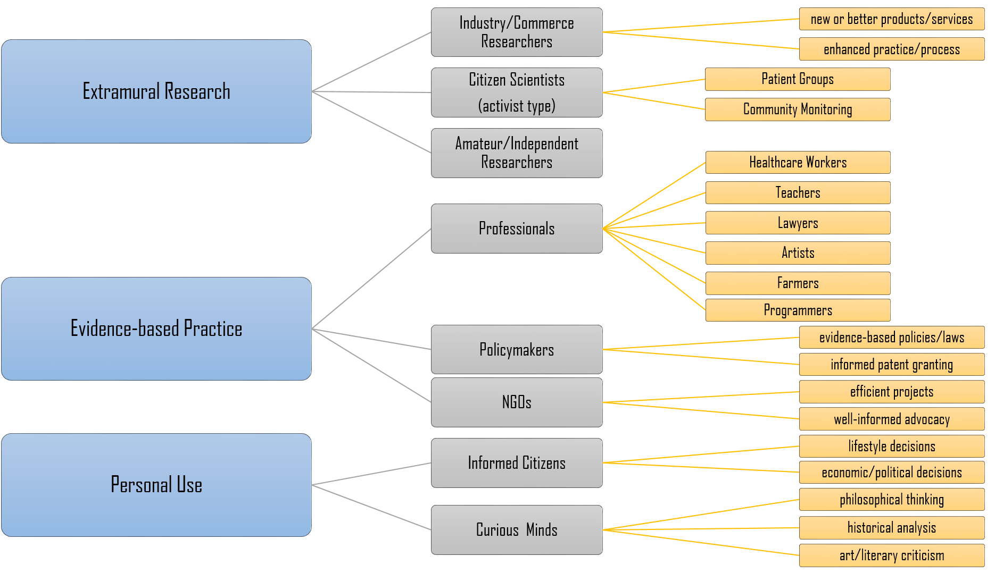
RQ2a: What is the typology of layperson OA use?
(ElSabry, 2017)

Slide 19
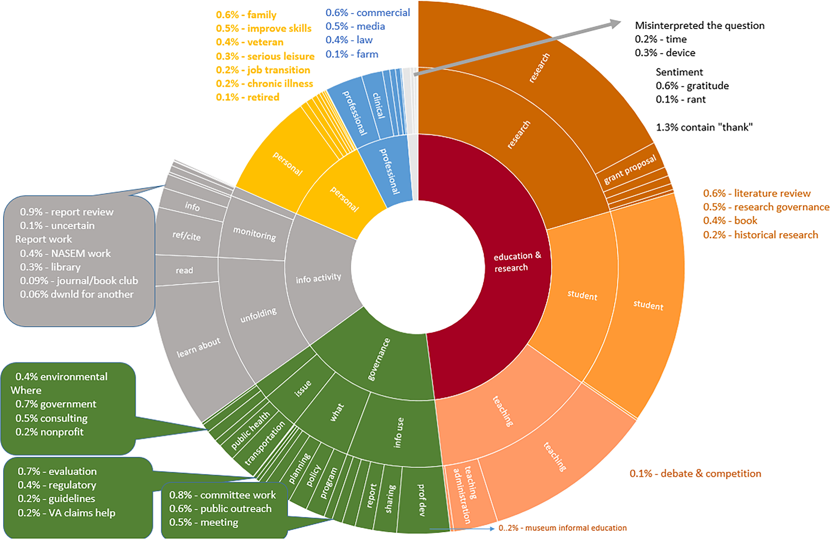
RQ2a: What is the typology of layperson OA use?
(Hicks, et al, 2022)

Slide 20
RQ2a: What is the typology of Harvard DASH OA use?
I'm doing research for a novel to be set in the 1890's. Needed some idea of single women's job options. Thank you for making this information available (“The Work and Wages of Single Women, 1870-1920”).
Classified as “Book” → “historical research” per Hicks, et al classification
Classified as “Extramural Research” Amateur / Independent Researcher” per ElSabry classification
I am fascinated by lizards, and this research being available helps me expand my own knowledge about them. Having research like this available online to everyone is so much more effective in spreading knowledge than having to pay for an article from a journal publication. Thank you Harvard for making learning more accessible! (“Detective Work in the West Indies: Integrating Historical and Experimental Approaches to Study Island Lizard Evolution”).
Classified as “Information Activity” → “learn about” per Hicks, et al classification
Classified as “Personal Use → Curious Minds” per ElSabry classification
→

Slide 21
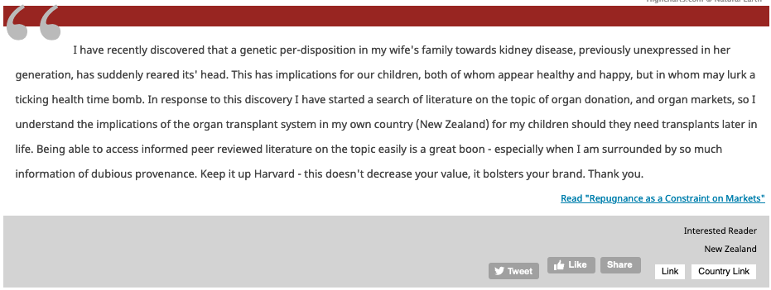
RQ2b: What is the sociocultural context of public OA use?
As part of this effort to understand public use of scientific information I leverage a unique data set obtained from Harvard’s DASH Open Access repository.

Slide 22
Results

Slide 23
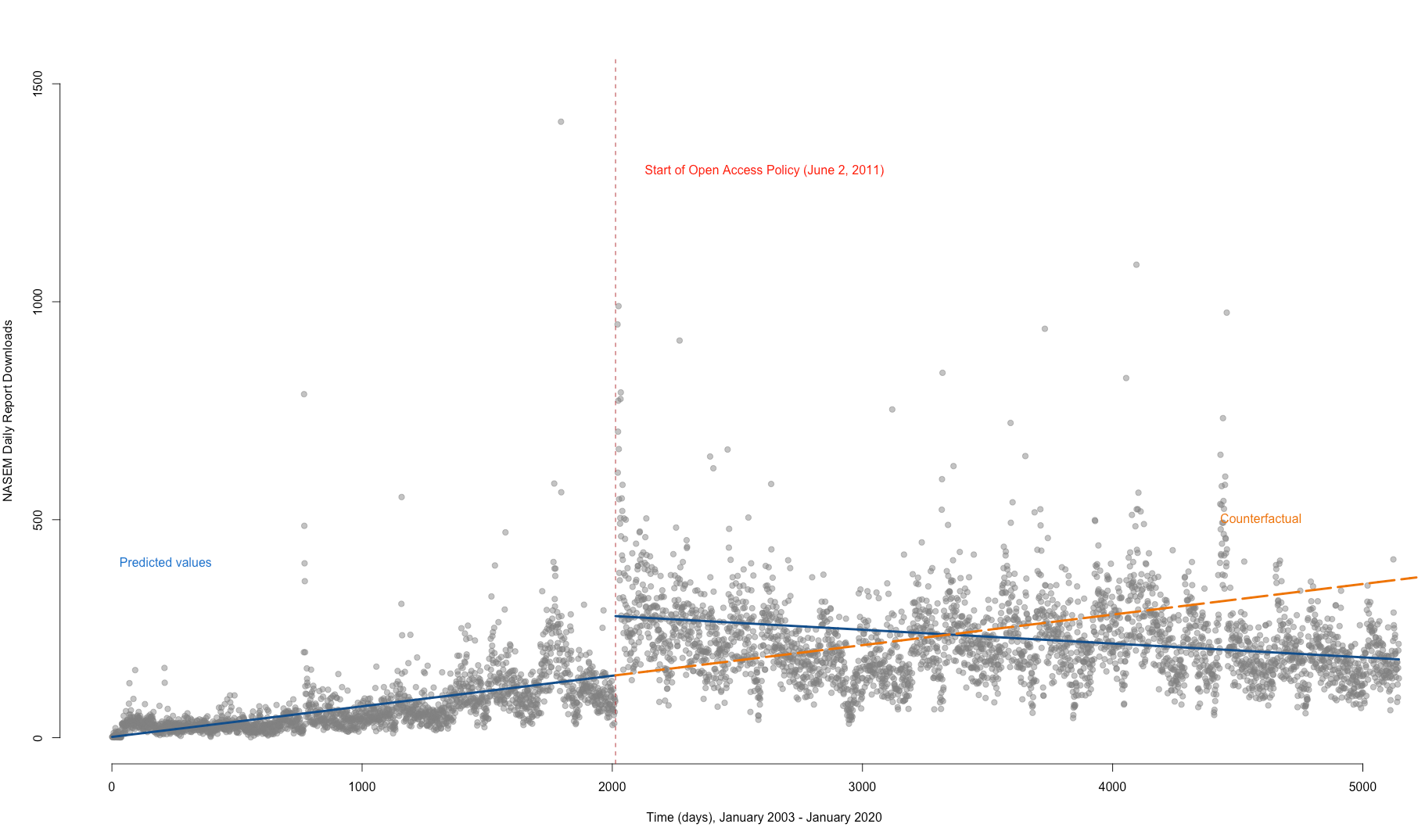
RQ1(a) Results: Effect of OA Policy on Non-Researcher Downloads (with Counterfactual)

Slide 24
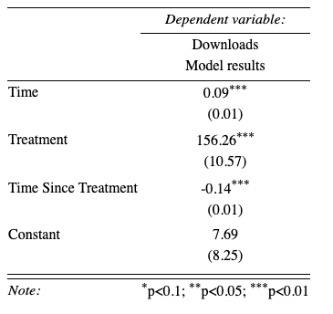
RQ1(a) Results: Effect of OA Policy on Non-Researcher Downloads (interrupted time-series)
Avg download rate pre-OA policy: 72 reports / day
Avg download rate post-OA policy: 229 reports / day

Slide 25
RQ2: Summary Info for “Your Story Matters”
3548 user “stories” from Oct 2012 to Dec 2018
1500 comments hand-coded.
Remaining 2048 comments coded using BERT Deep Learning natural language classifier.
Average DASH story length: 51 words (median: 38).
Maximum # of words: 770 and Minimum # of word: 1.
“It has really help[ed] me to read more on the free papers or articles on the Anti malaria drug resistance in respect to Arthemisinin.” (Accessed from Ghana. Article: “Artemisinin resistance without pfkelch13 mutations in Plasmodium falciparum isolates from Cambodia”)
“73 yr old g-ma, searching for a source of info I can trust. THANKS” (Accessed from US. Article: “Partisanship, Propaganda, and Disinformation: Online Media and the 2016 U.S. Presidential Election”)
“I am a manager in the IT department of a large industrial company. This article gave me clarity on how to approach resolving software architecture issues and technical debt within the code base of my organization.” (Accessed from US. Article: “Hidden Structure: Using Network Methods to Map Product Architecture”)

Slide 26
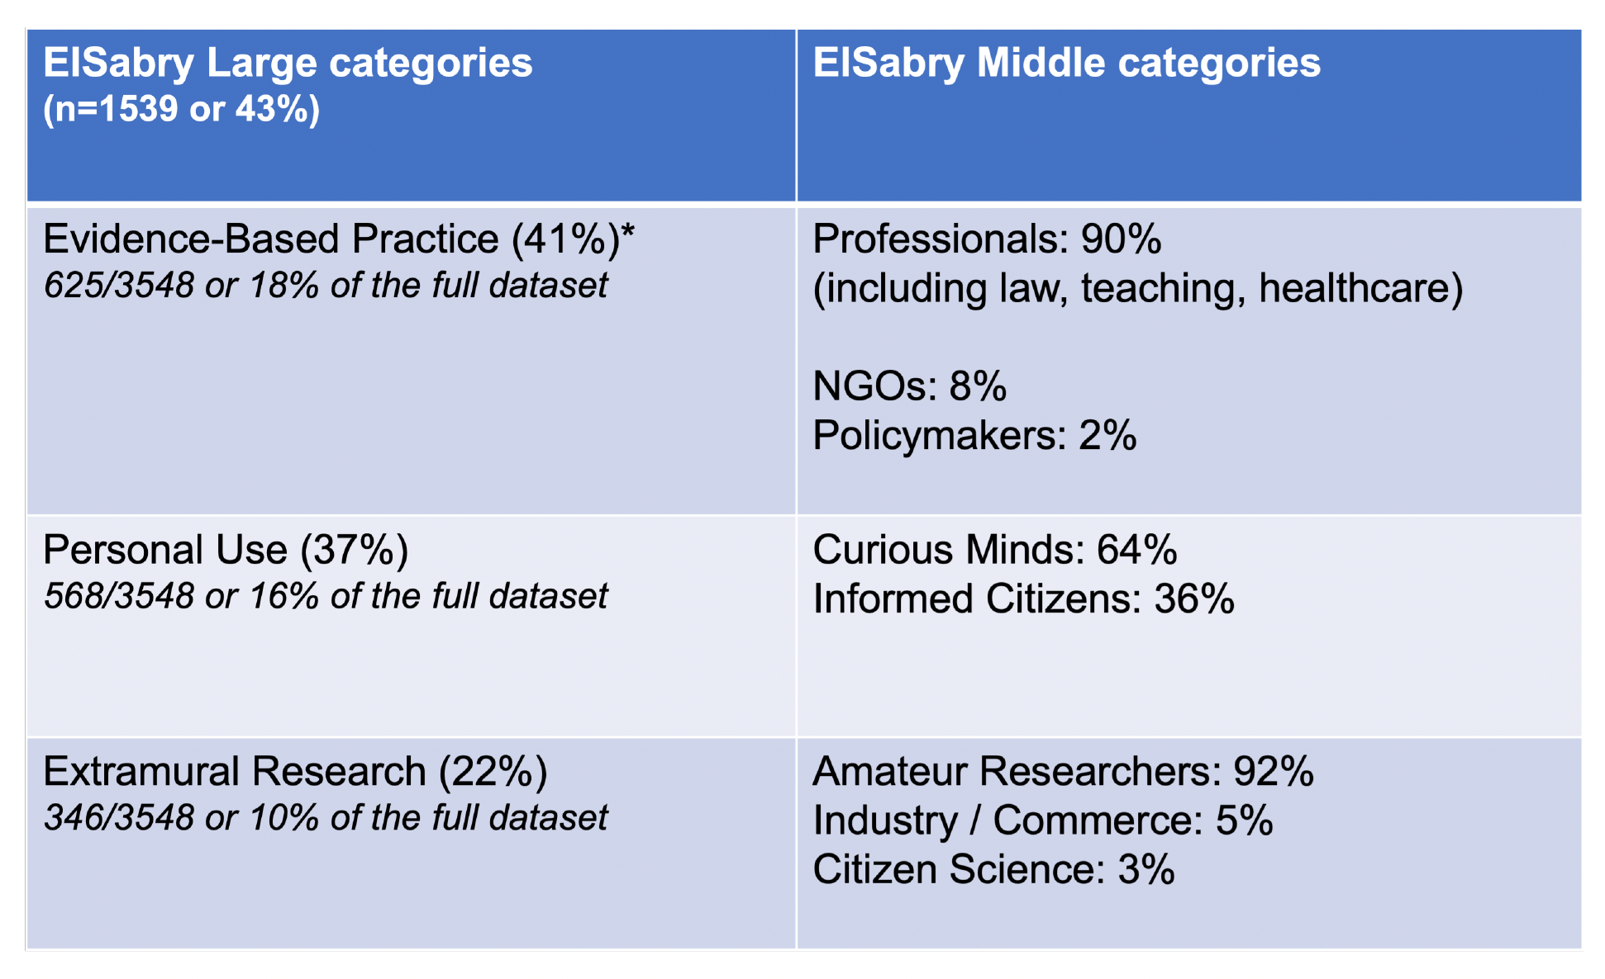
RQ2a: Results from BERT-based DASH Typology Coding
Note ElSabry typology includes “teaching” in Evidence-Based Practice and is included in above analysis.

Slide 27
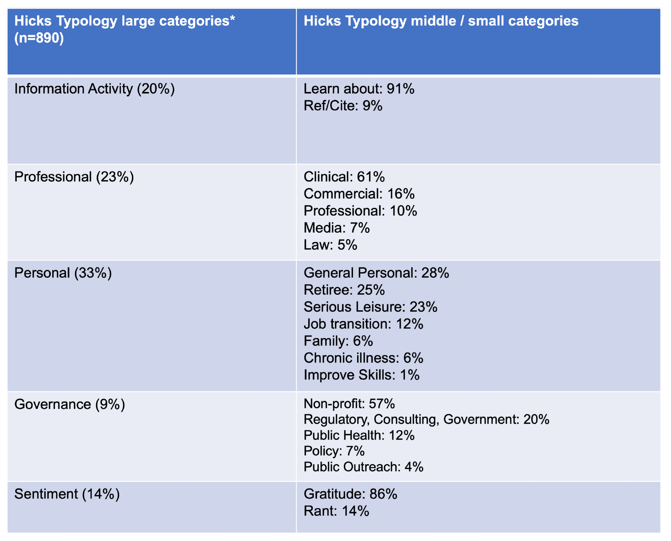
RQ2a: Results from Hicks Typology Classification
* “Education & Research” category (n=2658) excluded
* Note: “Misinterpreted” (1%)
Notes:
25% because “Research and Education” category is not included and comprise the majority of use.

Slide 28
RQ2a: Typology Gap Analysis
Students preparing for graduate school
Enrolled in online courses
Searching for general health information, distinct from chronic illness (“current situation of life”).
International student use of OA is significant.
NGO use of specific articles
Chaplains
Dual identity downloaders, working and attending classes.
Ease-of-use / Ease-of-access.
Nuance of healthcare clinical vs. healthcare administration.
Cost of journals as a factor and motivator (“material capital”).
Genealogy research.
Translators

Slide 29
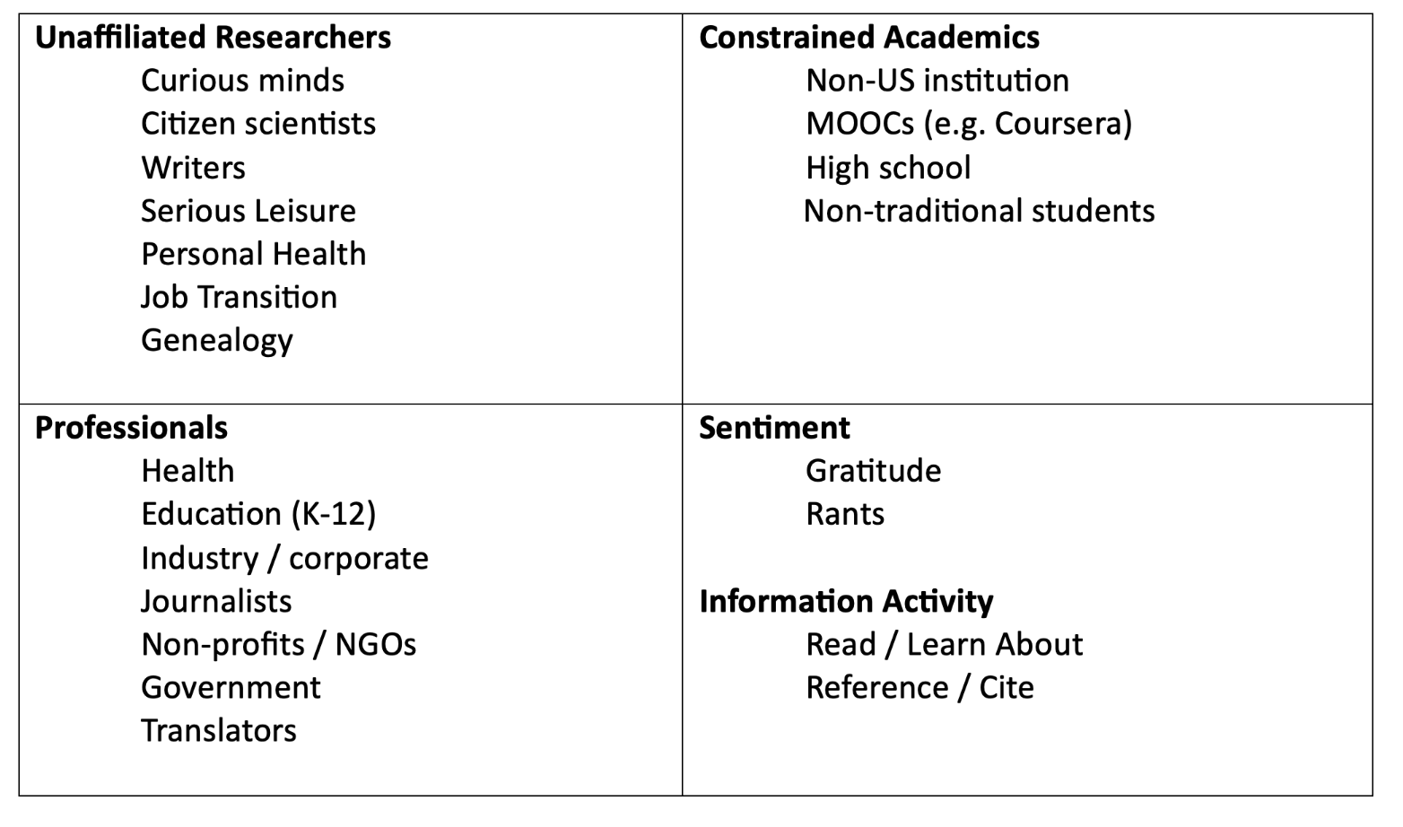
RQ2a: Proposed multi-option typology

Slide 30
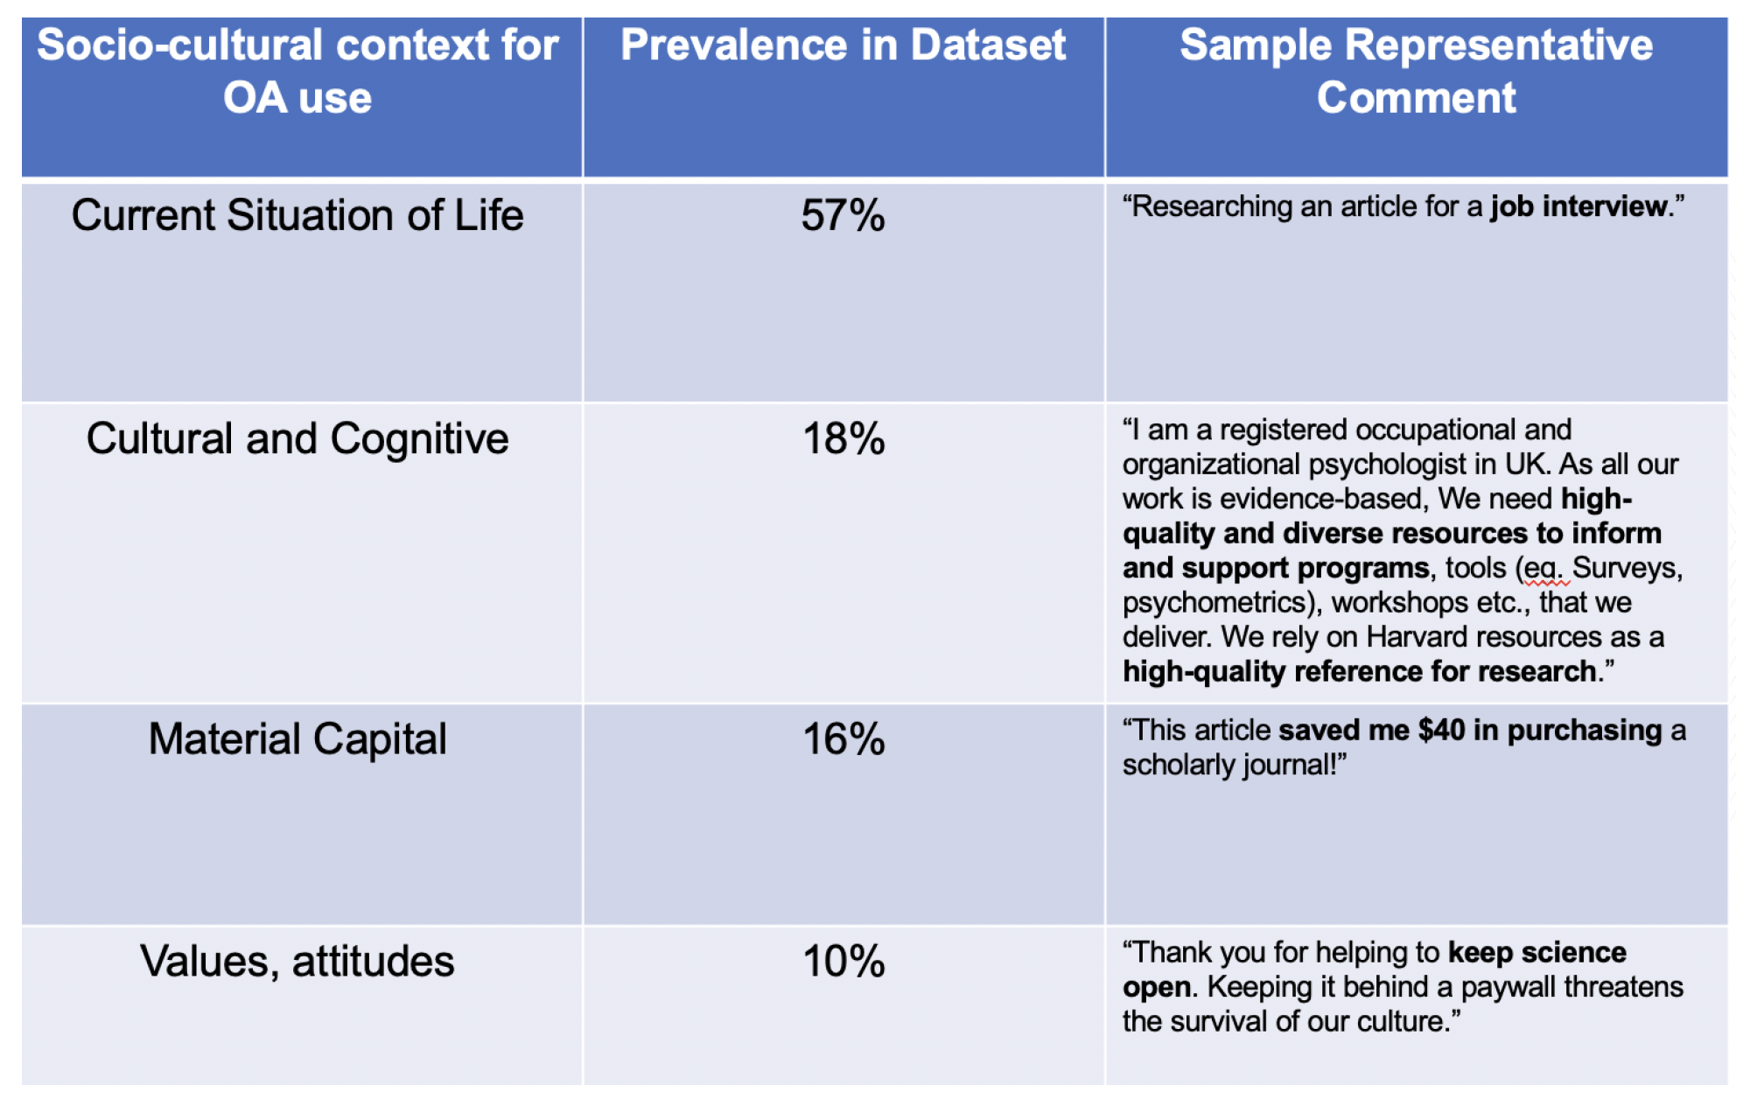
RQ2b: Sociocultural Context for Non-Research Use of OA (Savolainen)

Slide 31
RQ2b: Comparing Story Distribution with DASH Disciplines
Discipline | % of DASH Stories by Author Discipline | % Represented in DASH (2023)
Economics | 33% | 7%
Psychology | 14% | 5%
History | 11% | 2%
History of Science | 8% | 2%
Anthropology | 7% | 2%
Sociology | 6% | 2%
Government | 6% | 3%
Engineering and Applied Sciences | 5% | 16%
Philosophy | 4% | 1%
Organismic and Evolutionary Biology | 3% | 7%
English and American Literature and Language | 3% | 1%
Other fields | < 1% | 52%
Implication: OA users (e.g. the public) are more interested in social sciences, yet repositories are more inclusive of physical and biological sciences.
Notes:
61% soc sci interest based on stories but only 16% representation in database

Slide 32
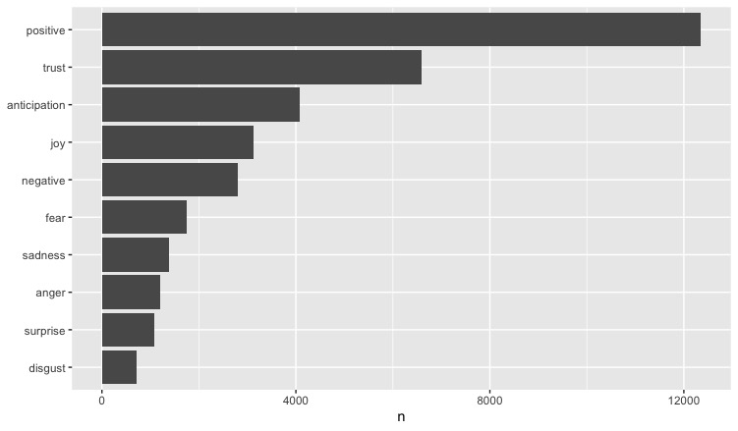
RQ2b Text Analysis: Sentiment / Emotion
Emotional sentiment expressed by Harvard DASH Story Commenters (NRC lexicon)

Slide 33

RQ2b Text Analysis: Sentiment / Emotion
Words associated with “trust” sentiment in DASH stories

Slide 34
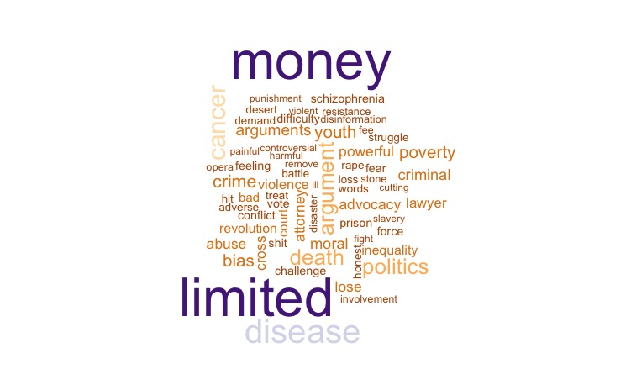
RQ2b Text Analysis: Sentiment / Emotion
Words associated with “anger” sentiment in DASH stories

Slide 35
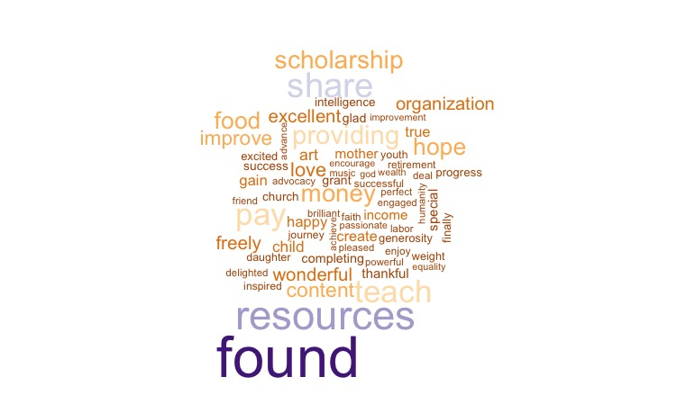
RQ2b Text Analysis: Sentiment / Emotion
Words associated with "joy" sentiment in DASH stories

Slide 36
Study Implications

Slide 37
Results
The 2011 NASEM open access policy resulted in non-researcher, public downloads of scientific research.
Initial public interest in NASEM reports has gradually faded.
The use of Harvard DASH OA driven by in-the-moment life needs.
A secondary consideration among DASH users is desire for high-quality, scholarly sources (”Cultural or Cognitive Capital”).
Lack of “material capital” is not a primary driver of DASH OA use.
Sentiment analysis indicates “trust” and positive affect are predominant.
Notes:
The research developed by the National Academies is of interest beyond researchers at academic institutions.

Slide 38
Work in Process: Public Use of Openly Accessible Monographs Analyzing the public impact of University of Michigan’s Fulcrum OA Monograph Platform With Diana Hicks (Georgia Tech) and Charles Watkinson (Michigan)

Slide 39
Public motivation
Why does the public read open access books published by university presses?

Slide 40
Method
Survey question: Why are you interested in this book?
Responses to other questions also helped
7,813 usable responses
Team (Doshi, Hicks, Watkinson) coded responses into 39 categories of use.

Slide 41
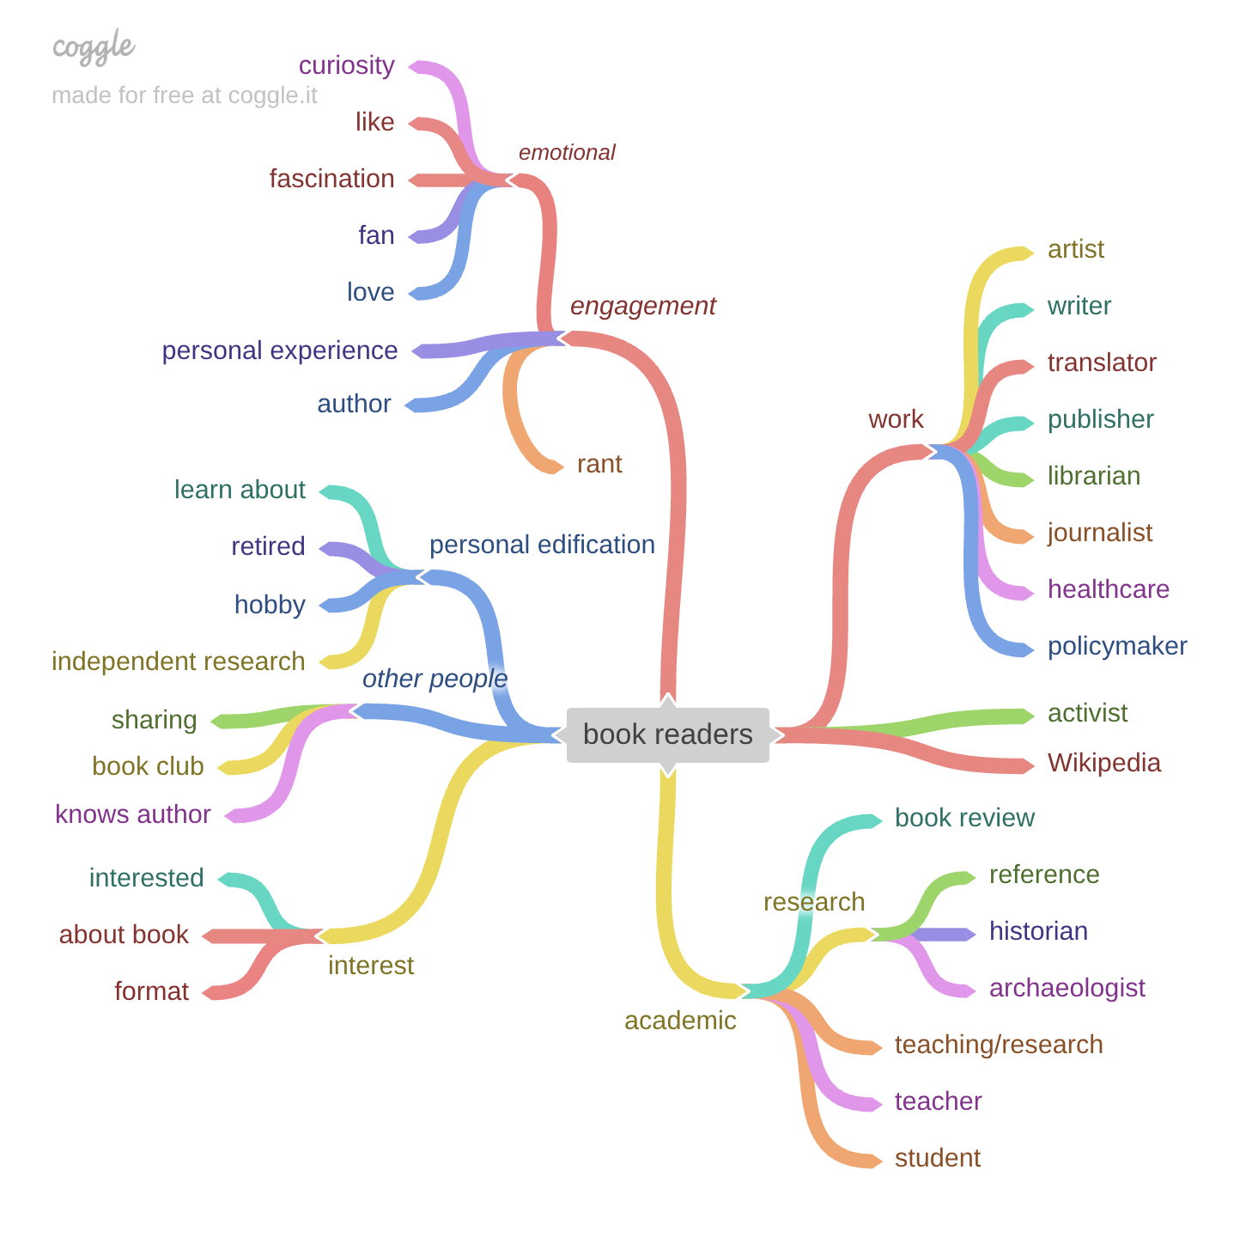
(Diana Hicks, Georgia Tech)

Slide 42
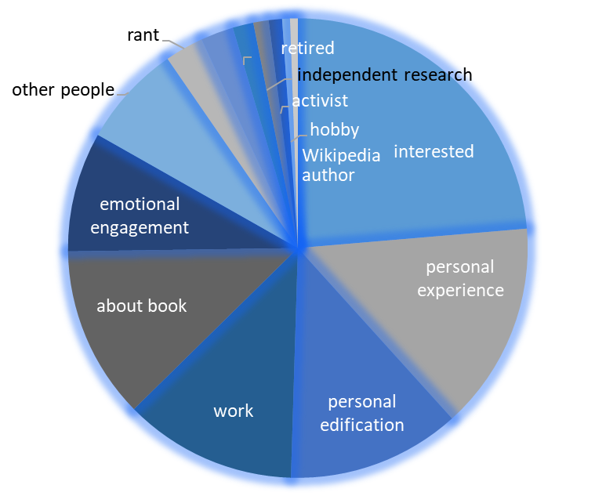
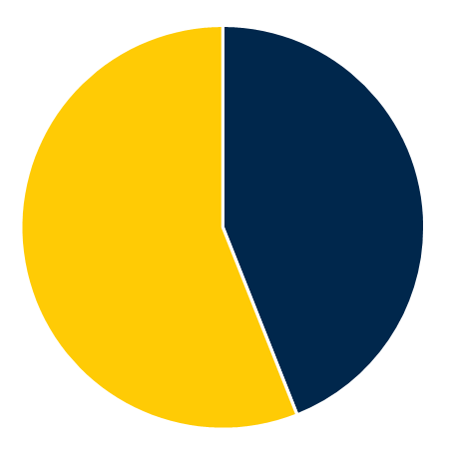
Non-academic users
56% of responses
Notes:
The boundaries in the pie chart on the right are fuzzy as a reminder our classification scheme is not precise. Responses might mention two categories, and we go with the most specific, least generic category. Responses don’t always fit neatly into categories, and their classification could be debated. Therefore, precise numbers are not useful. Rather the scheme indicates broad differences in frequency between types of responses

Slide 43
phd: 110 | digital humanities: 30 | covid: 23 | social media: 18
I’m: 69 | research interests: 30 | curious: 23 | topic: 18
china: 67 | 's work: 30 | related: 22 | love: 18
history: 53 | public history: 29 | dickinson: 22 | working: 17
emily dickinson: 52 | relevant: 29 | african: 21 | america: 17
tumblr: 52 | covid-19: 29 | twine: 21 | personal interest: 17
english: 47 | india: 29 | want: 21 | thank: 17
ai: 47 | asia: 28 | amherst: 21 | oa: 17
japan: 45 | i'm: 26 | michigan: 20 | black: 17
subject matter: 40 | wikipedia: 26 | video games: 20 | reading: 17
writing: 37 | academic: 26 | social justice: 19 | it’s: 16
open access: 37 | research interest: 25 | graduate student: 19 | researching: 16
interest: 36 | disability studies: 25 | doing: 19 | uk: 16
looking: 34 | research paper: 24 | personal: 19 | brazil: 16
own research: 34 | research project: 24 | learning: 19 | philippines: 15
general interest: 33 | access: 24 | interesting: 18 | mexico: 14
russia: 31 | subject: 23 | africa: 18 | korean: 14

Slide 44
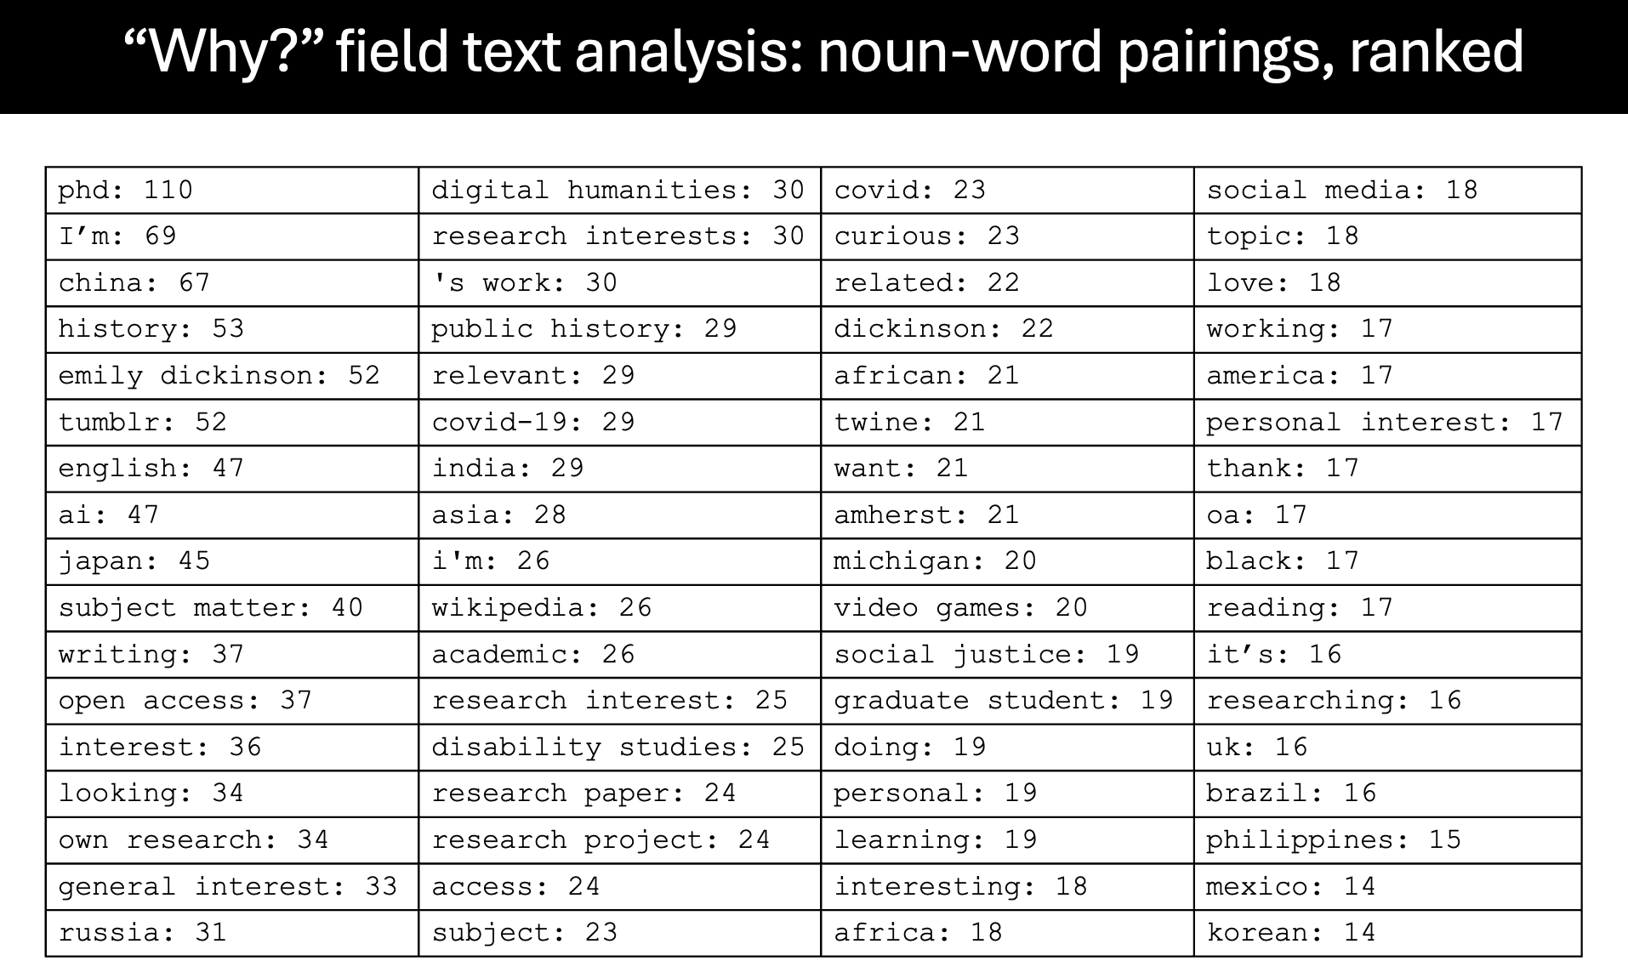
“Why?” field text analysis: noun-word pairings, ranked

Slide 45
“Why?” column responses: sentiment (NRC lexicon)
'fear’: 3%
'anger’: 2%
'trust’: 18%
'surprise’: 3%
'positive’: 39%
'negative’: 6%
'sadness’: 8%
'disgust’: 5%
'joy’: 8%
'anticipation’: 7%

Slide 46
Theories: Everyday-Life Information Seeking (Savolainen) and Serious Leisure (Stebbins)
Savolainen’s ELIS frames non‑work information seeking as part of maintaining one’s “way of life,” emphasizing habitual, convenient sources and practical problem‑solving. Serious Leisure includes the following dimensions of systematic information use:
personal projects
hobbies and creative pursuits
civic and political orientation
self‑education
cultural interests

Slide 47
Public Uptake: “Long-tail” Economics (Brynjolfsson, et al)
“Anecdotal evidence suggests that Internet markets have helped shift the balance from a few best-selling products to niche products that were previously obscure. For example, Frank Urbanowski, Director of MIT Press, observes that the increased accessibility to backlist titles through the Internet has resulted in a 12% increase in sales for those titles.”
Brynjolfsson, E., Yu (Jeffrey) Hu, & Simester, D. (2011). Goodbye Pareto Principle, Hello Long Tail:
The Effect of Search Costs on the Concentration of Product Sales. Management Science, 57 (8), 1373–1386. http://www.jstor.org/stable/25835786

Slide 48
Advancing the Endless Frontier
“The frontiers of science must be thrown open so that all who have the ability
to explore may advance from the farthest position which anyone has attained.”
- Vannevar Bush, The Endless Frontier, 1945

Slide 49
Thank you!

